Slide 1

2021 New Mexico State
Science Olympiad Coaches Workshop
Director: Sharon Sessions (sharon.sessions@nmt.edu)
Coordinator: Ann Dunklee (ann.dunklee@nmt.edu)

Slide 2
Agenda
Proposed Virtual Event Slate
scilympiad.com/nm walk-through
Q&A, comments, discussion

Slide 3
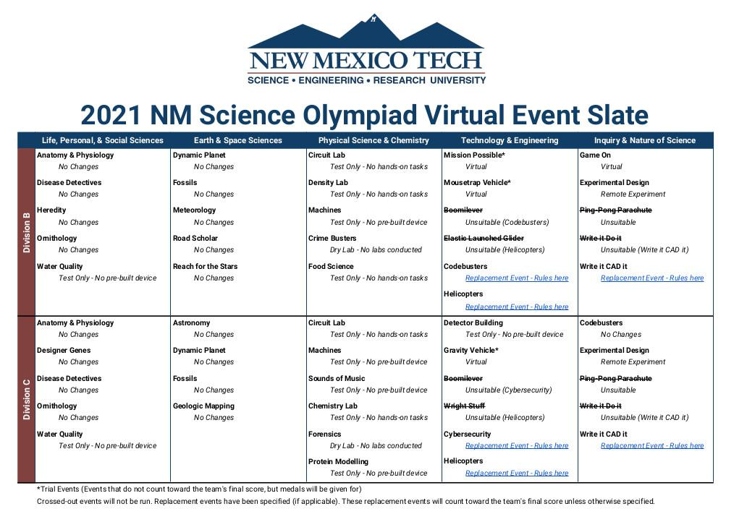

Slide 4
scilympiad.com/[regional tournament site]
Register as a coach
Register your school
Add/edit teams
Add co-head coaches
Student Roster
Email student release forms, login ID, login instructions for students (video)
Wait for Reigonal Director to assign team numbers
Assign students to teams
Wait for event schedule
Assign students to events

Slide 5
IMPORTANT NOTES
Only register for the REGIONAL site on scilympiad.com.
After the tournament, the Regional Director will advance all teams to state, and your information will be automatically transferred.
Once the event schedule is set, you will be able to assign students to events.
If your team is not participating in a regional event, please inform Ann Dunklee so we can make sure we can get your team registered for state.
My apologies for the confusion on this process!

