Slide 1
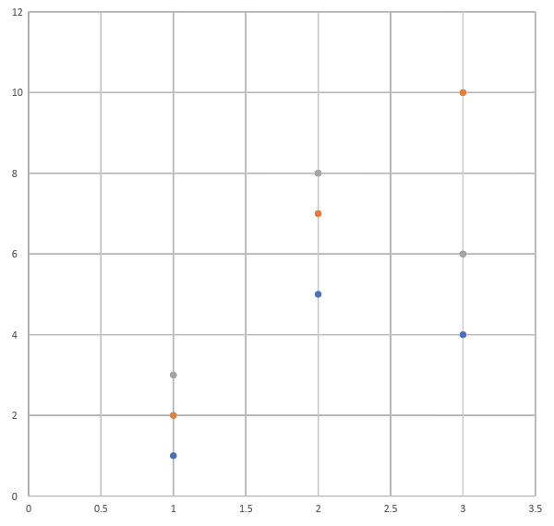
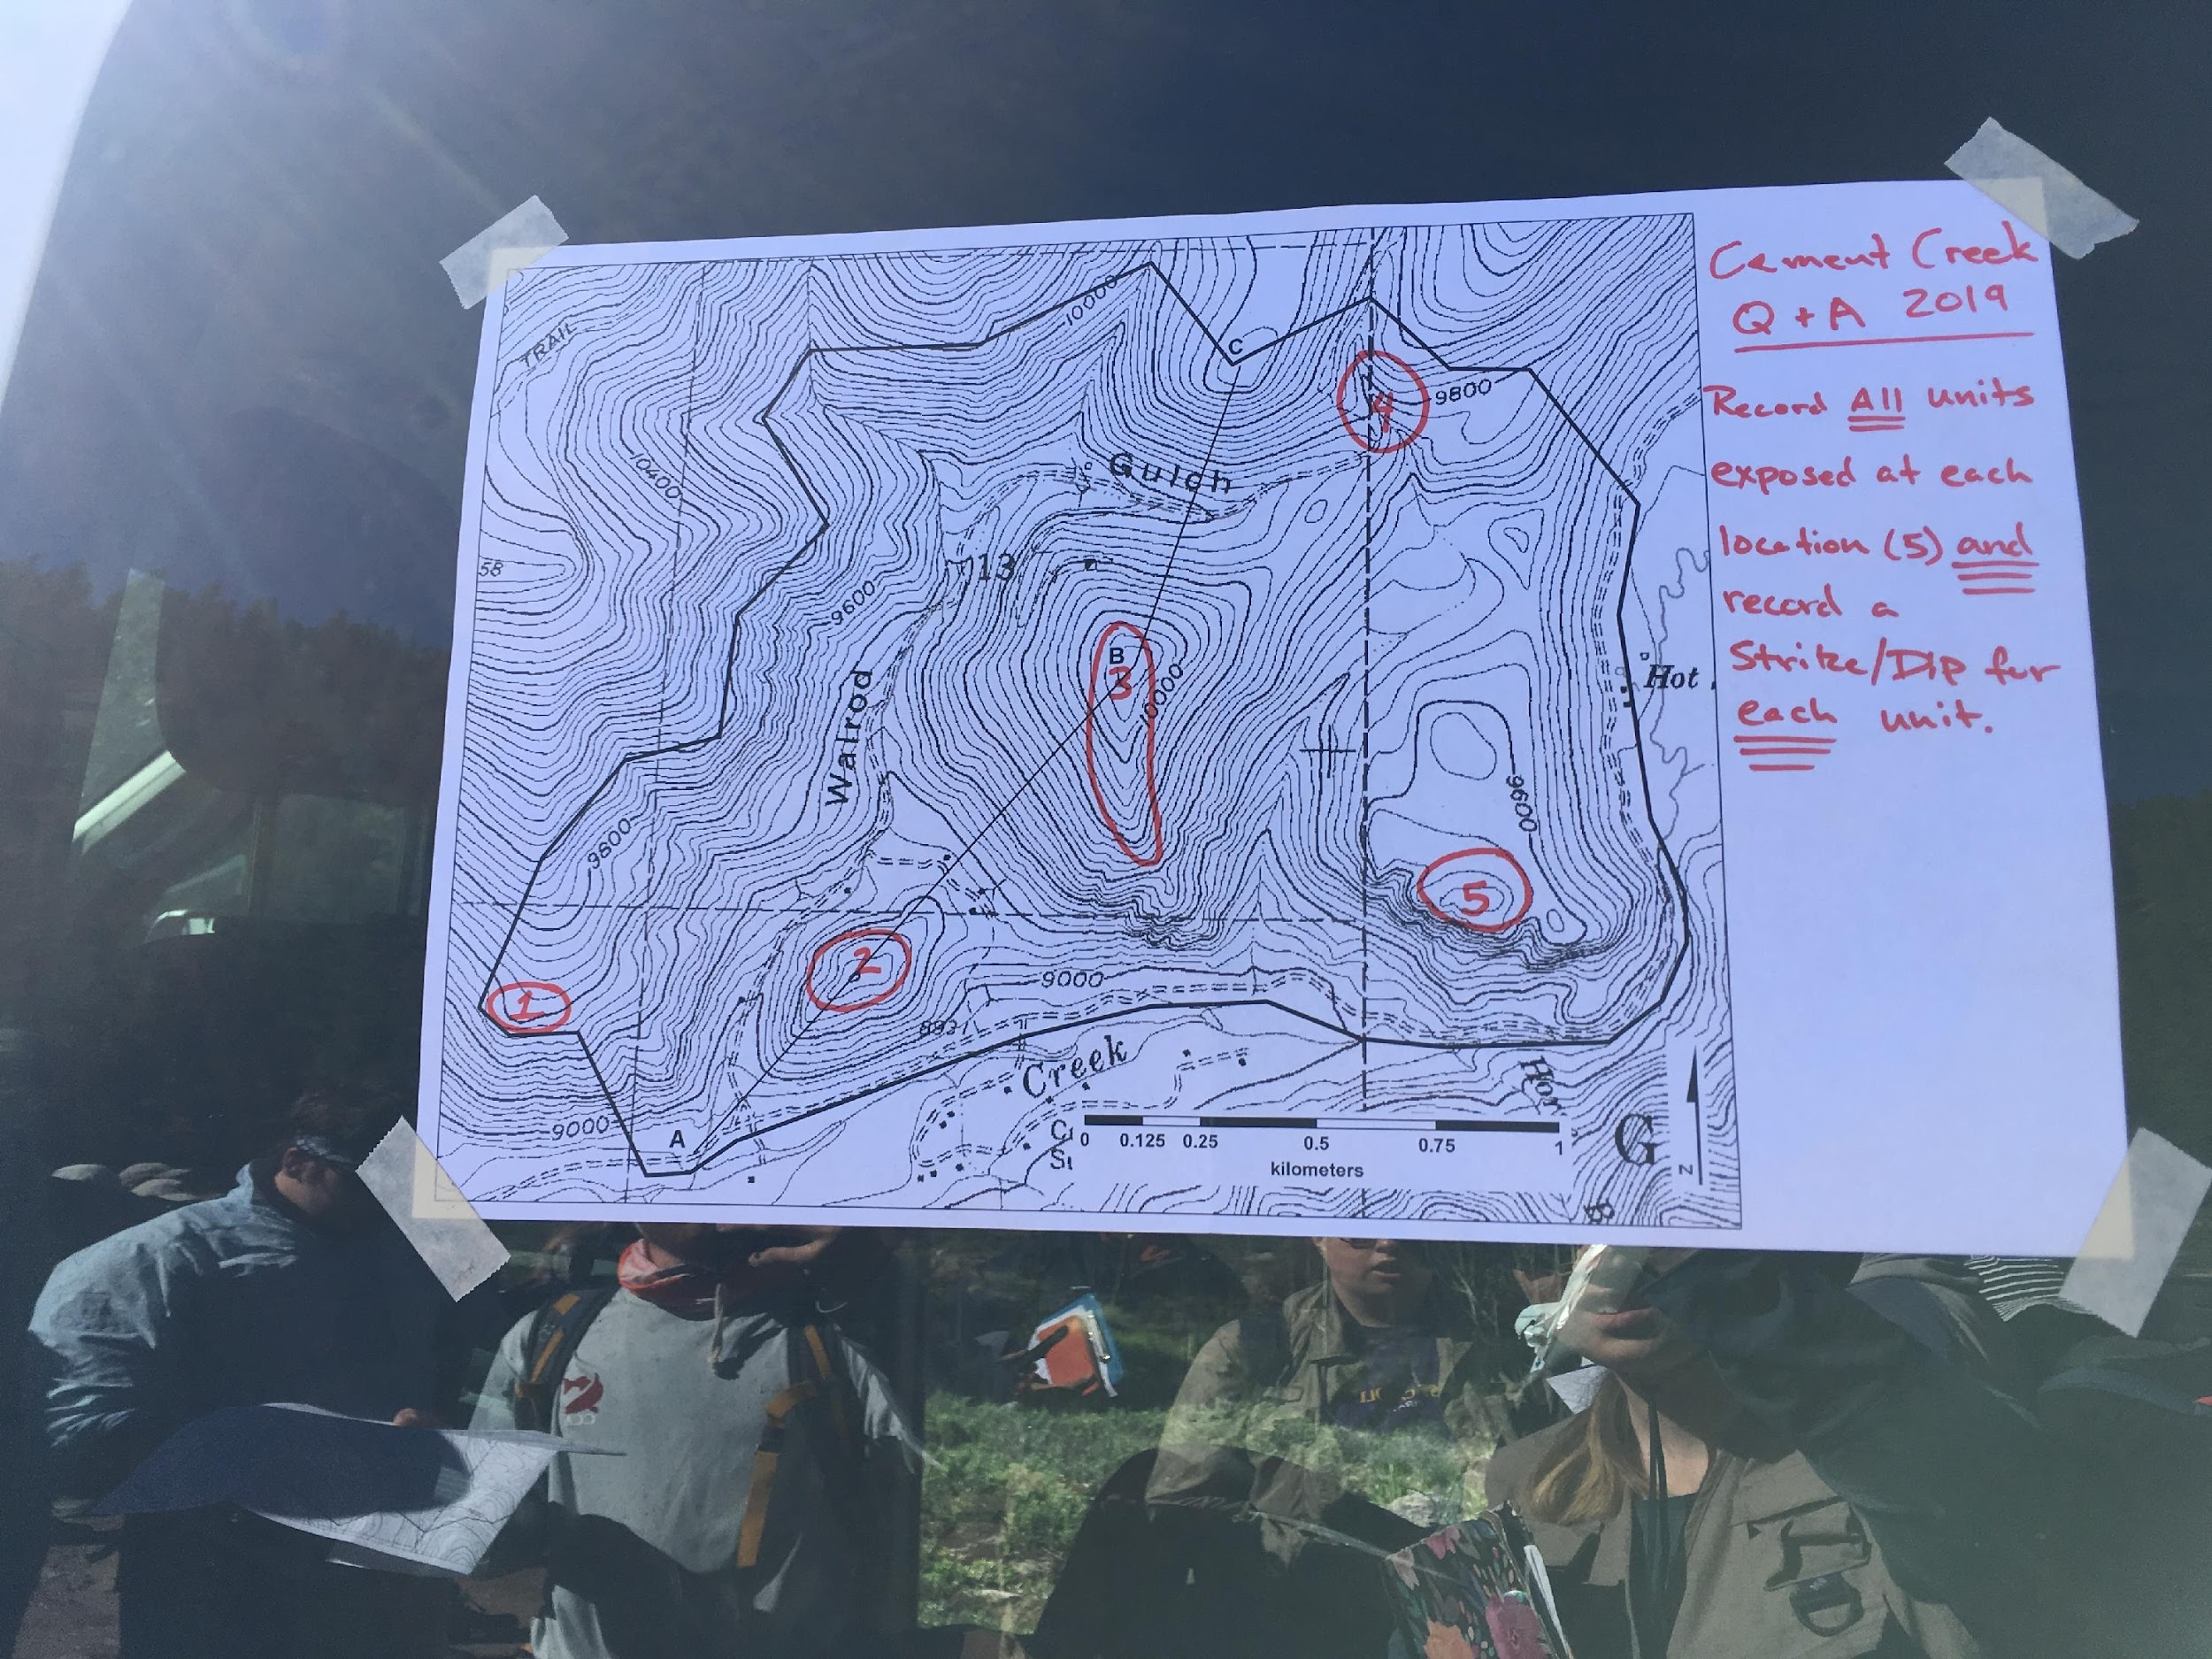
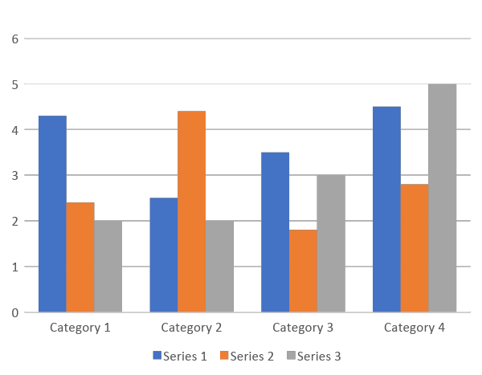
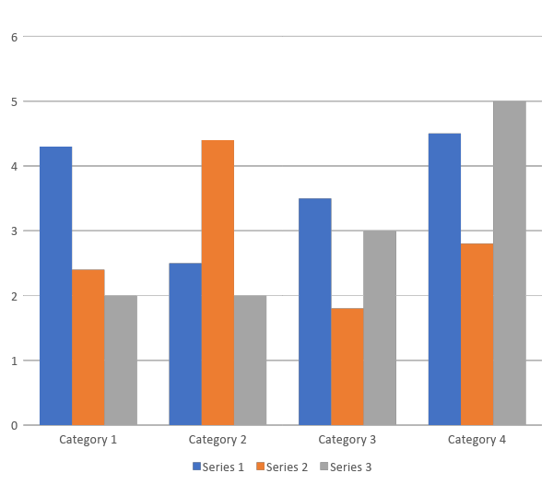
Poster Template 48 x 36 – NMT WCL
Researcher Name & Collaborators
Department of “ “, New Mexico Institute of Mining and Technology
SRS Registration #
Introduction
x-
Results
x-
Recommendations
• Use your introduction as a way to introduce the aim of your project and your hypothesis.
• Try to avoid walls of text and use of jargon
• When structuring, go from general to specific, in order to help your reader stay focused.
• For font choice, sans serif is recommended to make reading easier for viewers, but Times New Roman is always a good choice if you prefer serif fonts.
• This is where you can put your data.
• Text should be relatively sparse in this section
• If you want to do more work, or feel that the study could have gone better, this is the place to explain.
• Otherwise, you can expand the discussion section.
• Charts and figures based on your data can go here.
• There’s also room for some discussion of results.
Methods
1 | 7 | 12
2 | 8 | 20
3 | 6 | 35
• Explain your research process. Lab equipment you used or places you went might go here.
• This can be made into a second results section if you have lots of data.
1 | 7 | 12
2 | 8 | 20
3 | 6 | 35
Subheading 1
• Prioritize using figures
• When using a figure, captions should be at least 18 points in order to be visible.
• Main text should not be smaller than 24 points
• If you’re adding a graph or chart, consider colorblind viewers (4.5% of the general population). Instead of red/green color combinations, substitute yellow/blue, green/magenta, or go with greyscale.
1 | 7 | 12
2 | 8 | 20
3 | 6 | 35
Discussion
• Use this space to explain why your study was valuable. What did you learn?
References
• All works cited in your research go here.
• Citation styles vary by study topic, so check with your mentor if you aren’t sure, or ask the writing center.
Subheading
• More text can go here.
• None of the figures here have captions (because they’re all filler), but in your final research poster they should be captioned with a brief explanation/citation if needed.
Acknowledgements
Coauthors go here. This is also a good section to put the logos of additional organizations that supported you (like the NSF) if they didn’t fit well in the header.
Your contact information here

