Slide 1

Persuasive Writing
Begin with the Benefit
Judy McShannon
Manager of Research Development
West Hall, room 228
575-835-6940
judith.mcshannon@nmt.edu
Taken in part from https://www.youtube.com/watch?v=PPhYt_T87So
Research Office

Slide 2
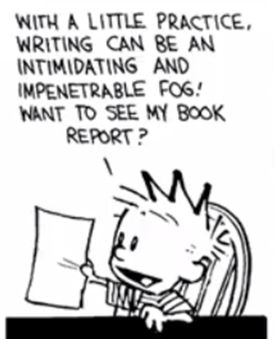
The Curse of Knowledge
The main cause of incomprehensible prose is the difficulty of imagining what it’s like for someone else not to know something that you know. (Steve Pinker, The Sense of Style)
The curse of knowledge is the single best explanation of why good people write bad prose. It simply doesn’t occur to the writer that her readers don’t know what she knows—that they haven’t mastered the argot of her guild, can’t divine the missing steps that seem too obvious to mention, have no way to visualize a scene that to her is as clear as day. And so the writer doesn’t bother to explain the jargon, or spell out the logic, or supply the necessary detail.
The key is to assume that your readers are as intelligent and sophisticated as you are, but that they happen not to know something you know.

Slide 3

First Rule in Proposal Writing - Get Read
Get Submitted
Make the Program Officer happy
Make your reviewers happy
Research Office

Slide 4
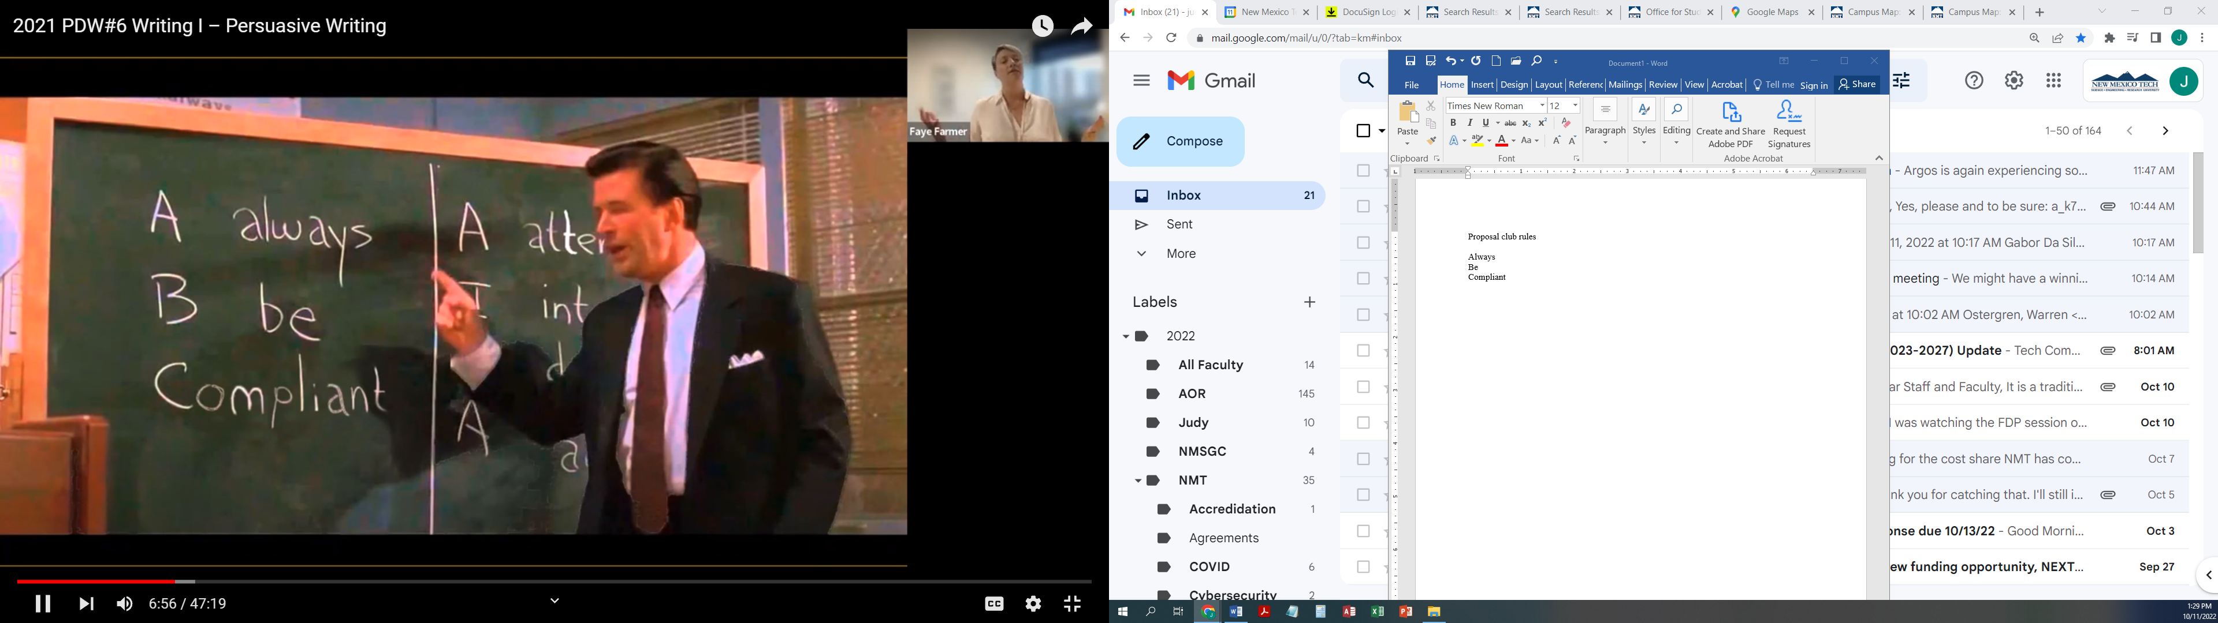

Slide 5
What does it mean to be Compliant? Follow the Directions in the Solicitation
The Project Description must have these section headers exactly.
Research Goals: Provide a brief description of the Pl's overall research goals.
Research Project: Provide a clear outline of the general plan of work including the research questions or hypotheses, the broad design of activities to be undertaken, and, where appropriate, a clear description of experimental methods and procedures. The proposal should include the motivation for the research and a discussion of the novelty of the work in the context of existing literature. The project description should also discuss mechanisms and plans for assessing success of the proposed activities. The proposed single-Pl activities may include activities to catalyze partnerships. The potential partner(s) must be named as Senior Personnel (see PAPPG I1.C.2). Partnership activities may enable access to instrumentation or resources, activities that establish a working relationship such as formulating new and sound plans for larger-scale projects in emerging research areas, travel for the Pl or trainees to strengthen the partnership, or other activities. Note that Subawards to R1 institutions are not permitted. Proposals that include a request for equipment must follow the PAPPG (I1.C.2.g.iii).
Broader Impacts: Provide a discussion of the broader impacts of the proposed activities. Broader impacts may be accomplished through the research itself, through the activities that are directly related to specific research projects, or through activities that are supported by, but are complementary to the project, such as education activities.
ERI Criteria: Provide a brief description of how the proposed work addresses the solicitation-specific review criteria, as described in the "Additional Solicitation Specific Review Criteria" section below.

Slide 6
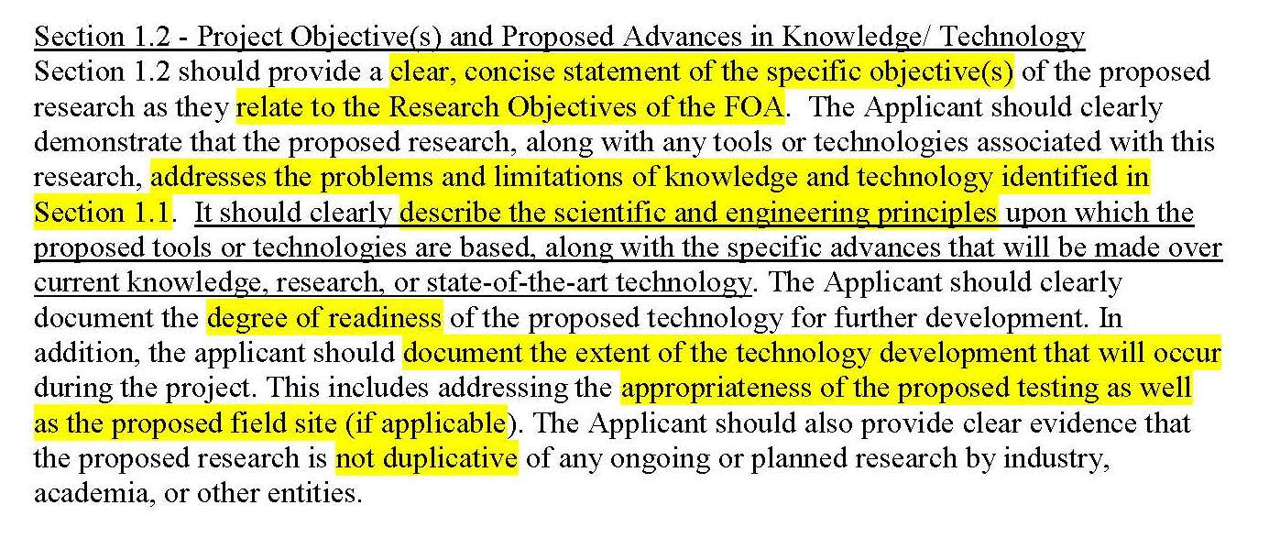

Follow the Directions in the Solicitation
6

Slide 7
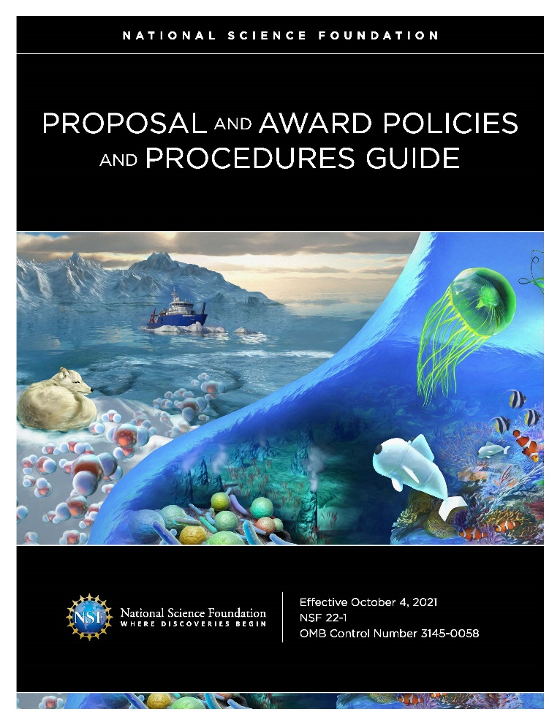
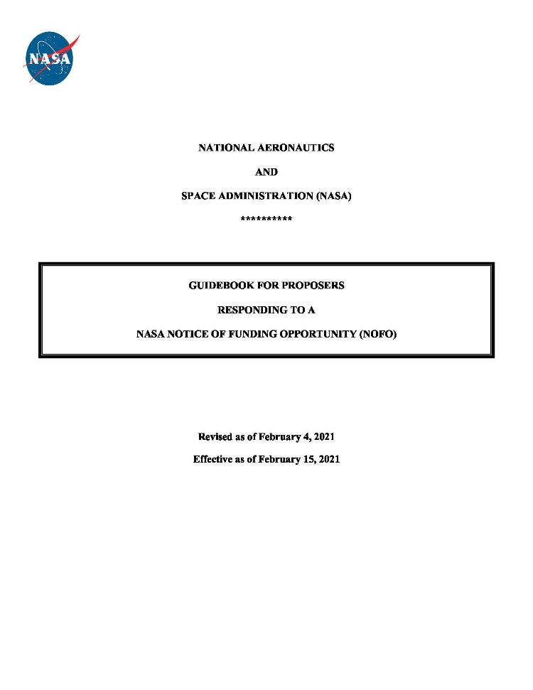

What does it mean to be Compliant? Follow the Directions in the Research Guide
Meet all the requirements
Page numbers, font, headings, additional documents
Research Office

Slide 8

Third Rule in Proposal Writing Know Your Audience
Connecting with your audience is a key part of persuading your audience.
They need to know that you respect them, their time, their needs, and their challenges
Who will read this?
Why should they care?
What do they want to achieve?
Research Office

Slide 9
Write to Your Reviewers
DO NOT write the application for yourself, unless you plan to fund it yourself
You MUST convince an entire review panel, the Program Officer, and the funding agency
Subject matter experts to generalists with minimal knowledge in the field
Limited time for reading your proposal
Review many proposals
Do not have time to find information that is not well organized, clear,
visual, or highlighted
First-time reviewers to veterans
Reviewers have varied experience
Research Office

Slide 10

How Do Reviewers Read Proposals?
Reviewers approach to your proposal is similar to how you approach reading a technical paper. Reviewers attempt to understand complex information quickly and clearly and, most importantly, to determine whether or not the value of the proposal warrants a closer reading
Reviewers look for shortcuts that help them do an “end run” around organizational structure of the document in a non-linear way
This approach helps to more quickly determine whether or not there is value to be gained from continued reading
http://www.sciencemag.org/careers/2016/03/how-seriously-read-scientific-paper
Research Office

Slide 11
Proposals are a Sales Document
Technical Writing
Persuasive Writing
Function/utilitarian
Journal Articles
Drab and Descriptive
Tell them what you have done
Sales/Marketing
Proposals
Passionate, even argumentative
Tell them what you will do and why they need you to do it

Slide 12
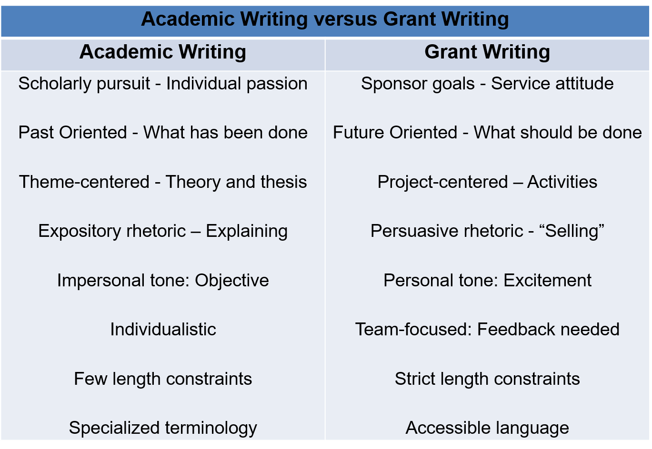

Slide 13

Academic Writing Grant Writing
Research Office

Slide 14

Write in an Active Voice
First person active
I am pioneering technique X.
Third person active
Dr. McShannon is pioneering technique X.
Our Center is pioneering technique X.
Passive
Technique X is pioneered by Dr. McShannon
Research Office

Slide 15
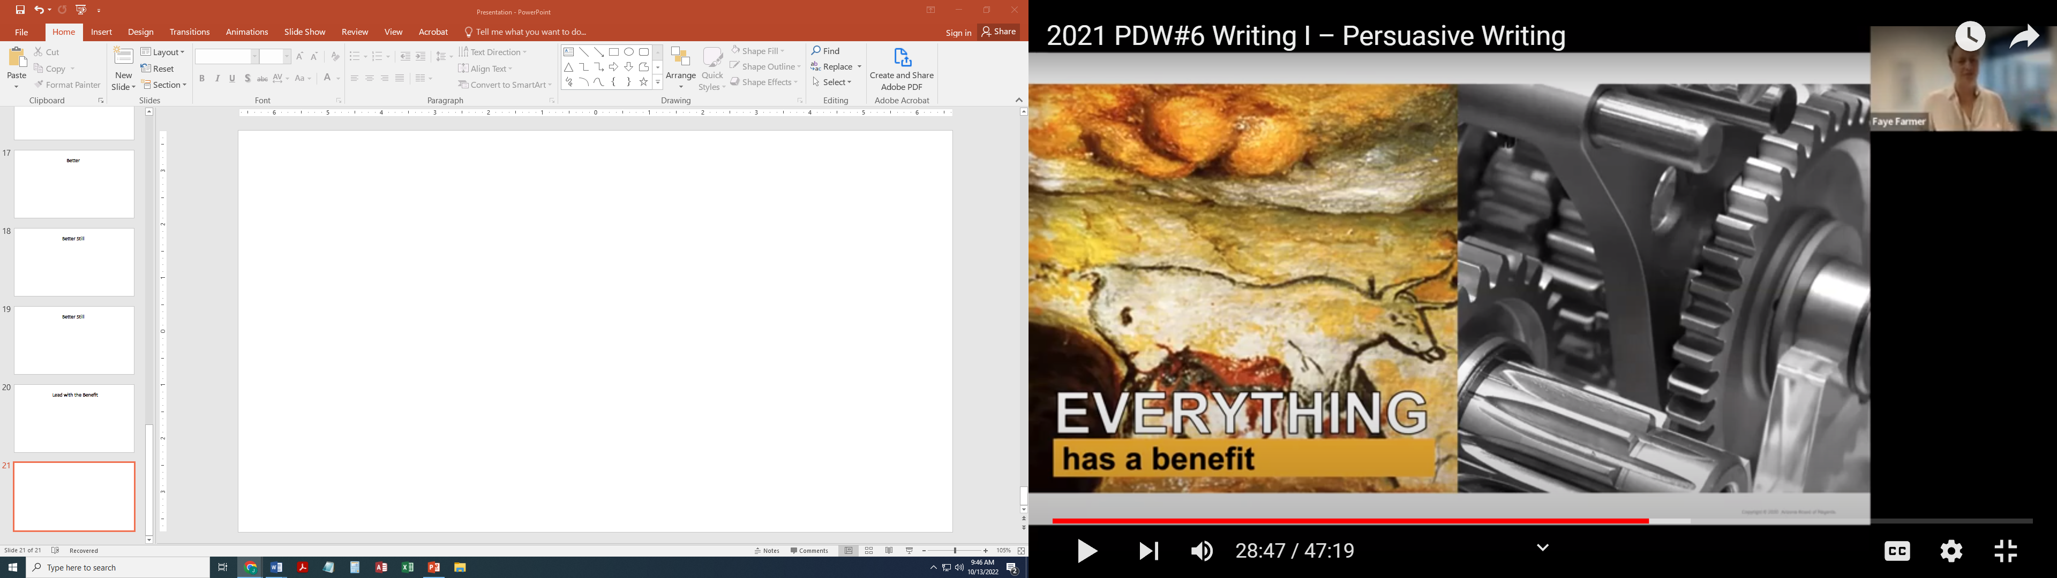
Start with the Benefits
Start your proposal with the WHY,
who, and what of your proposed research

Slide 16
Key Concepts
Features | Discrete aspects of your idea, approach, or solution
Benefits | How it can help your funder Advantages that solve a funder’s problem
Differentiators | Features unique to what you are offering AND are important to the funder
Research Office

Slide 17
Key Concepts
Feature(s) | Spectral imagining, interdisciplinary team
Benefits | Able to see things that were previously missed Enables scholarship on endangered artifacts
Differentiator(s) | This team is the only team that can offer their technology to access new information for other scholars
Research Office

Slide 18
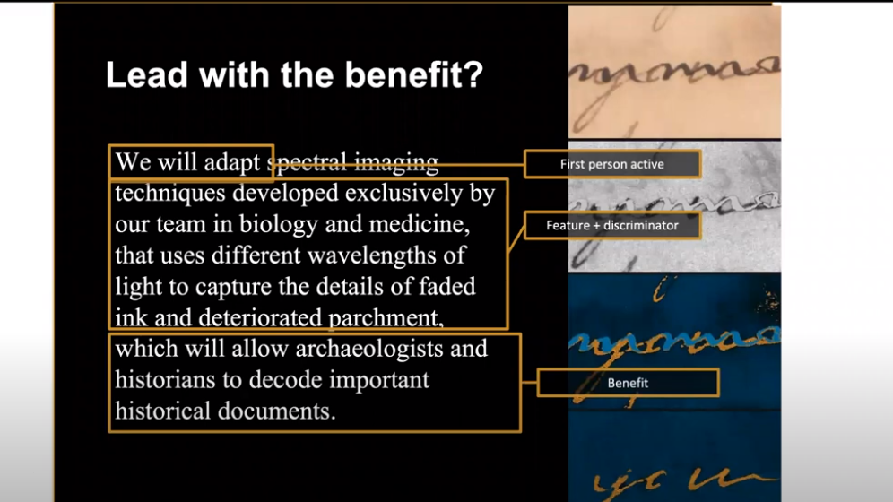

Slide 19
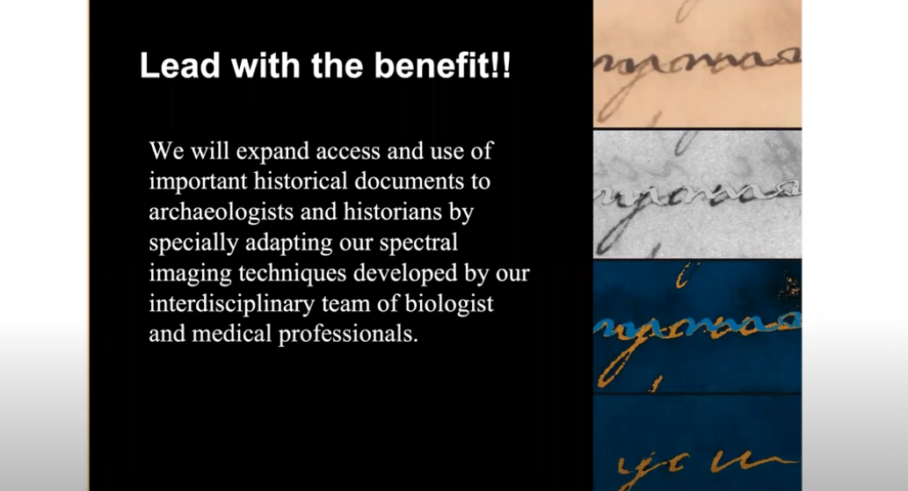

Benefit
First Person
Feature

Slide 20
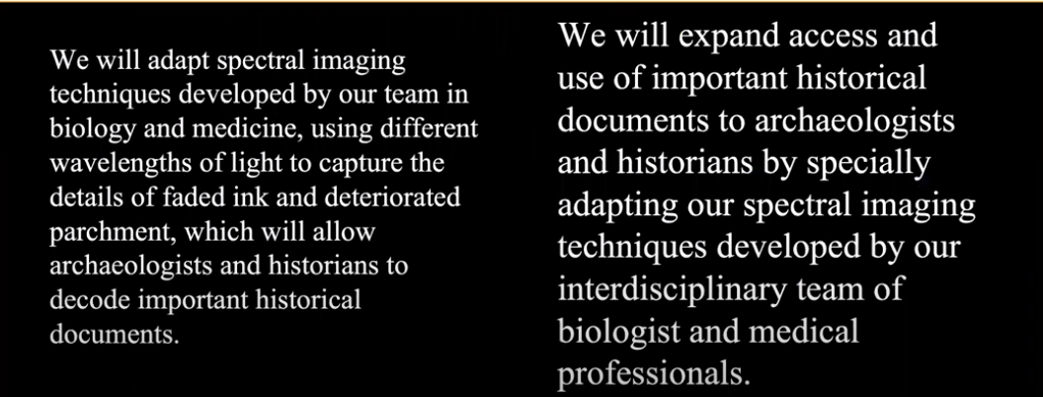
Research Office

Slide 21
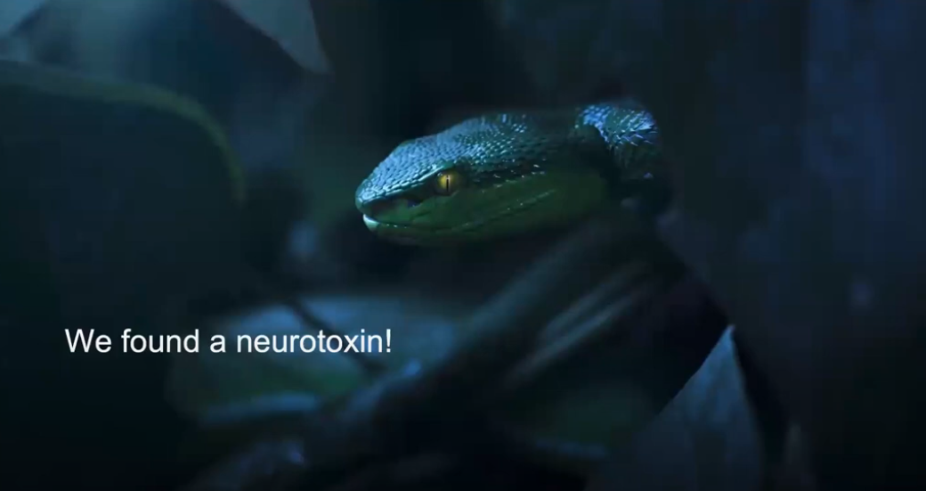
Research Office

Slide 22
Key Concepts
Feature(s) | Drugs from chemicals synthesized from black mamba venom for treating Alzheimer’s
Benefits | Drugs significantly more effective and less expensive then what is on the market. Symptomatic relief and increased quality of life and lifespan for people who suffer from Alzheimer’s and reduce worldwide costs of treating Alzheimer’s by 50%
Differentiator(s) | Three universities across three countries have preliminary research data; Dr. Ramirez has demonstrated success.
Research Office

Slide 23
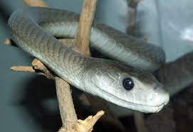
Basic Requirement
First person active
We will partner with Clodomio Picado Research Institute in Costa Rica, the Universidad Central del Caribe in Puerto Rico, and the University of Pretoria to study how synthesized neurotoxins in black mamba venom tightly bind to nerve cells.
Feature
Research Office

Slide 24
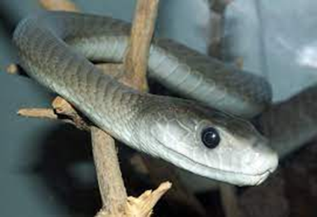
Better
First person active
We will partner with Clodomio Picado Research Institute in Costa Rica, the Universidad Central del Caribe in Puerto Rico, and the University of Pretoria to study how synthesized neurotoxins in black mamba venom work and how they could be used to treat people who suffer from Alzheimer’s disease.
Feature
Benefit
Research Office

Slide 25
Better Still
We will partner with Clodomio Picado Research Institute in Costa Rica, the Universidad Central del Caribe in Puerto Rico, and the University of Pretoria to study how synthesized neurotoxins in black mamba venom work and how they could be used to treat the 29.8 million people who suffer from Alzheimer’s disease and significantly lower the cost of treatment in the developed countries worldwide from $150 billion to $80 billion. Co-PI Ramirez has already discovered that black mamba neurotoxins bind tightly to neve cells, making them very effective at destroying nerve cells and causing neurogenic shock in snake bite victims.
First person active
Feature
Benefit
Differentiator
Research Office

Slide 26
Better Still
In order to decrease the cost and increase effectiveness of treatment in developed countries for Alzheimer’s disease my group will study how synthesized neurotoxins in black mamba venom work and how they could be used to treat the 29.8 million people who suffer from Alzheimer’s disease and significantly lower the cost of treatment in the developed countries worldwide from $150 billion to $80 billion. Co-PI Ramirez has already discovered that black mamba neurotoxins bind tightly to neve cells, making them very effective at destroying nerve cells and causing neurogenic shock in snake bite victims.
Benefit
First person active
Feature
Differentiator
Research Office

Slide 27
Lead with the Benefit
In order to decrease the cost and increase the effectiveness of treatment in developed countries for Alzheimer’s disease my group will study how synthesized neurotoxins in black mamba venom work and how they could be used to treat the 29.8 million people who suffer from Alzheimer’s disease and significantly lower the cost of treatment in the developed countries worldwide from $150 billion to $80 billion. Co-PI Ramirez has already discovered that black mamba neurotoxins bind tightly to neve cells, making them very effective at destroying nerve cells and causing neurogenic shock in snake bite victims.
We will partner with Clodomio Picado Research Institute in Costa Rica, the Universidad Central del Caribe in Puerto Rico, and the University of Pretoria to study how synthesized neurotoxins in black mamba venom tightly bind to nerve cells.
Research Office

Slide 28

Benefits are scalable
What is benefit to the field?
What is the benefit to society?
What is the benefit to the funder?
What is the benefit of my technical approach?
Research Office

