Slide 1



New Mexico Tech Research Colloquium
2024
Simultaneous observations of lightning processes from space and ground
Adonis F.R. Leal
March 1st - 2024

Slide 2
Introduction

Slide 3
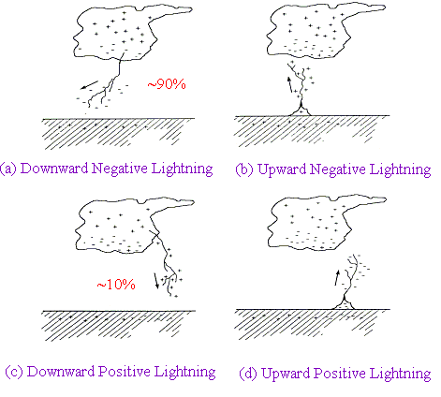
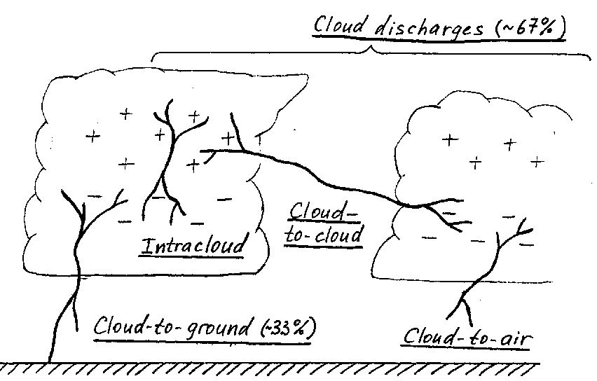
Cloud discharges (75%)
Cloud-to-
cloud
Intracloud
Cloud-to-ground (25%)
Cloud-to-air
Adapted from (RAKOV; UMAN, 2003)

Slide 4
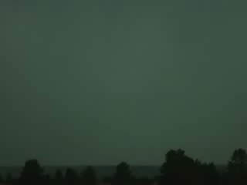
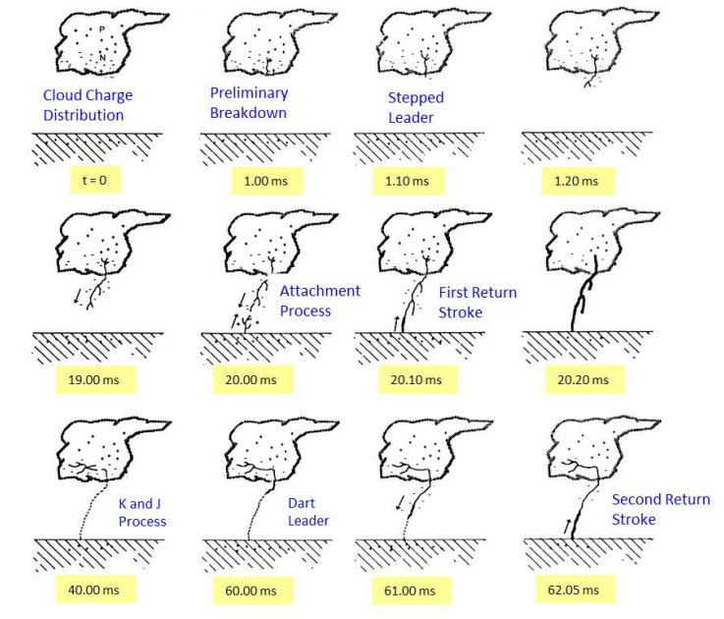
Various processes comprising a negative cloud-to-ground lightning flash.
Adapted from (UMAN, 1987)

Slide 5
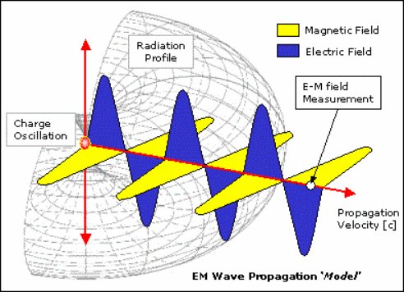
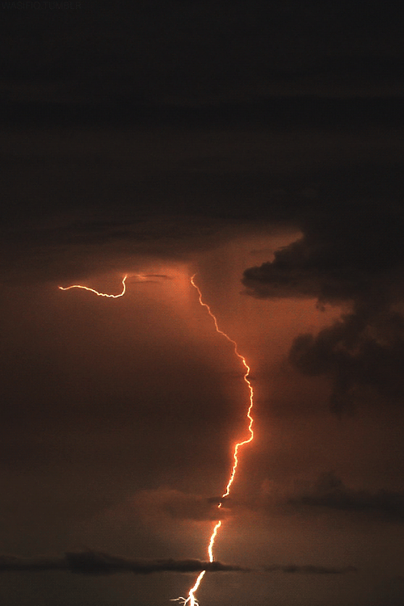
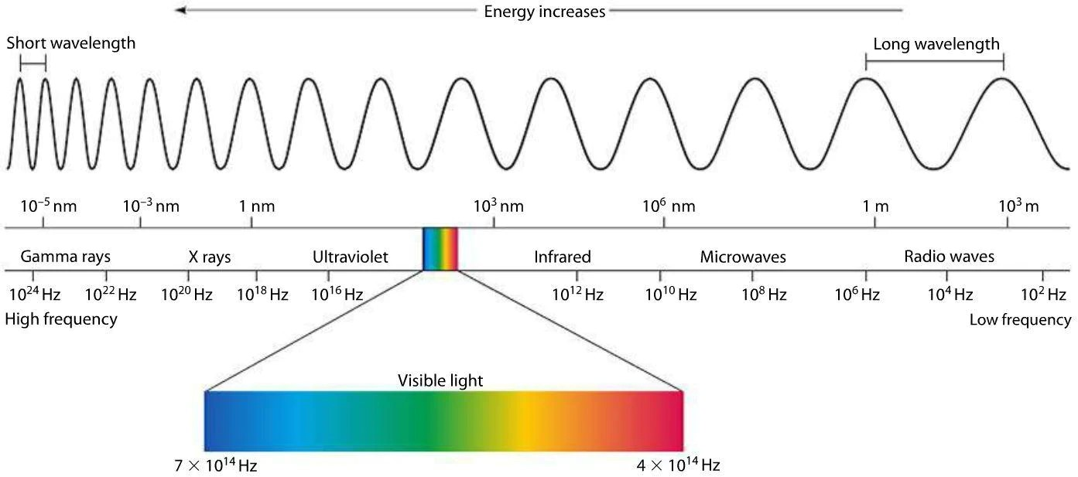

Slide 6
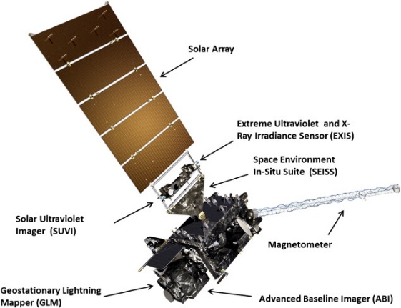
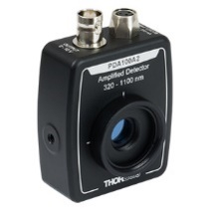
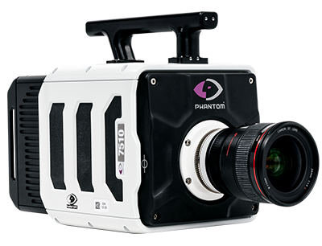
Methodology
The lightning data recorded at ground level was compared against GLM group data (optical energy in Joules).
GLM
Photometer
LMA
HSV
E-field

Slide 7
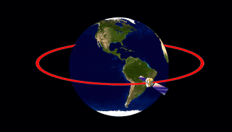
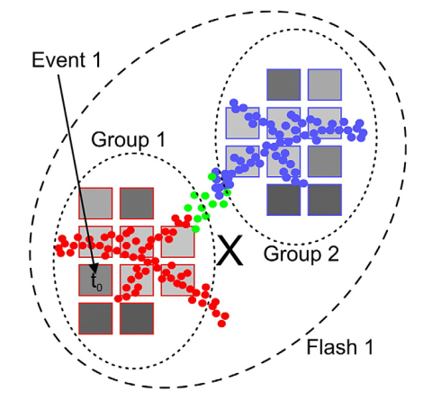
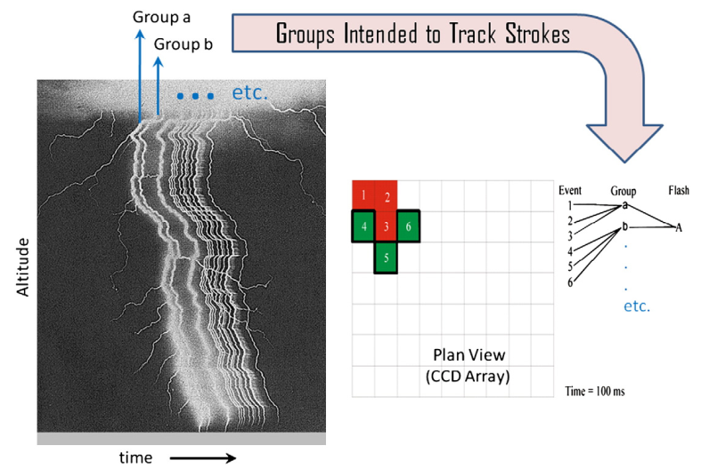
Geostationary Lightning Mapper (GLM)
Geostationary Lightning Mapper (GLM)
Near uniform spatial resolution 8 km nadir, 14 km edge fov;
70-90% flash detection day and night;
Single band 777.4 nm;
2 ms frame rate;

Slide 8
Results and Discussion

Slide 9
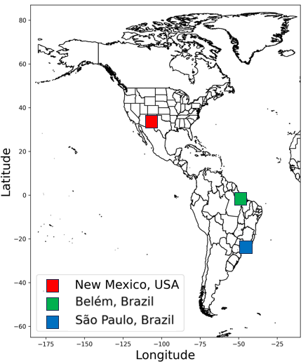
Return stroke GLM detection efficiency

Slide 10
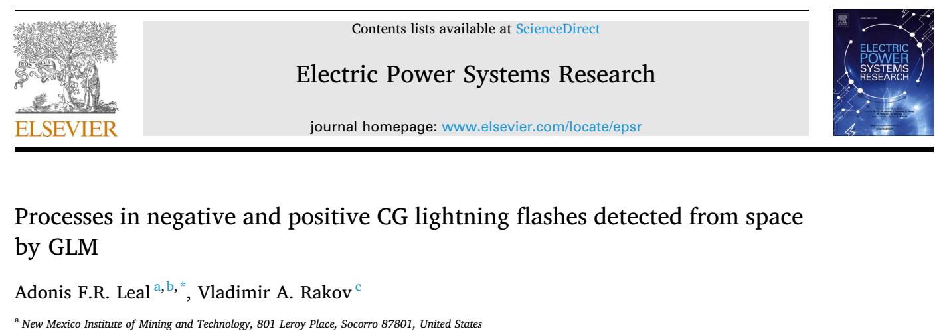
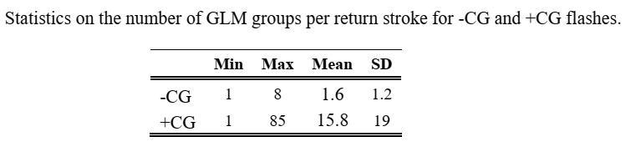
Results and discussion

Slide 11
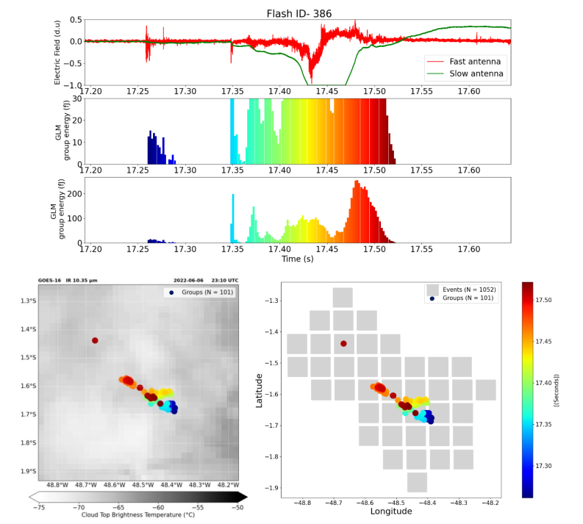
170 ms

Slide 12
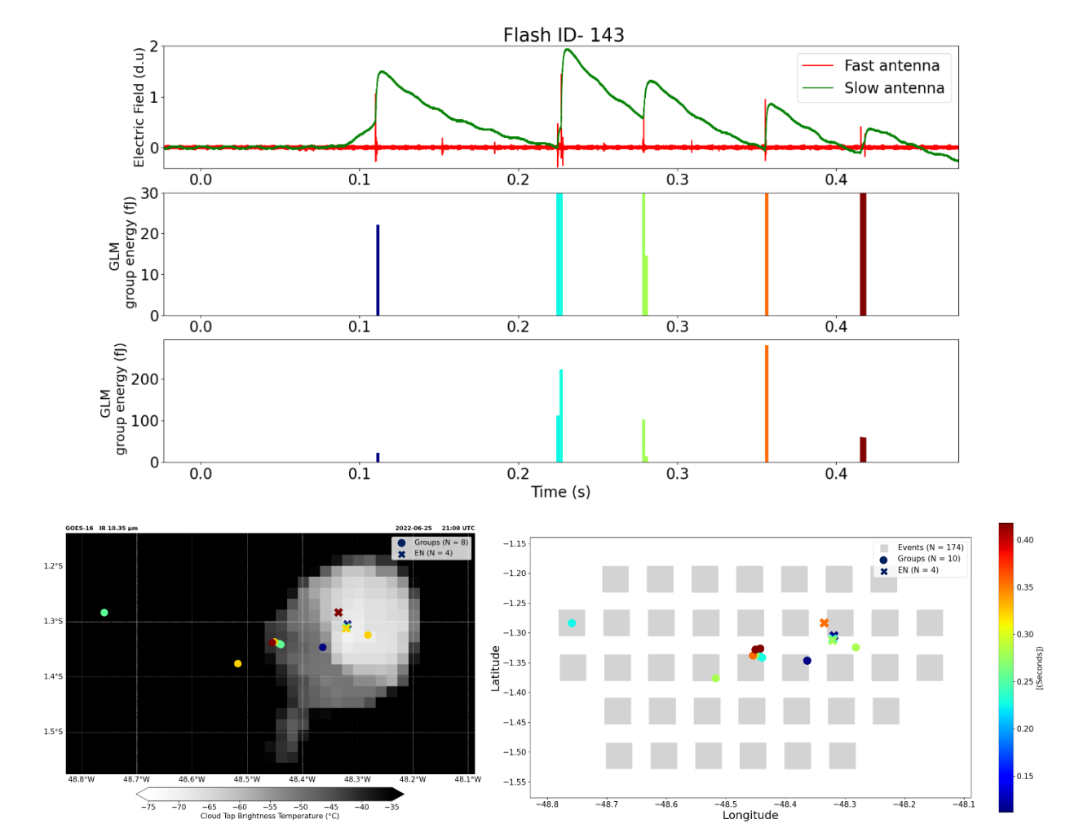

Slide 13
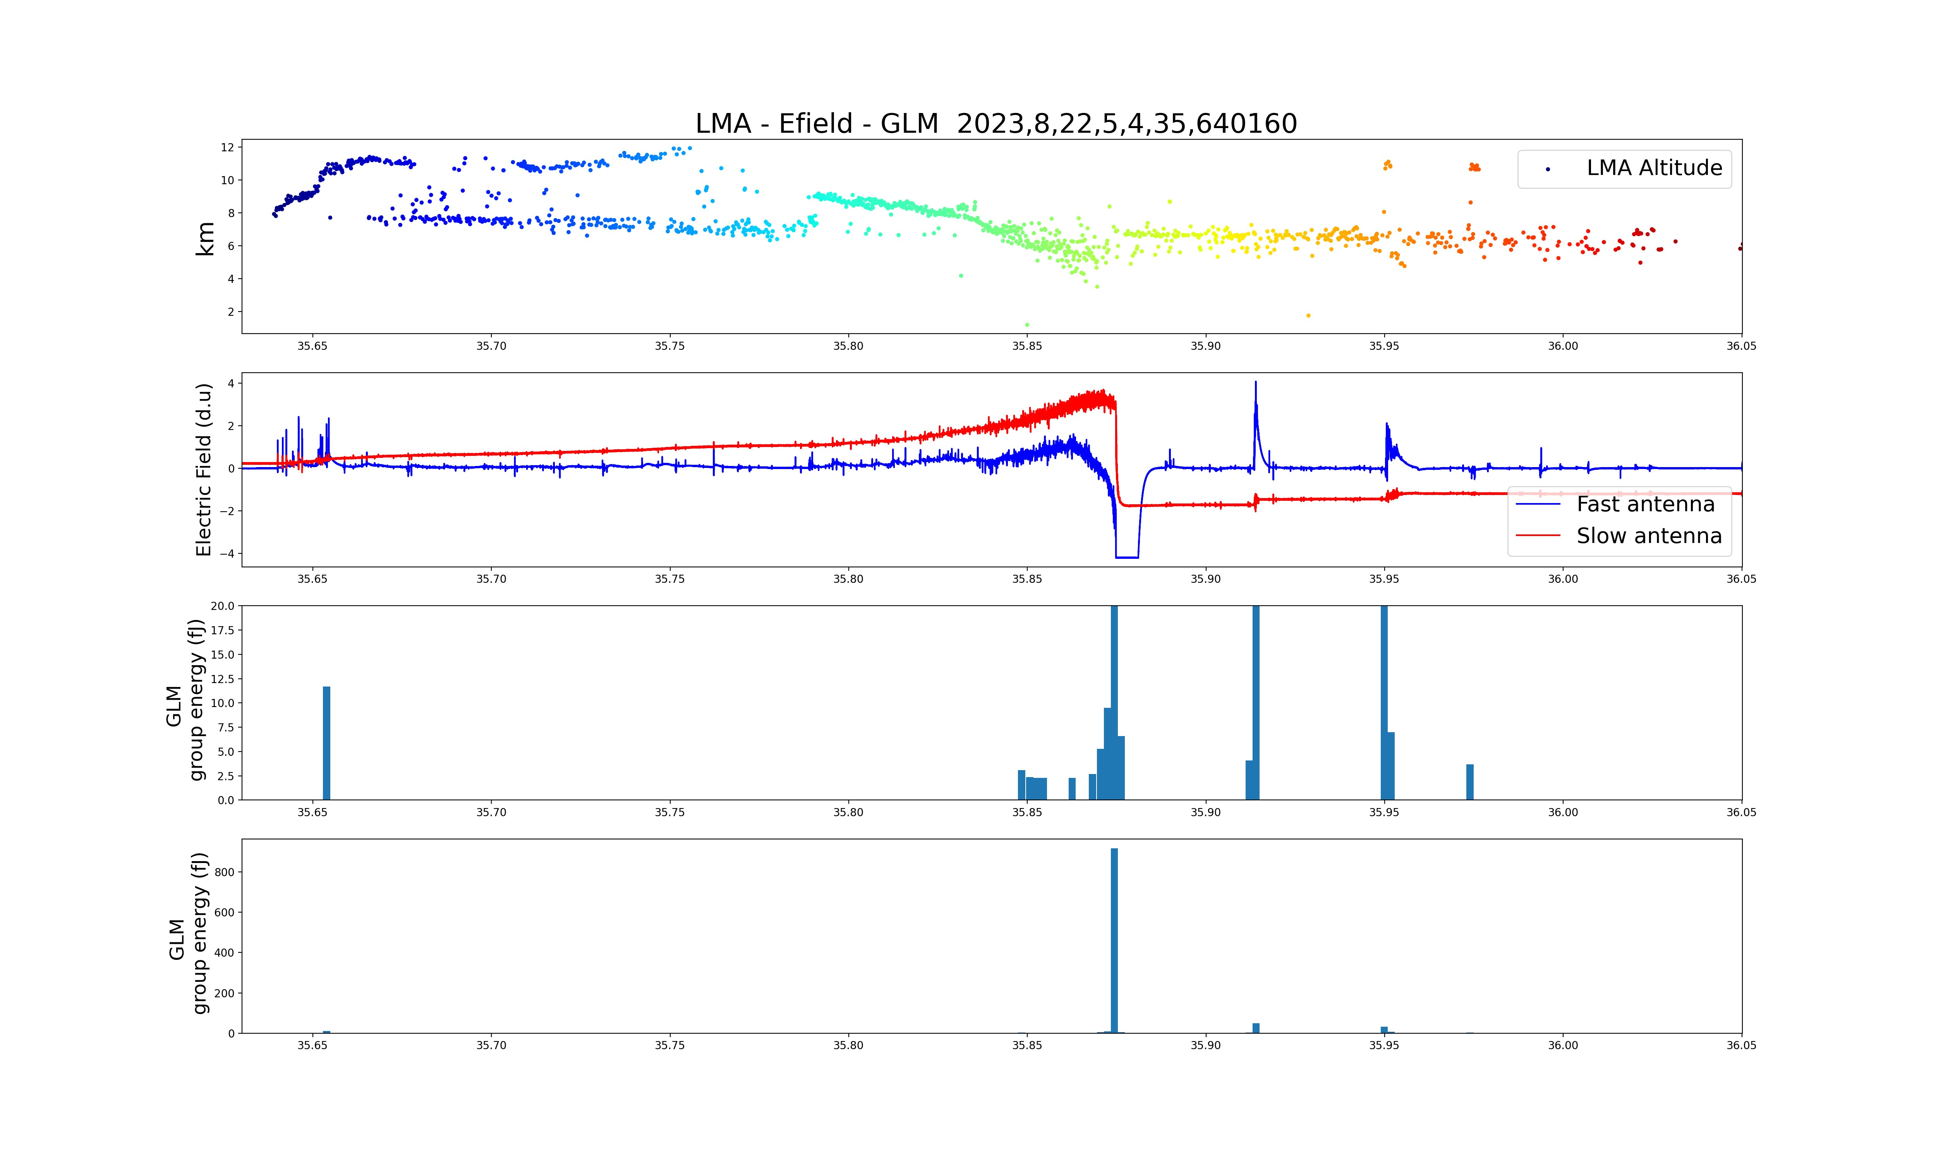
LMA
E-field
GLM
PB
RS
K-Leaders
Leader

Slide 14
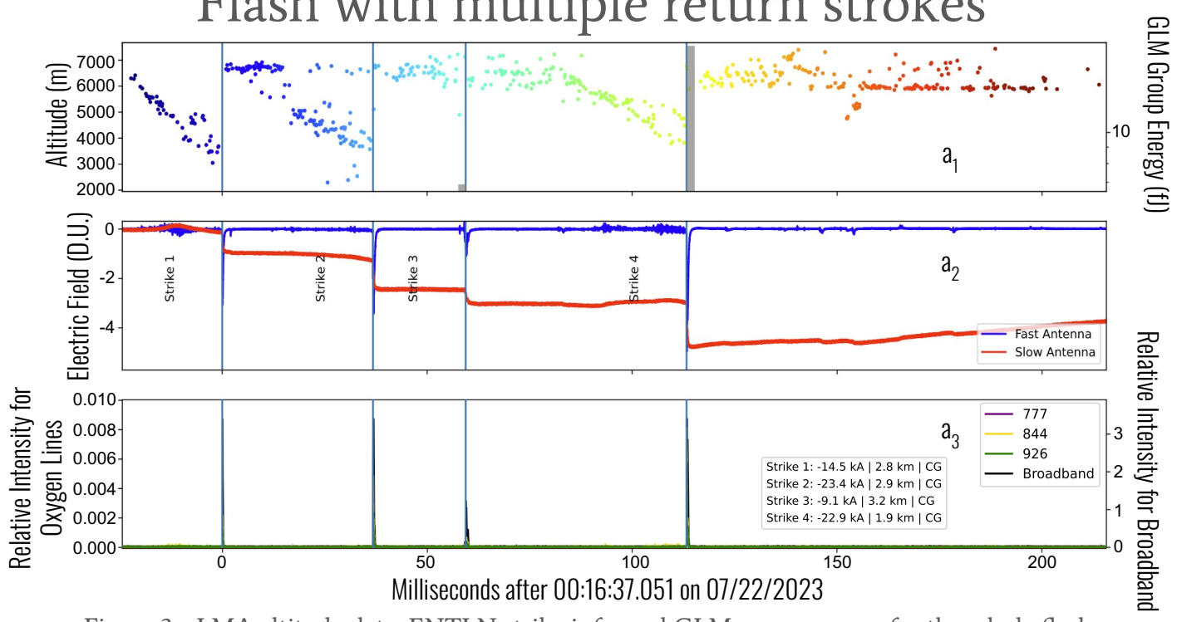
Photometer
E-field
GLM

Slide 15
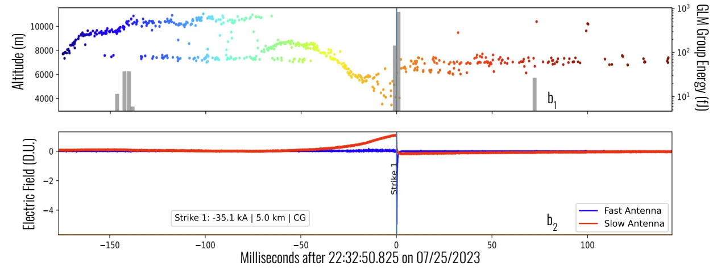
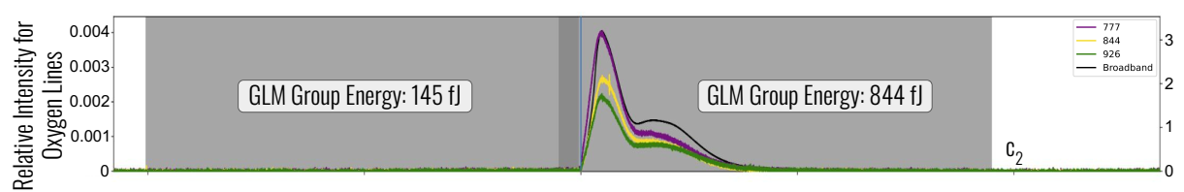
Photometer
E-field
GLM

Slide 16
Future goals
How the clouds interferer on GLM detection?
GLM
Photometer

Slide 17
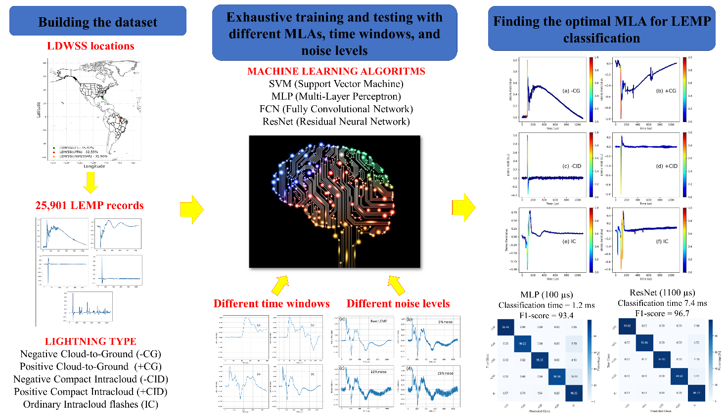
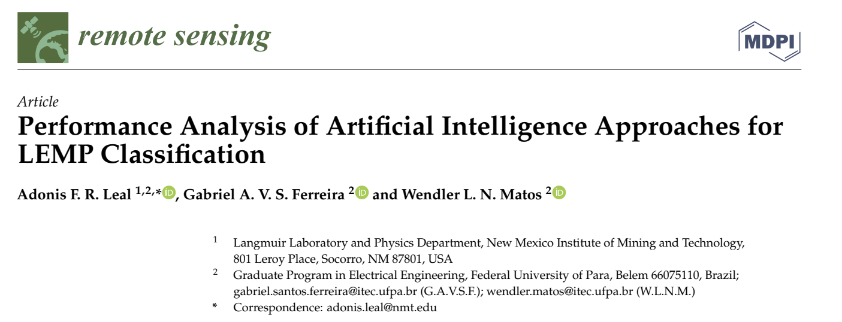
Future goals
How the clouds interferer on GLM detection?
Is possible to identify different types of lightning from space?

Slide 18
Future goals
How the clouds interferer on GLM detection?
Is possible to identify different types of lightning from space?
Is there specific lightning processes that are more likely to be detected from space?

Slide 19
Acknowledgments
Olivia Cantrell
Richard Sonnenfeld
Caitano da Silva
Jacob Wemhoner
Gabriel A. V. S. Ferreira
Wendler L. N. Matos
Vladimir A Rakov
Marcelo M Saba

Slide 20
Thank You!
Questions?
adonis.leal@nmt.edu

