Slide 1

Observations and numerical simulations of gas giant atmospheres
Dr. Raúl Morales-Juberías
Feb 30, 2024 - New Mexico Tech Research Workshop

Slide 2
Outline
Observations and numerical simulations of gas giant atmospheres
Planetary atmospheres
Measuring winds - two techniques
      Cloud correlations (1D & 2D winds)
      Doppler (3D)
Life cycle of spots
      Neptune
Conclusions & Questions

Slide 3
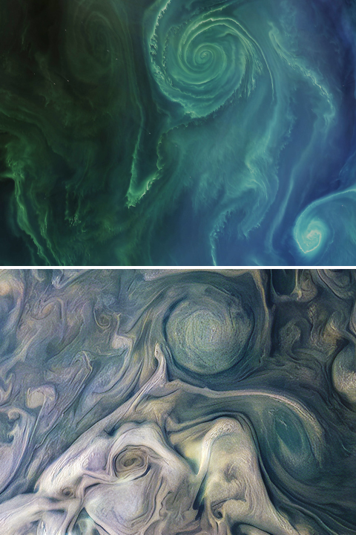
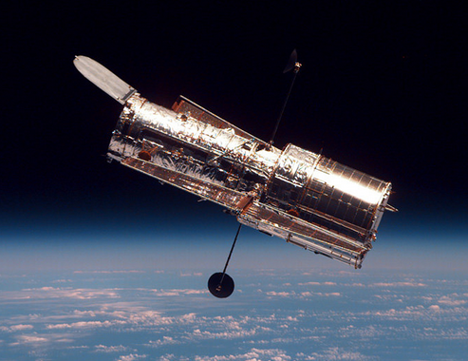
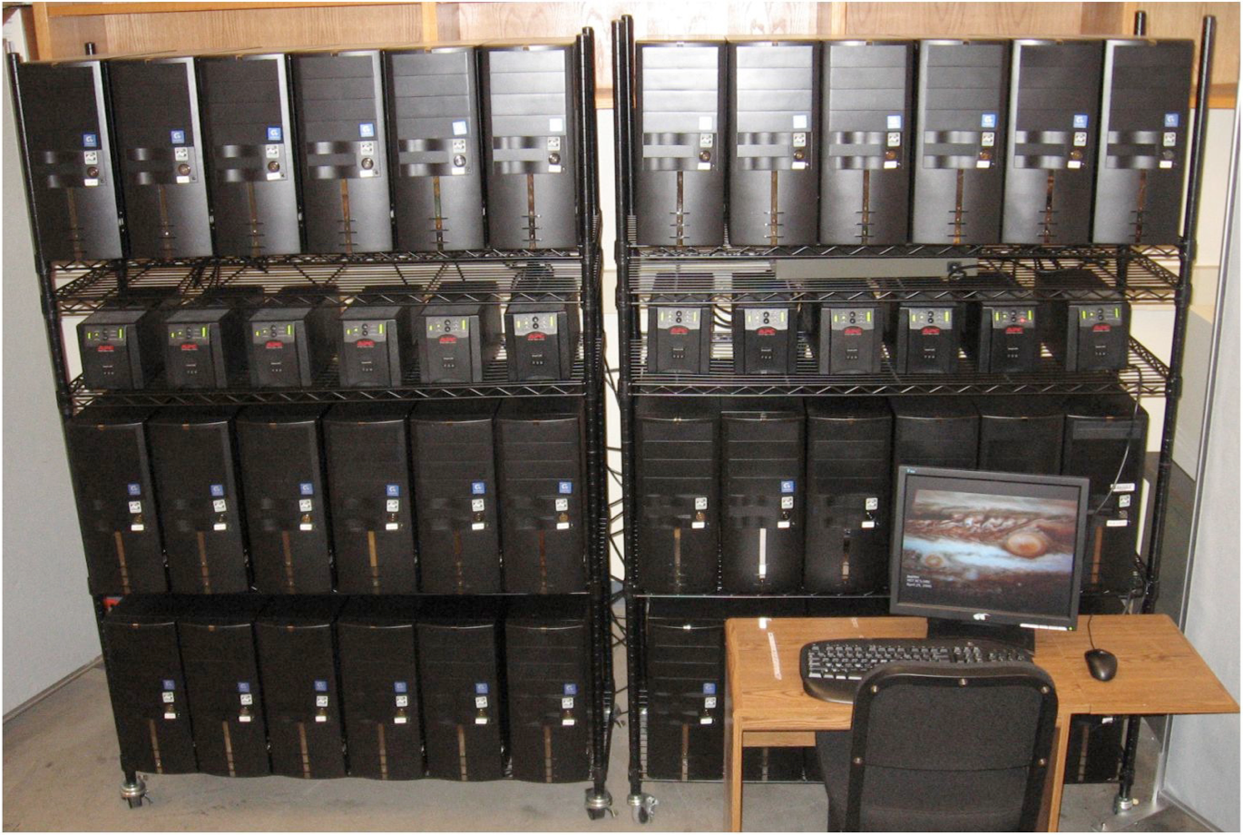
Planetary Atmospheres
Earth
Interdisciplinary research
HST
Jupiter
Dynamics (Oceans & Atmospheres)
Astrophysics
Computational Physics
VLT

Slide 4
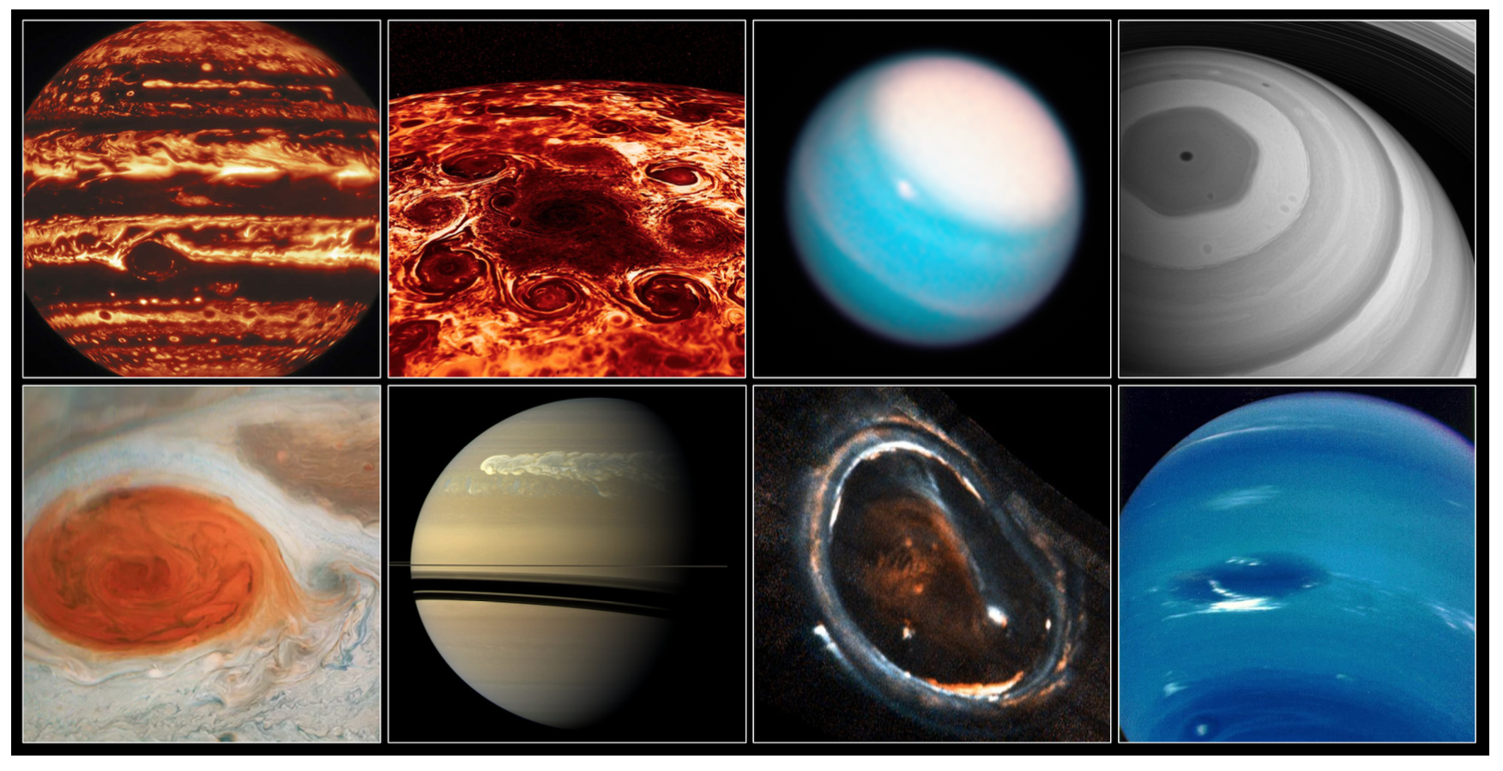
Planetary atmospheres
Rich phenomenology

Slide 5
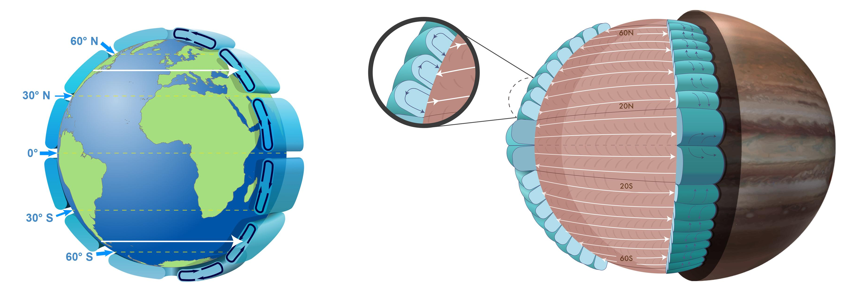
Planetary atmospheres
Circulation Models
Notes:
In this figure we show Jupiter’s temperature vs pressure profile together with the saturation curves for Water, Ammonia Hydrosulfide, and Ammonia.
Since the abundance of ammonia is uncertain the figure shows four different curves for different abundances.
The points where these saturation curves cross the temperature profile of the atmosphere are the altitudes on the atmosphere where one can expect to find clouds from by these different elements. Thus one could expect to find water clouds around 7 bars (CLICK), Ammonia hydrosulfide clouds at about 2 bars (CLICK) and finally a top layer of ammonia clouds at about 0.8 bars.

Slide 6
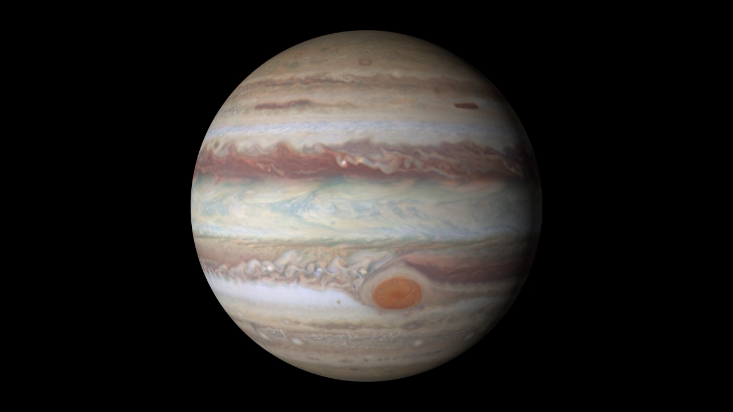
Measuring winds - Cloud tracking
Ex. Jupiter
NASA/JPL/University of Arizona
NASA/JPL/University of Arizona

Slide 7
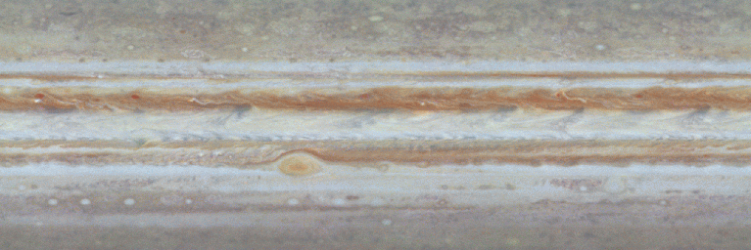
Measuring winds - Cloud tracking
Ex. Jupiter
NASA/JPL

Slide 8
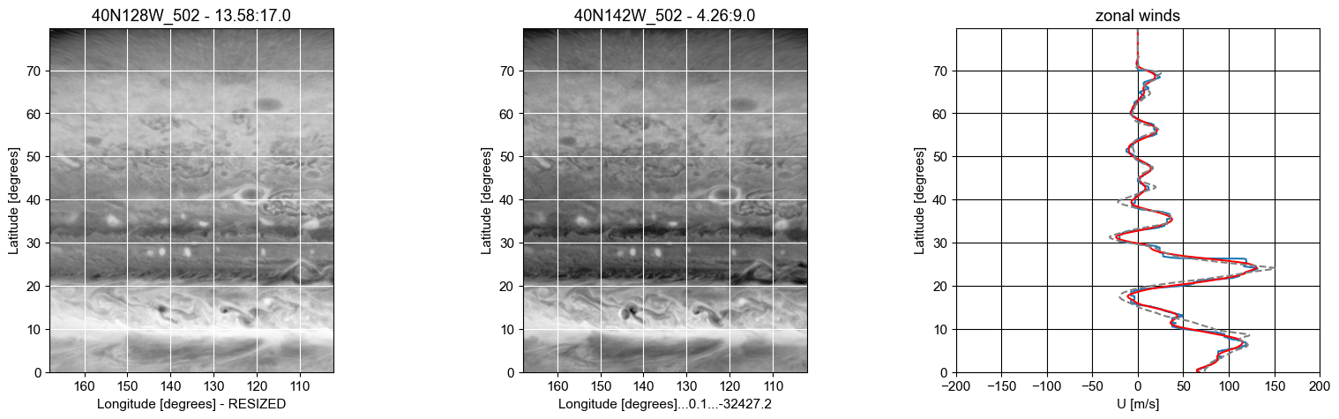
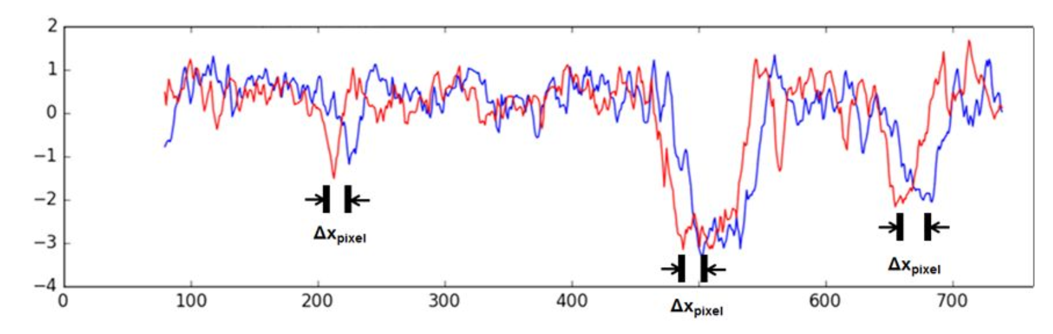
Measuring winds - Cloud tracking
Correlations
$$\frac{Δx}{Δt}=v$$

Slide 9
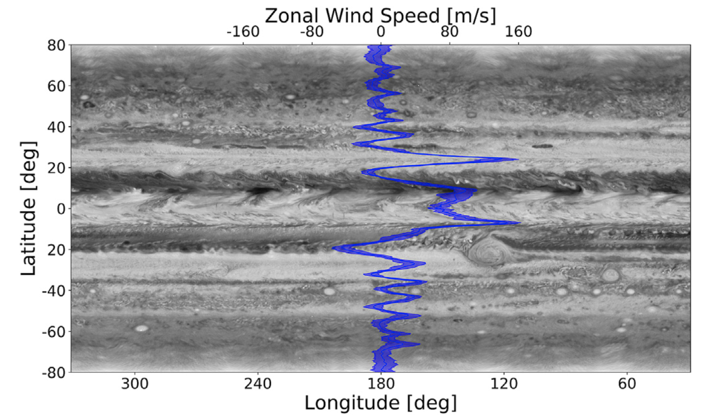
Measuring winds - Cloud tracking
1D Zonal Winds
Johnson et al. 2018. Planetary and Space Science 155, 2–11

Slide 10
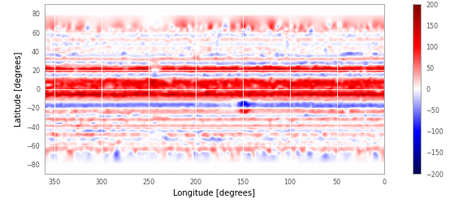
Measuring winds - Cloud tracking
2D Zonal Winds
Tollefson et al 2018

Slide 11
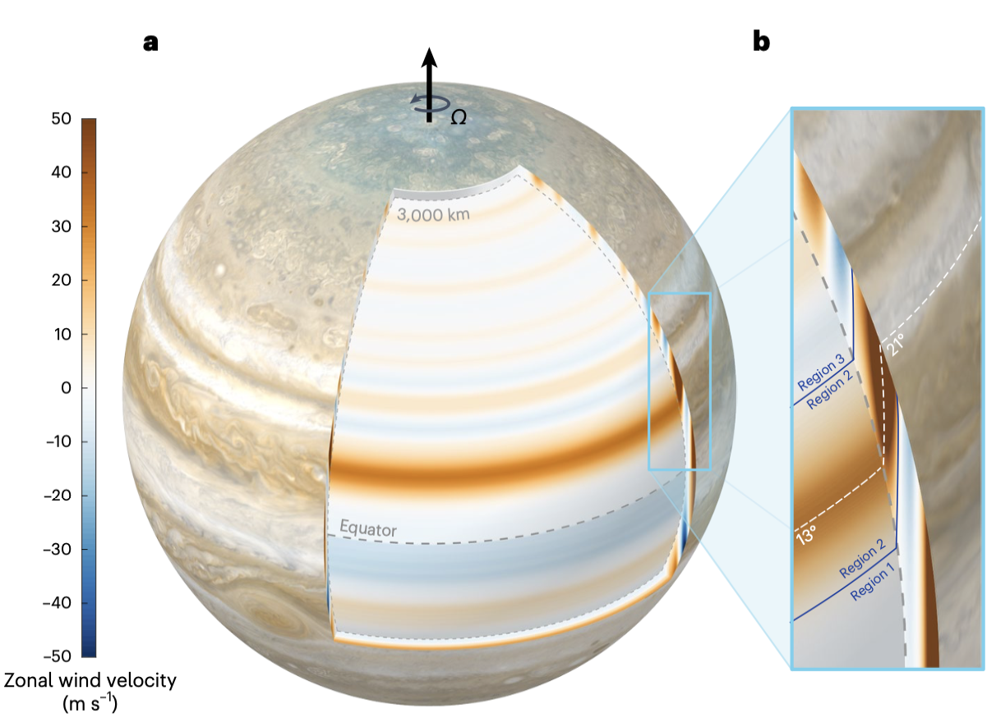
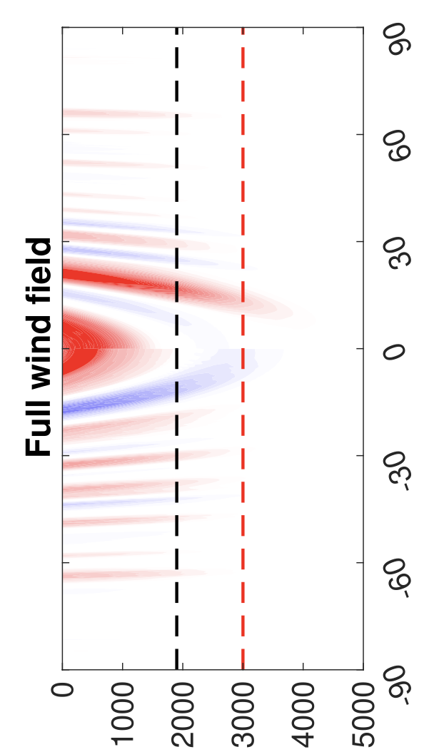
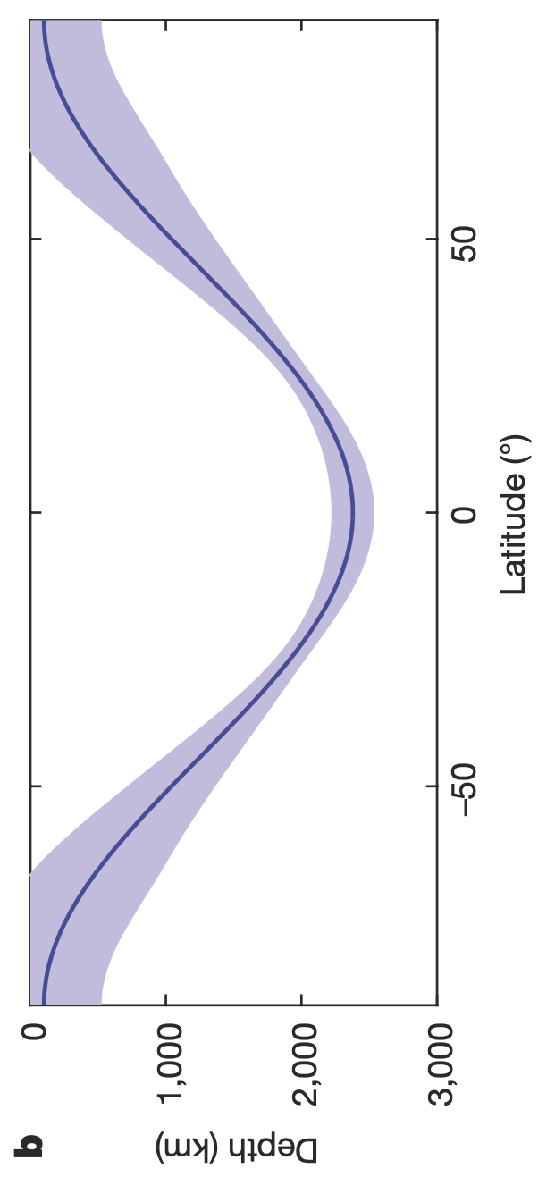
Planetary atmospheres
Winds with depth
Kaspi et al. 2023
Notes:
In this figure we show Jupiter’s temperature vs pressure profile together with the saturation curves for Water, Ammonia Hydrosulfide, and Ammonia.
Since the abundance of ammonia is uncertain the figure shows four different curves for different abundances.
The points where these saturation curves cross the temperature profile of the atmosphere are the altitudes on the atmosphere where one can expect to find clouds from by these different elements. Thus one could expect to find water clouds around 7 bars (CLICK), Ammonia hydrosulfide clouds at about 2 bars (CLICK) and finally a top layer of ammonia clouds at about 0.8 bars.

Slide 12
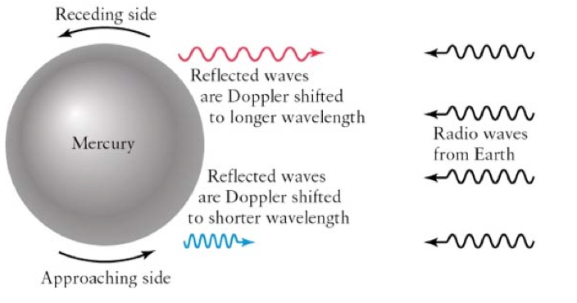
Measuring winds - Doppler
Main idea
1962 – Rotation period of Mercury (~ 59 days) measured by bouncing radar waves from the surface of the planet

Slide 13
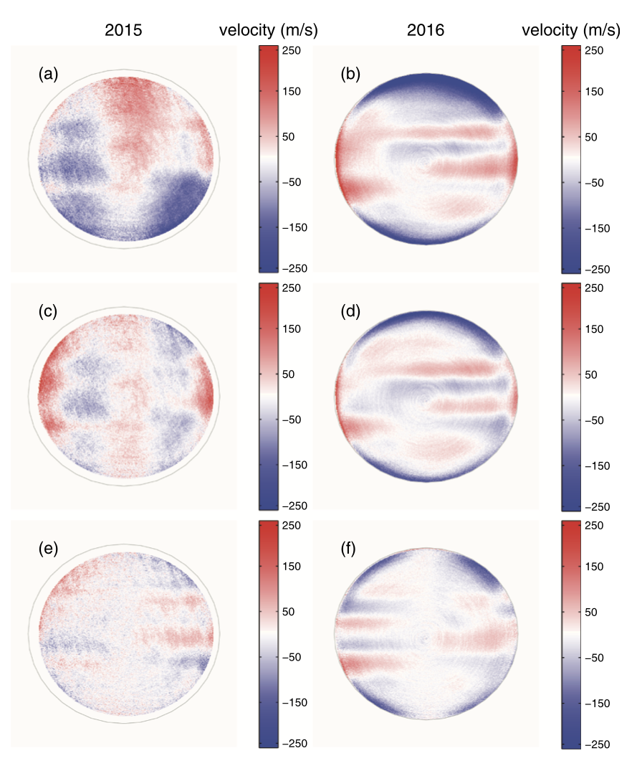
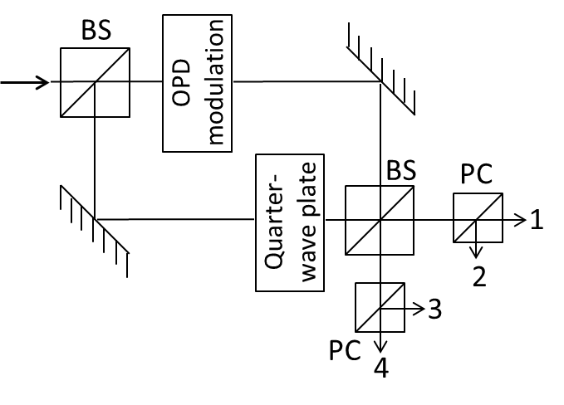
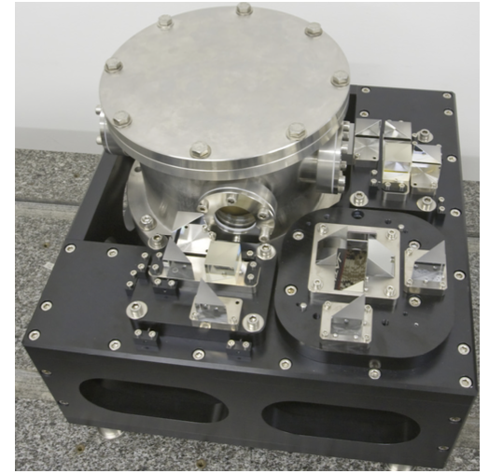
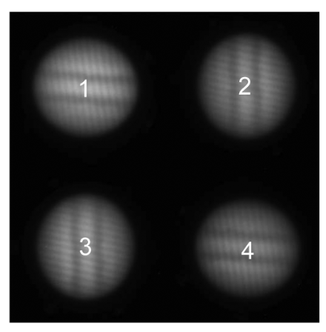
Measuring winds - Doppler
JIVE instrument
Goncalves et al. 2019 Icarus 319, 795–811

Slide 14
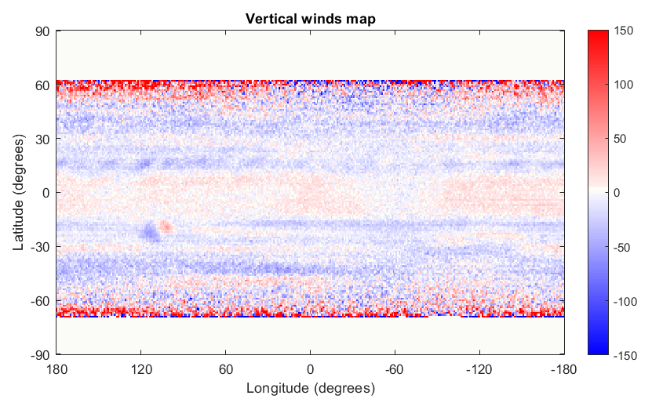
Measuring winds - Doppler
3D winds
Schmider et al.2024 accepted

Slide 15
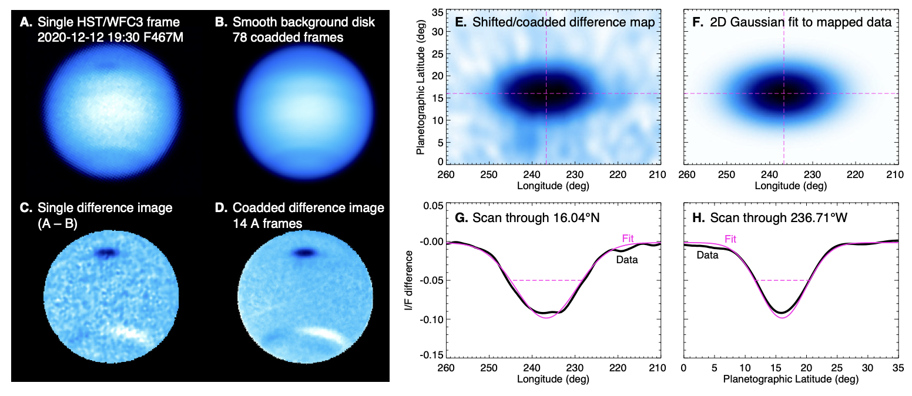
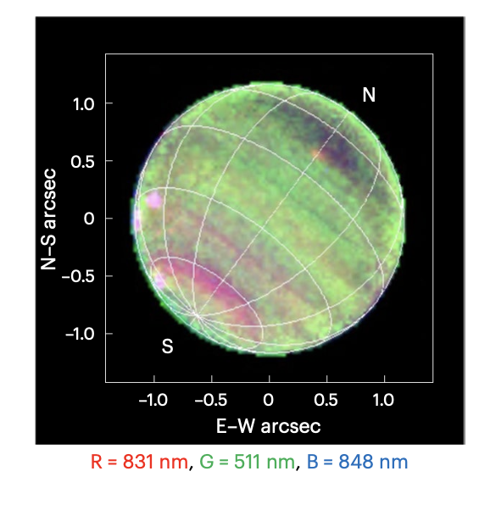
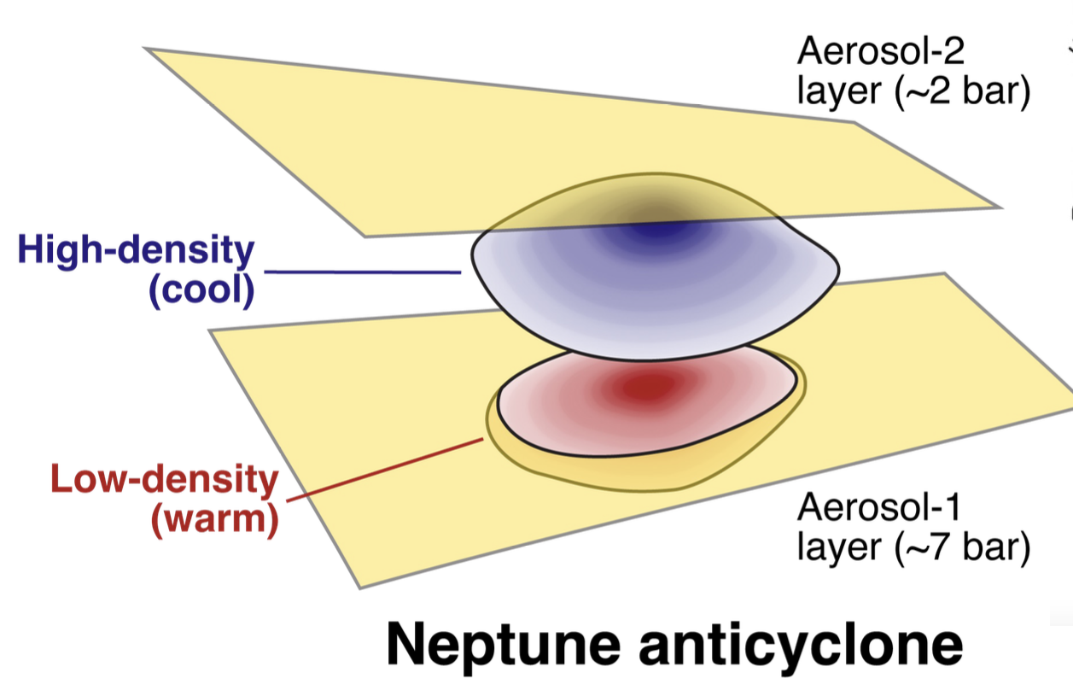
Vortices
Neptune’s Great Dark Spots
2020
Wong et al 2022 Icarus 387
1989
NASA/JPL
Irwin et al 2023 GRL Planets

Slide 16
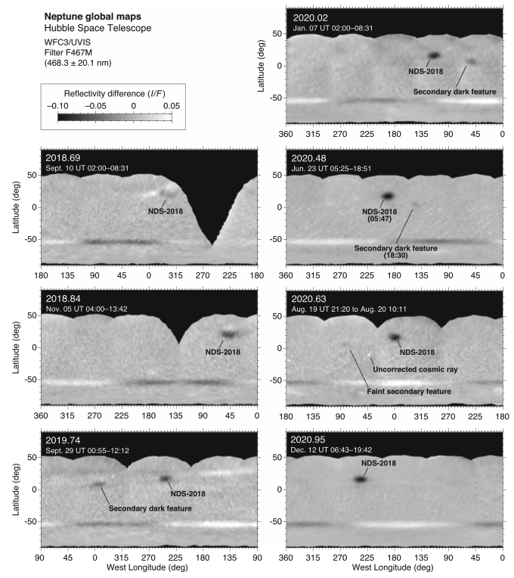
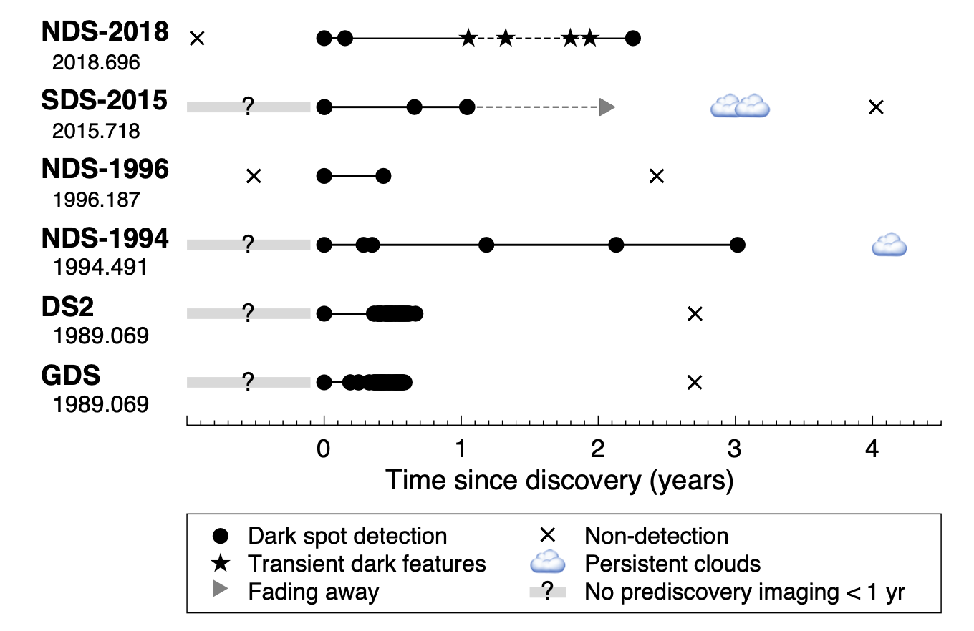
Vortices
NDS 2018 - life cycle
Wong et al 2022 Icarus 387

Slide 17
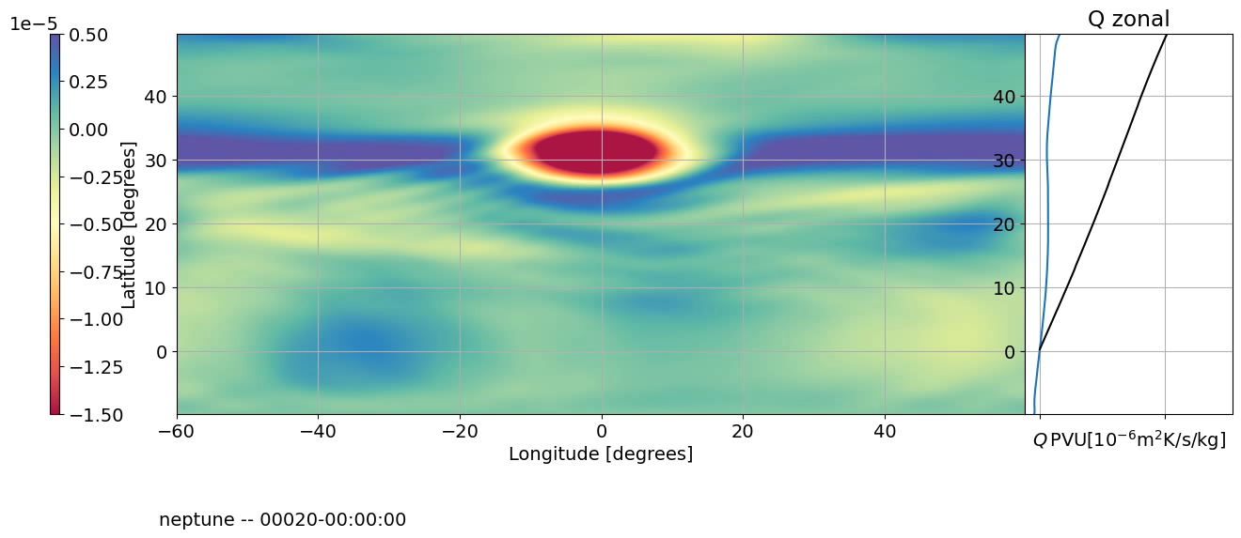
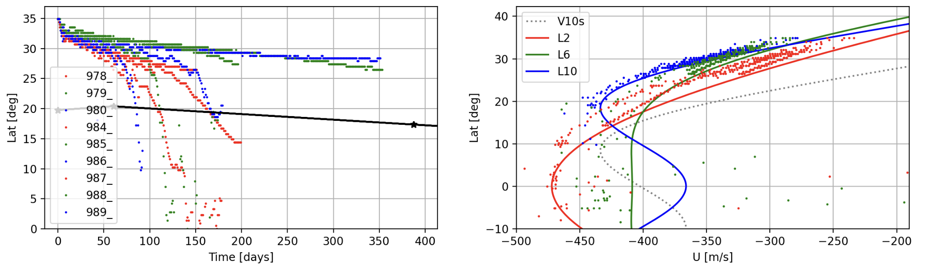
Vortices
NDS 2018 - New simulations
$$\frac{dλ}{dt}∝N(β-uyy)V_{t}$$
$$\text{equatorial drift rate}∝\text{atm. static stability}×\text{zonal wind curvature}×\text{vortex strength}$$
Morales-Juberias in preparation

Slide 18
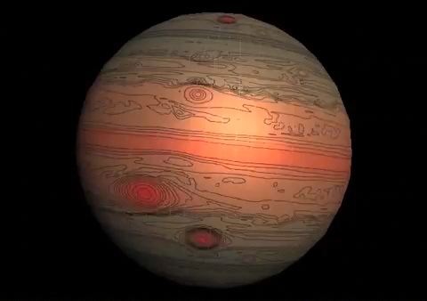
Conclusions
Atmospheric circulation in these planets changes in complex and surprising ways as a function of height and latitude.
Measuring accurate winds is important to understand the 3D dynamical structure of these atmospheres.
Measuring & simulating spots drift rates and oscillations is also important to better understand the 3D structure of these atmospheres.
High resolution and high temporal cadence observations are needed to improve our models and understanding of these atmospheres.
Raúl Morales-Juberías
rmjube@nmt.edu

