Slide 1
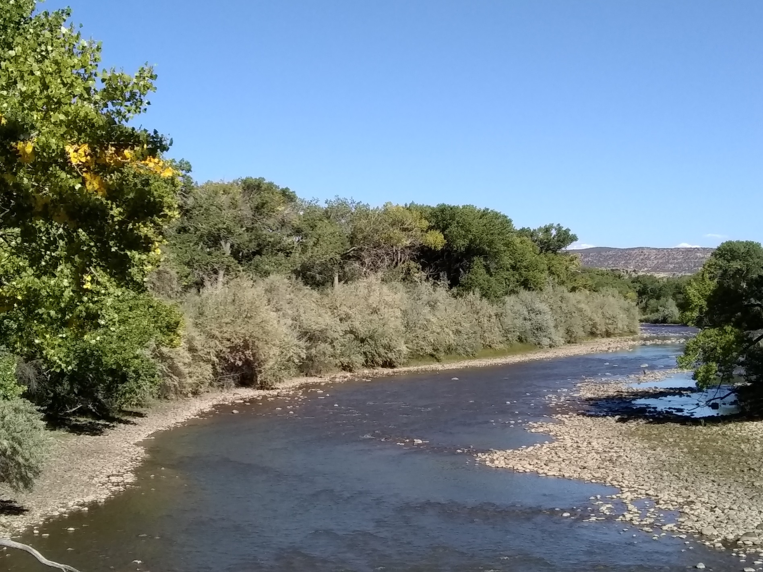
Duval Lab & The Compatriots
Russian olive influence along the Rio Grande:
ecosystem restoration, climate, chemistry, bugs & bacteria

Slide 2
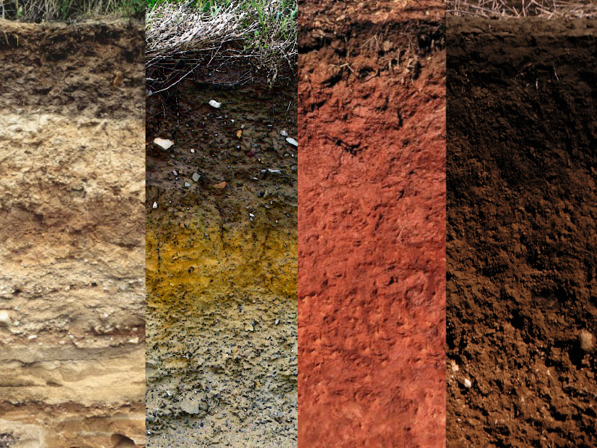
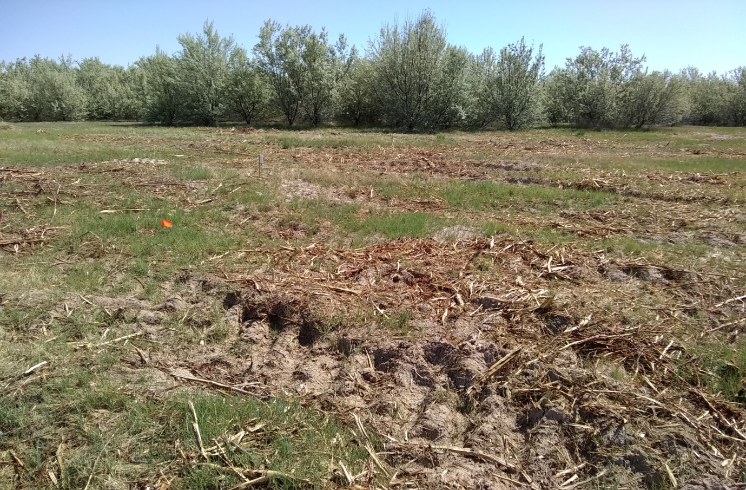
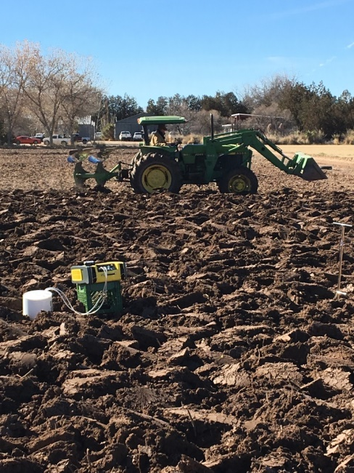
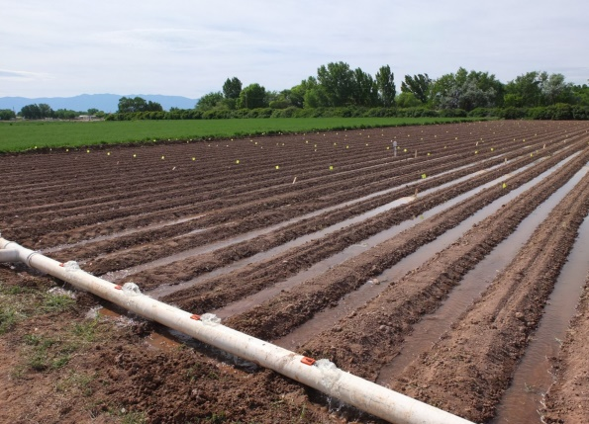
Motivation:
Soil biology is fundamental to understanding and mitigating climate change
Invasive spp: We don’t often understand their functional role in ecosystems
Control on atmospheric
gases and nutrients
(source and sink)
Influence climate via intentional land use

Slide 3
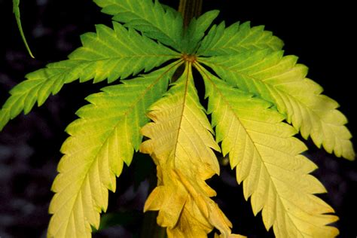
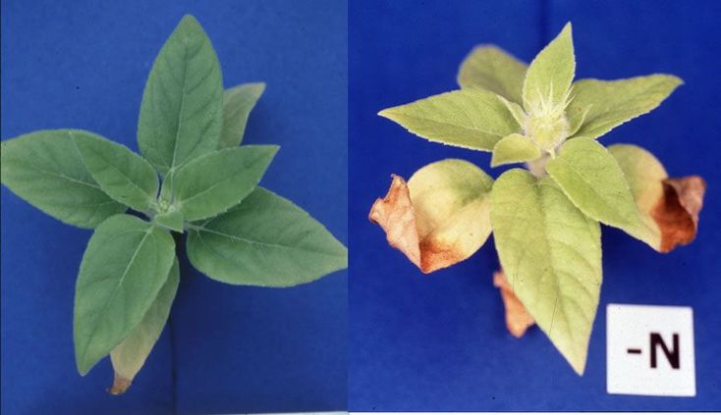
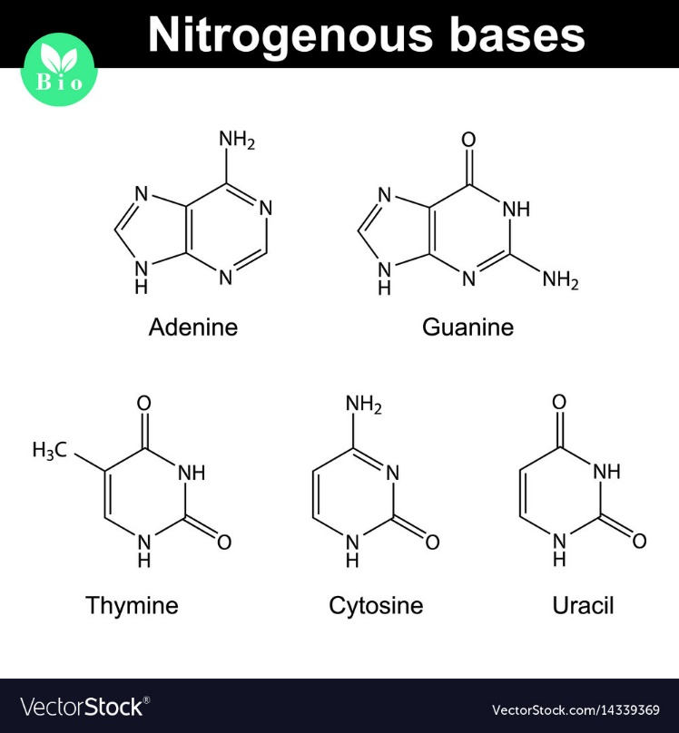
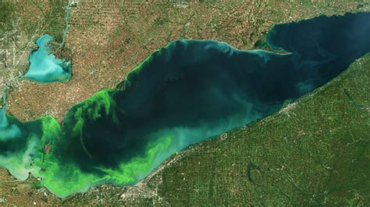
Nitrogen is a “keystone” element (+/-)
Also a nutrient for things we
don’t want to grow…
noaa.gov
Excess N (often fertilizer overuse) = higher N₂O/NO/NO_{x} emissions
= generally lower native plant diversity
= P and other element limitation due to stoichiometric mis-matches

Slide 4
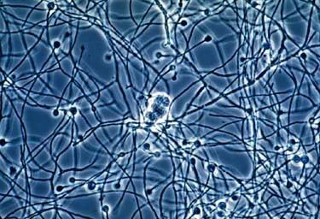
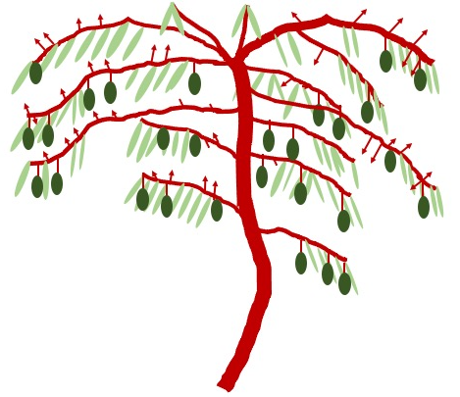
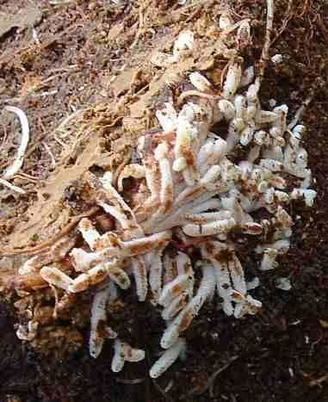
Elaeagnus angustifolia
Frankia sp.
OrgN
N
N
OrgN
OrgN
NH₃

Slide 5
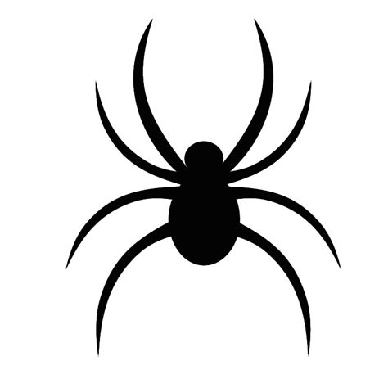
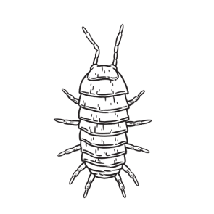
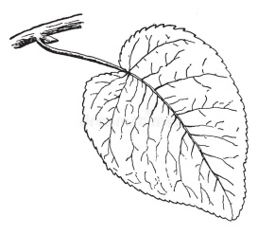

Nitrogen cycling: incorporates climate and
ecological variables of interest
CO₂
N₂O
CO₂
N₂O
N₂
N₂O
NH₄⁺
NO₃⁻

Slide 6
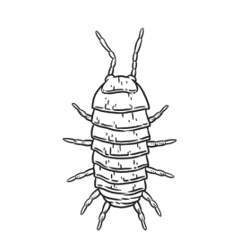
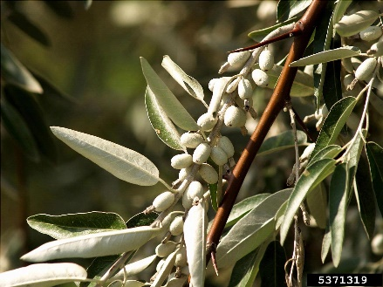
Nitrogen cycling: incorporates climate and
ecological variables of interest
CO₂
N₂O
CO₂
N₂O
N₂
N₂O
NH₄⁺
NO₃⁻

Slide 7

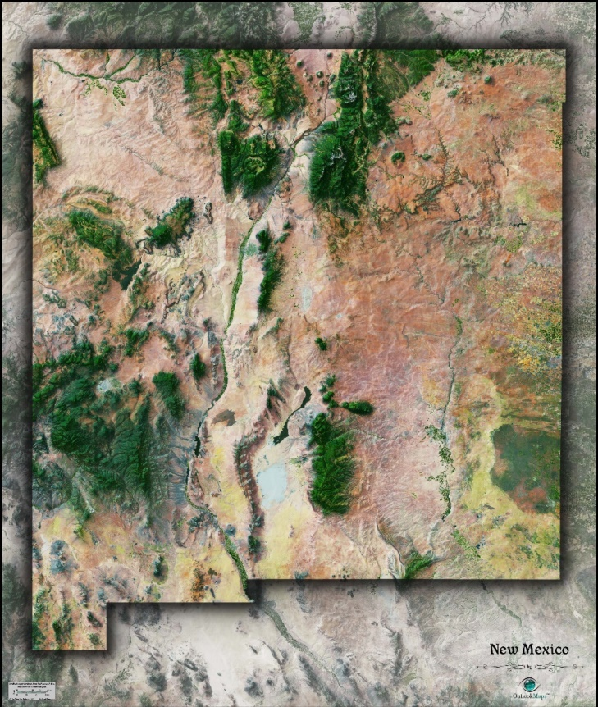
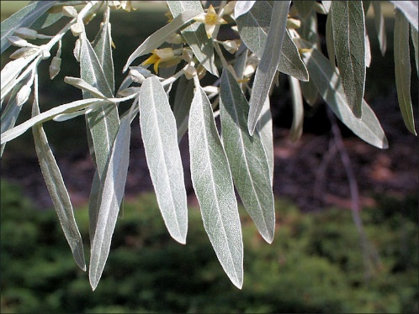
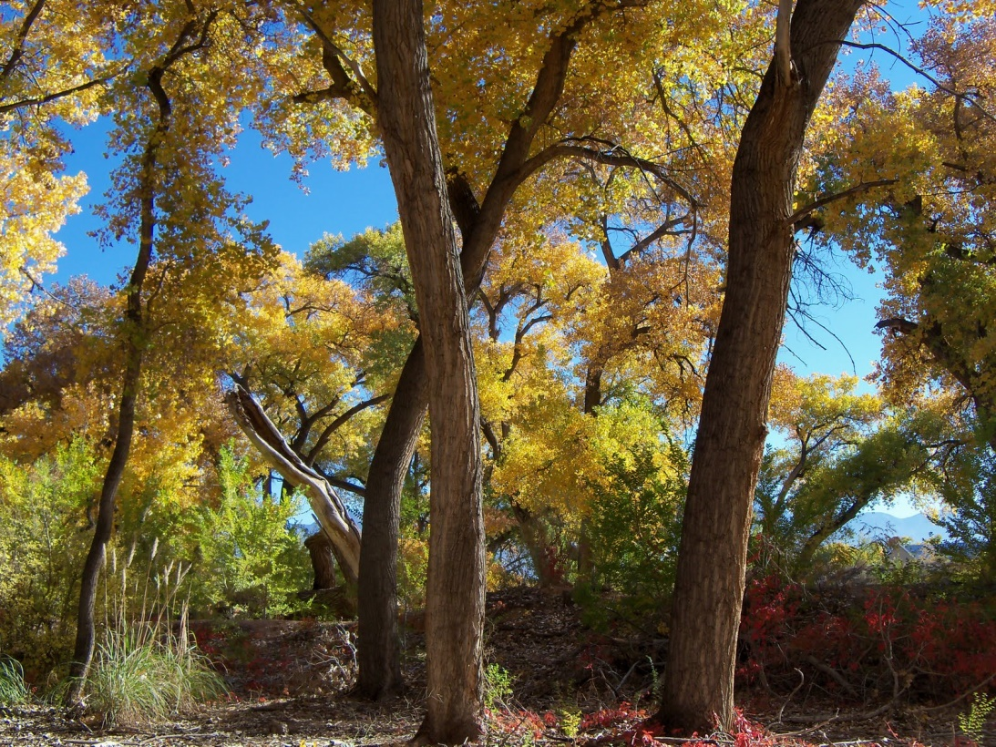
Middle Rio Grande
140 hectares removed
POP vs. ROS vs. ROX
Plant effect on soil N?
Soil N influence on arthropods?
Microbial response/feedbacks?

Slide 8
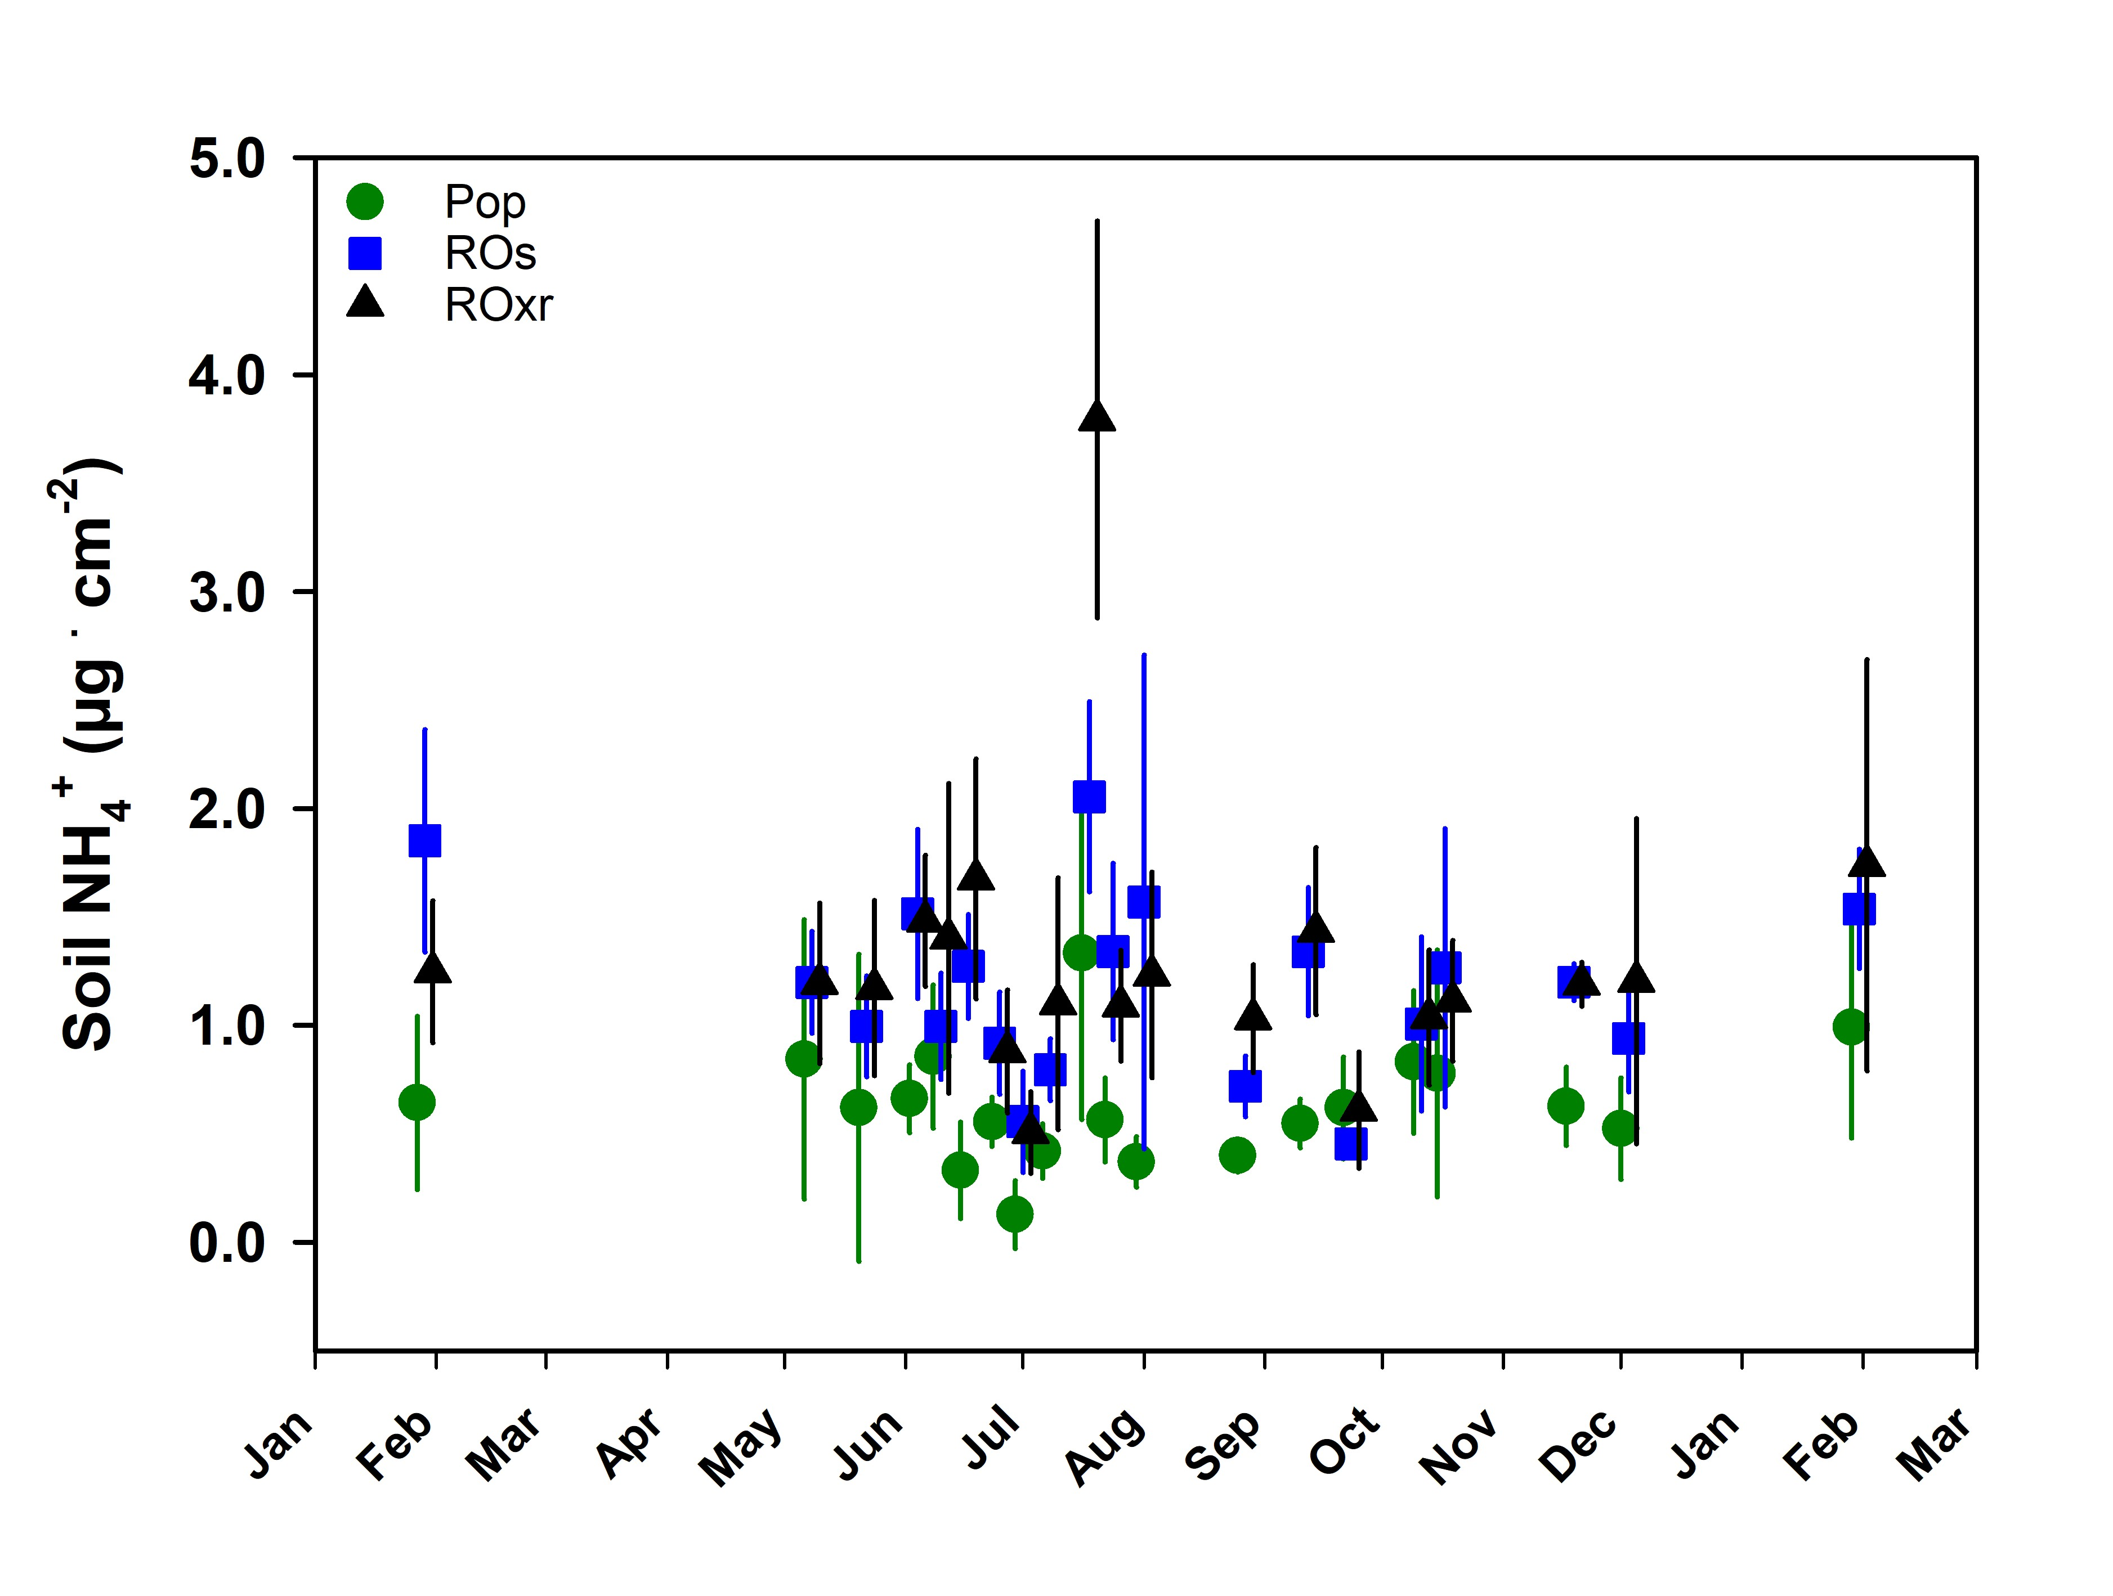
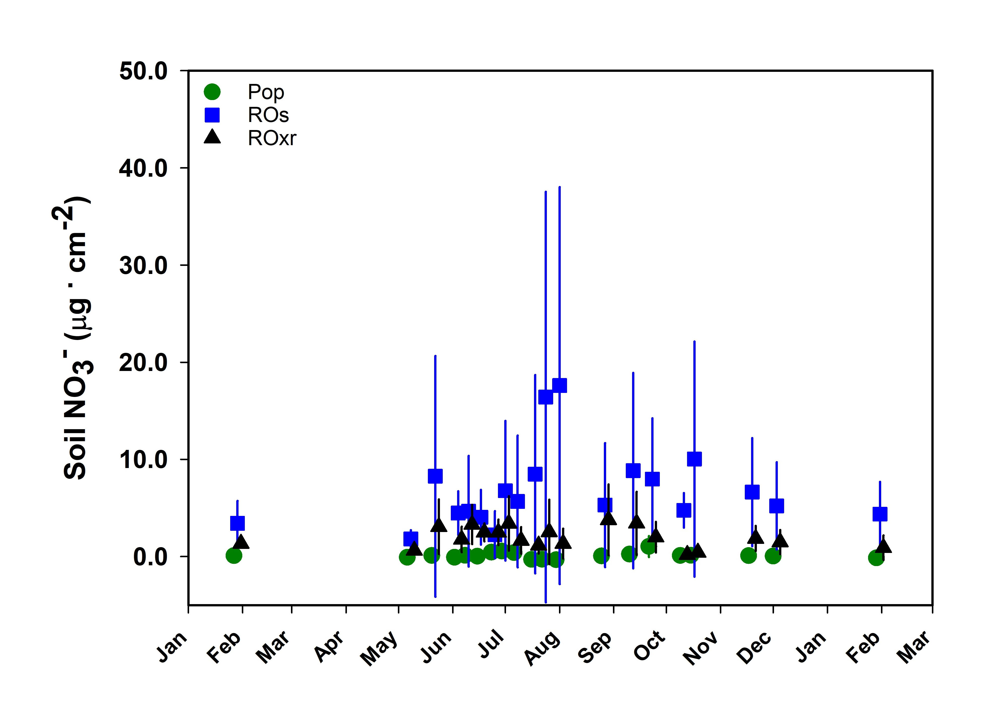
More NH₄⁺ and NO₃⁻ in both E. angustifolia plots
Removal plots >GHG, 1yr post

Slide 9
μg ion . g soil⁻¹

Slide 10
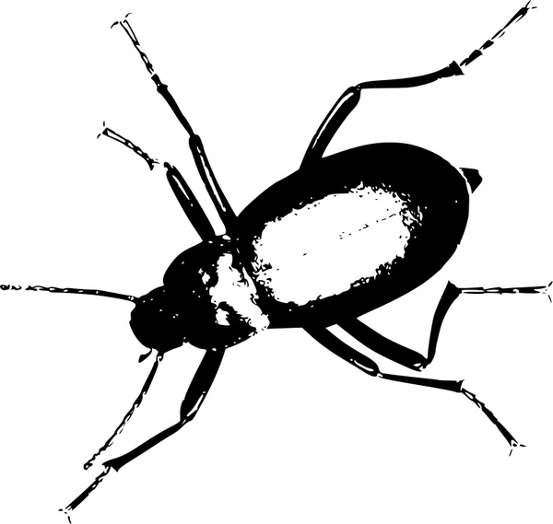
Nitrogen : Phosphorus

Slide 11
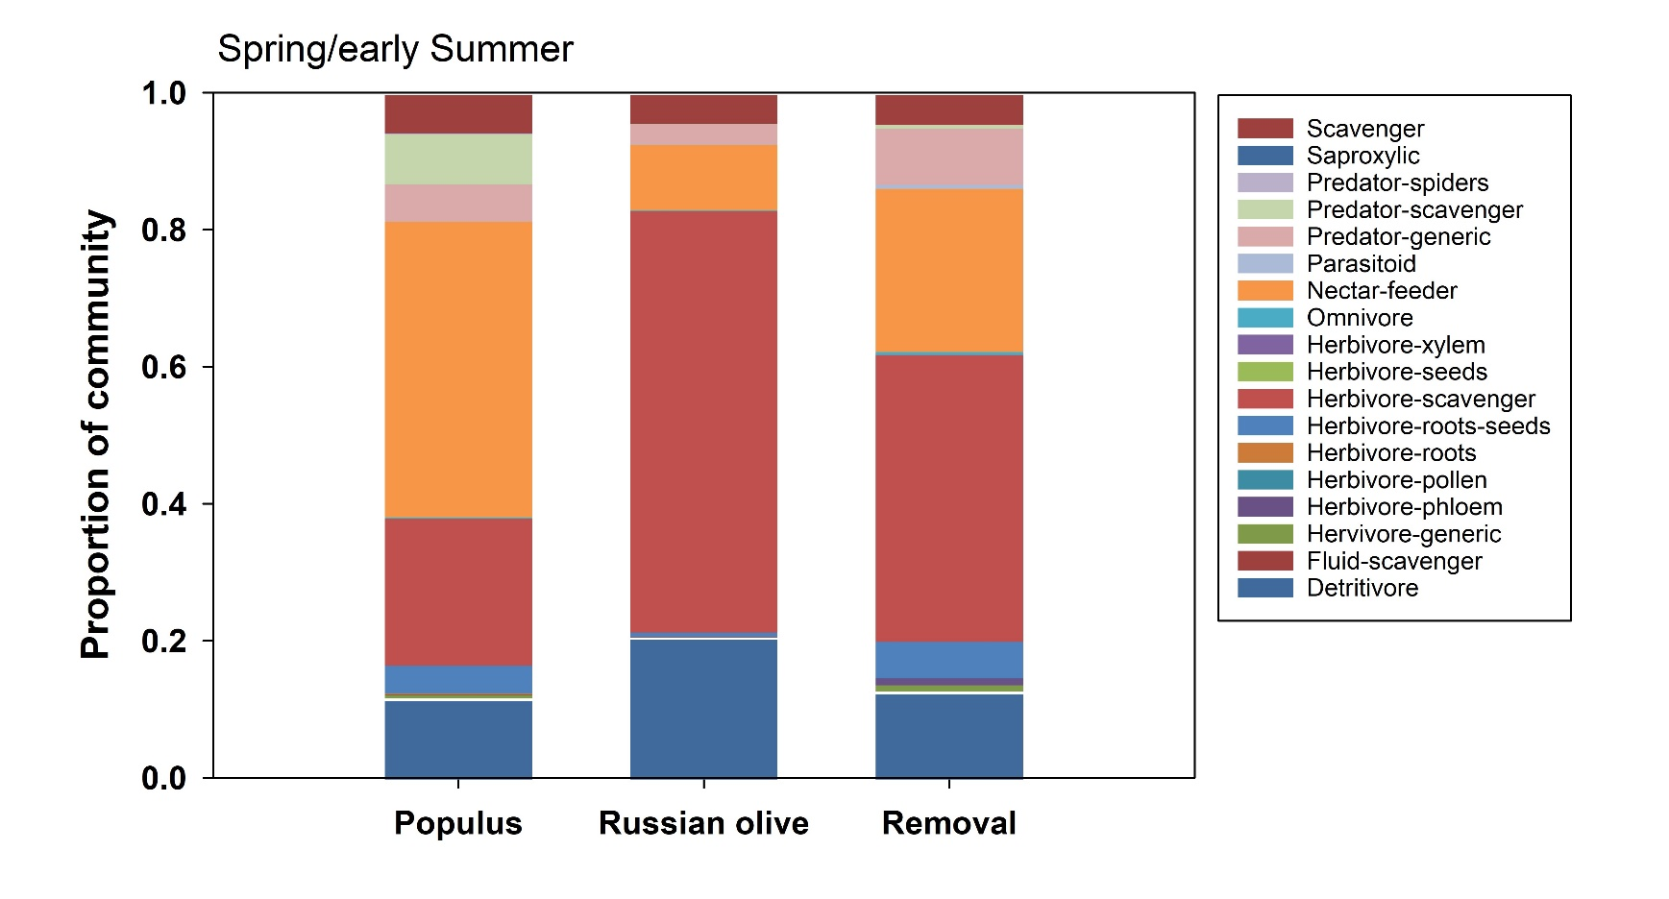
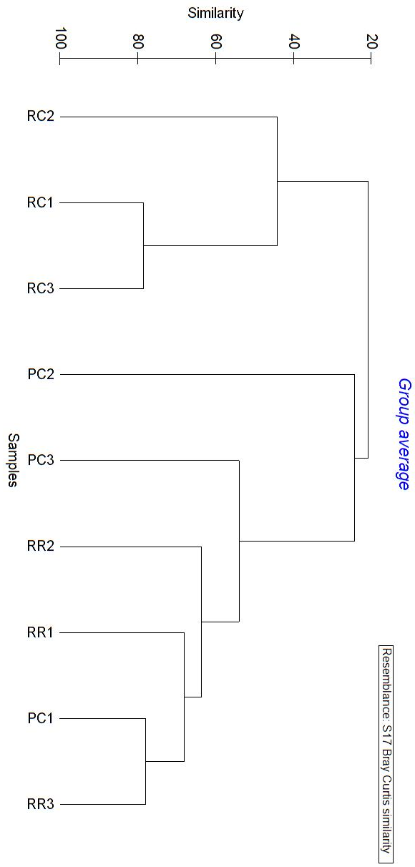
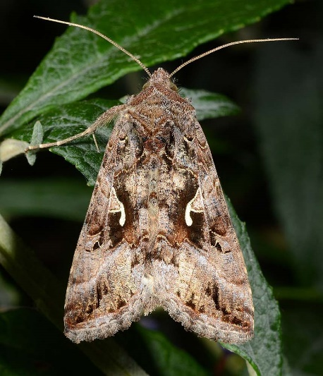
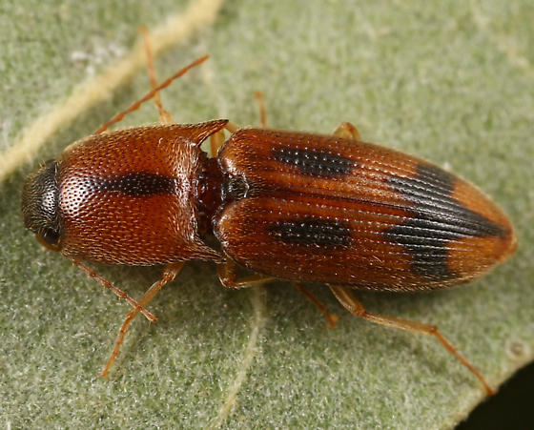
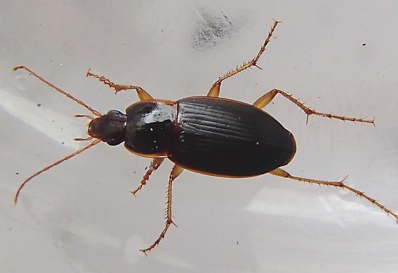
Noctuidae
Callathus opaoulus
Aeolus livens

Slide 12
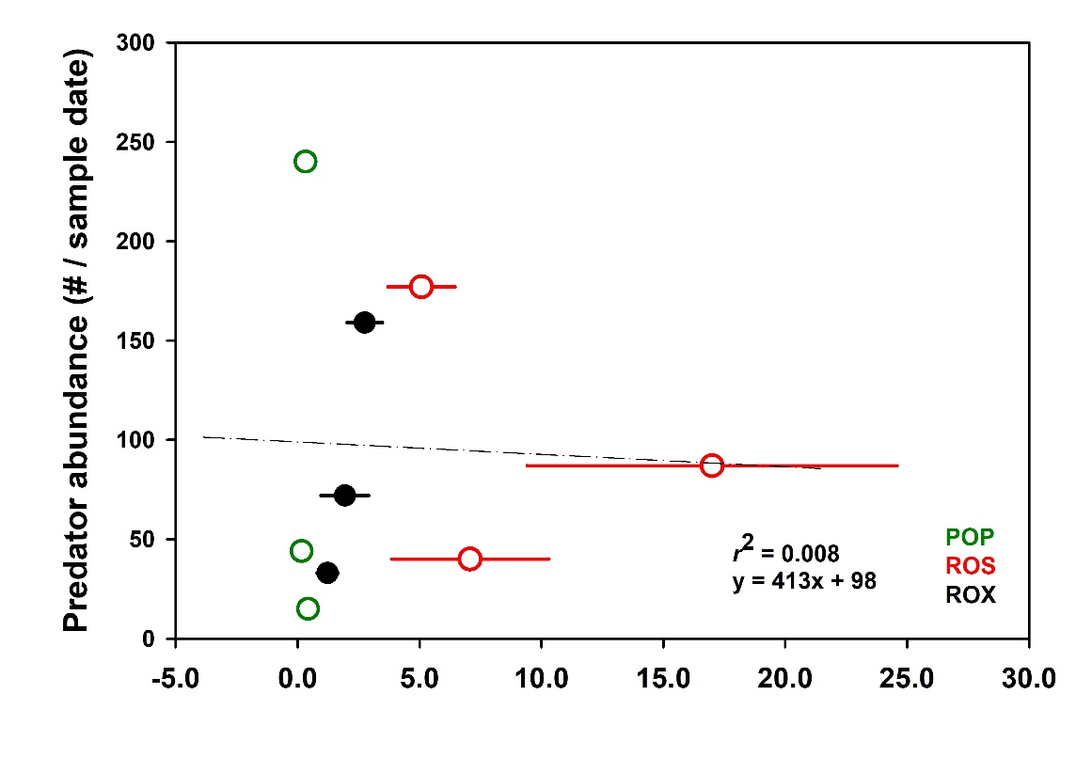
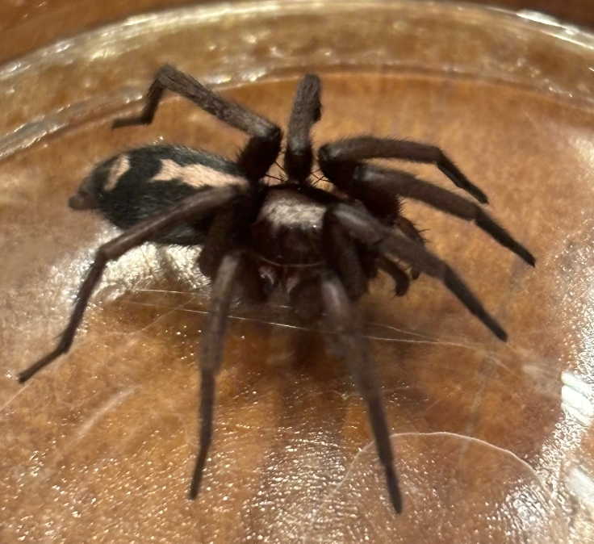
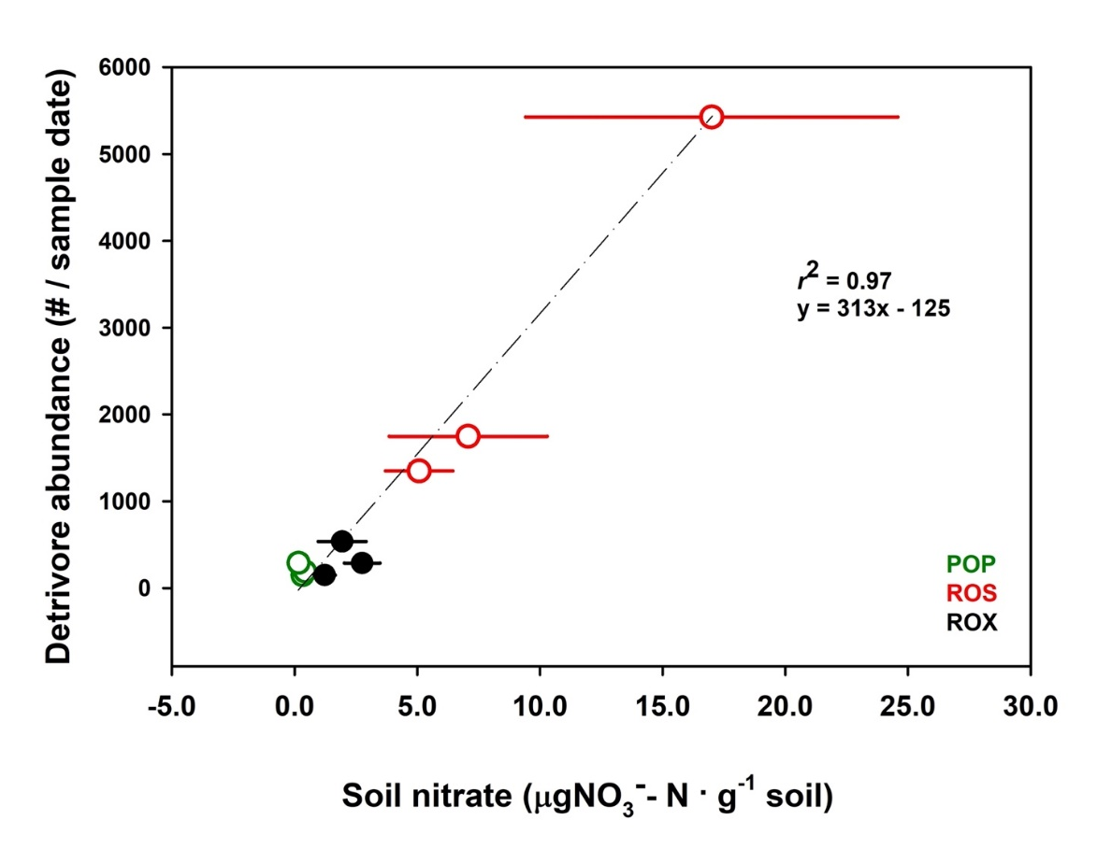
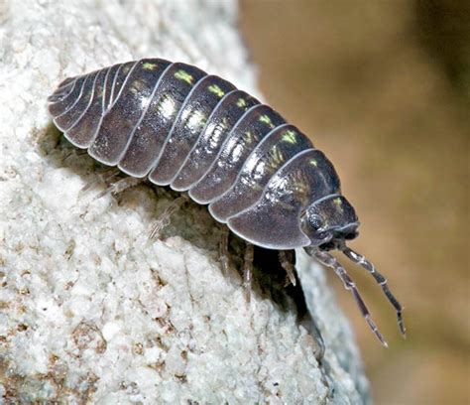
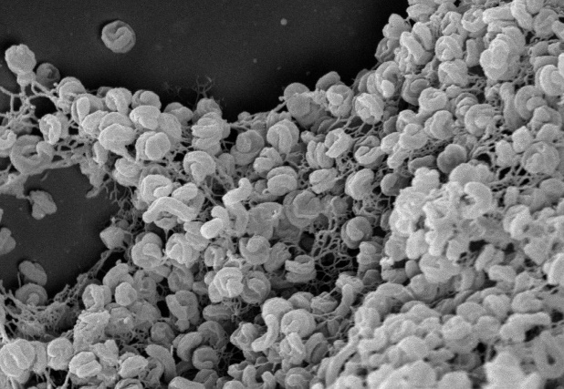
Herpyllus ecclesiasticus
Armadillidium vulgarae

Slide 13
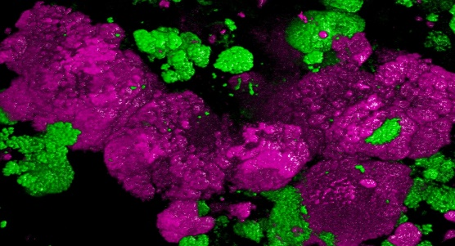
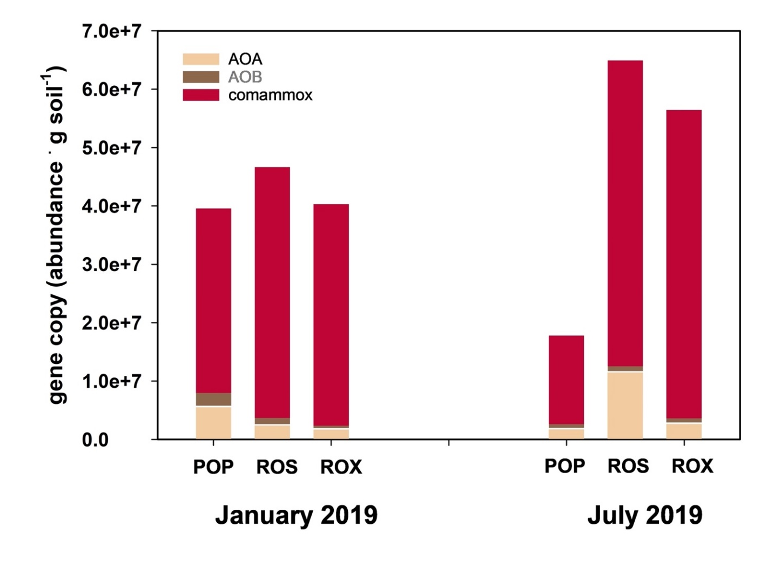
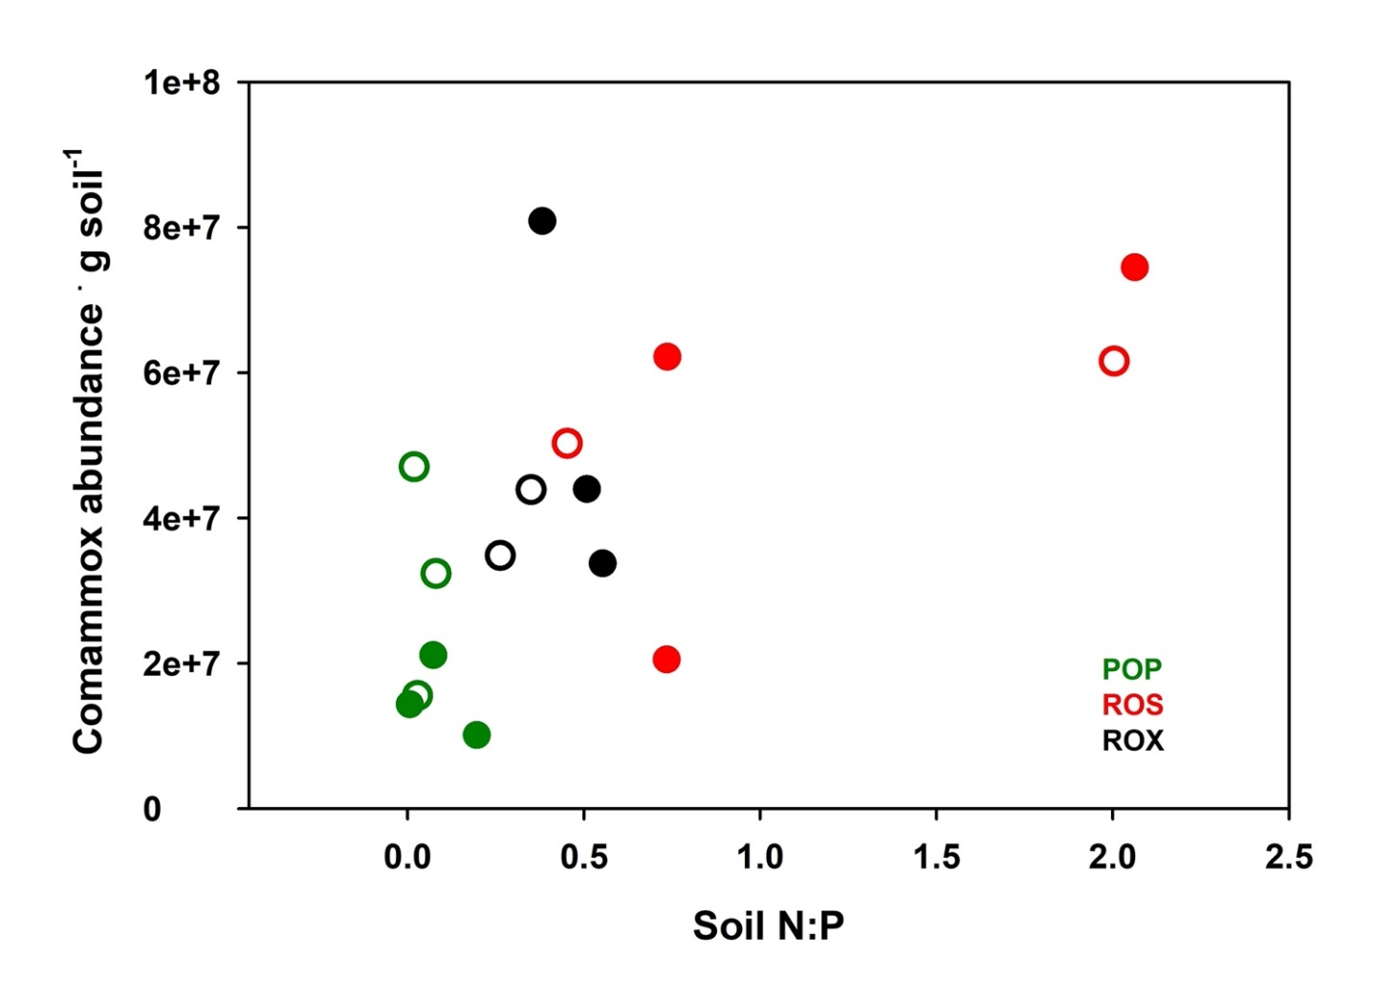
AOA/B
NOB
NH₄⁺
NO₂⁻
NO₃⁻
Nitrospira inopinata
comammox
r² = 0.39
(Image source: © Anne Daebeler and Stefano Romano)

Slide 14
Where we are:
Ongoing lab incubations to dial in process rates just due to microbes:
(decomp, nitrification, GHG production finer resolution, C cycling)
Arthropod functional patterns with soil chemistry
multivariate story with archaea/bacteria/comammox?

Slide 15
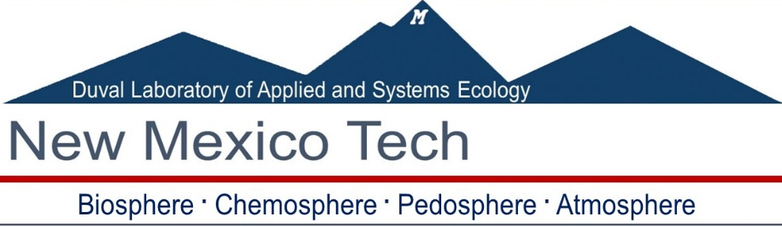
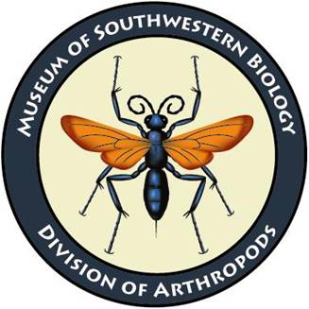

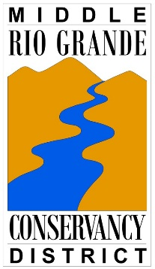

Sergio de Tomas-Marin
Eva Carabotta
Kateri Zamora
Noah Patterson
BIOL 4002/5002
Dan Cadol
Dan Jones
Talon Newton
Stacy Timmons
Bonnie Frey
David Lightfoot
Steve McBride
Ryan Darr
Carrie Parris
Vanessa Q, MAC & Don Gustavo the Falcon

Slide 16
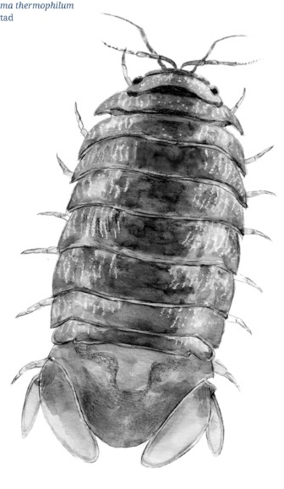
New Mexico Tech
Biology
Thermosphaeroma thermophilum
Socorro Isopod

Slide 17
Photo credits for arthropods
https://all-free-download.com/free-vector/download/tenebrionidae_54319.html
Tenbrionidae line drawing
https://bugguide.net/node/view/1178220
Aeolus livens
https://bugguide.net/node/view/932913/bgpage
Callathus opaoulus
https://www.monaconatureencyclopedia.com/armadillidium-vulgare/
Armadillidium vulgarae
https://www.thorninger.net/eng/Noctuidae.html
Noctuidae

Slide 19
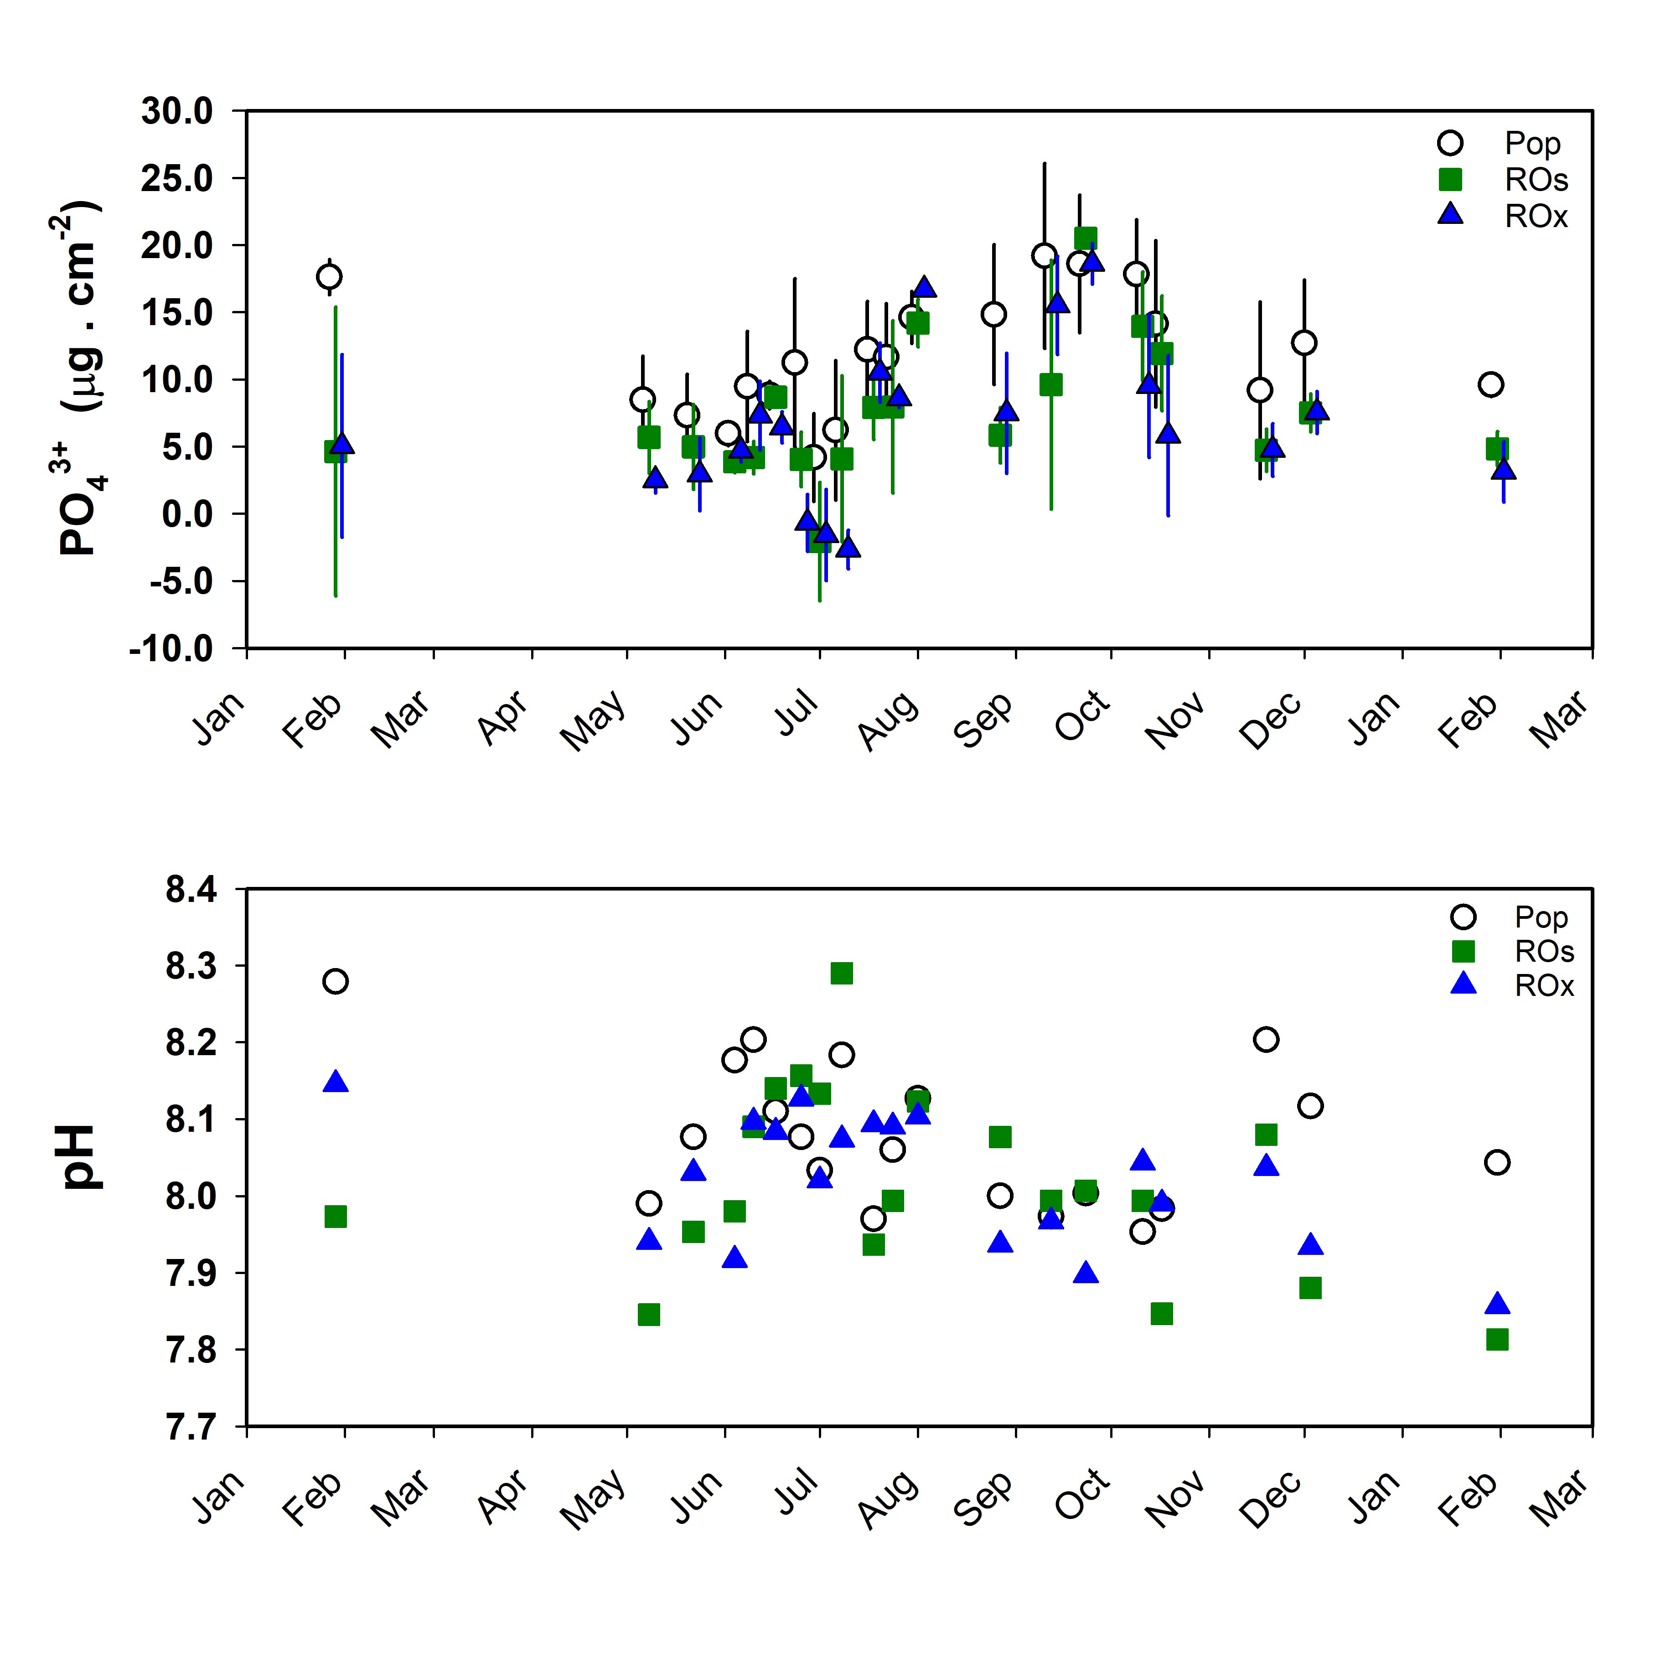
>PO₄³⁻
in cottonwood

Slide 20
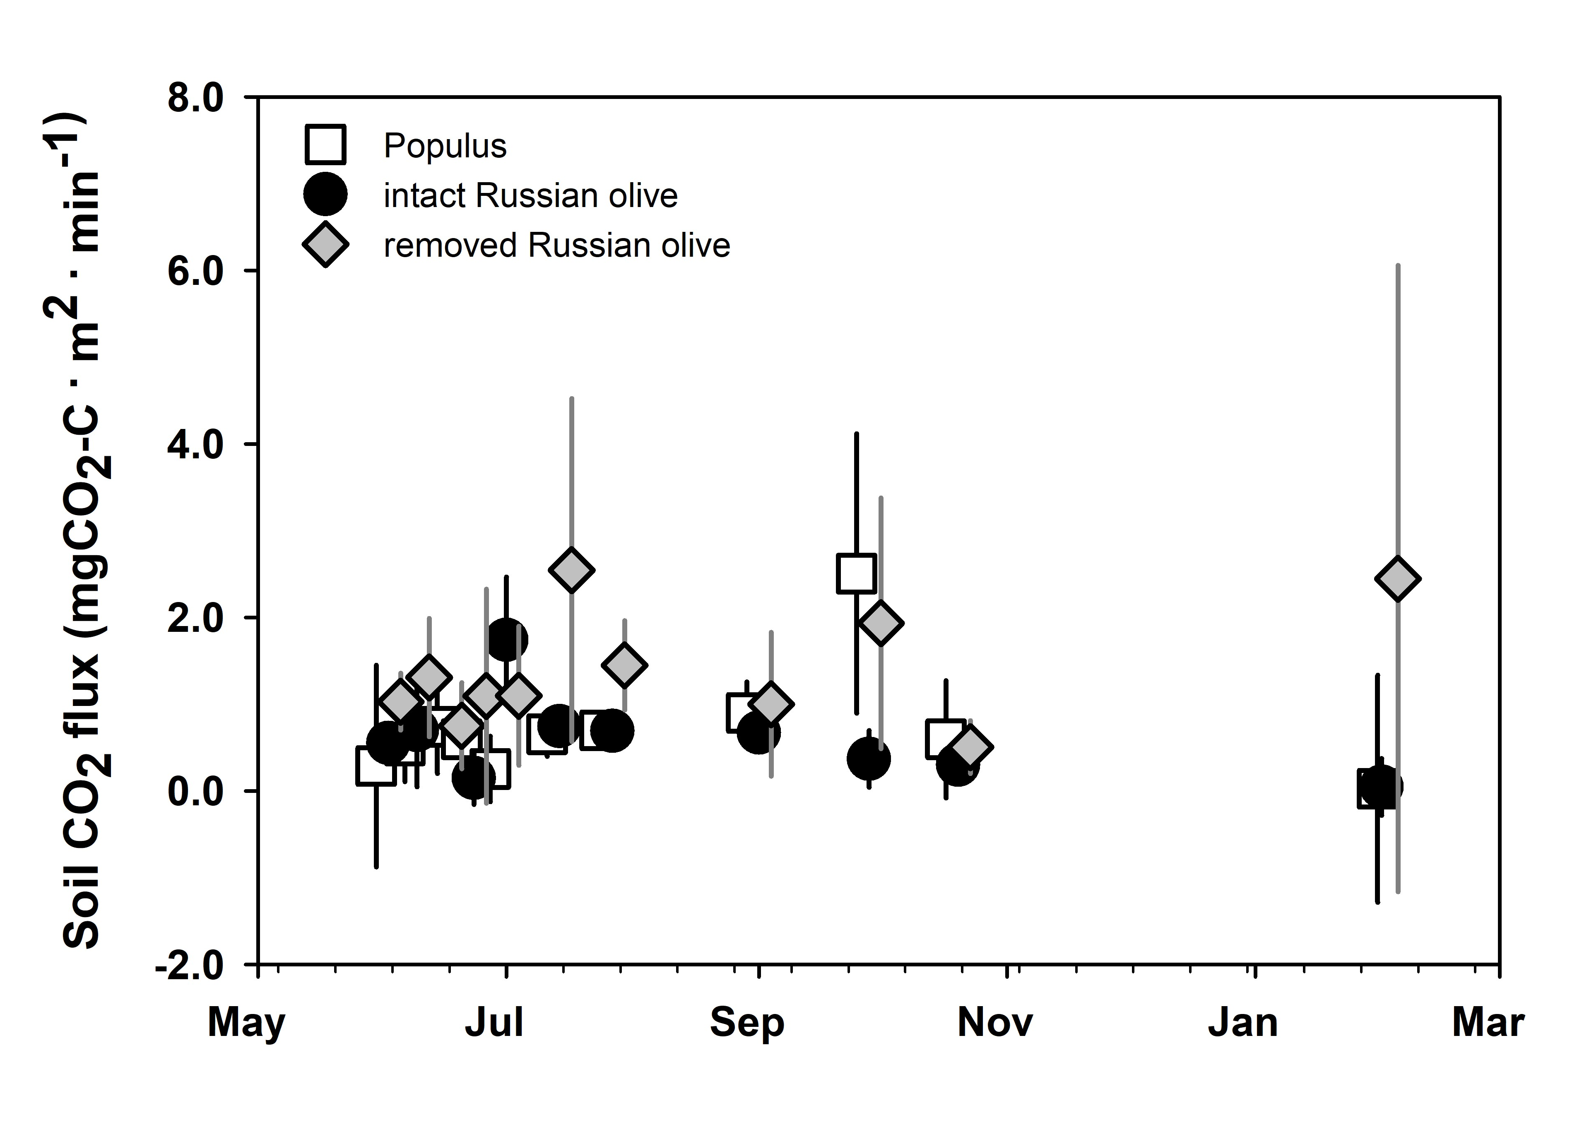
*Treatment effect
>ROx plots

