Slide 1

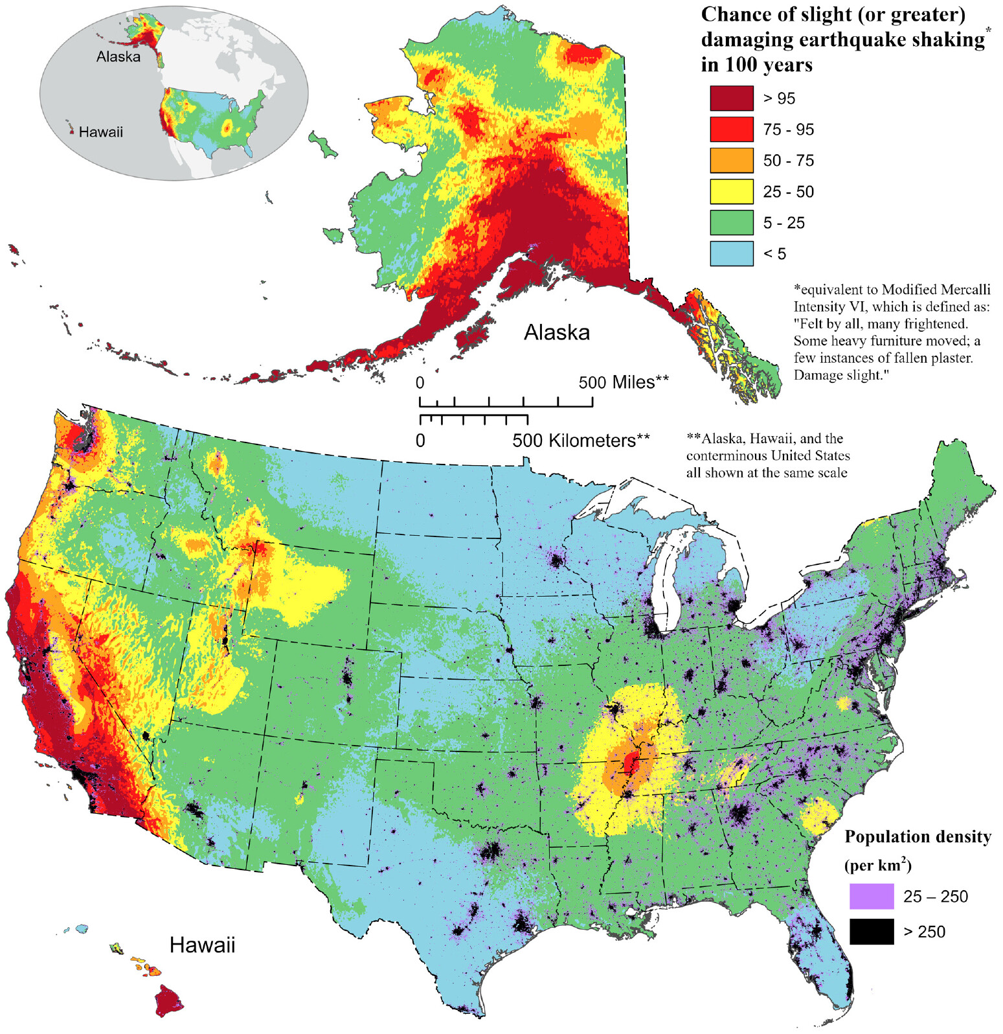
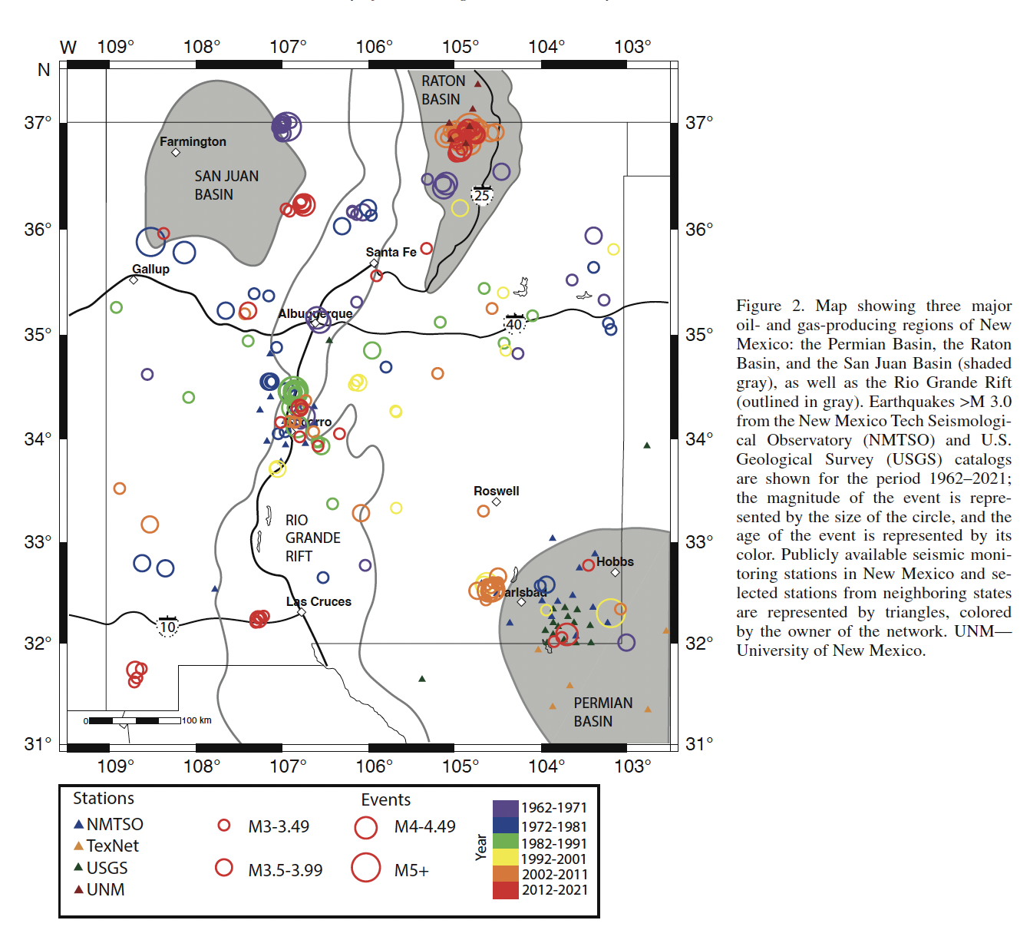


Optimizing automated earthquake detection methods in Delaware basin, southeastern New Mexico
Urbi Basu^{1,2}, Susan Bilek¹, Mairi Litherland²
¹New Mexico Institute of Mining and Technology
²New Mexico Bureau of Geology and Mineral Resources

Slide 2
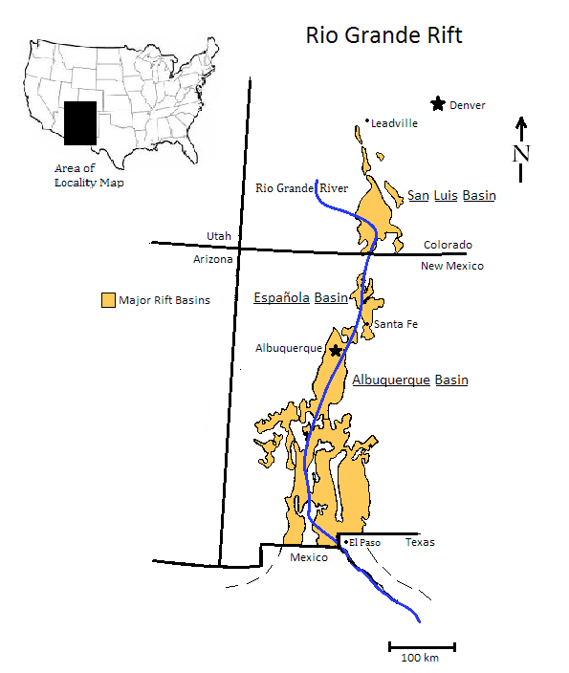
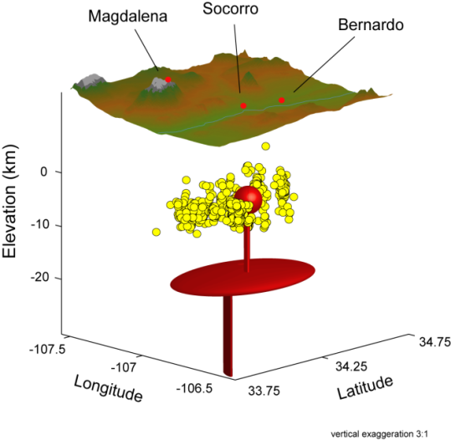
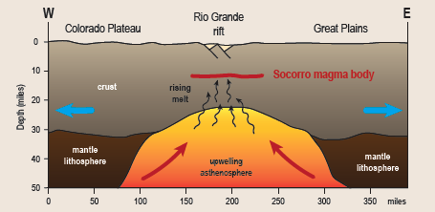
EARTHQUAKES IN NEW MEXICO
Tectonic activity from Rio Grande Rift, E-W extending rift that extends from Colorado to northern Mexico
Socorro magma body
Shallow, thin sill of magma at ~19 km depth
1906 ~M6.2 earthquake in Socorro
Socorro Seismic Anomaly Region with ~50% of state’s tectonic seismic activity
Recent activity from induced seismicity

Slide 3
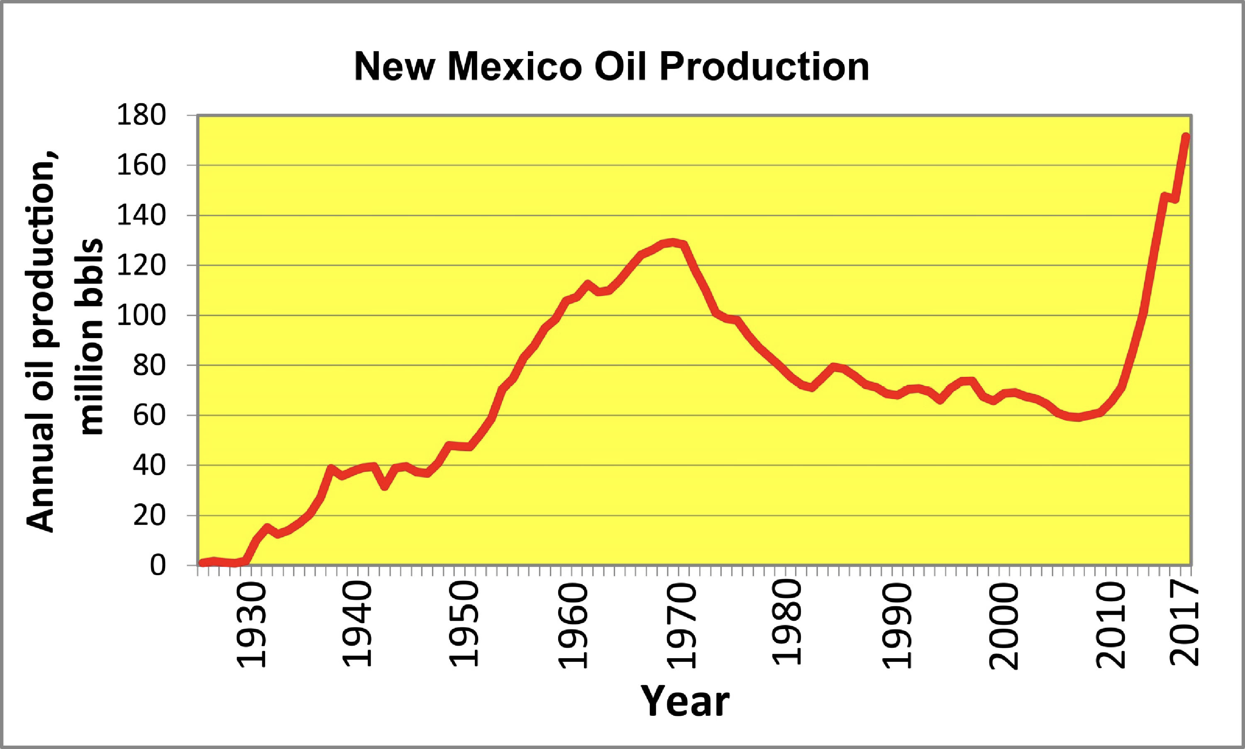
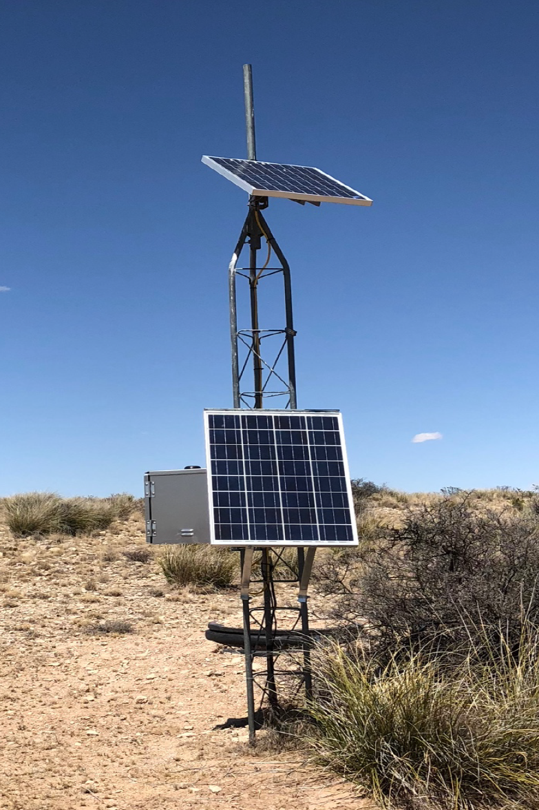
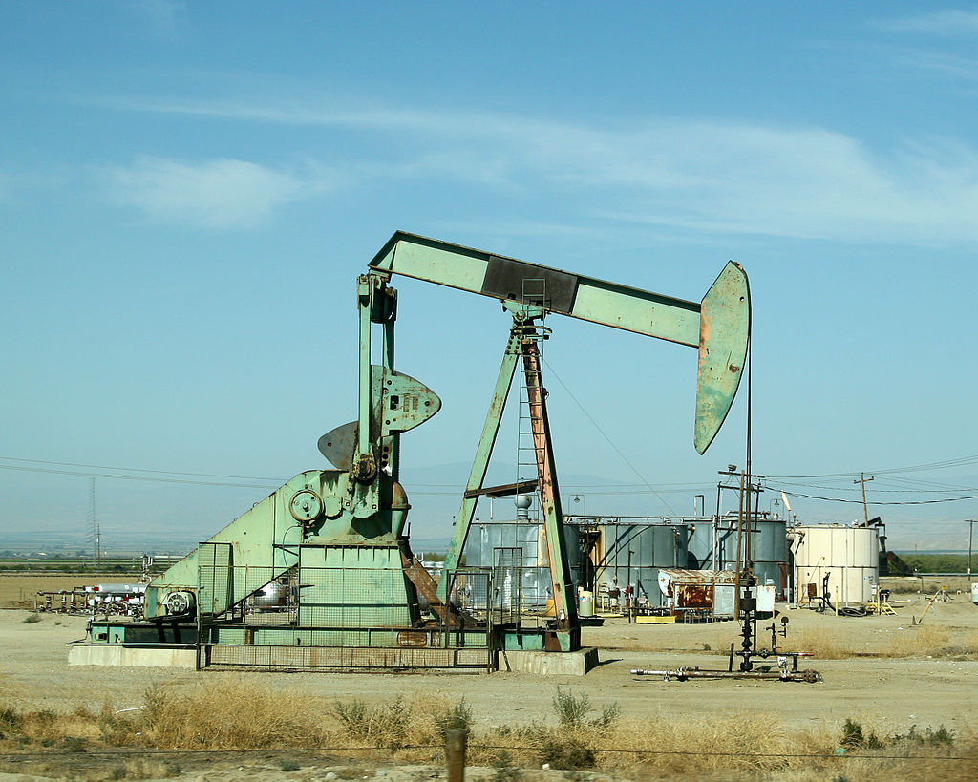
INDUCED SEISMICITY
Human activities such as oil and gas production, mining, geothermal extraction, and carbon sequestration can produce earthquakes
Oil and gas production in New Mexico has increased significantly in recent years, which has led to an increase in induced earthquakes
Existing seismic network
Oil production in different basins in New Mexico
Map showing the earthquakes (M>3.0) from the USGS and NMTSO catalog from 1962-2021 (Litherland, 2023)
Notes:
~ 25 short period (1 Hz) vertical component instruments and 3 component broadband stations

Slide 4
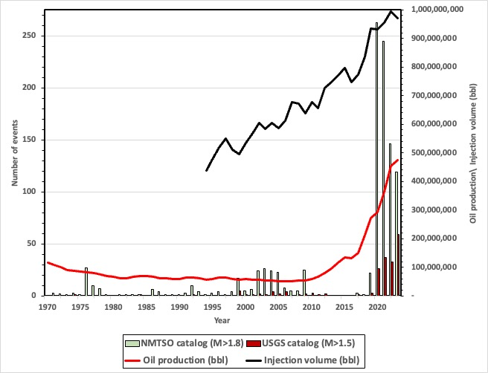
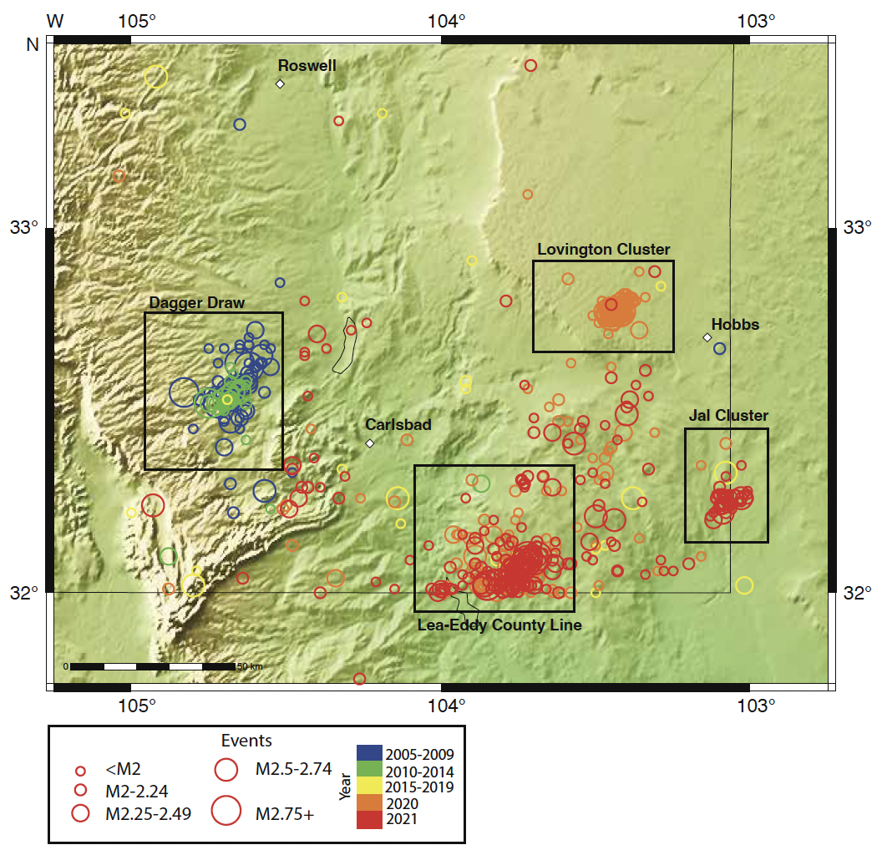
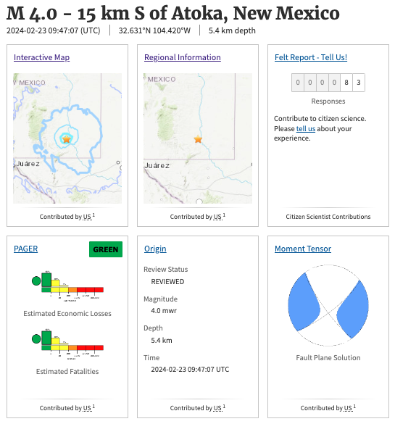
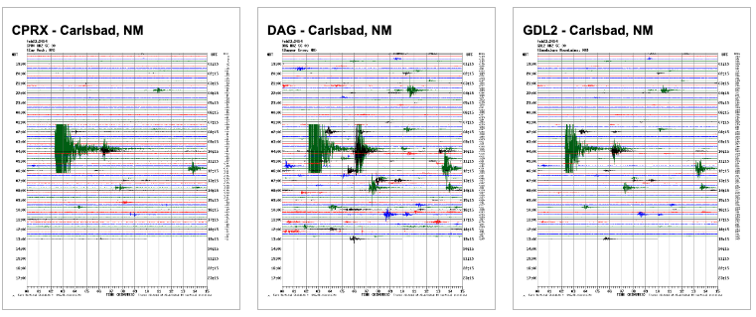
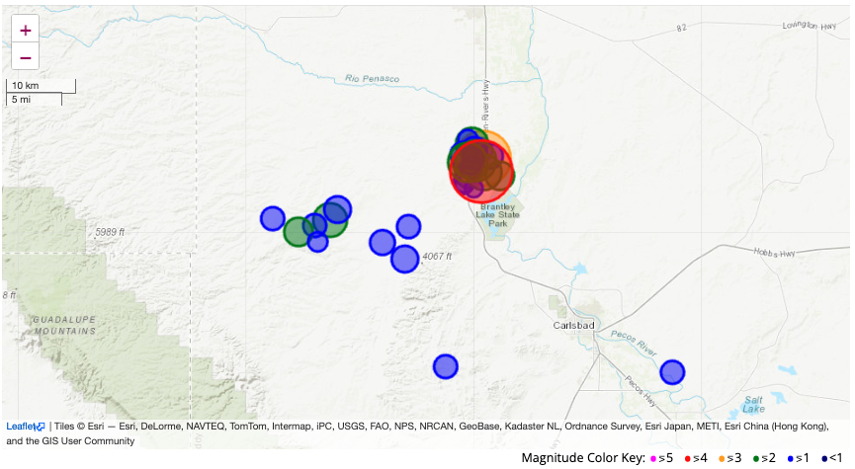
BACKGROUND
South eastern New Mexico – Part of the Delaware basin with significant oil and gas extraction activities since the 1960’s
Substantial increase in seismicity since 2010 associated with an increase in oil and gas production and wastewater disposal
Source: NMTSO website
Source: USGS website
Oil production and seismicity in southeast New Mexico for 1970-2023. Histograms show number of earthquakes larger than M 1.8 and M 1.5 recorded in southeastern New Mexico by the New Mexico Tech Seismological Observatory (NMTSO) and USGS ComCat from 1970 to 2023 (Basu et al., 2024 in prep)
Earthquakes larger than M 1.8 recorded by the NMTSO from 2005 to 2021 (Litherland, 2023)
Source: NMTSO website
Notes:
Over 97% of the oil produced in New Mexico comes from the Permian Basin in southeastern New Mexico.
Since 2010, oil production in the New Mexico portion of the Permian Basin has increased by over six times. This rise has been accompanied by an increase in the amount of produced water that must be disposed of, more than doubling since 2011 to over 600 million barrels
Studies linked the patterns of seismicity to changes in the fluid injection within nearby wells; drilling and wastewater injection activity has only increased in the basin, and seismic activity has increased as well, especially since 2017-2018
Red line shows yearly oil production in New Mexico from 1970 to 2021 (bbl); production was steady during this period until 2010, when production increased significantly. Blue line shows yearly saltwater (SW) disposal in southeastern New Mexico from 2011 to 2020 (value for 2020 is estimated; water disposal data are from Rinehart et al., 2020). Gray bars show number of earthquakes larger than M 1.8 recorded in southeastern New Mexico by the New Mexico Tech Seismological Observatory (NMTSO) from 2005 to 2021.
Patterns of changes seismicity linked to wastewater disposal and hydraulic fracturing
USGS ComCat catalog contains 102 earthquakes for the 10 year period 2012-2022 with magnitudes > 1, and the New Mexico Tech Seismological Observatory catalog contains 1569 earthquakes with magnitudes >1 for the period 2017 -2022
Red line shows yearly oil production in southeast New Mexico from 1970 to 2023 (bbl) highlighting increase in production since 2010. Black line shows yearly injection volume (bbl) in southeastern New Mexico from 1994 to 2023 (oil production and injection data from Oil Conservation Division (provide website and date accessed).

Slide 5
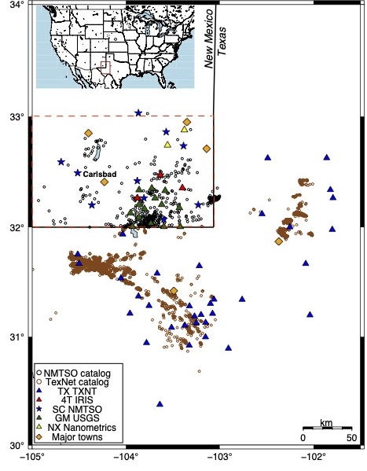
PROJECT OBJECTIVE
Test multiple template matching and machine learning tools (EQTransformer and PhaseNet) to improve automated earthquake detection capabilities for the south-eastern New Mexico region
Recommend automated earthquake detection workflow for real time monitoring at the New Mexico Tech Seismological Observatory (NMTSO)
Reduce manual review effort for earthquake detection and location at the NMTSO
Southeast New Mexico: 485 events in the NMTSO catalog and 37 events in the USGS catalog larger than M1
Broader region including a portion of west Texas and southeast New Mexico, there are 4859 events in the TexNet catalog and 3317 earthquakes in the USGS catalog larger than M1
Maximum of 64 seismic stations
The NMTSO catalog will serve as the baseline for comparison with the new automated catalogs.
Study region showing earthquake activity for the year 2021 and seismic stations used in the study (Basu et al., 2024 in prep)
Notes:
This project will test several automated and machine learning tools using existing seismic waveform data and earthquake catalogs to improve the event detection capabilities for the southeastern New Mexico region, an area of recent seismicity increases due to anthropogenic activities in the Delaware Basin.
Station: majority three component, with a majority from the NMTSO seismic network, temporary USGS array and the TexNet seismic network.

Slide 6
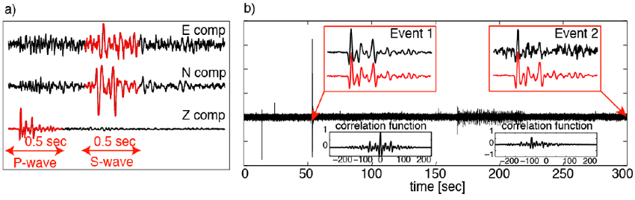
DATASET AND METHODOLOGY
Automated earthquake detection workflow divided into three sections:
Phase auto picking → Event association → Initial earthquake location
P and S phase auto picking
Template matching
Cross-correlation based scanning algorithm to identify events of similar signature (Aster and Rowe, 2000; Rowe et al., 2002, Stankova et al., 2008)
Comparison of a previously identified earthquake (master event) to a continuous time series at the same station
33 event templates with magnitude > 2.0
Correlation coefficient thresholds ranging from 0.5 -0.3 tested to minimize the number of false positive and false negatives
EQTransformer
PhaseNet
Illustration of template matching method (Goertz-Allmann et al., 2014)
Notes:
Red waveform indicates the master event used for waveform cross-correlation analysis. (b) Example sketch of waveform cross-correlation for 5 min of continuous data. Two events are detected within this time interval. The enlargements of the seismogram show the detected events (black) compared to the master event (red). Event 1 is the master event itself. Event 2 is a smaller magnitude event detected during this time period. The respective correlation functions are shown below.
Continuous waveform data of all available one or three component seismic stations filtered between 2-15Hz
TM:
cross-correlation based scanning algorithm (Aster and Rowe, 2000; Rowe et al., 2002, Stankova et al., 2008) to identify events of similar signature ;compares user-defined master events to continuous waveform data for the same seismic station and detects similar waveforms which surpasses the set cross-correlation coefficient threshold.
The continuous waveform (50 Hz sample rate) were filtered between 2-15Hz.
33 earthquake templates with M>2
earthquake templates 60 s in length; manually checked; spatial and temporal variation; P phase arrival times manually picked on the master events. P-phase picks from templates assigned to the detected events as preliminary P arrival time picks;
ObsPy based autopicker (ar_pick) used to estimate S wave arrivals on the detections; Correlation coefficient thresholds ranging from 0.5 -0.3 tested to minimize the number of false positive and false negatives
EQT
The original dataset used for training and validation consists of 113K examples of earthquakes and noise from the Stanford Earthquake Dataset (STEAD) (Mousavi et al., 2019).
Parameters tested - Detection, P pick and S pick thresholds in the predictor module
does not require predefined known earthquakes from any particular region for the automated detections
EQT conservative model chosen as training model as it significantly reduced the number of false positives.
open-source machine learning tool that uses a globally trained dataset for detecting earthquakes from continuous waveform data
Automatic P and S phase picks are made on individual station data based on user-defined threshold parameter
Phasenet
outputs phase arrival times along with the detection probability
Model trained by manually labelled P and S arrival times from the Northern California Earthquake Data Center ; The locations of 234 117 earthquakes (red points) and 889 seismic stations (black triangles)
REAL (zhang et al., 2019)
IASP91 velocity model
helped to remove false positives and noise events which were detected at one or two stations
Parameters used: Search grid size of 0.1° degree and 5km for depth, travel time residual threshold of three seconds and a minimum of 3 phase picks for each earthquake
VELEST (Kissling et al., 1994)
1D Vp and Vs velocity model extracted from Huang et al., 2019

Slide 7
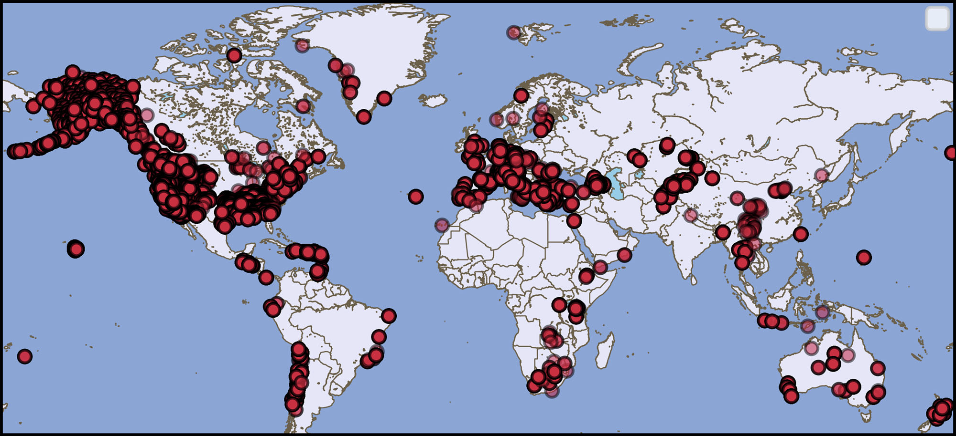
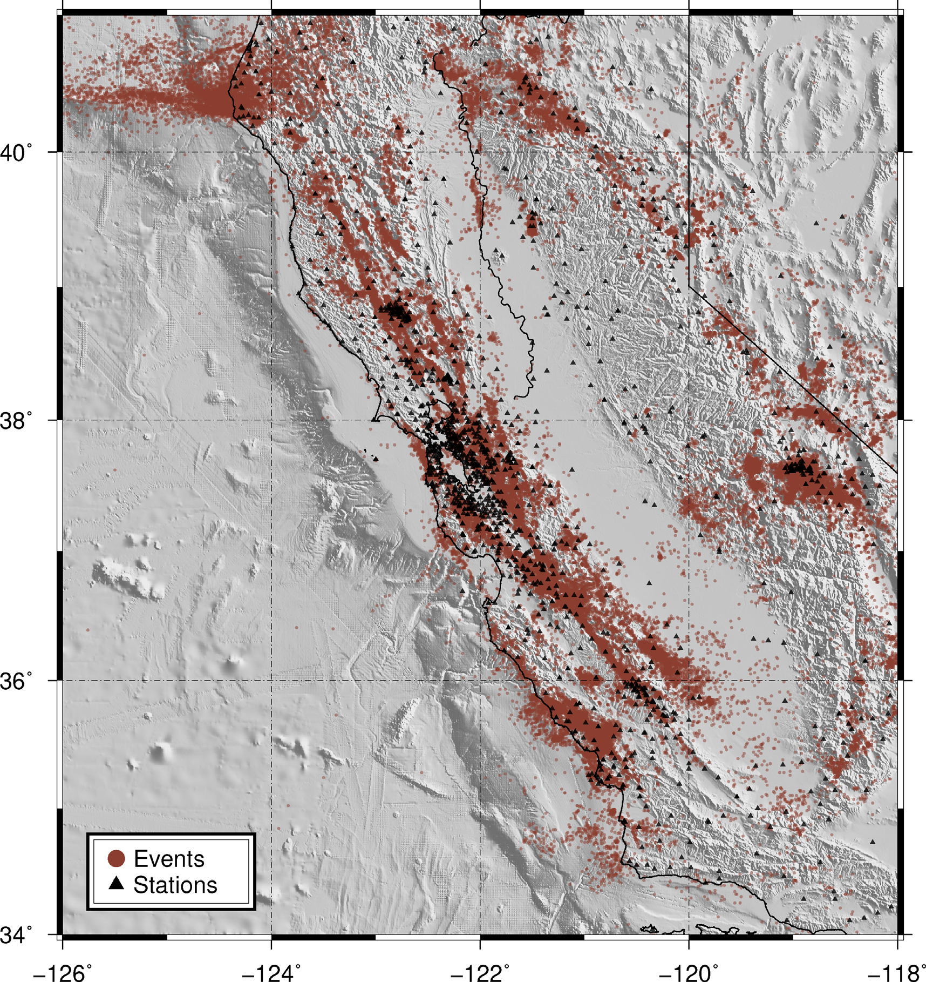
DATASET AND METHODOLOGY
Automated earthquake detection workflow divided into three sections:
Phase auto picking → Event association → Initial earthquake location
P and S phase auto picking
Template matching
EQTransformer
Machine learning tool designed for automated phase picking that utilizes neural network approach for automated earthquake detection
Uses a globally trained dataset for detecting earthquakes from continuous waveform data
PhaseNet
Machine learning based seismic phase auto picker
Model trained by manually labelled P and S arrival times from the Northern California Earthquake Data Center
No existing earthquake information from study region needed
Training dataset (Zhu and Beroza, 2018)
Training and test dataset for EQTransformer (Mousavi et al., 2020)
Notes:
Continuous waveform data of all available one or three component seismic stations filtered between 2-15Hz
TM:
cross-correlation based scanning algorithm (Aster and Rowe, 2000; Rowe et al., 2002, Stankova et al., 2008) to identify events of similar signature ;compares user-defined master events to continuous waveform data for the same seismic station and detects similar waveforms which surpasses the set cross-correlation coefficient threshold.
The continuous waveform (50 Hz sample rate) were filtered between 2-15Hz.
33 earthquake templates with M>2
earthquake templates 60 s in length; manually checked; spatial and temporal variation; P phase arrival times manually picked on the master events. P-phase picks from templates assigned to the detected events as preliminary P arrival time picks;
ObsPy based autopicker (ar_pick) used to estimate S wave arrivals on the detections; Correlation coefficient thresholds ranging from 0.5 -0.3 tested to minimize the number of false positive and false negatives
EQT
The original dataset used for training and validation consists of 113K examples of earthquakes and noise from the Stanford Earthquake Dataset (STEAD) (Mousavi et al., 2019).
Parameters tested - Detection, P pick and S pick thresholds in the predictor module
does not require predefined known earthquakes from any particular region for the automated detections
EQT conservative model chosen as training model as it significantly reduced the number of false positives.
open-source machine learning tool that uses a globally trained dataset for detecting earthquakes from continuous waveform data
Automatic P and S phase picks are made on individual station data based on user-defined threshold parameter
Phasenet
outputs phase arrival times along with the detection probability
Model trained by manually labelled P and S arrival times from the Northern California Earthquake Data Center ; The locations of 234 117 earthquakes (red points) and 889 seismic stations (black triangles)
REAL (zhang et al., 2019)
IASP91 velocity model
helped to remove false positives and noise events which were detected at one or two stations
Parameters used: Search grid size of 0.1° degree and 5km for depth, travel time residual threshold of three seconds and a minimum of 3 phase picks for each earthquake
VELEST (Kissling et al., 1994)
1D Vp and Vs velocity model extracted from Huang et al., 2019

Slide 8
DATASET AND METHODOLOGY
Automated earthquake detection workflow divided into three sections:
Phase auto picking → Event association → Initial earthquake location
P and S phase auto picking
Template matching
EQTransformer
PhaseNet
Event association
P and S phase arrival times, number of phase picks and travel time residuals used to associate automated detections into initial earthquake locations at grid points
Initial earthquake location
Refined the initial grid earthquake locations using the least-squares location method VELEST
Notes:
REAL (zhang et al., 2019)
IASP91 velocity model
helped to remove false positives and noise events which were detected at one or two stations
Parameters used: Search grid size of 0.1° degree and 5km for depth, travel time residual threshold of three seconds and a minimum of 3 phase picks for each earthquake
The distributions of seismic event (red star) and seismic stations (blue triangles). b) P arrival time curve (red) with its uncertainty range (red dashed), associated P picks and other false P picks (blue bars). c) same as b) but for S picks. d) The optimal location is determined to be at the grid point with most picks or e) the grid point with smallest traveltime residual (shown in bottom parentheses, unit: second) among multiple locations with the same maximum number of picks. (from REAL software manual)
VELEST (Kissling et al., 1994)
1D Vp and Vs velocity model extracted from Huang et al., 2019

Slide 9
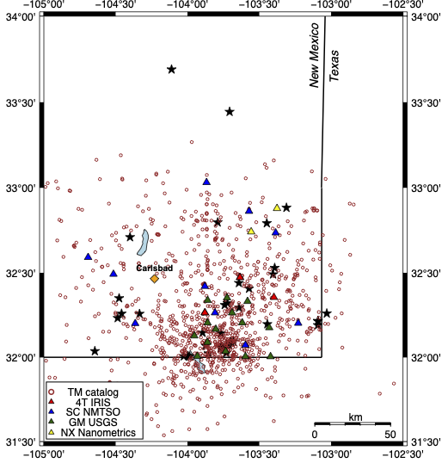
RESULTS
TEMPLATE MATCHING RESULTS
Each of the automated detection methods produced an increase in the number of detected events during 2021, both within only southeast New Mexico as well a broader region extending into west Texas
Detection tool | Total events | False positive (%) | Number of missed events ($≥5 stations)$ | Number of missed events ($≥3 stations)$
Template matching | 1044 | 15 | 168 | 307
EQTransformer | 19540 | 13 | 64 | 188
PhaseNet | 63378 | 30 | 33 | 110
Comparison of the automated detections from the three automated catalogs
Earthquakes detected from Template matching – REAL – VELEST workflow. The black stars indicate the earthquake templates used as master events in the study (Basu et al., 2024 in prep)
Notes:
We restrict our comparisons of the automated catalogs with just that region for the NMTSO (485 events) and USGS (37 events) catalogs of events with M > 1; USGS ComCat catalog (3317 earthquakes) and the combined NMTSO and TexNet catalog (5342 earthquakes) larger than M1 for our study region
Comparison of the automated catalogs with the NMTSO catalog based on the total number of events detected, percent of false positives (detection made but not a real earthquake) based on manual review of 5% of the overall new events, and number of missed events (earthquake contained in existing catalog but not detected in our test)
Template matching results only constrained within the southeast New Mexico region
Template matching tool detected 1044 events for the year 2021; missed multiple true events which were detected in the NMTSO catalog with five or more stations and have around 15% false positive rate.

Slide 10
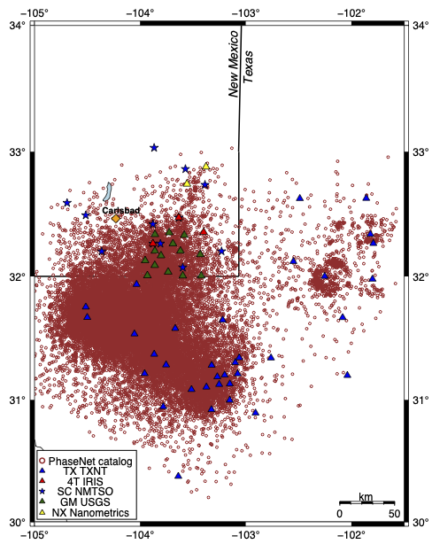
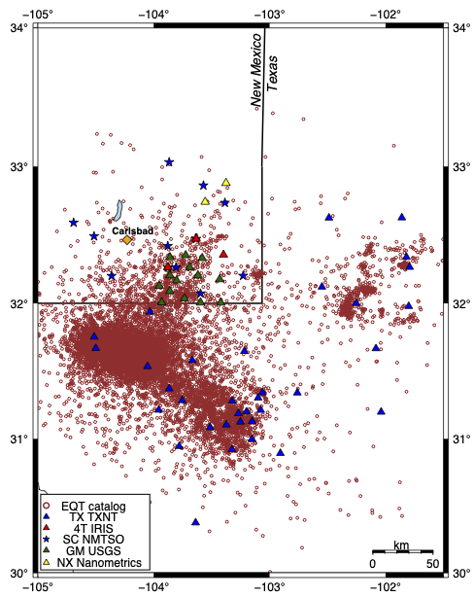
RESULTS
MACHINE LEARNING BASED AUTO DETECTOR RESULTS
PhaseNet
EQTransformer
Initial locations of earthquakes detected from PhaseNet– REAL – VELEST workflow (Basu et al., 2024 in prep)
Initial locations of earthquakes detected from EQTransformer – REAL – VELEST workflow (Basu et al., 2024 in prep)
Notes:
We restrict our comparisons of the automated catalogs with just that region for the NMTSO (485 events) and USGS (37 events) catalogs of events with M > 1; USGS ComCat catalog (3317 earthquakes) and the combined NMTSO and TexNet catalog (5342 earthquakes) larger than M1 for our study region
PhaseNet detected significantly higher number of events than the EQTransformer method and includes almost five times more events than the NMTSO catalog

Slide 11
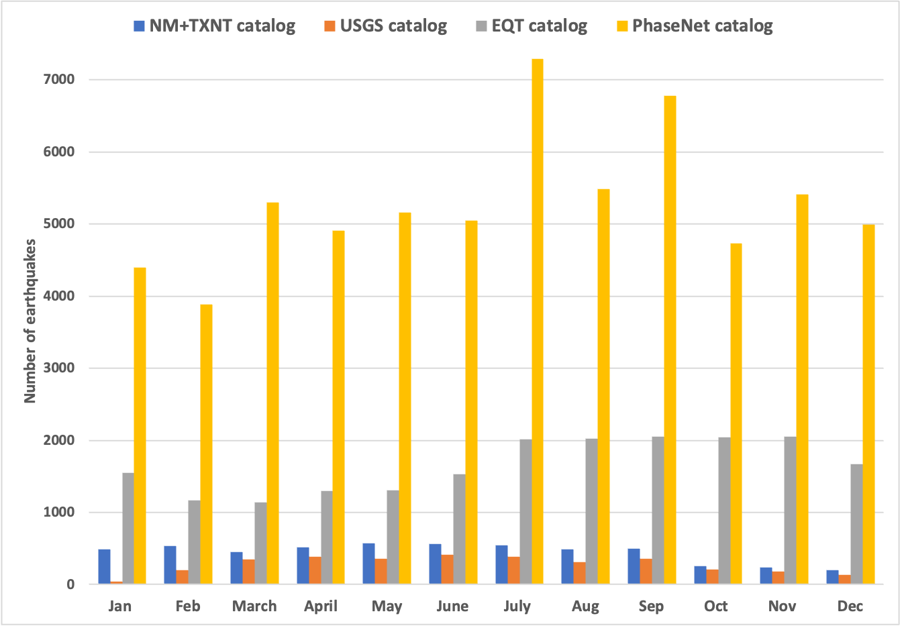
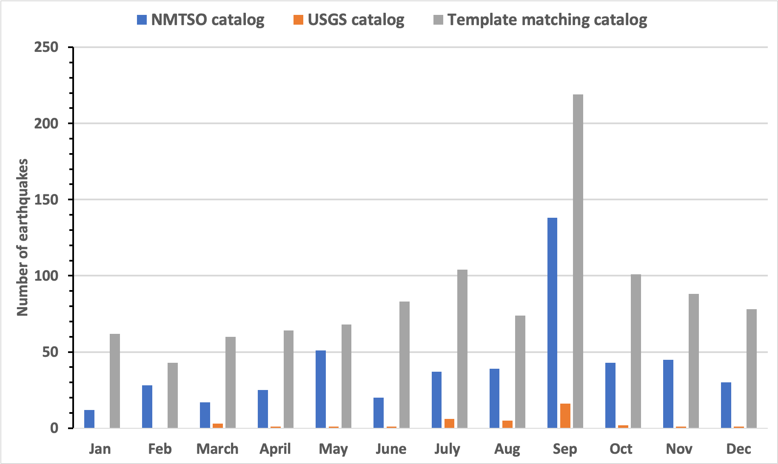
RESULTS
Evaluation of the earthquake count of the different catalogs
The overall monthly seismicity trend is similar between the NMTSO and three automated detection catalogs
Increase of monthly trends in the EQTransformer and PhaseNet catalogs is positively correlated with high magnitude earthquakes (M > 2.5) in the later half of 2021
Comparison of the monthly earthquake count from machine learning automated catalogs (Basu et al., 2024 in prep)
Comparison of the monthly earthquake count from the NMTSO, USGS catalogs with the template matching results for southeast New Mexico (Basu et al., 2024 in prep)
Notes:
The left Y-axis indicates the number of events for the template matching (TM) method and the right Y-axis indicates the number of events for EQTransformer and PhaseNet methods.
EQ comparison plot: for larger than M1 earthquakes for the year 2021
Higher number of earthquakes detected from the automated catalog suggests the automated tools might be detecting similar or smaller magnitude events associated with a known larger magnitude earthquake

Slide 12
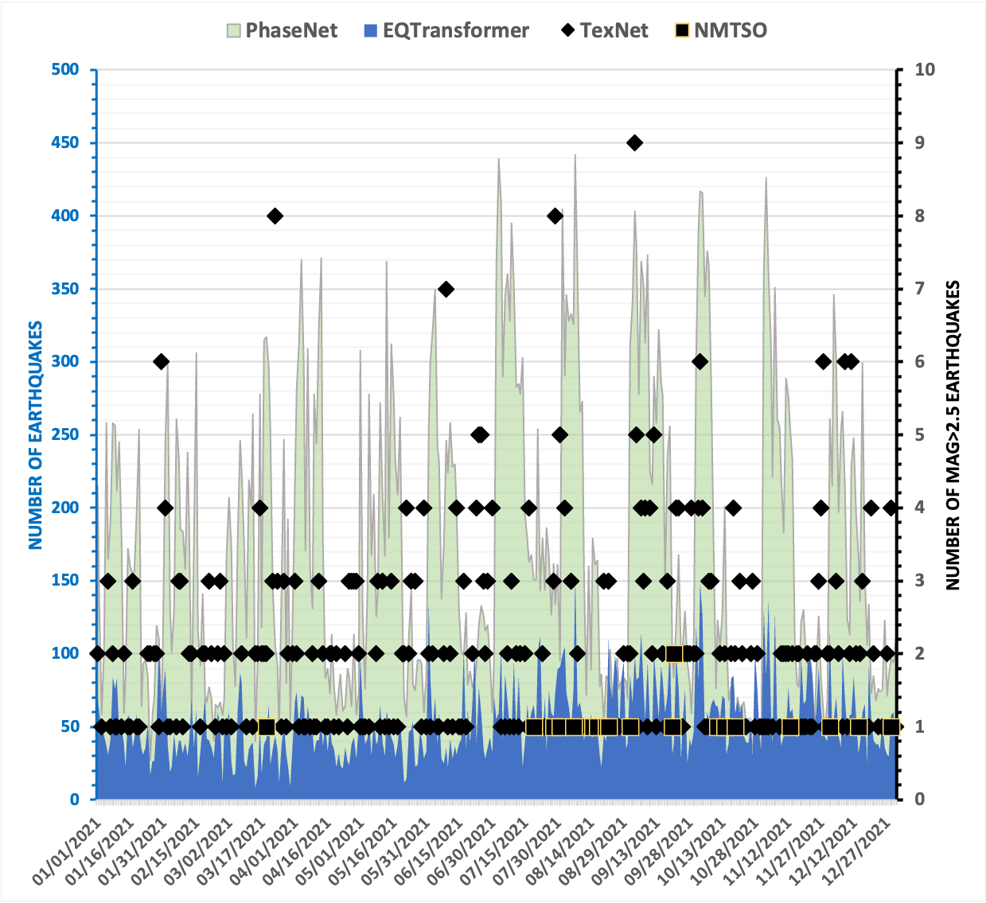
RESULTS
Evaluation of the earthquake count of the different catalogs
The overall monthly seismicity trend is similar between the NMTSO and three automated detection catalogs
Increase of monthly trends in the EQTransformer and PhaseNet catalogs is positively correlated with high magnitude earthquakes (M > 2.5) in the later half of 2021
Comparison of the monthly earthquake count from machine learning automated catalogs (Basu et al., 2024 in prep)
Daily earthquake count from EQTransformer and PhaseNet catalogs (Basu et al., 2024 in prep)
Notes:
Higher number of earthquakes detected from the automated catalog suggests the automated tools might be detecting similar or smaller magnitude events associated with a known larger magnitude earthquake

Slide 13
CONCLUSION
Performance criteria | Template matching | EQTransformer | PhaseNet
Missed detections | 168 | 64 | 33
Overall detection number | ~ Two times as compared to NMTSO catalog | ~ Four times as compared to (NMTSO+ TexNet) catalog for study region | ~ Twelve times as compared to (NMTSO+ TexNet) catalog for study region
False positive rate | 15% | 13% | 30%
Requirements of existing templates | Yes | No | No
Ease of implementation | Difficult | Moderate | Easy
NEXT STEPS
Implementing the automated tools in real time earthquake monitoring workflow
Earthquake relocations
Use machine learning tools to detect more earthquakes from previous years AND in other parts of New Mexico
Improving the seismic velocity model for better earthquake locations
Notes:
at least 5 stations for location ; eqtransformer conservative model & TM few templates used
We had chosen 33 templates out of 137 earthquakes with M>2.0 from the NMTSO catalog, which contains another 263 events with M>1.5 earthquakes. Using more templates could potentially increase the number of detections, but will also significantly increase the computational effort.
Based on our selection criteria and parameter testing, EQTransformer and PhaseNet have performed better and is under consideration for implementation at NMTSO

Slide 14

Thank you

Slide 15
RESULTS
EQTransformer
PhaseNet
MACHINE LEARNING BASED AUTO DETECTOR RESULTS
The PhaseNet and EQTransformer earthquake catalogs detected significantly higher number of earthquakes than detected by the USGS ComCat catalog and the combined NMTSO and TexNet catalog
Higher rate of detections from PhaseNet helped to minimize the false negative rate. However the false positive rate is considerably higher than the other catalogs.
Detection tool | Total events | False positive (%) | Number of missed events ($≥5 stations)$ | Number of missed events ($≥3 stations)$
Template matching | 1044 | 15 | 168 | 307
EQTransformer | 19540 | 13 | 64 | 188
PhaseNet | 63378 | 30 | 33 | 110
Initial locations of earthquakes detected from EQTransformer – REAL – VELEST workflow (Basu et al., 2024 in prep)
Initial locations of earthquakes detected from PhaseNet– REAL – VELEST workflow (Basu et al., 2024 in prep)
Comparison of the automated detections from the three automated catalogs
Notes:
We restrict our comparisons of the automated catalogs with just that region for the NMTSO (485 events) and USGS (37 events) catalogs of events with M > 1; USGS ComCat catalog (3317 earthquakes) and the combined NMTSO and TexNet catalog (5342 earthquakes) larger than M1 for our study region
PhaseNet detected significantly higher number of events than the EQTransformer method and includes almost five times more events than the NMTSO catalog

Slide 16
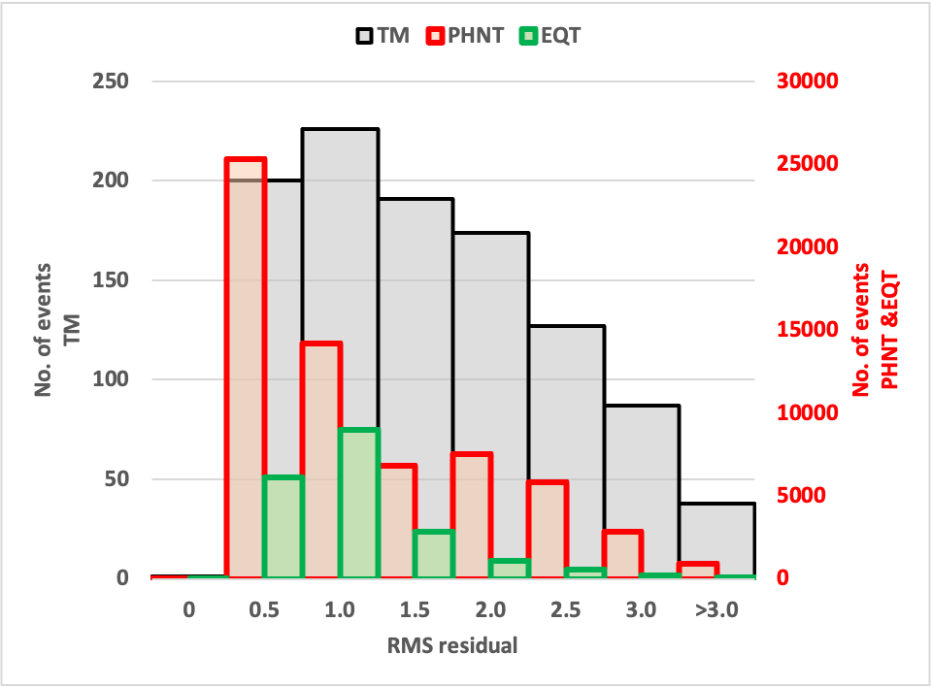
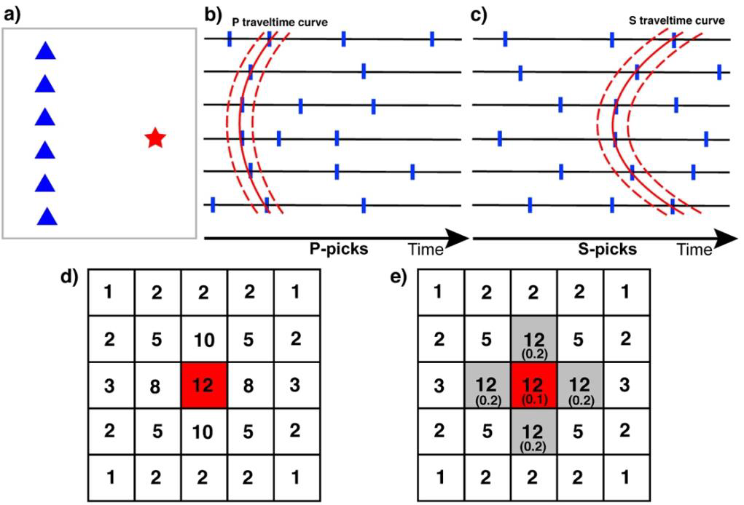
DATASET AND METHODOLOGY
Automated earthquake detection workflow divided into three sections:
Phase auto picking → Event association → Initial earthquake location
P and S phase auto picking
Template matching
EQTransformer
PhaseNet
Event association
P and S phase arrival times, number of phase picks and travel time residuals used to associate automated detections into initial earthquake locations at grid points
Helped to remove false positives and noise events which were detected on only one or two stations
Histogram plot of the RMS residuals from the VELEST location for the three automated methods (Basu et al., 2023 in prep)
Cartoon illustrating the concept of Rapid Earthquake Association and Location (Zhang et al., 2019)
Notes:
REAL (zhang et al., 2019)
IASP91 velocity model
helped to remove false positives and noise events which were detected at one or two stations
Parameters used: Search grid size of 0.1° degree and 5km for depth, travel time residual threshold of three seconds and a minimum of 3 phase picks for each earthquake
The distributions of seismic event (red star) and seismic stations (blue triangles). b) P arrival time curve (red) with its uncertainty range (red dashed), associated P picks and other false P picks (blue bars). c) same as b) but for S picks. d) The optimal location is determined to be at the grid point with most picks or e) the grid point with smallest traveltime residual (shown in bottom parentheses, unit: second) among multiple locations with the same maximum number of picks. (from REAL software manual)
VELEST (Kissling et al., 1994)
1D Vp and Vs velocity model extracted from Huang et al., 2019

