Slide 1
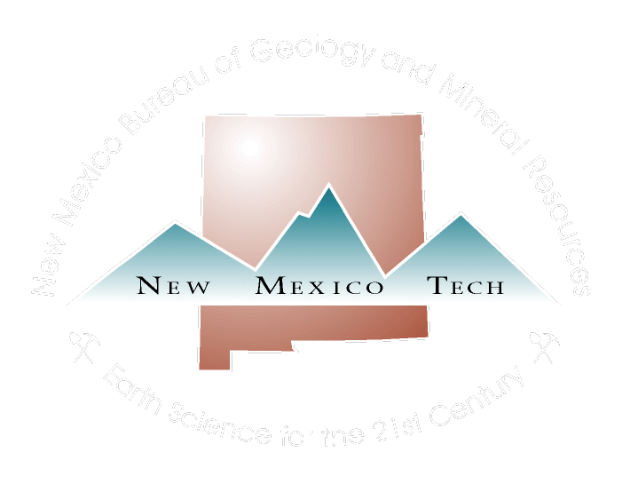

The Geothermal Program at the New Mexico Bureau of Geology
Shari Kelley
Geophysicist/Field Geologist
March 1,2024
NMT Research Symposium
A Research Division of New Mexico Institute of Mining and Technology

Slide 2
History of the program
Catalog of Thermal Waters by W.K. Summers, 1976
Marshall Reiter, 1976-2010
Crustal scale thermal processes
Aquifer studies and mine waste piles
Current program with Mark Person, Hydrology 2010-now
Geothermal database
Geophysical surveys using EM methods
Truth or Consequences
Rincon
Regional studies

Slide 3
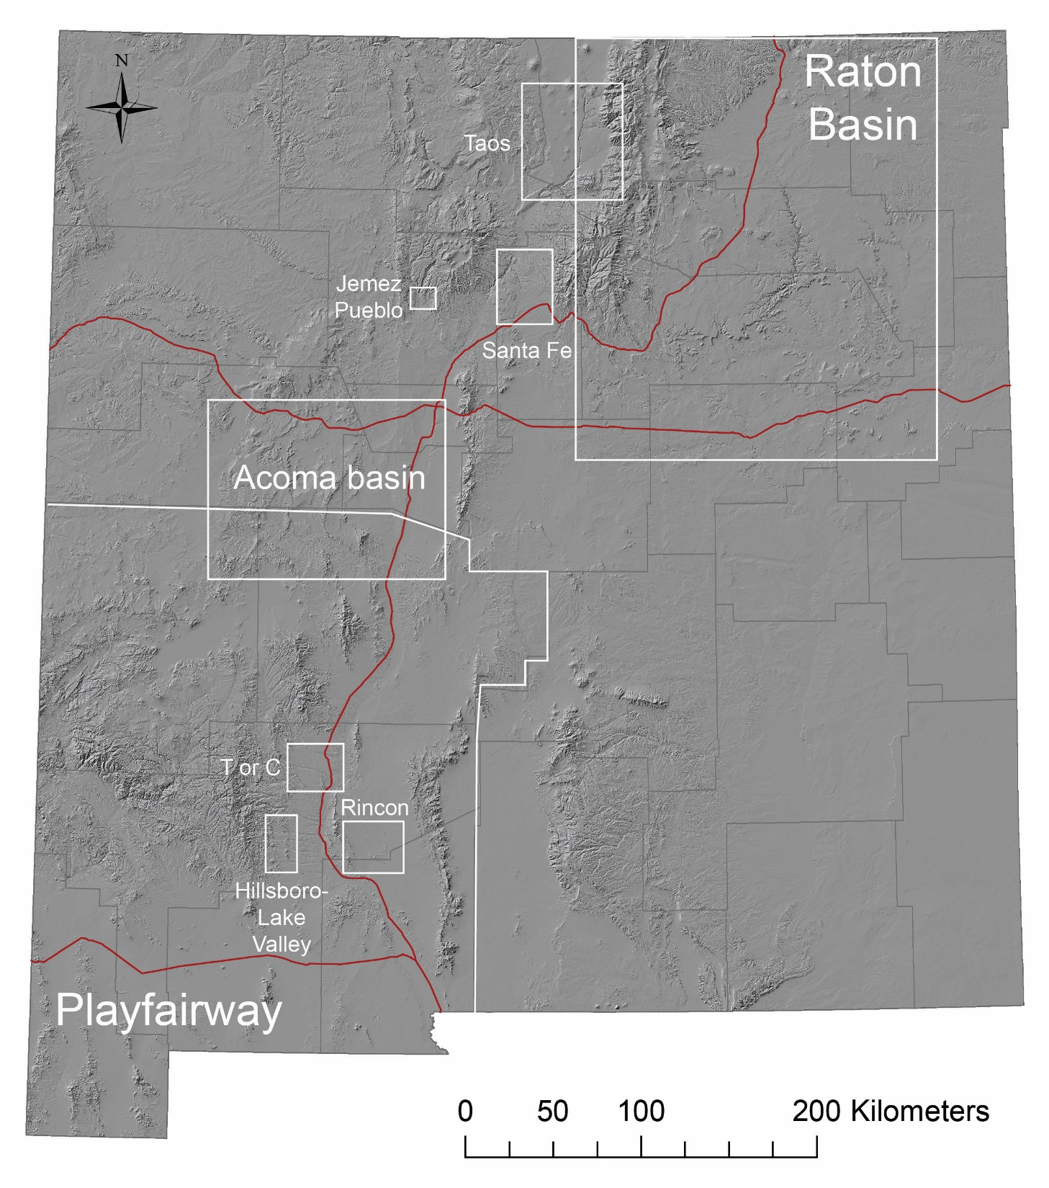

Slide 4
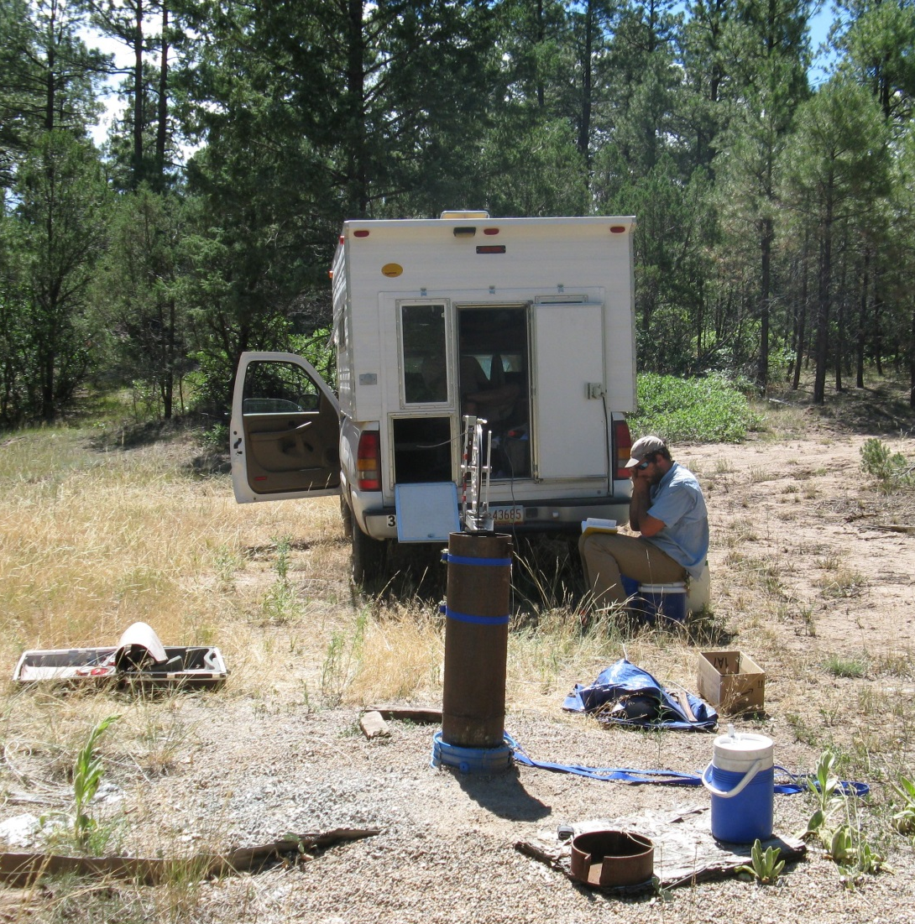
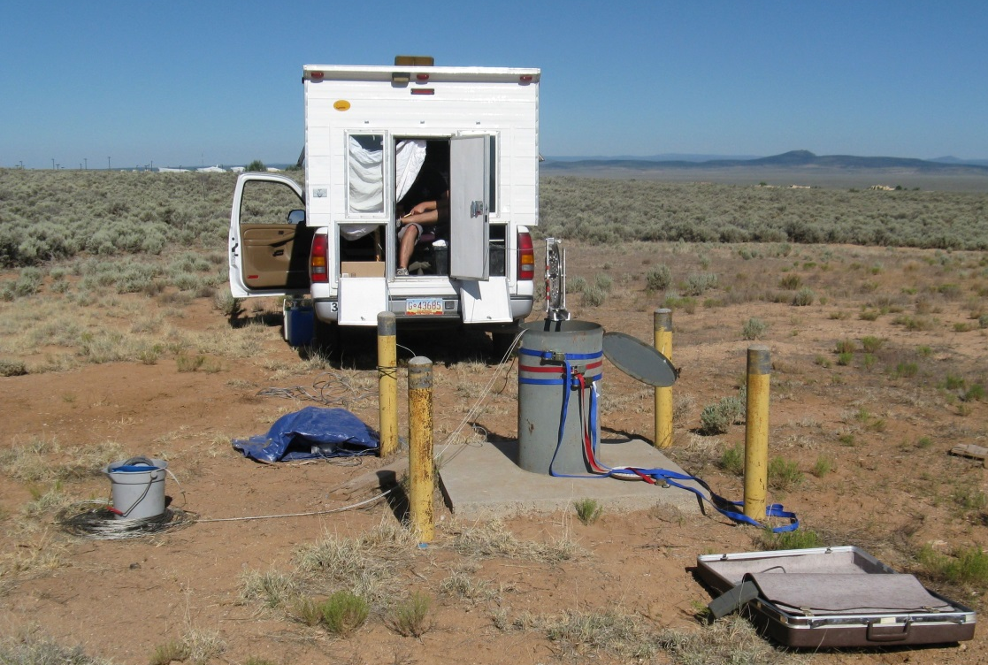
NMBGMR temperature
logging truck

Slide 5
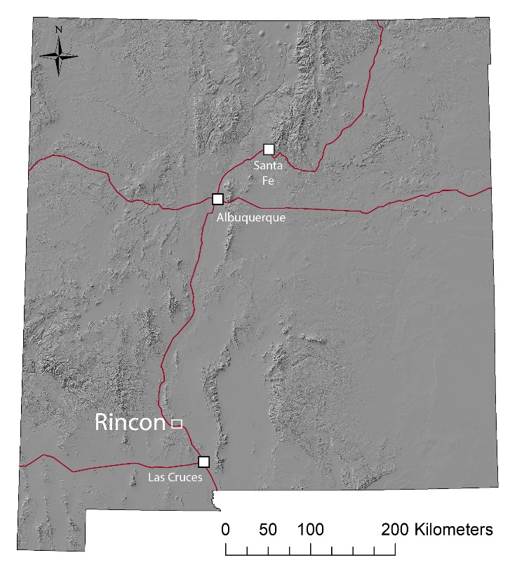
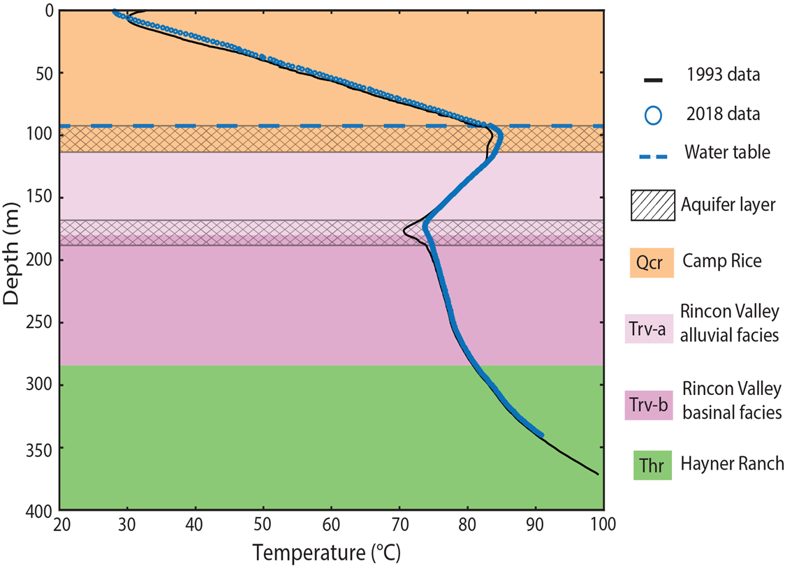
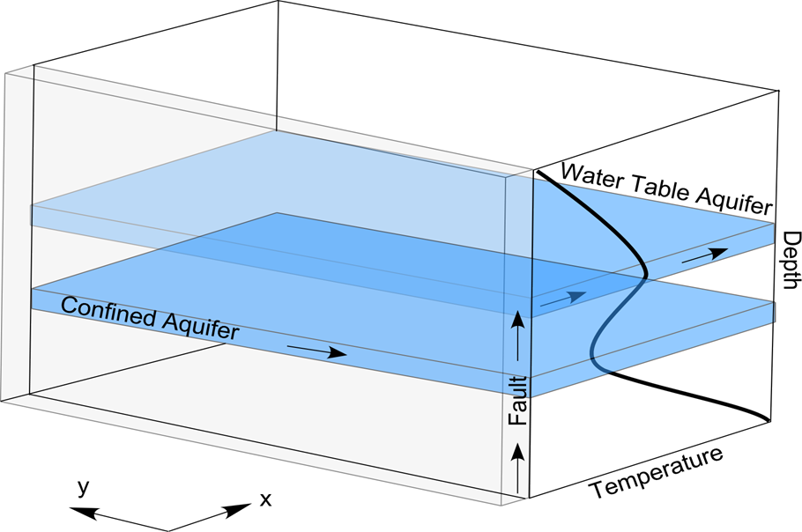

Slide 6
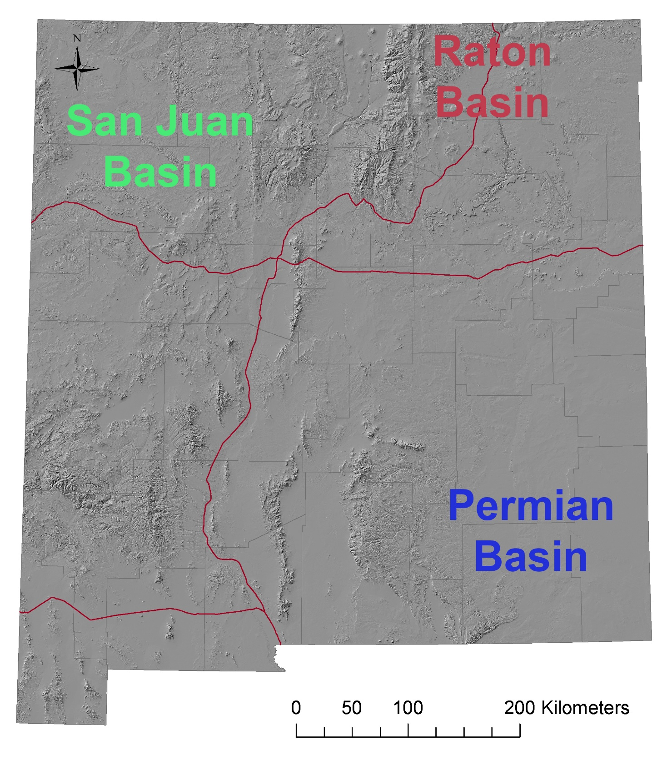
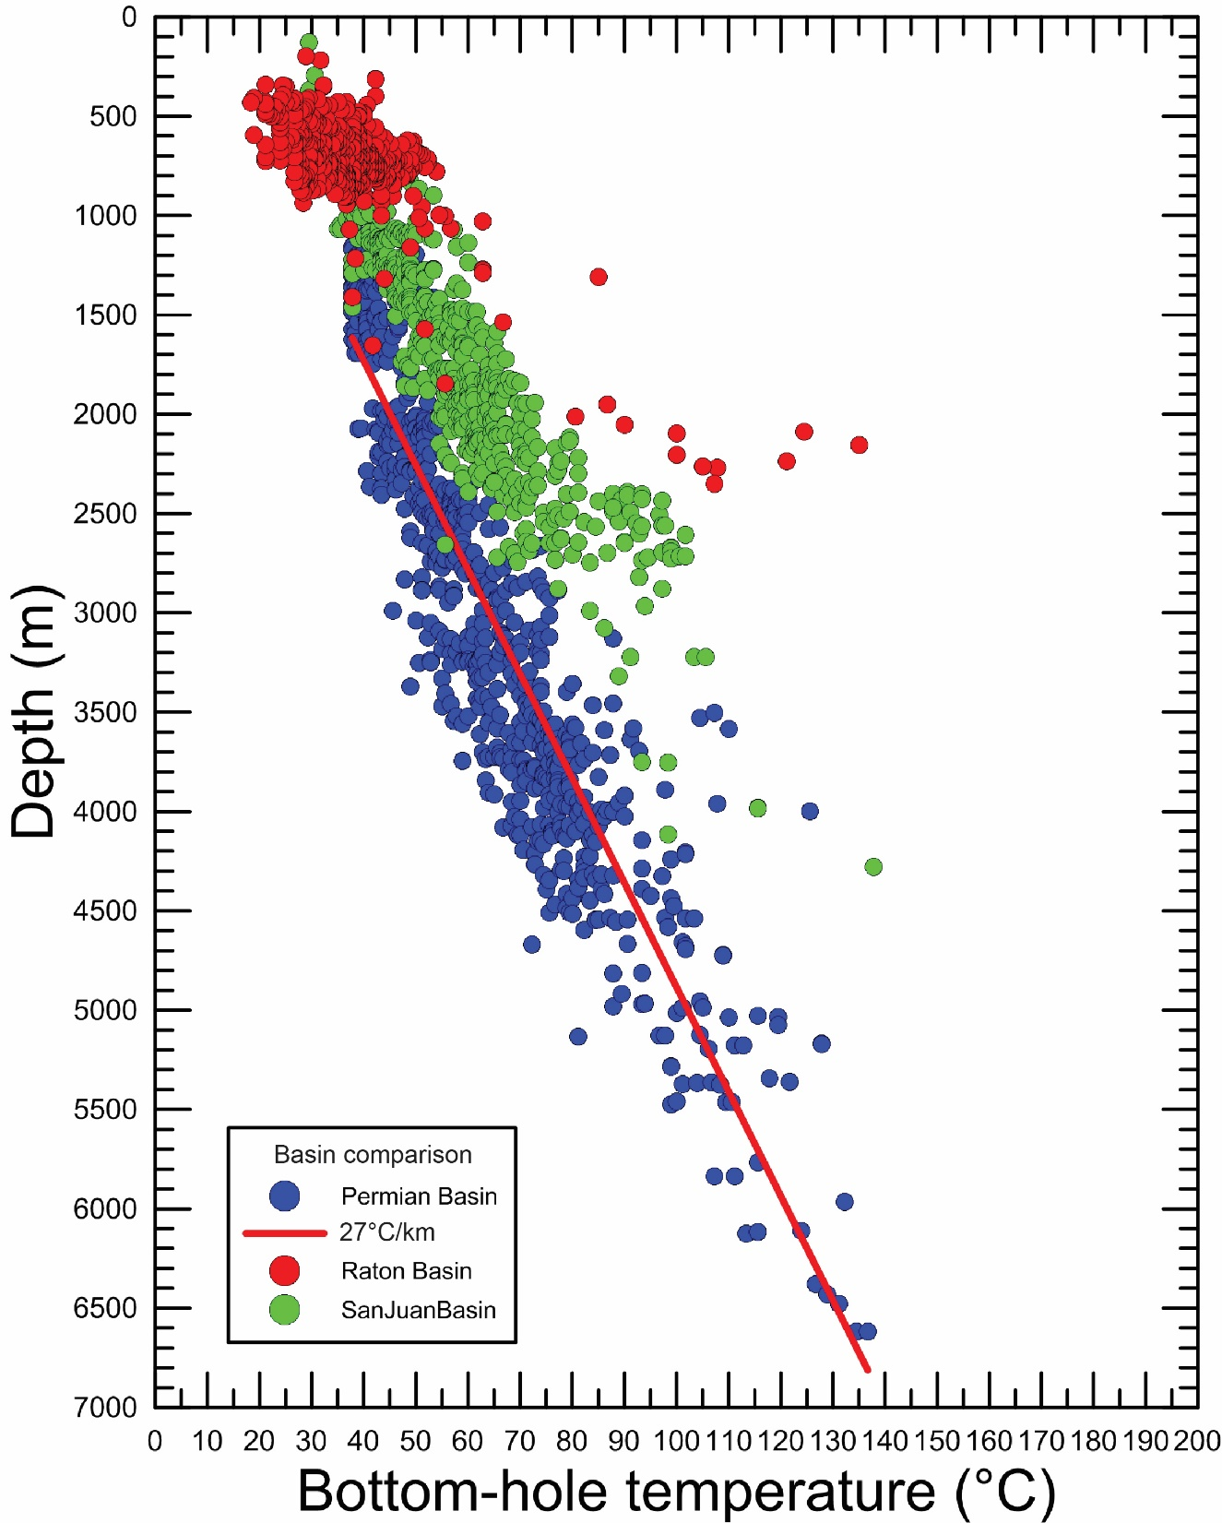

Slide 7
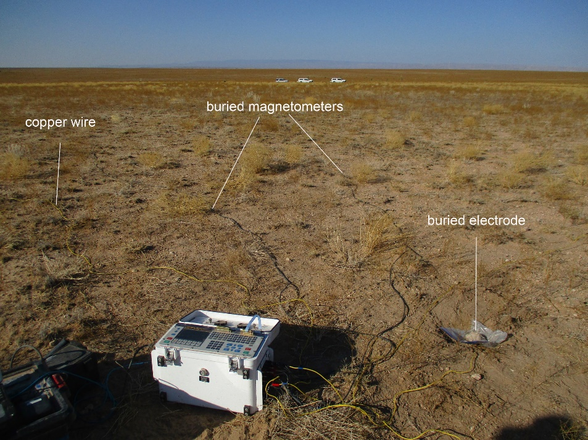
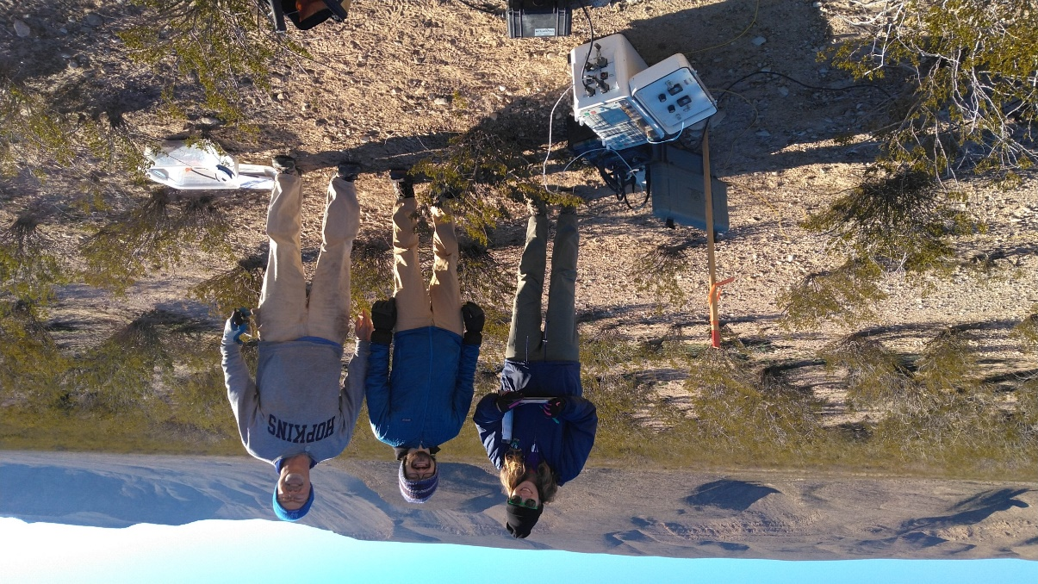
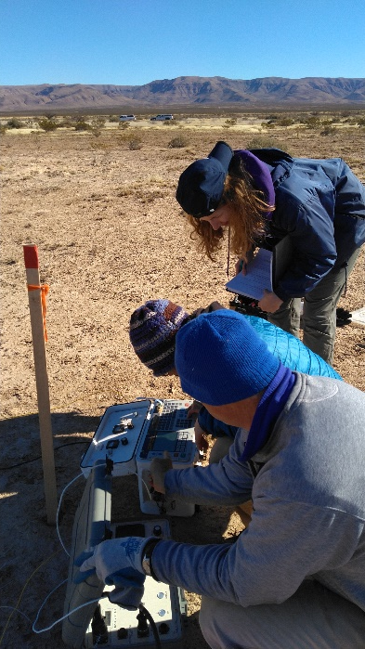
Magnetotelluric and transient electromagnetic surveys

Slide 8
The geothermal community is now embracing the development of the entire spectrum Earth’s heat
Thermal
Storage
&
Community
Thermal
Networks
Heating
& Cooling
Buildings
Ground
Source
Heat
Pumps
Heating
& Cooling
Buildings
Hydrothermal
Systems
Electricity
Engineered
Systems
Electricity
Direct Use
Greenhouses
Fish Farms
Agricultural
Drying, etc.
10–15°C 15–70°C 70–150°C >150°C >150°C

Slide 9
Geothermal Working Group
Meeting monthly since Feb 2022
Senator Gerald Ortiz y Pino
Senate Pro Tem Mimi Stewart
Representative Patricia Roybal Caballero
Tom Solomon, facilitator
Dr. Shari Kelley, NMBGMR
Dr. Olga Lavrova, NMSU
Dr. Patricia Sullivan, NMSU
Representatives from Sen. Martin Heinrich DC office
Notes:
Senator Gerald Ortiz y Pino, SD12-Abq, chair, Senate Health & Public Affairs committee
Dr. Shari Kelley, Sr. Geophysicist, Field Geologist, New Mexico Bureau of Geology & Mineral Resources, New Mexico Institute of Mining & Technology
Tom Solomon, geothermal development working group facilitator, electrical engineer, co-coordinator 350 New Mexico
Dr. Olga Lavrova, associate professor, College of Engineering, New Mexico State University
Dr. Patricia Sullivan, Associate Dean of Outreach and Recruitment, NMSU
Started to attend as of Sept 28 were also Rep. Candie Sweetser, Rep. Gail Armstrong

Slide 10
Proposed Legislation
A. HB91 Geothermal Project Funding & Management
1. Amends the geothermal duties of the EMNRD Energy Minerals and Natural Resources
Department to include applying for federal grants for geothermal resource development and administering two new geothermal funds. The EMNRD budget requested 1 FTE to carry out the duties of the act.
2. Establishes the geothermal resources development fund and the geothermal resources
revolving loan fund at $2.5M each: to study the costs and benefits of geothermal resource
development projects and provide grants & loans to help finance them.
(Separately, the House budget proposes to fund a geothermal research program at NM Tech at $0.5M/year for FY 2025-2027.)
B. SB 58 the Geothermal Electricity Tax Credit act provides a combined $5M/yr cap on tax credits for income tax plus corporate income tax, for electricity at $0.015/kWh through 2031. It also provides capital equipment gross receipts tax deductions for projects constructed from 2025-2031.
C. SB40 the Geothermal Heat Pump Tax Credit act allows tax credits of 30% of the system cost of ground-coupled heat pumps up to $9000 with an aggregate annual cap of $16M.

Slide 11
Current NMT research group includes:
Mark Person, Hydrology, NMT
Luke Martin, Petroleum Geology, NMBGMR
Hamid Rahnema, Petroleum Engineering, NMT
Sajjad Esmailpur, Petroleum Engineering, NMT
Tan Nguyen, Petroleum Engineering, NMT

Slide 12
Tasks to this point
Updating the geothermal database
Examined the NMSU system; determined that it is not operational
Workshop last fall; began making connections
Workshop April 18, 2024, Fidel Center; build on previous collaborations and make new connections.
Upcoming goals
Build NMT connections to drive new research and develop workforce training; geothermal certificate
Write a comprehensive report about multifaceted aspects of geothermal development. The report will examine the size of the geothermal opportunity, where to best develop our resources, the engagement of the oil and gas industry, community benefits and impacts, entrepreneurial opportunities, and policy and political considerations.

Slide 13
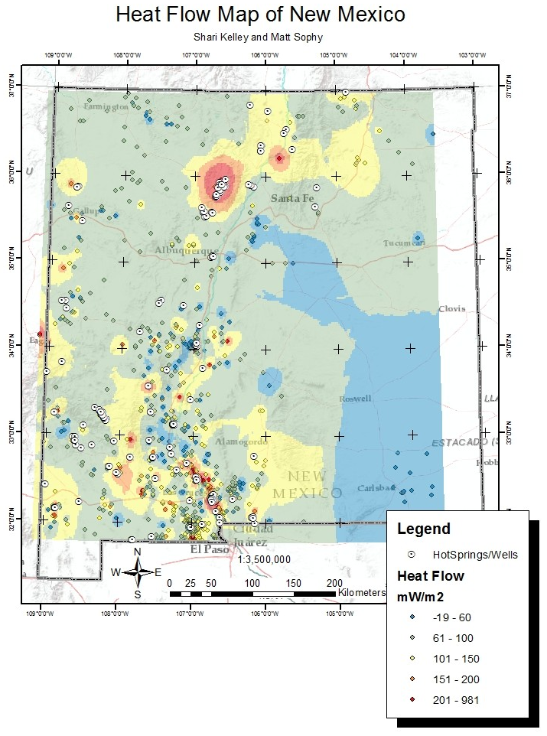

For more Information
Shari Kelley
www.geoinfo.nmt.edu
Shari.kelley@nmt.edu

