Slide 1


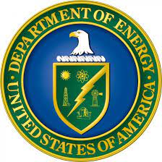


Additive Manufacturing of Energetics: from propellants to energetic initiator inks
Chelsey Hargather, Associate Professor
D.C. Purcell, PhD student, Mechanical Engineering, manuscript →→
New Mexico Tech Research Colloquium
1 March, 2024

Slide 2
Why additive manufacturing of propellants and energetics?
Propellants are typically cast, producing excess waste and long lead times
AM techniques allow for on-the-fly alteration of compositions, and the ability to tailor burn rate
Mobile AM centers could drastically reduce shipping costs of motors or other energetics
Challenges
  Safety issues have prevented large scale adoption of AM of energetics
  Propellant, for example, is a high solids loading slurry
  Interfaces present in the system that don’t exist in casting techniques

Slide 3
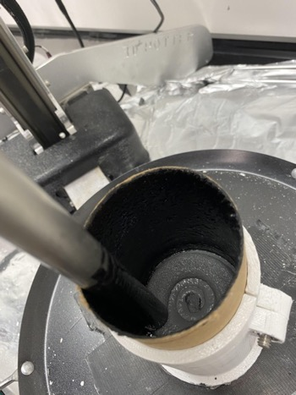
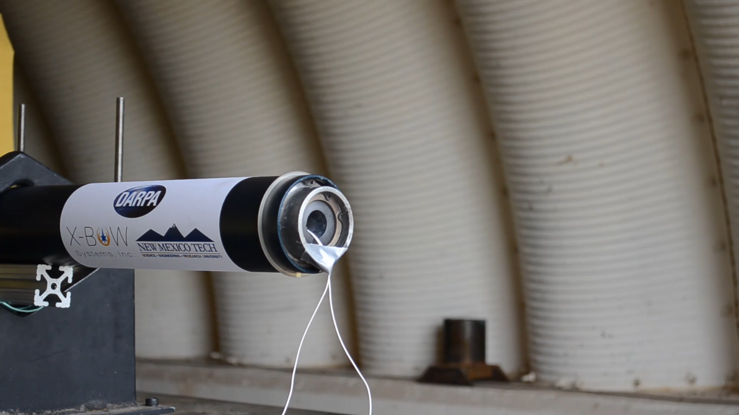
ACML built a system to print rocket propellant into cases, and tested them on Dr. M. Hargather’s test stand at EMRTC
Hargather et al., (2024). Additively Manufactured Rocket Fuel Grains and Competitive Simulation of the Same (US Patent No. 11,913,410). USPTO.

Slide 4
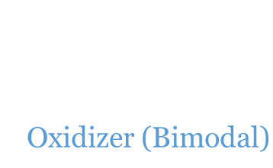
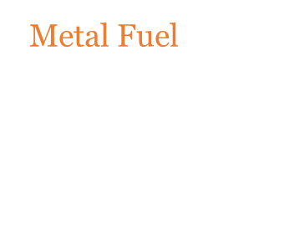
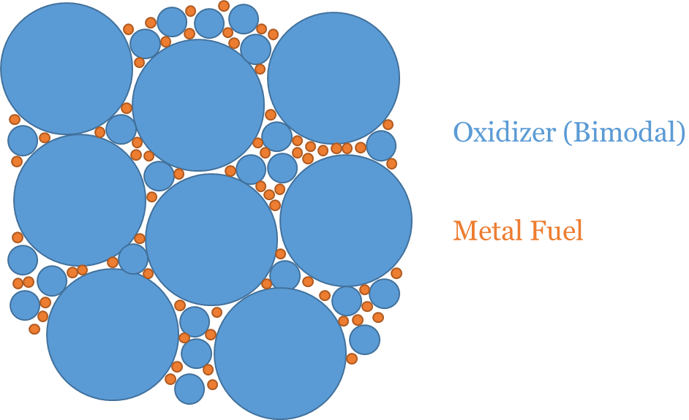
Goal: gain an understanding of printability and extrudability of ammonium perchlorate composite propellant (APCP)
Develop formulations of ammonium perchlorate composite propellant (APCP)
  Suitable for additive manufacturing in a custom-built extrusion-based system
  7 formulations
Characterize formulations
  Viscosity – two ways
  Yield stress
  Burn rate
  Mechanical properties
Binder
400 µm

Slide 5
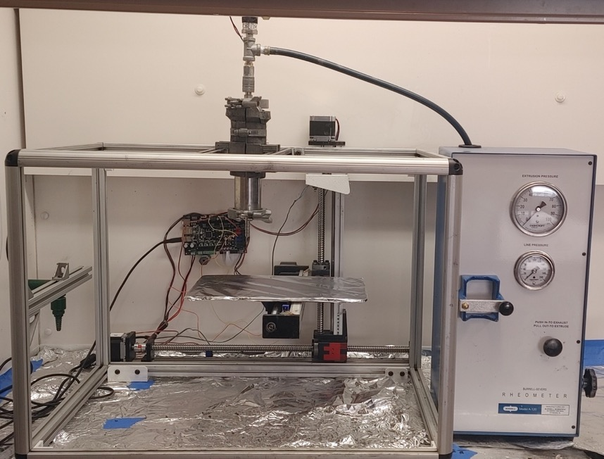
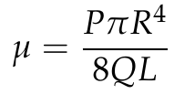
3-axis extrusion system used to print solid composite propellant and calculate viscosity
For the extrusion rheology, the material is loaded into a tube and extruded with air pressure.
The viscosity can be found using:
Burrell. Extrusion rheometer manual.
Notes:
Details on Operation are in Section 2 and Appendix in my Thesis
assumption about negligible losses from geometric changes has been verified in case anyone asks the question.

Slide 6
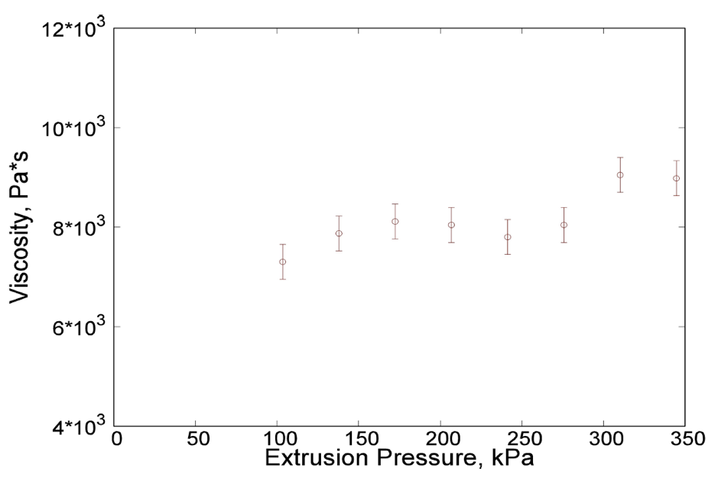
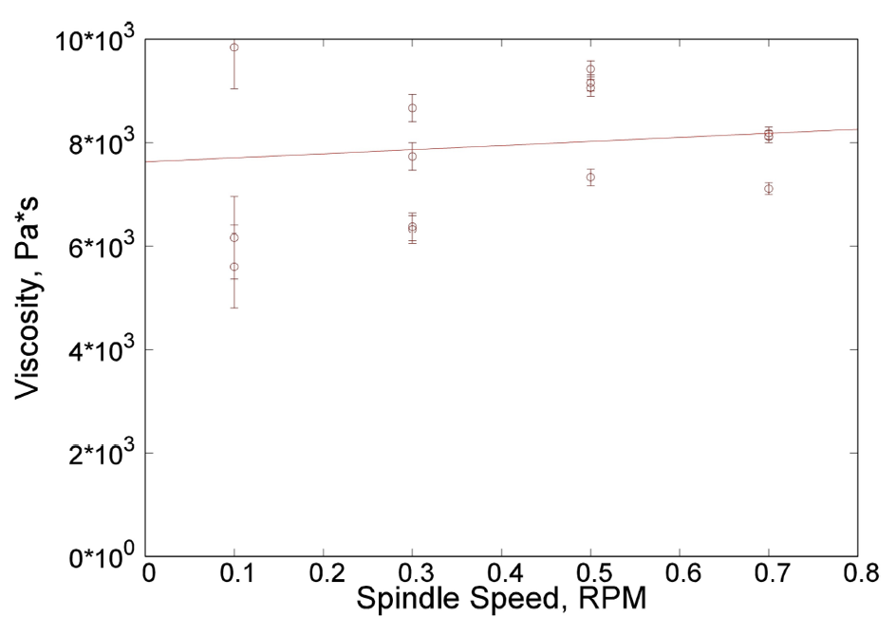
Measured apparent viscosity of single formulation compared on our 3-axis system (left) and a Brookfield rotational viscometer (right)
Extrusion
Brookfield
Purcell, Hargather, Hargather, Propellants, Explosives, Pyrotechnics, 49:e202300154, 2023.
Notes:
Irregularity in Formula 6 data points to its non-New tonian behavior

Slide 7
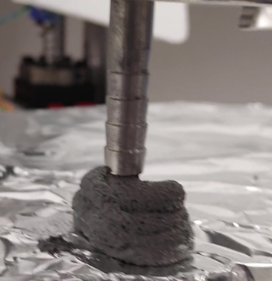
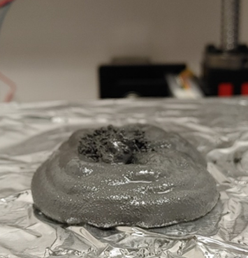
Application-Based Selection of Formula
Free-standing printing requires a material with high yield stress and relatively high viscosity for metered control and self-supporting deposition
  Formula 6 was observed to be the strongest candidate for this application
Printing directly to completely fill a mold, or to flow into long channels, requires a lower-viscosity formula with little to no yield stress
  Formula 1 was observed to meet these criteria most effectively

Slide 8
Yield stress of Formula 6 obtained based on Bingham’s work
Volumetric flow rate measured for curing and non-curing trials of Formula 6
Intercept of the trendline with the x-axis is the yield stress
  1 kPa
Corresponds to the stress resulting from the weight of the propellant in a column at its base to be 5.8 cm
Purcell, Hargather, Hargather, Propellants, Explosives, Pyrotechnics, 49:e202300154, 2023.
Bingham, An investigation of the laws of plastic flow. Number 278. US Government Printing Office, 1917.
Notes:
Yield Stress calculated from linear regression of data is 997 Pa. (For reference, this corresponds to approximately 5 cm of material height)

Slide 9
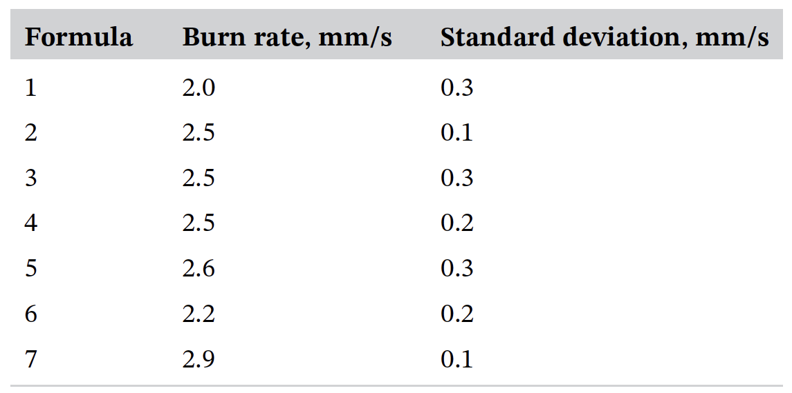


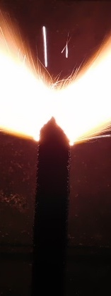


Burn performance of the 7 propellant formulations is lower compared to industry standard, due to our lower Al content
10 mm
Purcell, Hargather, Hargather, Propellants, Explosives, Pyrotechnics, 49:e202300154, 2023.

Slide 10
Pyrotechnic initiator ink
Benito Silva (BS, Materials Engineering)
Hannah Morgan Smith-Meyers (BS/MS, Materials Engineering)
Kayleigh Cameron (BS/MS, Materials Engineering)
MSIPP

Slide 11
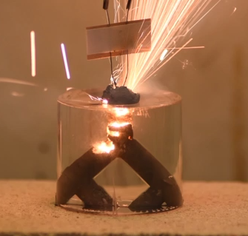
Pyrotechnic initiator ink for additive manufacturing applications
Develop a pyrotechnic fuse capable of igniting less sensitive energetic materials
Goal: demonstrate multi-point or simultaneous initiation of the energetic material.
3 thermite formulations + Fe-S blended within a polymer binder.
  Burn rate, viscosity, burn temperature, printability

Slide 12
36 formulations studied in this project, varying particle size, thermite type, and % solids loading
Amount of secondary fuel is varied
Characterize: ambient burn rate, combustion temperature, viscosity and printability in relation to potlife
Solids |  | Liquids
Purpose | Material | Purpose | Material
Oxidizer | Sr(NO₃)₂ or Ba(NO₃)₂ or MnO₂ | Binder | Hydroxyl-terminated polybutadiene (HTPB)
Fuel | Aluminum (Al) | Catalyst | Dibutyltin dilaurate (DBTDL)
Secondary Fuel | Iron Sulfur (Fe-S) | Curative | Isophorone diisocyanate (IPDI)
Oberth, Principles of Solid Propellant Development, 1987
Farris, Trans. Soc. Rheol., vol. 12, no. 2, pp. 281–301, Jul. 1968

Slide 13
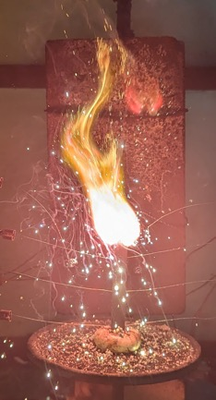
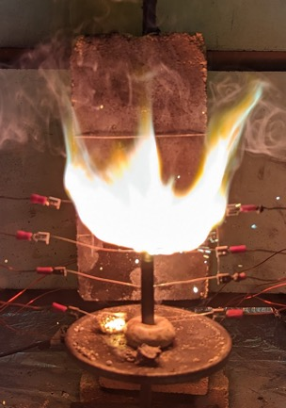
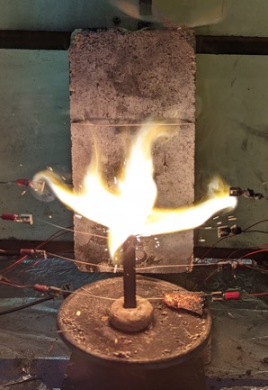
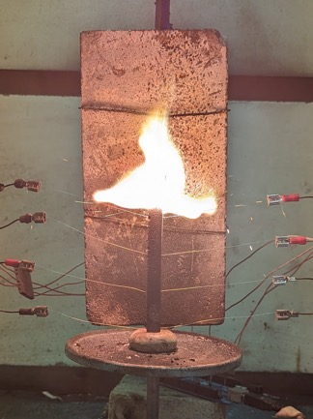
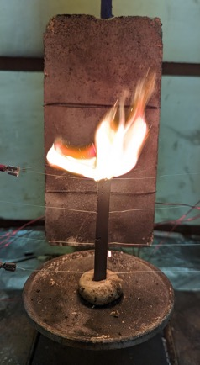
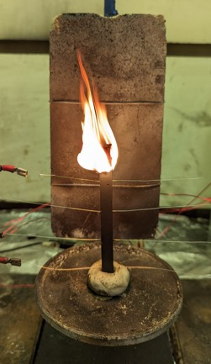
Combustion testing is performed on a custom-built apparatus
Combustion testing
  Inhibitor paint and steel break wires
  Modified strand burner with Arduino
  Returns three individual burn rates per sample
5%
15%
25%
35%
50%
65%
13
Notes:
This is the Sr 85% SL series
Strand dimensions are 4.26x0.36x0.36 inches

Slide 14
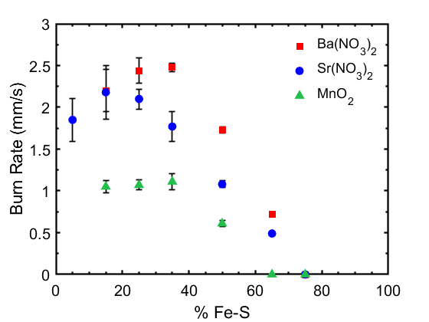
Ba(NO₃)₂ based formulations yield the highest combustion rate, and MnO₂ the lowest (85% solids loading)

Slide 15
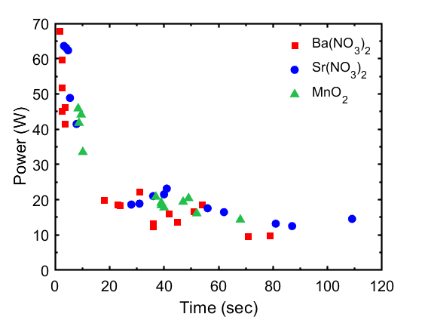
Ongoing work: characterizing power and energy requirements to ignite inks (85% solids loading)

Slide 16
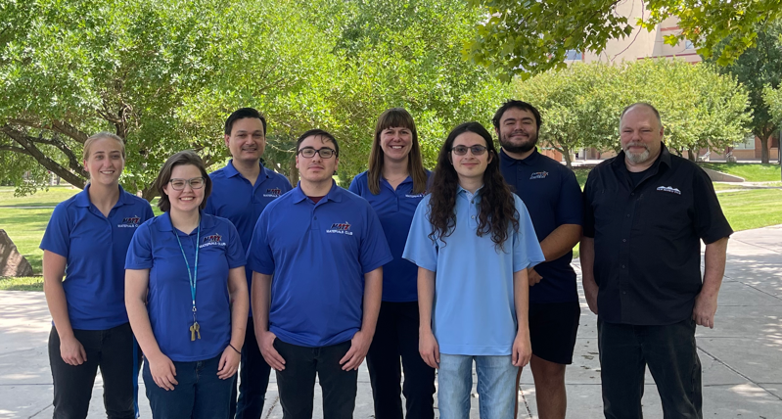

Questions?
Advanced Computational Metallurgy and Additive Composite Manufacturing Laboratory (ACML²)
chelsey.hargather@nmt.edu
www.nmt.edu/hargatherlab

Slide 17
Abstract
Additive manufacturing (AM) is a growing field of research, offering advantages in accuracy, logistics, and design that are difficult or impossible through conventional manufacturing. Adaptation of AM techniques for energetic materials, whether it is munition propellant, rocket propellants, or pyrotechnics, has lagged behind most other materials in being adapted to AM methods. In this talk, results from two AM projects related to energetic materials in Dr. Hargather’s research lab are given. First, seven propellant formulations designed for additive manufacture in a custom-built extrusion-driven platform are characterized in terms of apparent initial viscosity, time-dependent viscosity changes, and combustion properties, as well as the tensile properties of the final product relative to a cast material. Both spindle and extrusion-based viscometry methods are employed and compared. The formulations that behave similarly to a Bingham plastic are determined to be most suitable for printing applications. Second, ongoing work on the development and characterization of a pyrotechnic initiator ink is presented. The goal of the initiator ink is to demonstrate multi-point initiation on an energetic substrate. Formulation development and initial characterization of the viscosity and burn rates of thermites blended with iron sulfide in an energetic binder are discussed.

Slide 18
Formulations explored in the present work, per 100 g
Chemical Name | Role | Formula 1 Weight (g) | Formula 2 Weight (g) | Formula 3 Weight (g) | Formula 4 Weight (g) | Formula 5 Weight (g) | Formula 6 Weight (g) | Formula 7 Weight (g)
HTPB | Polymer Resin | 13.7 | 12.3 | 11.4 | 11.4 | 11.4 | 11.4 | 9.12
IPDI | Curative | 1.24 | 1.11 | 1.03 | 1.03 | 1.03 | 1.03 | 0.824
IDP | Plasticizer | 0.598 | 0.538 | 0.498 | 0.498 | 0.498 | 0.498 | 0.398
DBTDL | Catalyst | 0.0030 | 0.0027 | 0.0025 | 0.0025 | 0.0025 | 0.0025 | 0.0020
400 μm AP | Oxidizer | 46.4 | 31.5 | 47.5 | 39.6 | 35.6 | 31.6 | 49.1
90 μm AP | Oxidizer | 30.9 | 47.2 | 31.6 | 39.6 | 42.5 | 47.5 | 32.7
3 μm Al | Fuel | 7.73 | 7.86 | 7.91 | 7.91 | 7.91 | 7.91 | 8.18
 | % solids | 85 | 86.5 | 87.5 | 87.5 | 87.5 | 87.5 | 87.5
 | AP ratio | 60:40 | 40:60 | 60:40 | 50:50 | 45:55 | 40:60 | 60:40
 | Density | 1.7 (1.71) | 1.7 (1.73) | 1.8 (1.75) | 1.7 (1.75) | 1.7 (1.75) | 1.7 (1.75) | (1.80)
Oberth, Principles of Solid Propellant Development, 1987
Farris, Trans. Soc. Rheol., vol. 12, no. 2, pp. 281–301, Jul. 1968
Purcell, New Mexico Tech MS thesis, 2022

Slide 19
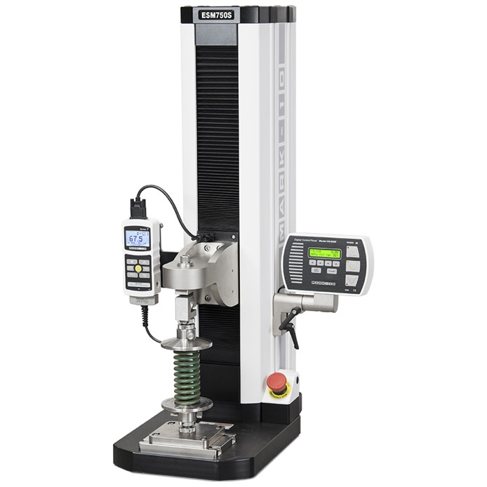
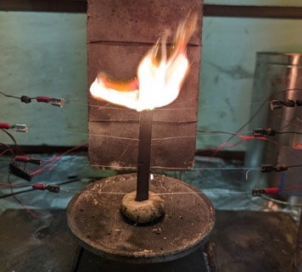
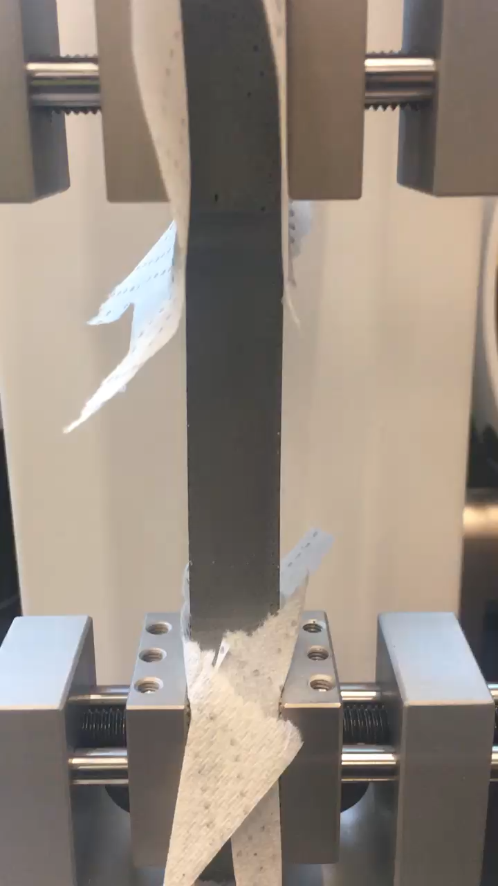
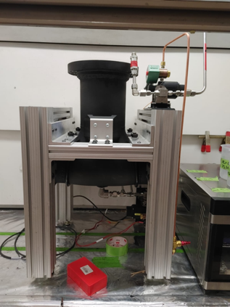
Other test methods used in the present work
Brookfield DV2T Viscometer
Mark-10 ESM 1500SLC Motorized Test Stand
Combustion Testing Apparatuses

Slide 20
First, establish comparison between viscosity calculation methods: 3-axis system and Brookfield rheometer
As propellant binder cures, viscosity dynamically changes
  Difficulty in determining a “baseline” viscosity since rate of cure is not necessarily linear
Non-curing formulations can be substituted to produce an approximate baseline for these materials
  Curative is replaced with a blend of binder resin and plasticizer to replicate displaced volume fraction, catalyst is removed entirely
Non-Newtonian properties of the propellant provide an ideal behavior for additive manufacture
  A yield stress of the fluid propellant determines its ability to self-support before curing
Notes:
Yield Stress calculated from linear regression of data is 997 Pa. (For reference, this corresponds to approximately 5 cm of material height)

Slide 21
Using Formula 6 (non-curing), measure viscosity vs extrusion pressure using the 3-axis system
Mostly constant relation between extrusion pressure and viscosity
Measured apparent viscosity around 8.0xE6 cP
Further tests were done at constant pressure, with similar results
Purcell, Hargather, Hargather, Propellants, Explosives, Pyrotechnics, accepted, 2023.

Slide 22
Second, validate the 3-axis system with results from a Brookfield DVT viscometer on Formula 6 (curing)
Apparent measured viscosity of Formula 6 as a function of spindle speed
Error bars from torque of viscometer
Results converge as spindle speed increases
8.0E6 cP consistent with extrusion trials
Purcell, Hargather, Hargather, Propellants, Explosives, Pyrotechnics, accepted, 2023.
Notes:
Supports conclusion that material is a Bingham plastic

Slide 23
Apparent viscosity results from the Brookfield at 0.7 RPM on all non-curing formulations
Formula # | 1 | 2 | 3 | 4 | 5 | 6 | 7
Solids Loading % | 85 | 86.5 | 87.5 | 87.5 | 87.5 | 87.5 | 90
AP 400 – AP 90 ratio | 60-40 | 40-60 | 60-40 | 50-50 | 45-55 | 40-60 | 60-40
Average Viscosity, cP | .83E6 | 3.4E6 | 2.5E6 | 3.3E6 | 3.4E6 | 2.8E6 | 3.4E6
Standard Deviation, cP | 1.6E5 | 1.6E5 | 2.2E5 | 2.6E5 | 2.7E5 | 61.E5 | 1.3E5
Formulas 6 and 7 are lower than expected
  In trials of extrusion viability, 7 was unable to extrude at all, while 6 exhibited higher apparent viscosity at the operating pressure than others
These formulas have the strongest non-Newtonian behavior in regards to yield stress
  From secondary observations, the estimated shear threshold is high
Spindle viscometry may not fully capture the behavior of these materials
Purcell, Hargather, Hargather, Propellants, Explosives, Pyrotechnics, accepted, 2023.

Slide 24
Measured apparent viscosity of curing Formulas 1 and 6
Establishing the change of viscosity as a function of time is also important
This allows us to establish an approximate range of times for when a material is useable in a printing setup
  Also provides a rudimentary method to estimate polymerization progression
Tests began at 15 minutes after curative addition to binder
  Test for 1 minute every 5 minutes

Slide 25
Application-Based Selection of Formula
Free-standing printing requires a material with high yield stress and relatively high viscosity for metered control and self-supporting deposition
  Formula 6 was observed to be the strongest candidate for this application
Printing directly to completely fill a mold, or to flow into long channels, requires a lower-viscosity formula with little to no yield stress
  Formula 1 was observed to meet these criteria most effectively

Slide 26
Thermites are the basis of the energetic ink
Thermite is a pyrotechnic material
  Redox reaction of a metal oxide and metal fuel
  Produces large amount of heat
  Well studied material
Performance characteristics of energetic ink
  Burn rate
  Density
Variations can change performance
  Composition
    Adding Fe-S to control burn rate
  Solids loading
26
Notes:
Talk about why adding Fe-S -> more control over burn rate and burn profile compared to pure thermite

Slide 27
Volume percent solids of testing matrix
Strontium nitrate (Sr(NO₃)₂), barium nitrate (Ba(NO₃)₂), and manganese oxide (MnO₂) thermite systems
 | Sr(NO₃)₂ |  | Ba(NO₃)₂ |  | MnO₂
 | 80% solids loading | 85%solids loading | 80% solids loading | 85% solids loading | 80% solids loading | 85% solids loading
15% Fe-S | 54.83 | 63.23 | 53.48 | 61.96 | 47.80 | 56.47
25% Fe-S | 54.21 | 62.65 | 52.99 | 61.49 | 47.94 | 56.61
35% Fe-S | 53.58 | 62.05 | 52.50 | 61.02 | 48.08 | 56.75
50% Fe-S | 52.59 | 61.11 | 51.73 | 60.29 | 48.29 | 56.96
65% Fe-S | 51.57 | 60.13 | 50.94 | 59.53 | 48.50 | 57.16
75% Fe-S | 50.86 | 59.45 | 50.40 | 59.00 | 48.64 | 57.30
27
Notes:
Values are volume% solids
36 individual compositions
Mn is the most dense of the oxidizers which is why it has the lowest volume solids

Slide 28
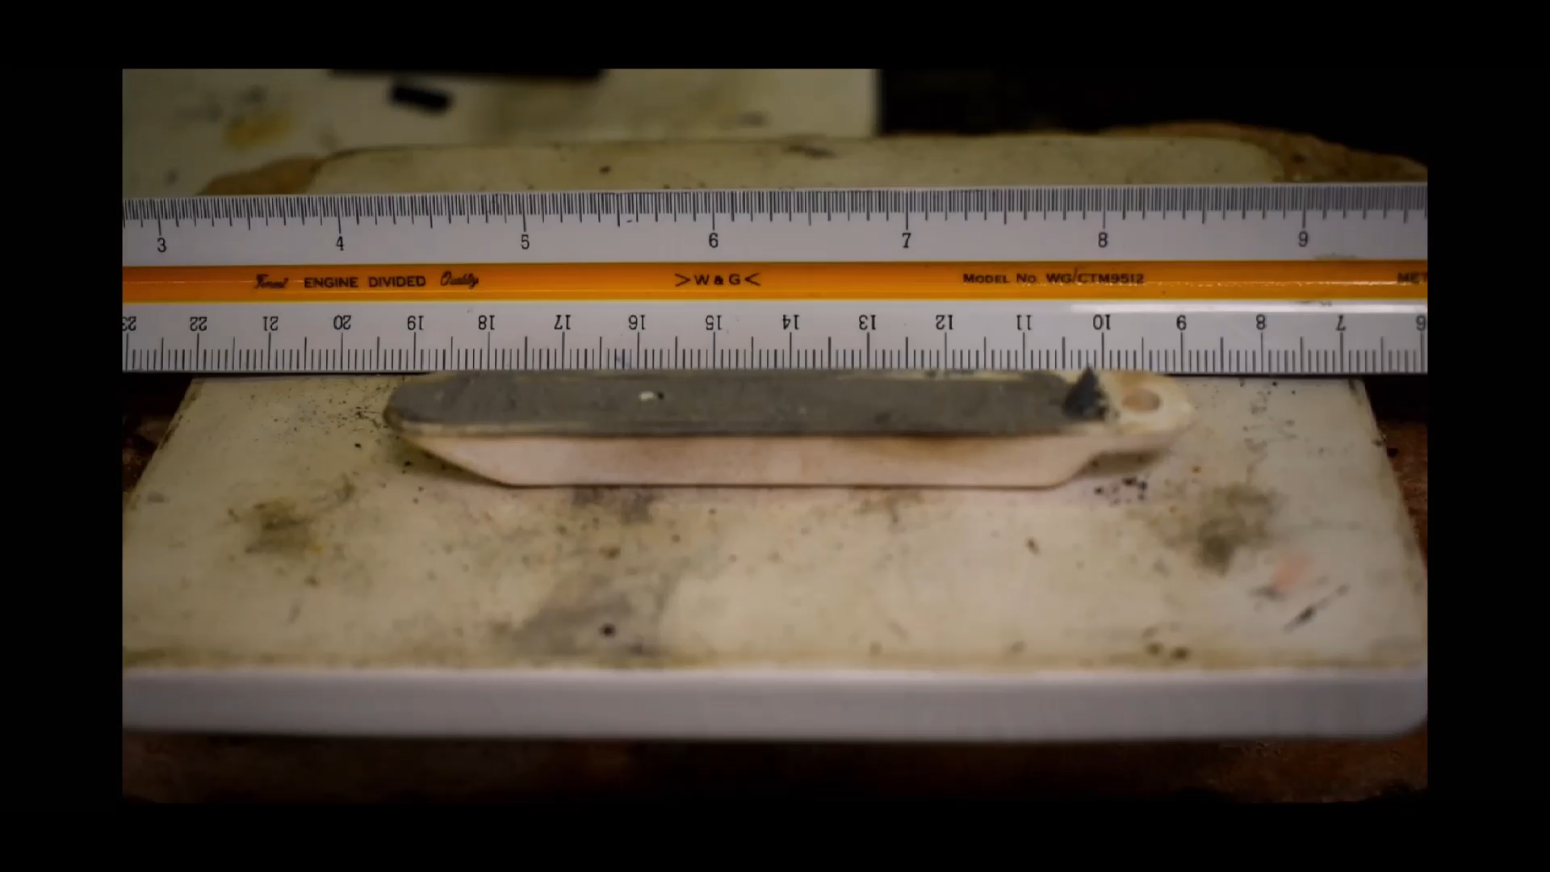
To control the combustion properties, thermite are blended at 50/50 wt% with Fe-S without losing heat output
Not classified as pyrotechnic
The exothermic reaction between iron and sulfur powders occurs resulting in iron sulfide
This reaction behaves similar to a pyrotechnic delay composition
Mass is 7:4 ratio for mixing
Fe°+S°→FeS
  S° + 2 e⁻ → S^{-II} (reduction)
  Fe° - 2 e⁻ → Fe^{II} (oxidation)

Slide 29
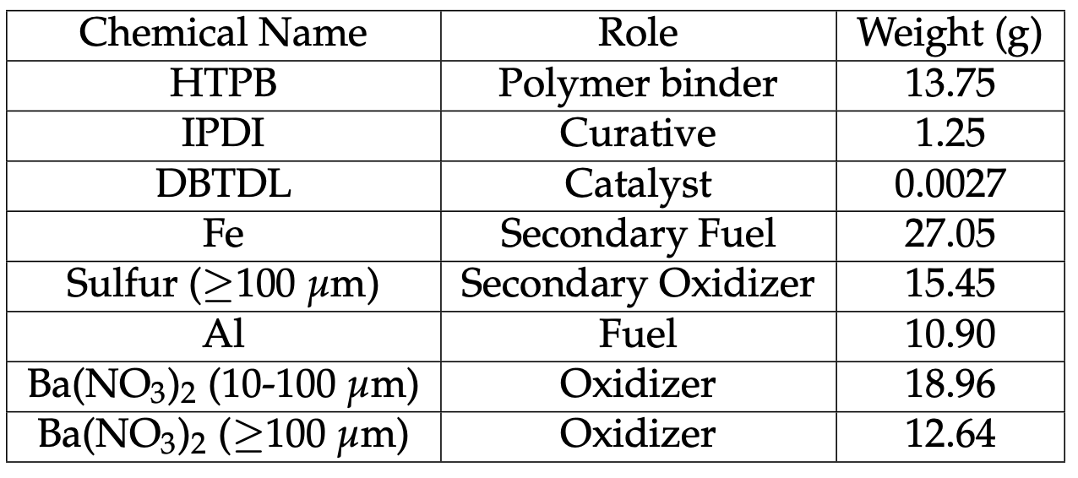
Example formulation for Ba(NO₃)₂ thermite in an HTPB binder system (85 % solids loading)
Particle ratios optimized based on Farris’ particle size distribution theory
Characterize the three materials in terms of
  Ambient burn rate
  Combustion temperature
  Viscosity and printability in relation to potlife
Oberth, Principles of Solid Propellant Development, 1987
Farris, Trans. Soc. Rheol., vol. 12, no. 2, pp. 281–301, Jul. 1968

Slide 30
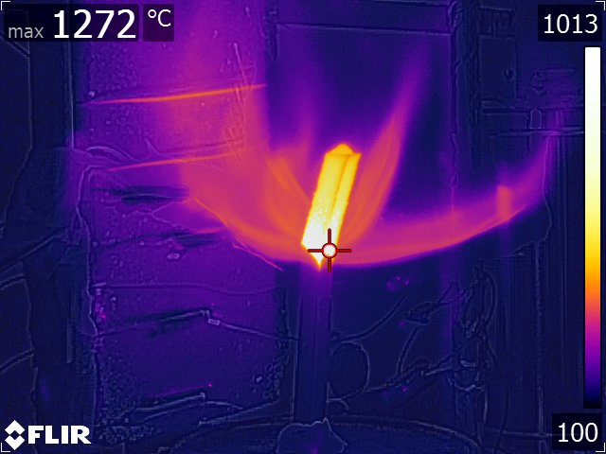
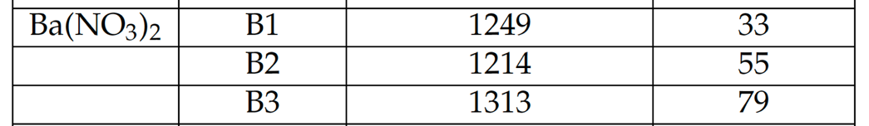
Preliminary testing: Flame front temperature of a 50/50 FeS/Ba(NO₃)₂ strands measured with a FLIR T640 infrared camera

