Slide 1

Direct Quantification of Multi-Scale Methane Emission Rates Using an Unmanned Aerial System
Jonathan F. Dooley (PhD Candidate)
Ken Minschwaner (Research Advisor)
New Mexico Institute of Mining and Technology (NMT)

Slide 2
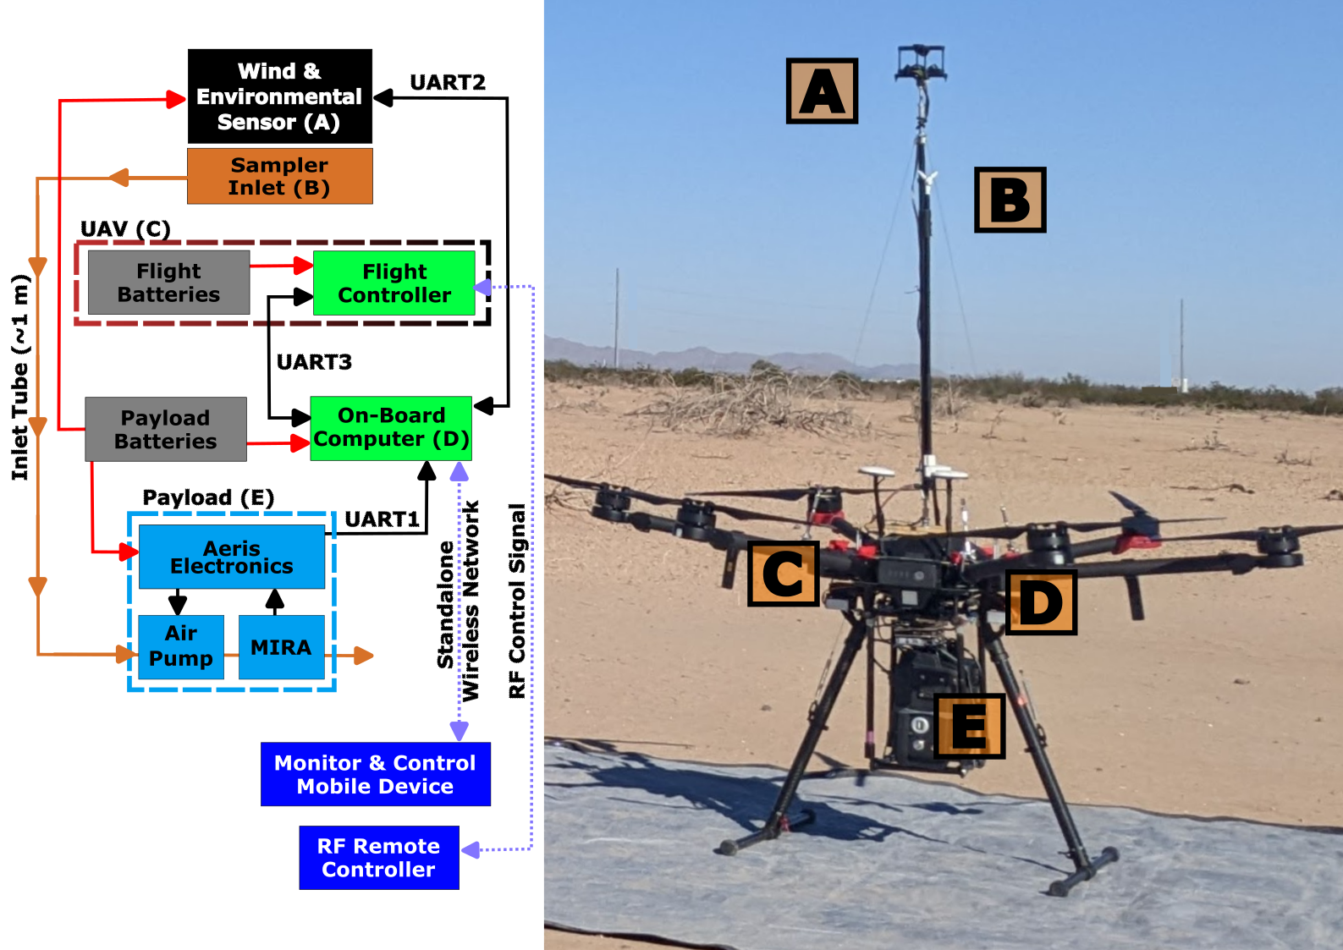
Unmanned Aerial System Design
Ultrasonic Anemometer
3D vector winds @ 5 Hz
Temperature, pressure, humidity
Vertical mast & Sampling Inlet
Above shallow inflow layer
Vertical takeoff hexacopter
Altitude range ~3 to 120 m
15-25 minute flight time
Up to 5 kg payload
Onboard Computer
Sensor synchronization
Built-in modularity
CH₄ & C₂H₆ Mid-IR Absorption Spectrometer
Sensitivity: 1 ppb CH₄ (500 ppt C₂H₆) @ 1 Hz

Slide 3
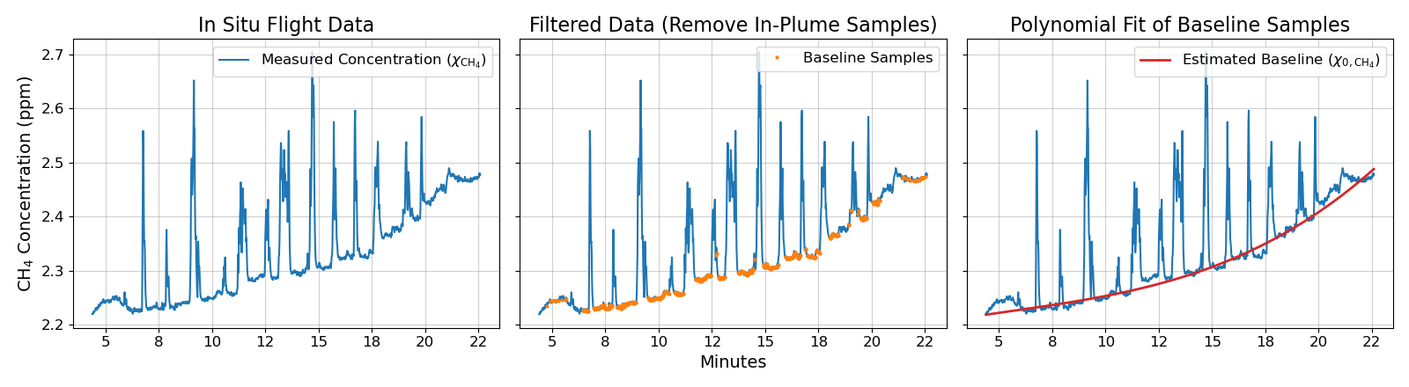
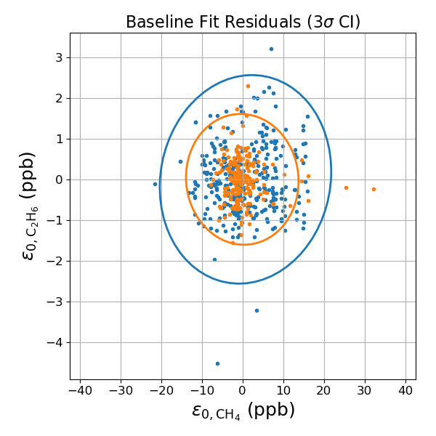
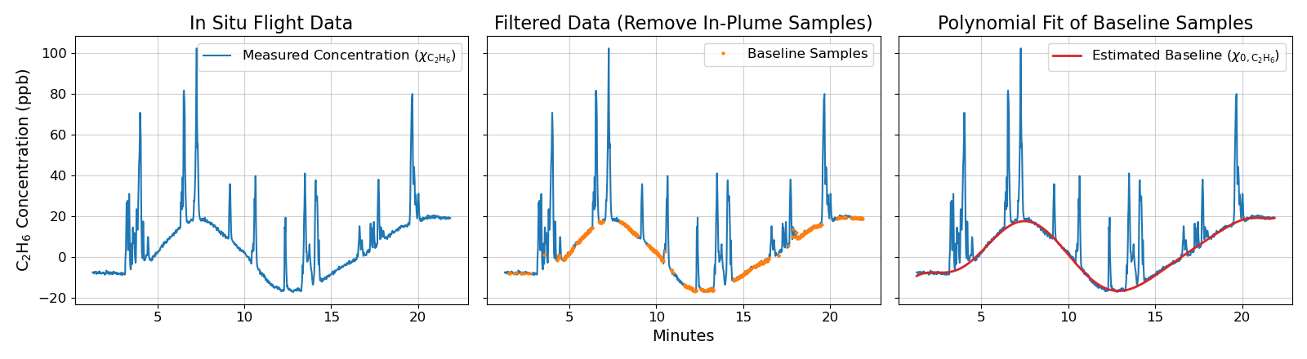
Background & Sensor Baseline Estimation
Raw measurement composed of two terms: 1) True ambient background mixing ratio and 2) Slow, time-variant sensor drift (5-10 min)

Slide 4
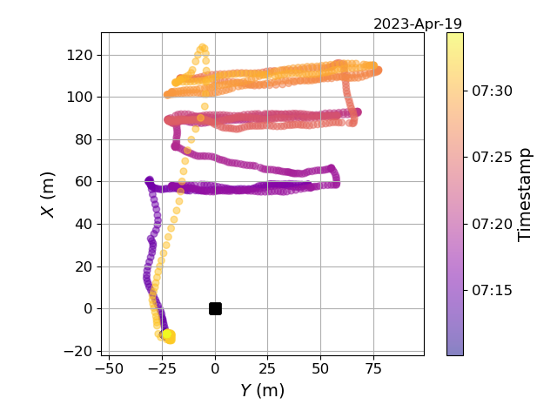
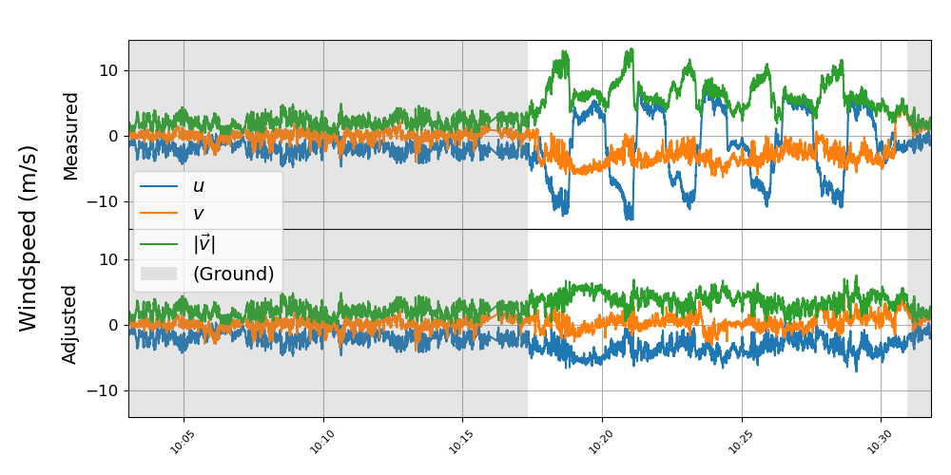
Motion and Environmental Adjustments
Typical flight path: Multiple horizontal legs downwind of target source, transecting plume at various altitudes.
Onboard anemometer records relative wind due to UAS heading and velocity; rotation matrices used to back out vector winds in static reference frame

Slide 5
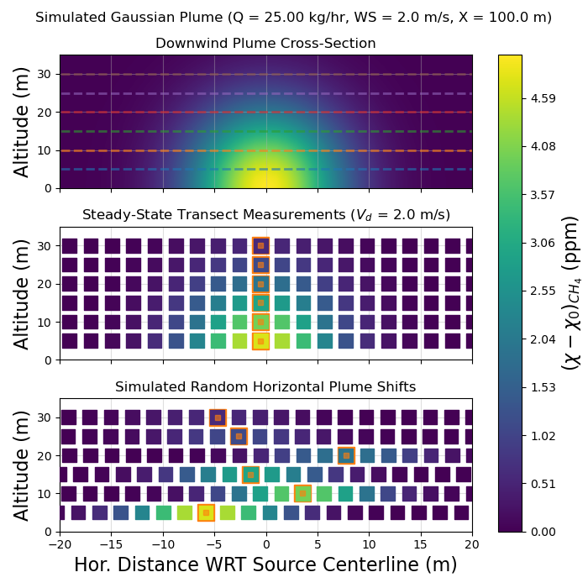
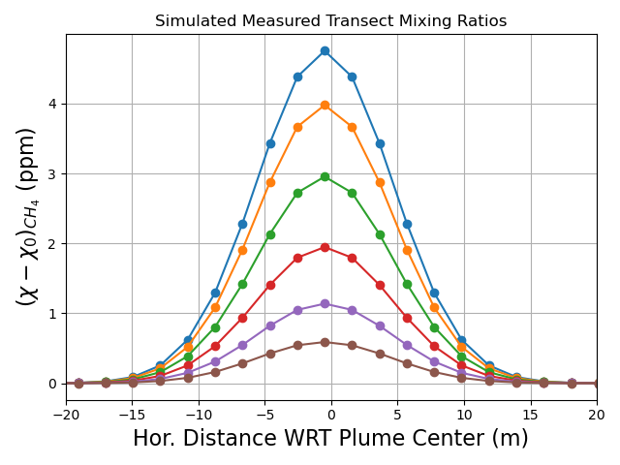
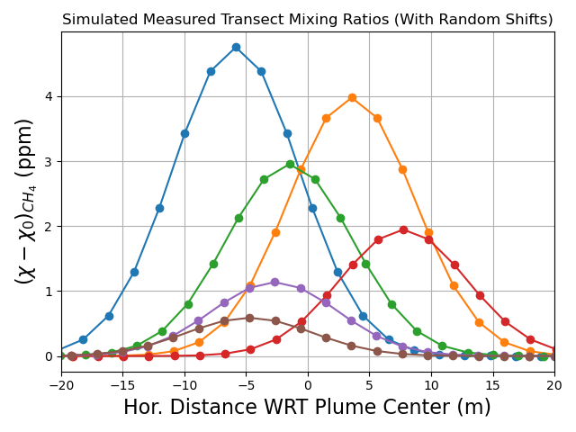
Deployment
Gaussian plume models for first-approximation concentration estimation & flight planning
Ground-based measurements miss a significant portion of dispersing plume; UAS raster scans show vertical profile of source plume
Gaussian modelling is not used for source flux estimates

Slide 6
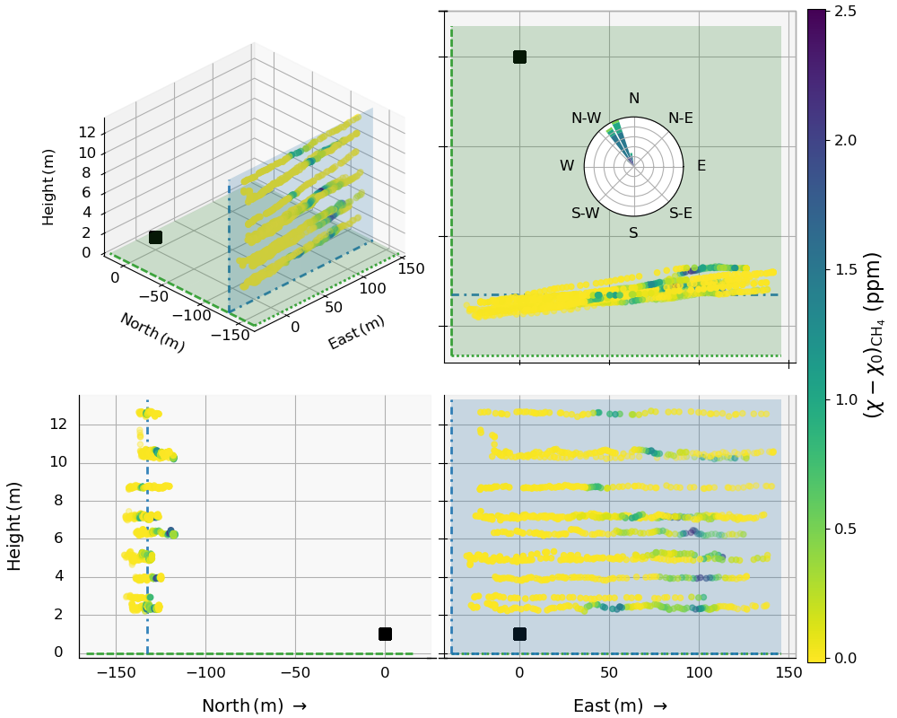
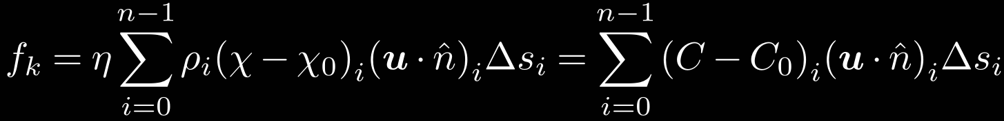
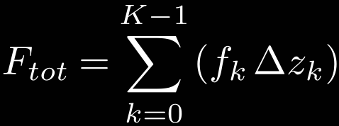
Plume Cross Sections Downwind of Orphan Well
Orthonormal views of flight path
Top Right: Aerial View
Bottom Left: West-Facing
Bottom Right: North-Facing
Flux Calculation Process:
Individual transects segmented & labelled (k)
‘Transect-Integrated Flux’ (f_{k}) for each k
Total flux (F) from integration of f_{k} and distance between adjacent k (Δz)

Slide 7
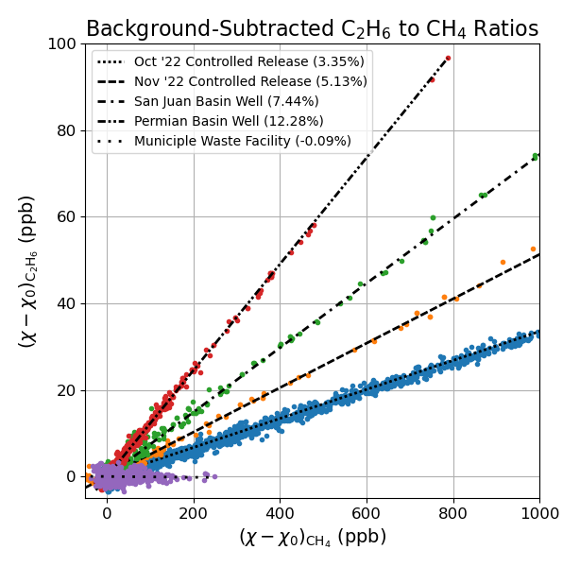
Source Attribution
C₂H₆ more than just attribution of source as biogenic or thermogenic
Thermogenic sources exhibit characteristic and consistent C₂H₆:CH₄ ratios.
Useful for detangling contributions from complex, distributed, or multi-sector source locations

Slide 8
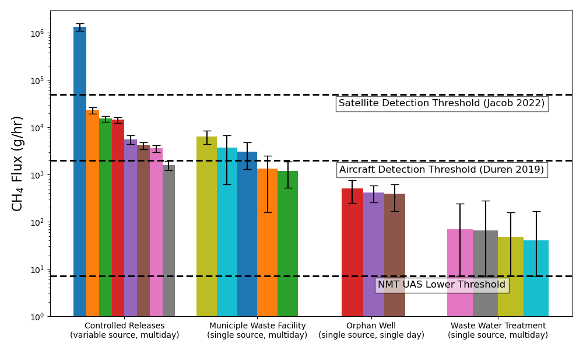
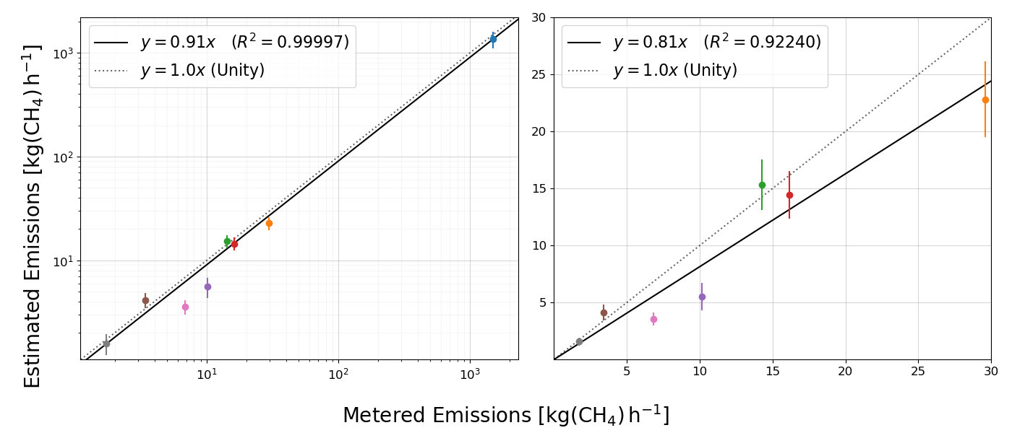
Distribution of Measured Fluxes by Sector
Participated in Controlled Release (2022)
Unbinded results helped with system development & flux quantification methodology
Municipal Waste Facility (2022-2023):
Small, local landfill at or below most aircraft system detection limits (~10 kg/h)
Permian Basin Orphan Well (2023):
Abandoned O&NG wells, emitting methane & other gases at low but constant rates
Wastewater Treatment Plant (2022-2023):
Very small emission rate around the estimated UAS lower quantification limit (~7 g/h)

Slide 9
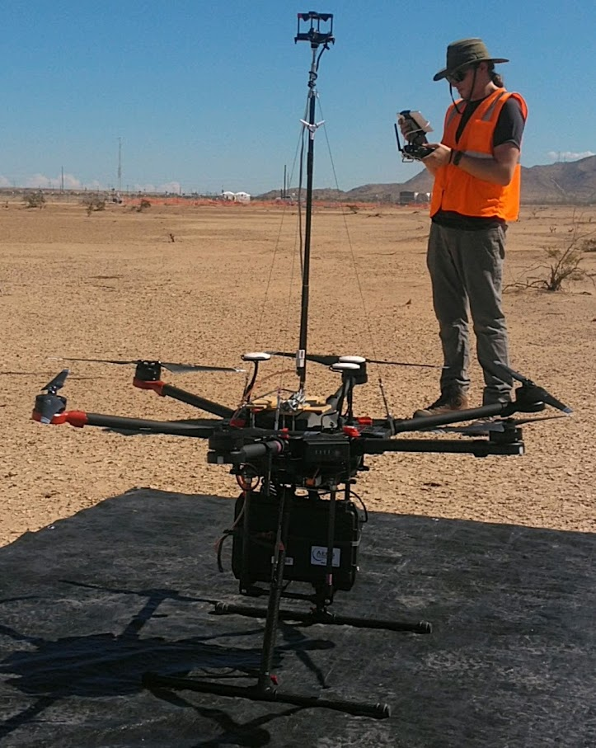
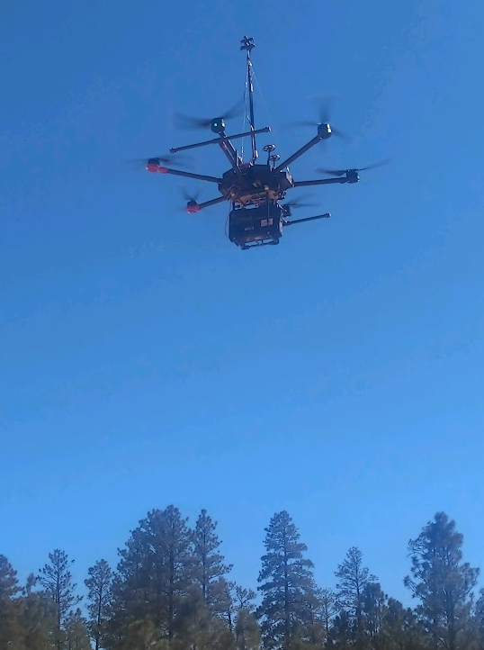
Acknowledgements & Further Info
Support for instrumentation and UAV equipment provided in part by the New Mexico Tech Office of Research. This project has benefitted from collaborations with the New Mexico Bureau of Mines, the New Mexico Petroleum Recovery Research Center, and Los Alamos National Laboratory. We thank the NMT Facilities Management Office for their support of field measurements during the course of this project.
Special thanks to operators of the controlled release in Casa Grande, AZ; recognizing the team members who contributed to field operations during the October and November 2022 testing periods and to processing the ground-truth data that was provided (in alphabetical order by last name): Adam R. Brandt, Philippine M. Burdeau, Yuanlei Chen, Zhenlin Chen, Sahar H. El Abbadi., Jeffrey S. Rutherford, Evan D. Sherwin. From Rawhide Leasing (operating the gas equipment): Mike Brandon, S.M.
THANK YOU
Contact: jonathan.dooley@student.nmt.edu

