Slide 1

Streamer inception imaged at 80 million frames per second
Luis Contreras-Vidal, Christian Peterson, Caitano da Silva, Michael Hargather, Richard Sonnenfeld
Dept. of Physics & Langmuir Lab
Dept. of Mechanical Engineering
New Mexico Institute of Mining and Technology

Slide 2
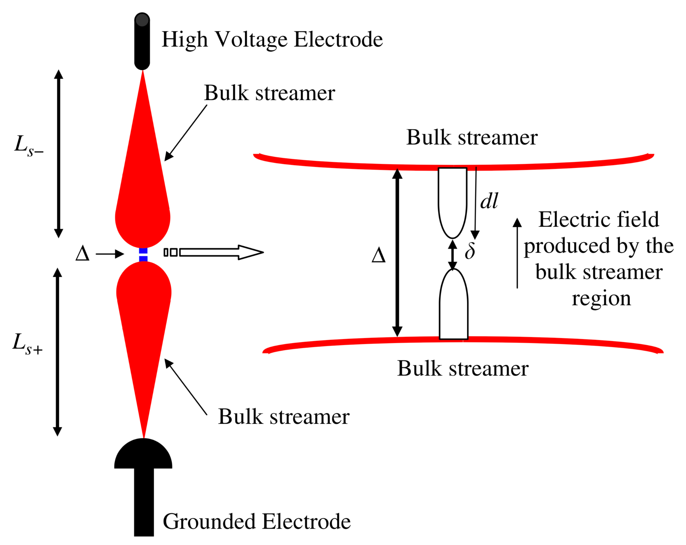
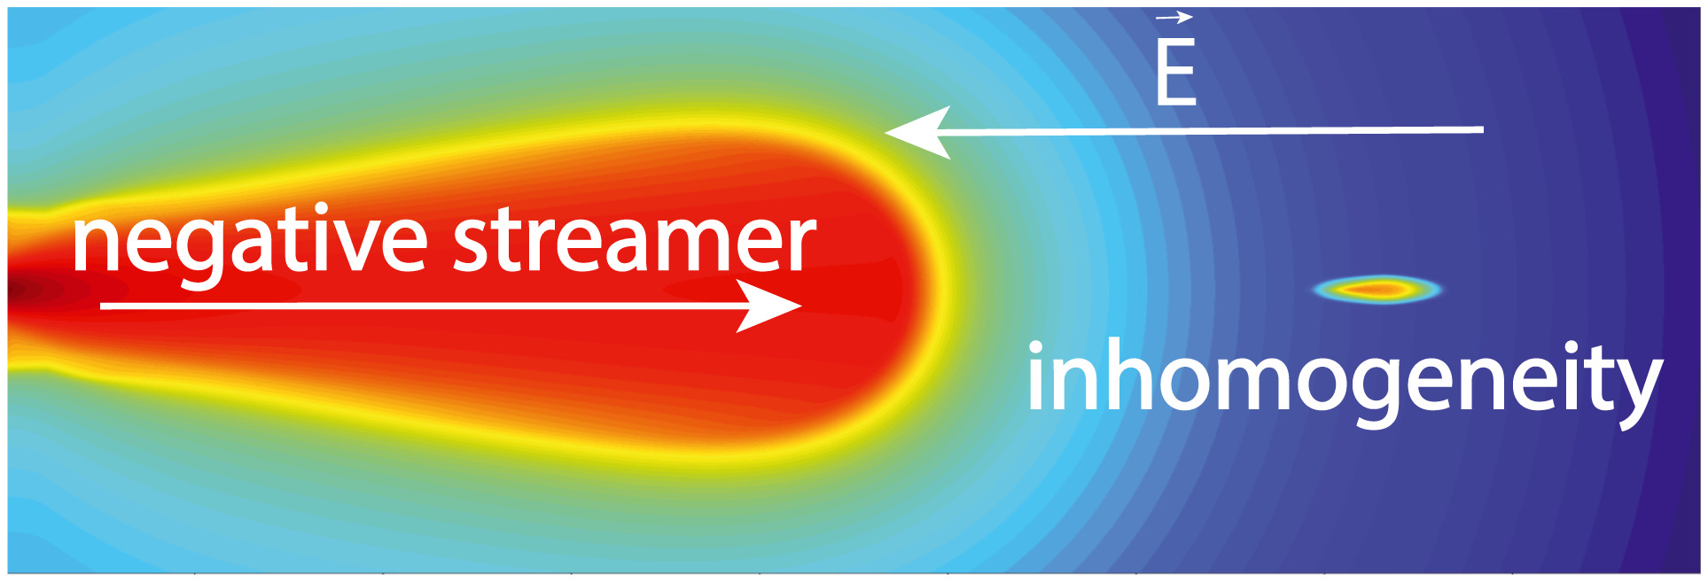
Runaway electron acceleration mechanisms
Ihaddadene, et al. (2019). Modeling of a new electron acceleration mechanism ahead of streamers. Journal of Geophysical Research: Space Physics.
Cooray, et al. (2009). On the possible origin of X-rays in long laboratory sparks. Journal of Atmospheric and Solar-Terrestrial Physics,

Slide 3
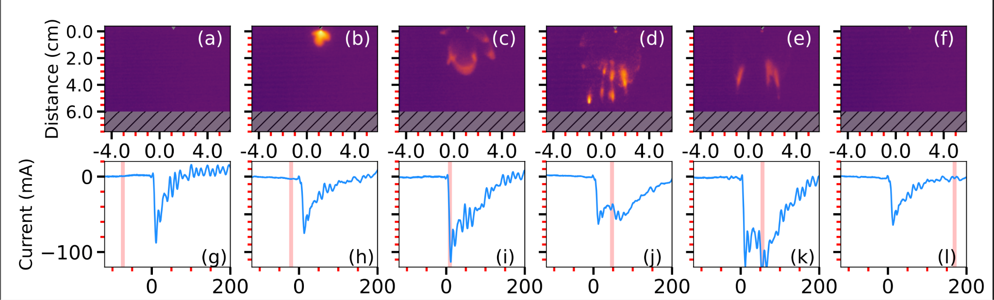
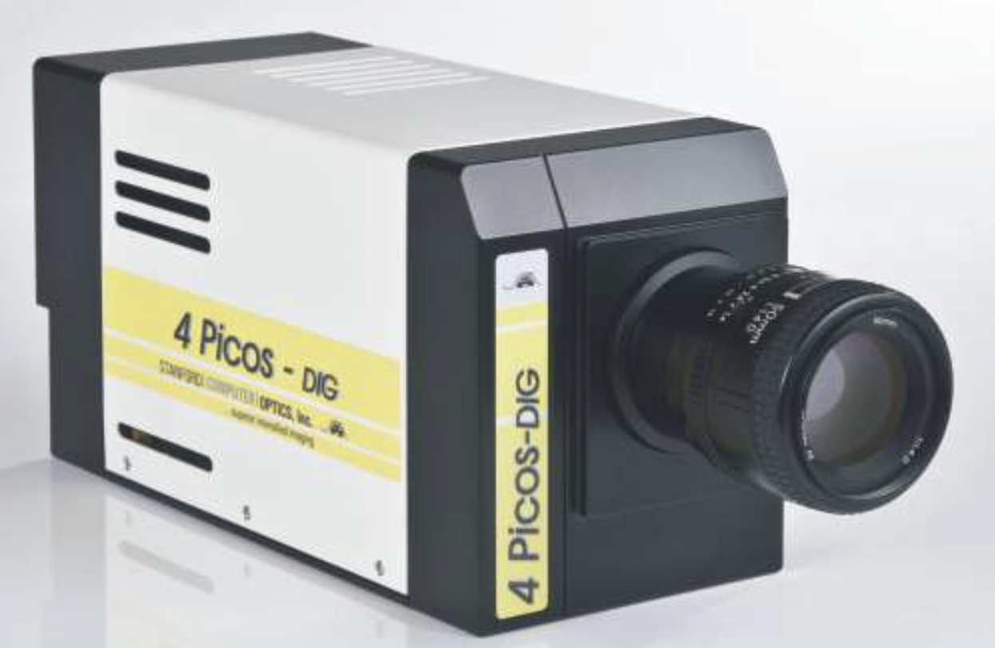
Production of runaway electrons during the streamer inception phase
Time (ns)
Luis Contreras-Vidal et al 2023 J. Phys. D: Appl. Phys. 56 055201

Slide 4
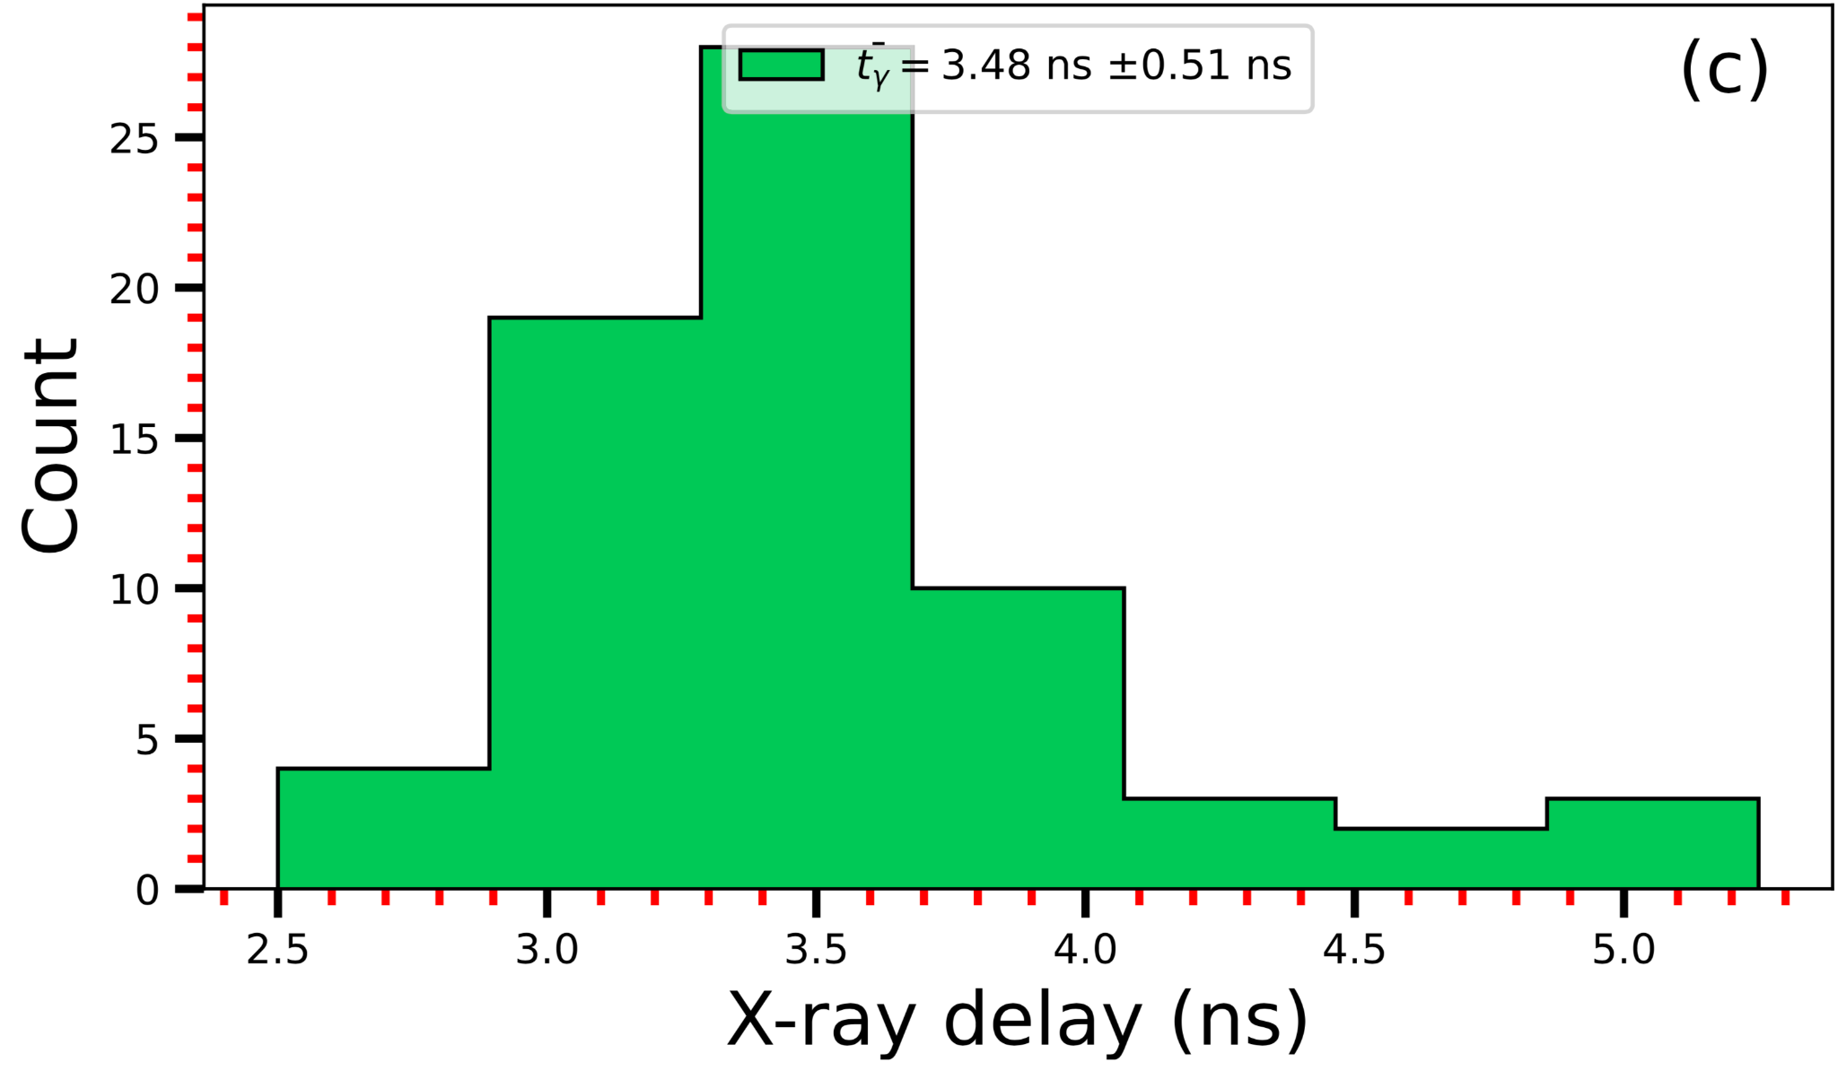
Production of runaway electrons during the streamer inception phase
N = 148
Luis Contreras-Vidal et al 2023 J. Phys. D: Appl. Phys. 56 055201

Slide 5
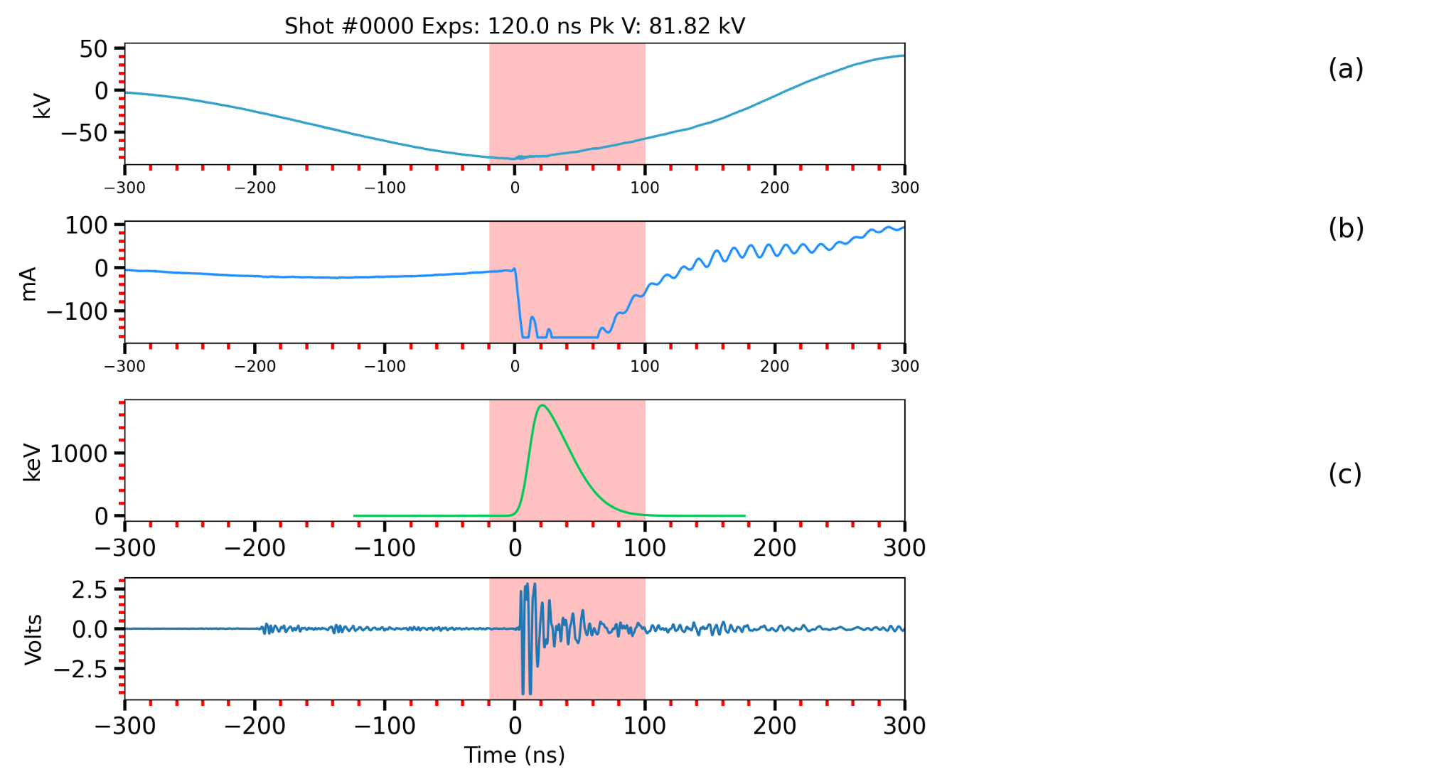
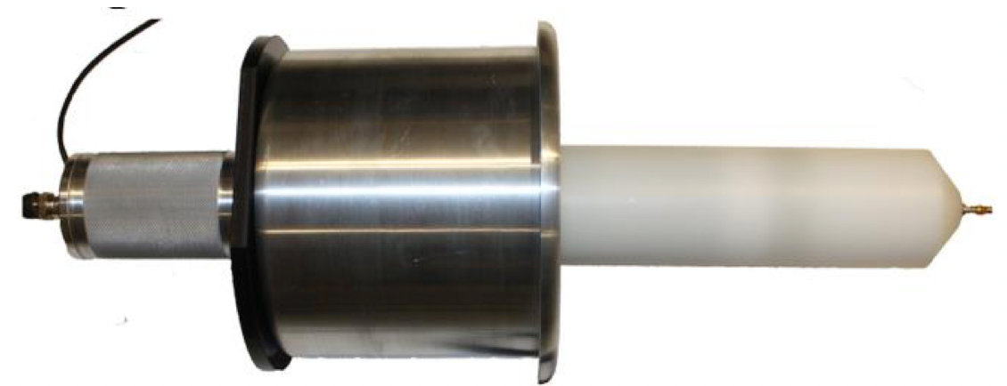
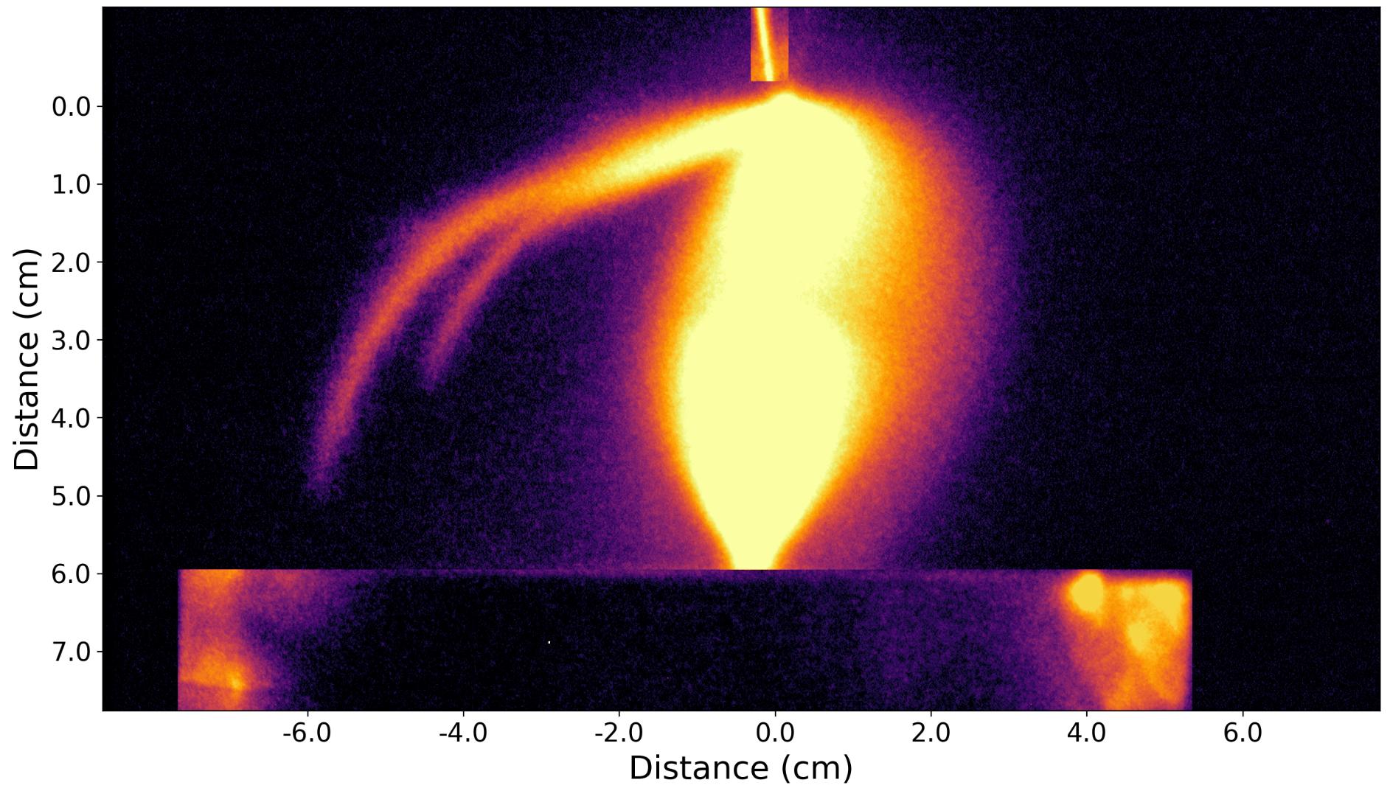
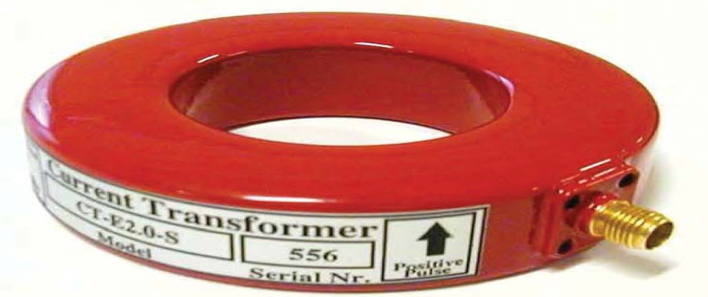
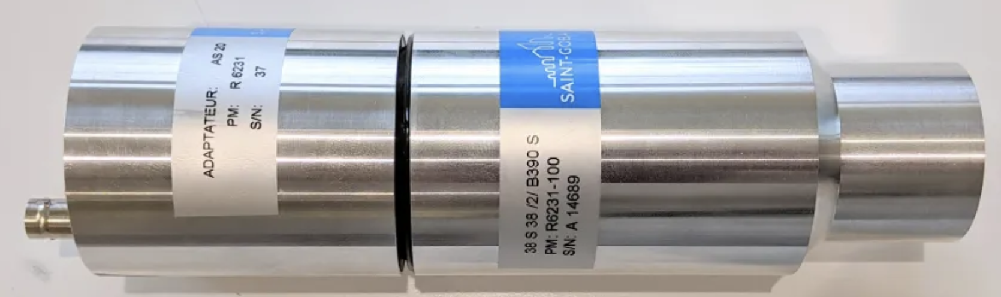
Negative discharge dynamics: Long exposure
Exposure time

Slide 6
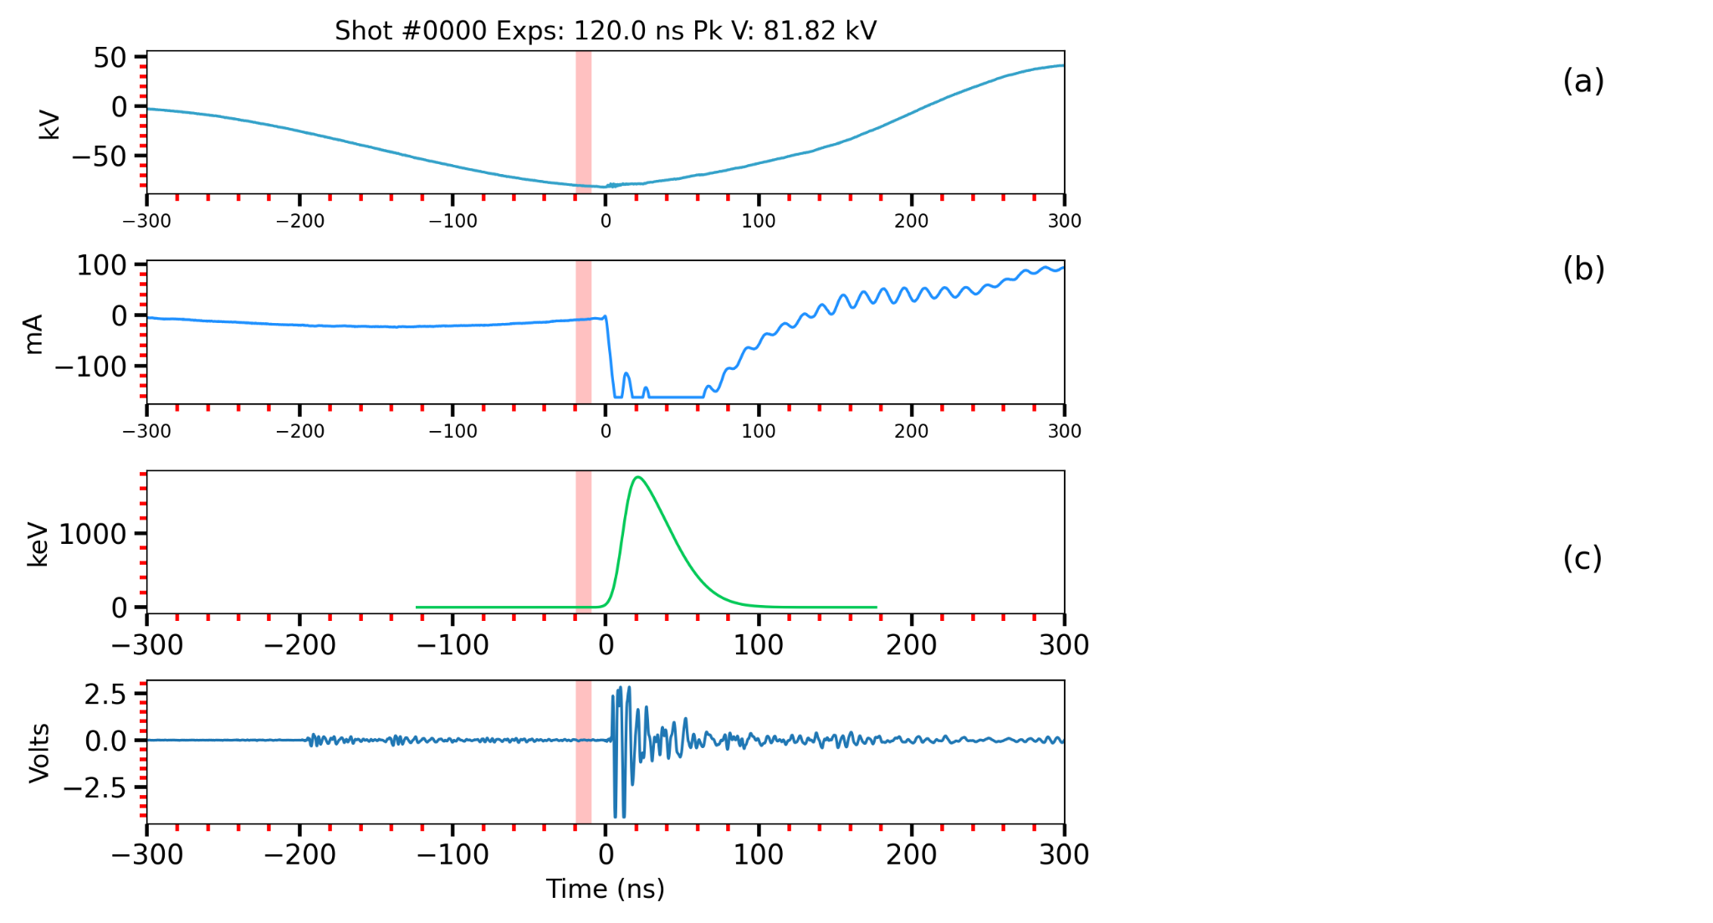
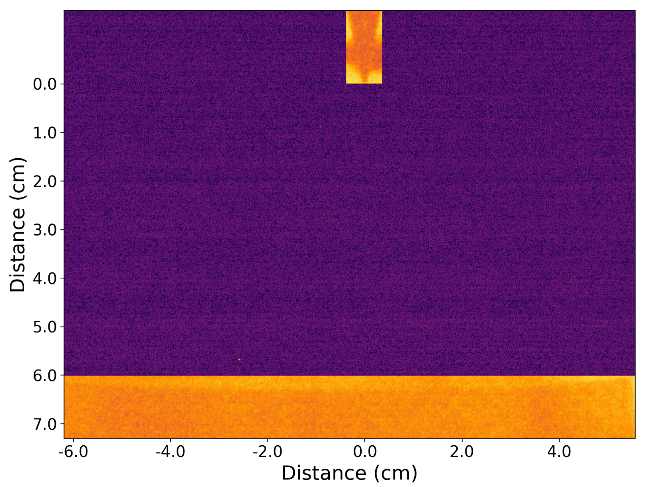
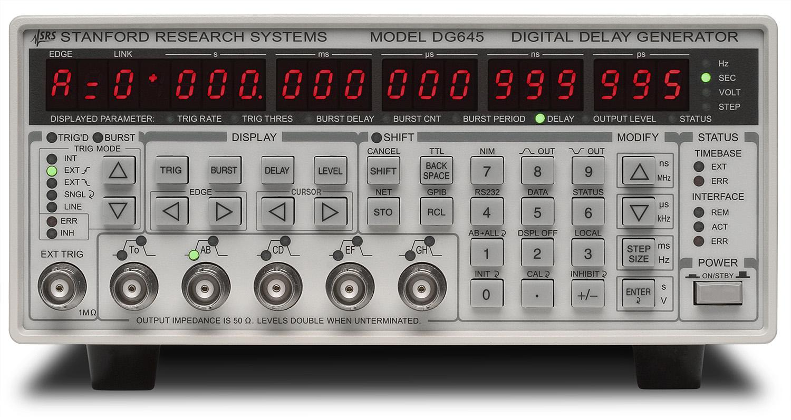
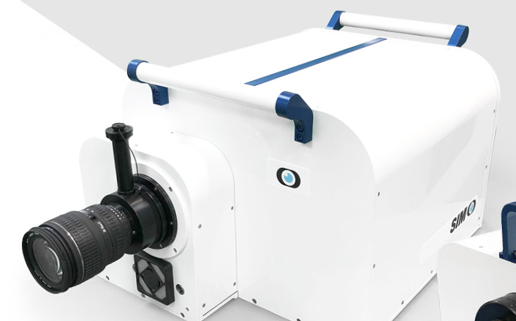
Negative discharge dynamics: Timelapse
–HV electrode
Ground electrode
SIMX

Slide 7
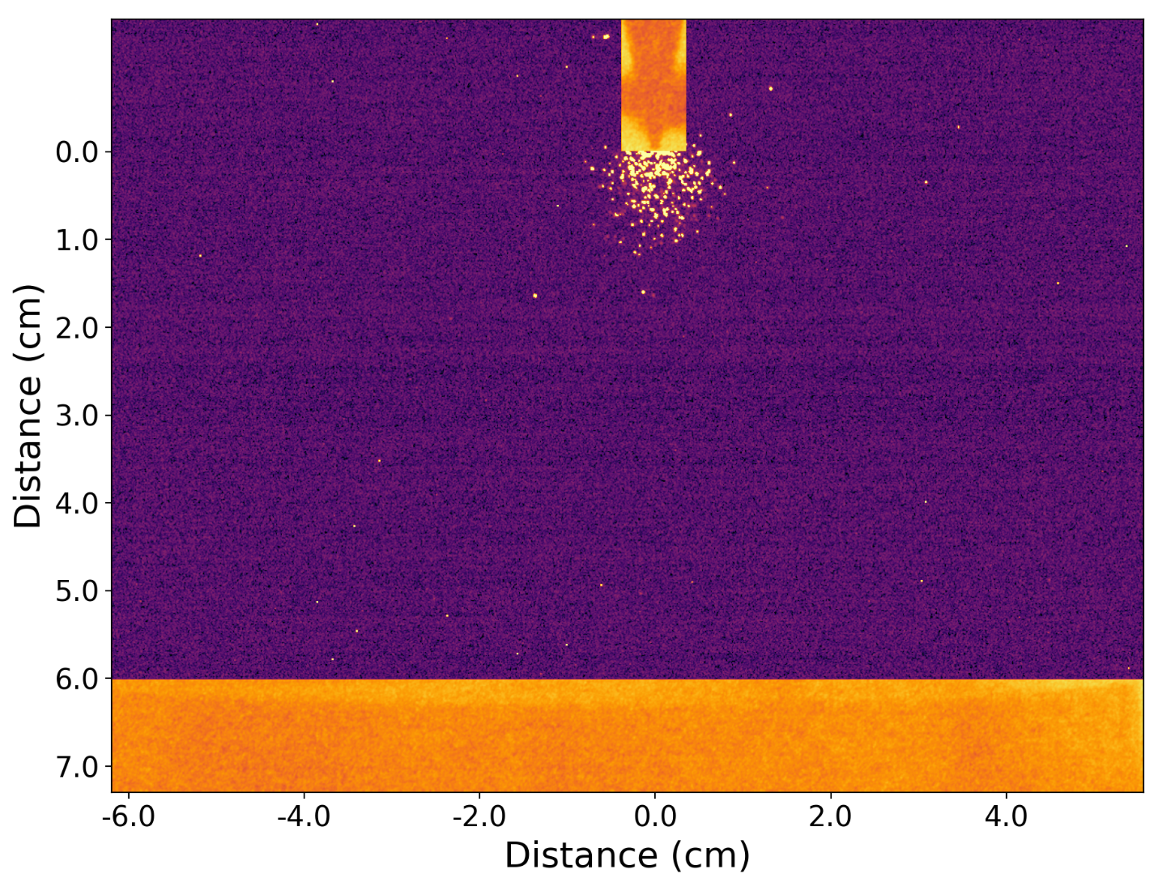
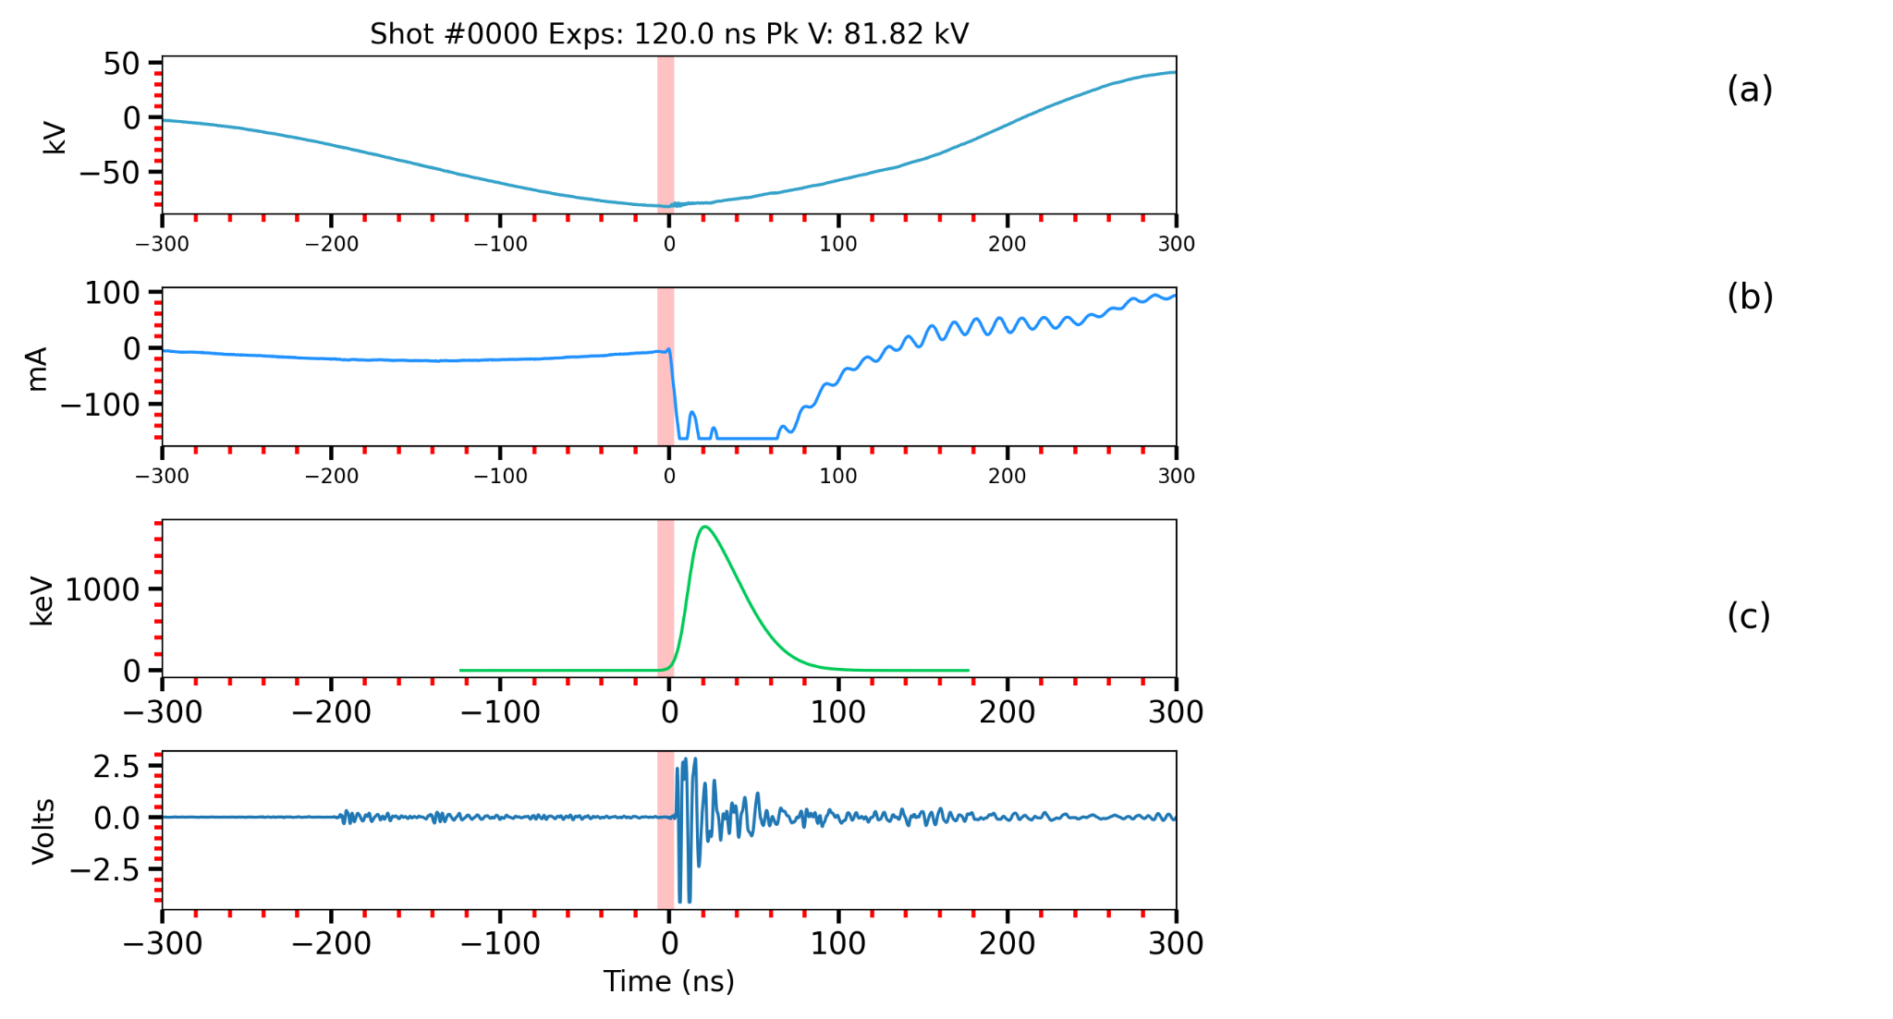
Negative discharge dynamics: Timelapse
SIMX

Slide 8
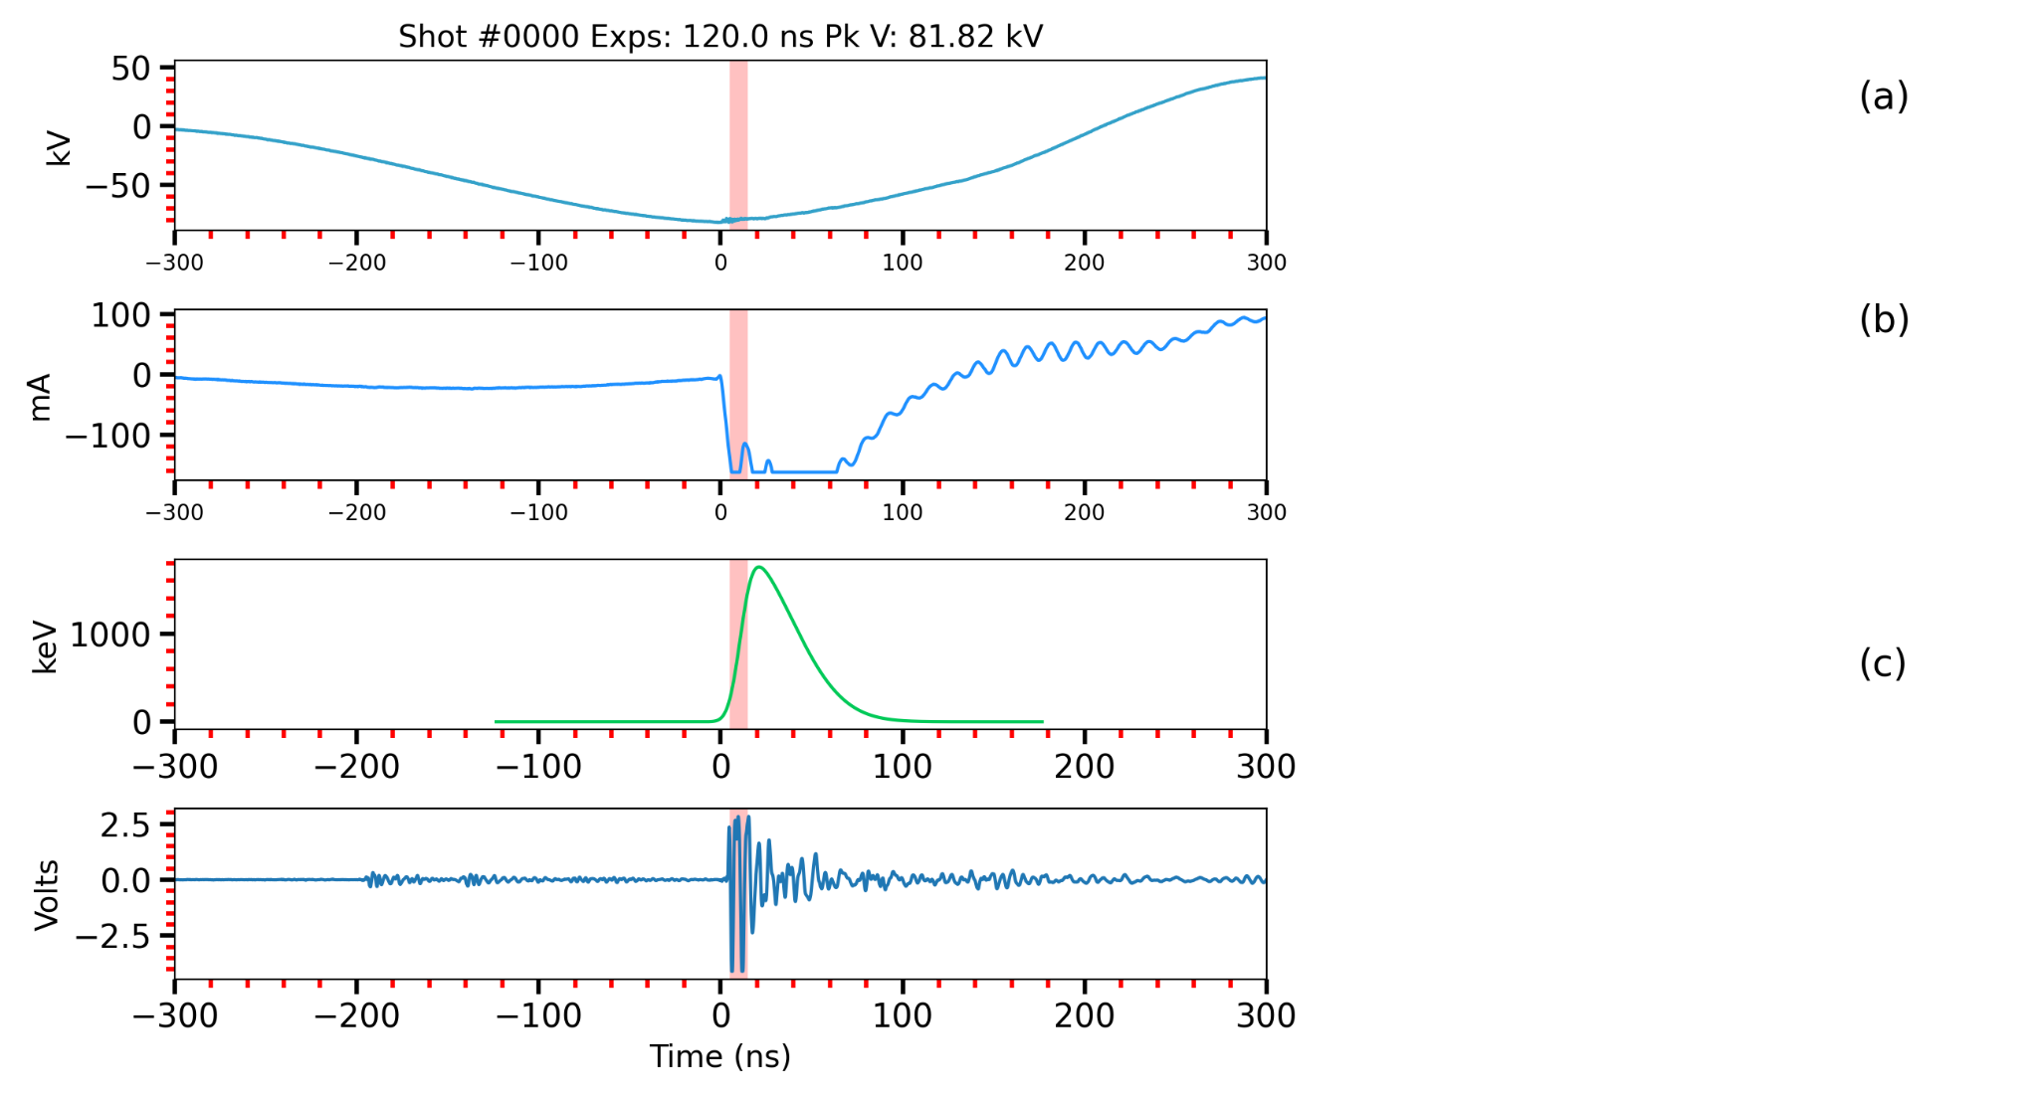
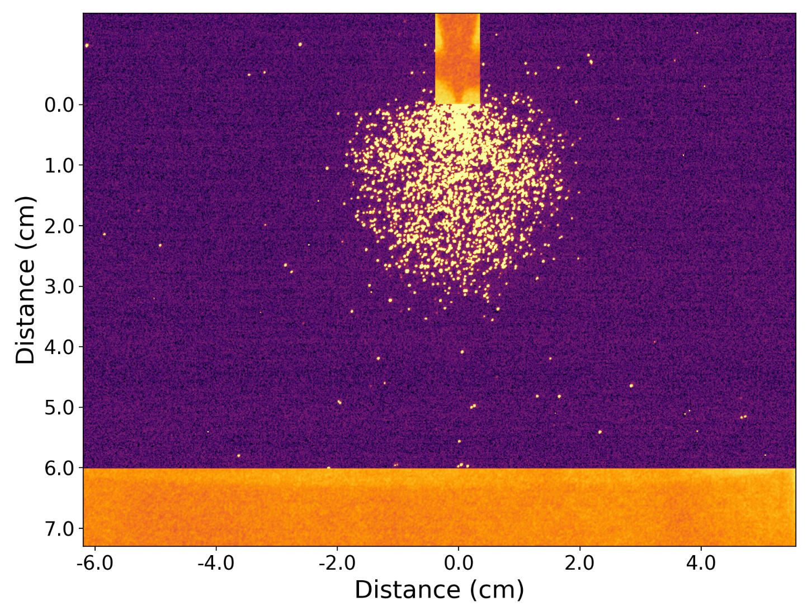
Negative discharge dynamics: Timelapse
SIMX

Slide 9
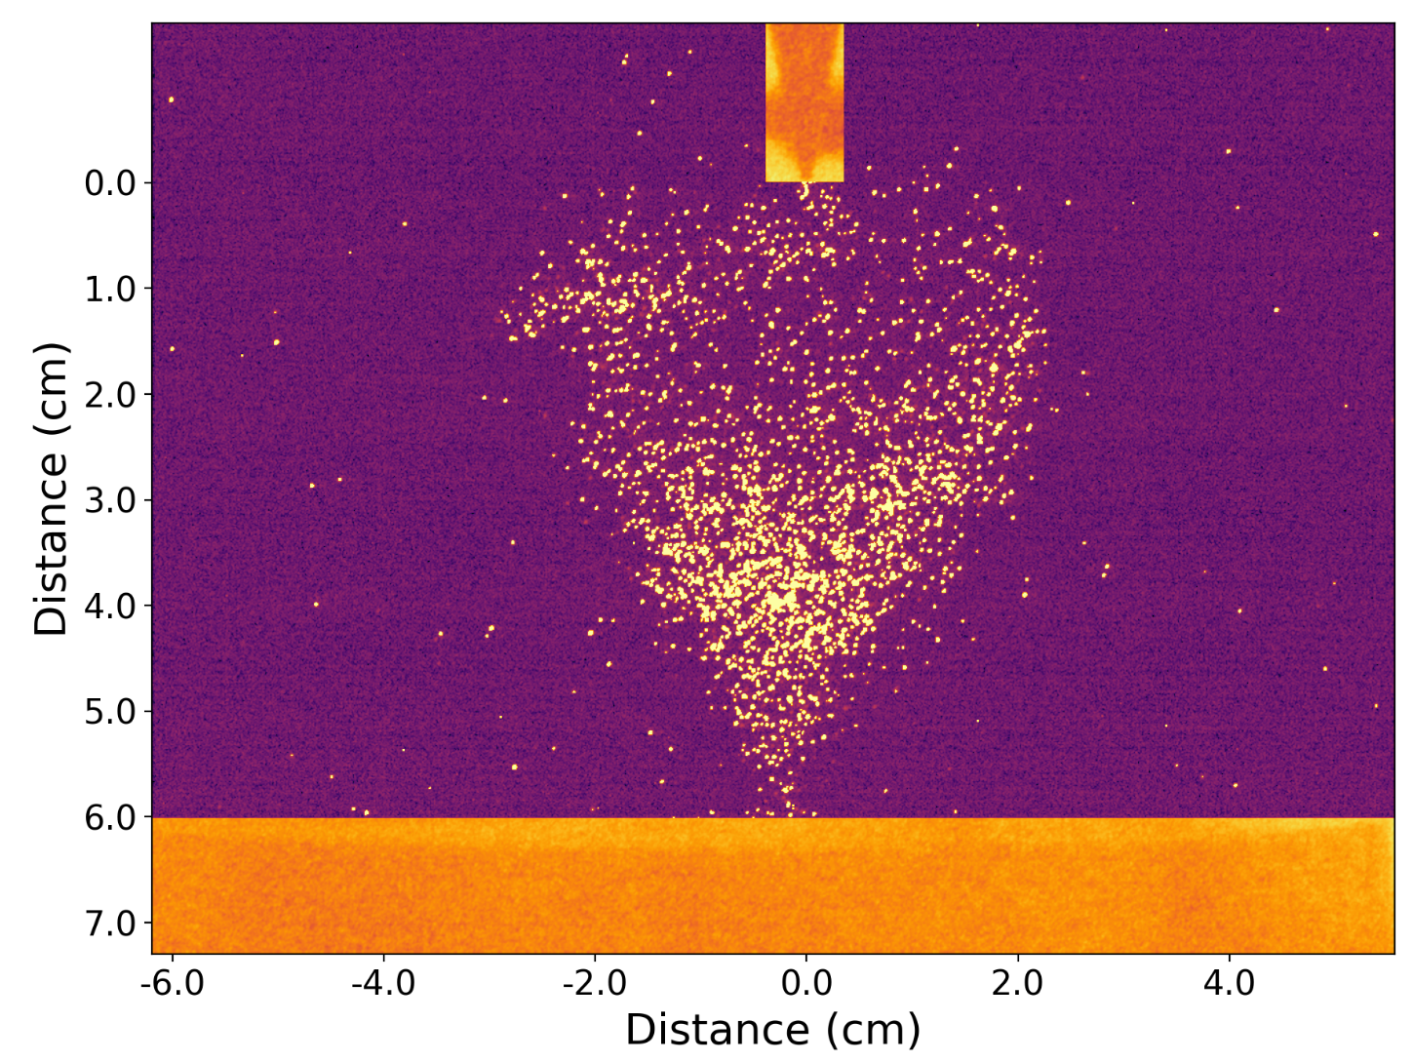
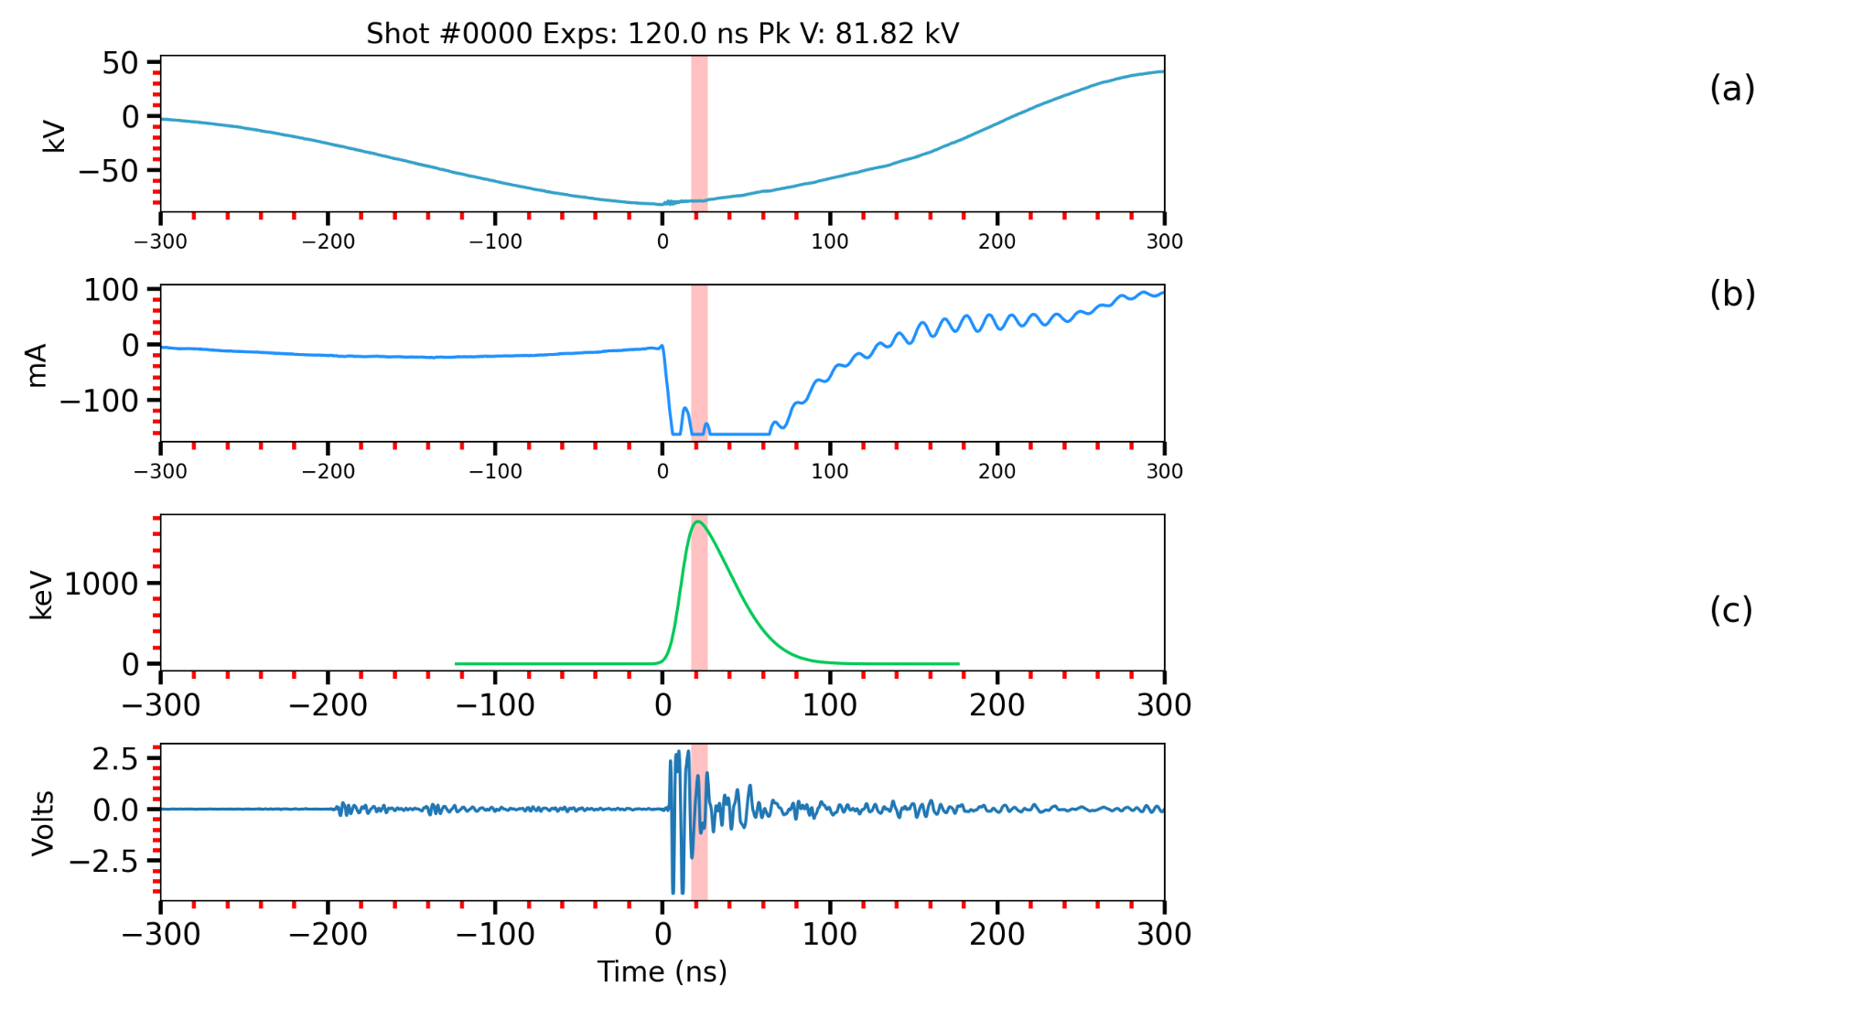
Negative discharge dynamics: Timelapse
SIMX

Slide 10

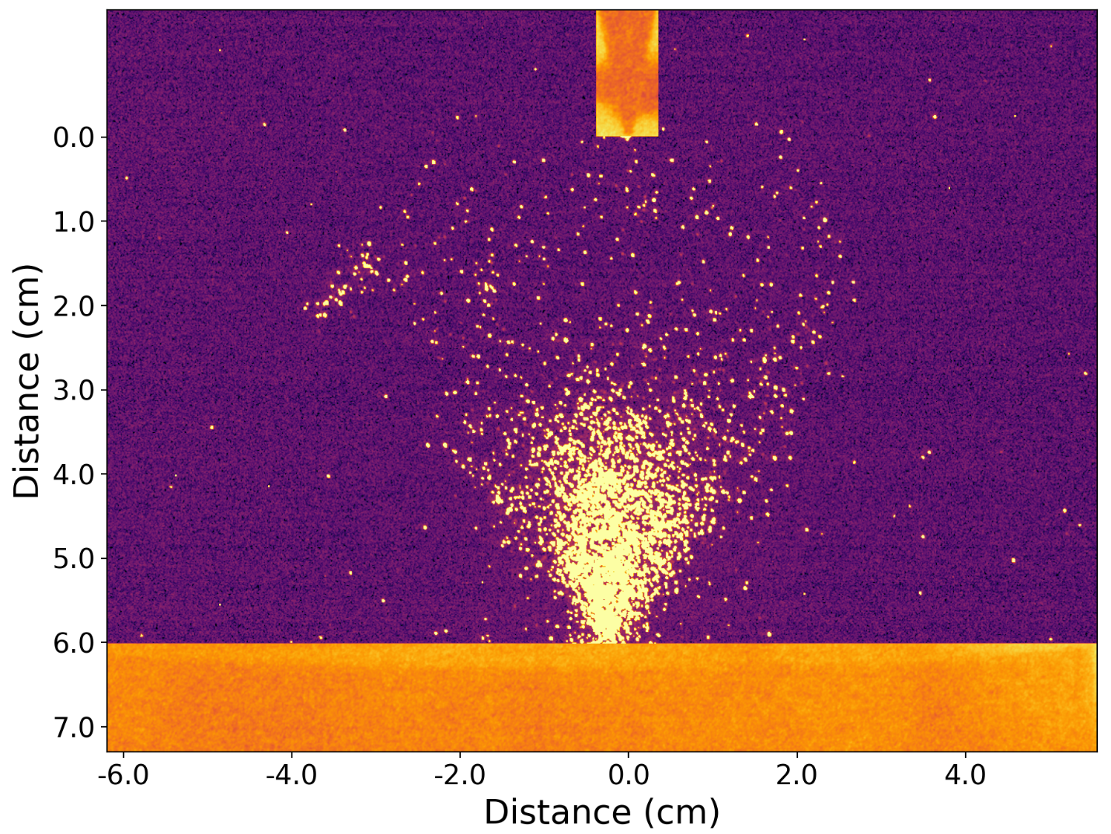
Negative discharge dynamics: Timelapse
SIMX

Slide 11
Negative discharge dynamics: Long vs short exposure
SIMX

Slide 12
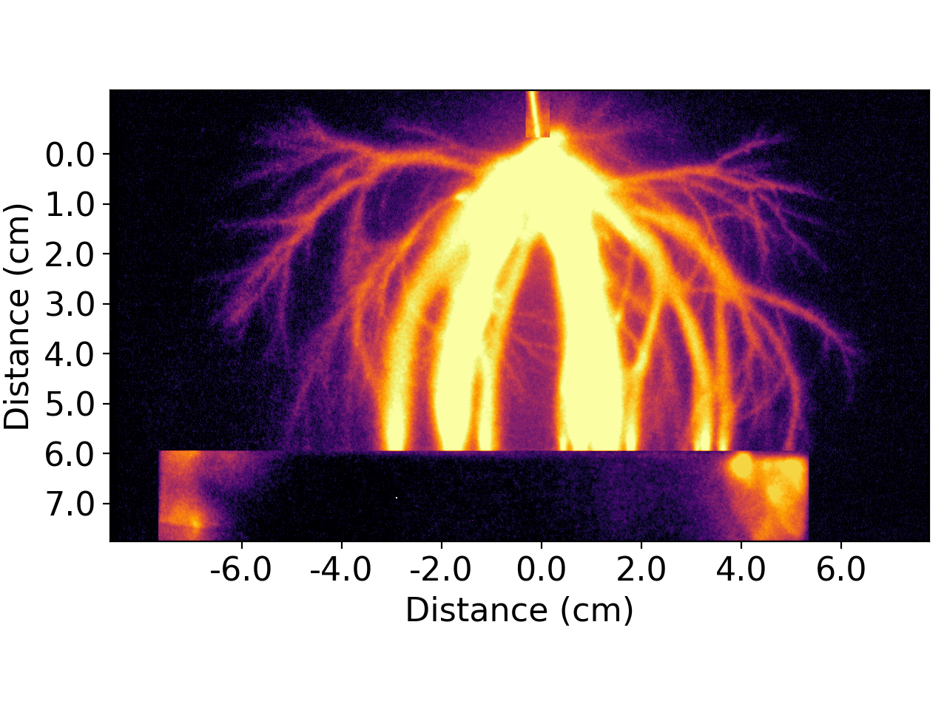
Positive vs negative discharge dynamics:
Positive
Negative

Slide 13
Summary and conclusions
Runaway electrons are produced early on during the streamer inception phase. Therefore:
  Runaway electrons may influence the discharge development; &
  No complex mechanisms are necessary to explain their production.
Positive discharges do not produce X-rays and have different morphological features.
Acknowledgements: This research has been primarily supported by NSF Grant AGS-1917069 to New Mexico Tech. The Spark Lab was largely built via DURIP Grant FA9550-19-1-009 from the Air Force Office of Scientific Research.

Slide 14
References
Cooray, et al. (2009). On the possible origin of X-rays in long laboratory sparks. Journal of Atmospheric and Solar-Terrestrial Physics,
Ihaddadene, et al. (2019). Modeling of a new electron acceleration mechanism ahead of streamers. Journal of Geophysical Research: Space Physics.
Petrov, N.I. Synchrotron mechanism of X-ray and gamma-ray emissions in lightning and spark discharges. Sci Rep 11, 19824 (2021).
Luis Contreras-Vidal et al. (2023) . Production of runaway electrons and x-rays during streamer inception phase. J. Phys. D: Appl. Phys. 56 055201
Sander Nijdam et al. (2020) The physics of streamer discharge phenomena. Plasma Sources Sci. Technol. 29 103001

