Slide 1

PRRC Carbon Storage Research Program
William Ampomah, PhD
Assistant Professor- Petroleum Engineering, NMT
Section Head- REACT Research Group, PRRC/NMT
NMT Research Symposium March 1, 2024

Slide 2
DOE Funded Projects- PRRC REACT Research Group
San Juan CarbonSAFE Phase III Project – [$28 Million]
San Juan Basin Fault Characterization Project – [$ 1.5 Million]
Subsurface Stress Characterization Project – [ $ 2 Million]
Basalt CO2 Storage in NM – [$1.2 Million]
Southwest Regional Partnership for CO2 Sequestration [SWP] – [$106 Million]
Carbon Utilization Storage Projects [CUSP-Western US] – [>$17 Million]
Utah CarbonSAFE Phase II - [$320,000]
Four Corners Regional Initiative Project – [$3.1 Million] ~ Starts in Spring 2024
Four Corners Carbon Storage Hub – [$52 Million] ~ Starts in Spring 2024
Permian Carbon Storage Hub – [$5 Million] ~ Starts in Spring 2024
Four Corners Integrated Storage Project – [$1.3 Million] ~ Starts in Spring 2024
Southwest Regional Direct Air Capture Hub– [$2.5 Million] ~ Starts in Spring 2024
Hydrogen Subsurface Engineering Solutions – [1.2 Million] ~ Starts in Summer 2024

Slide 3
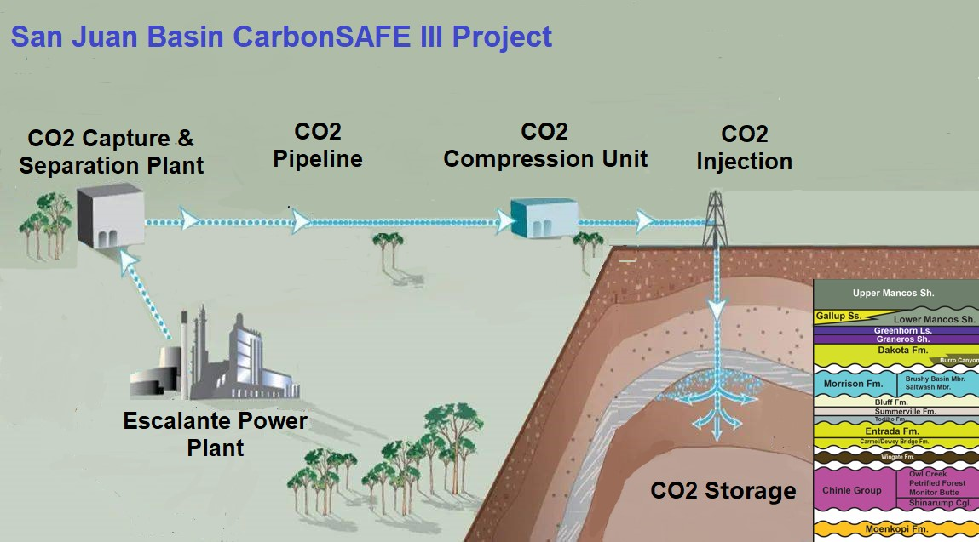
Overview of Carbon Storage

Slide 4
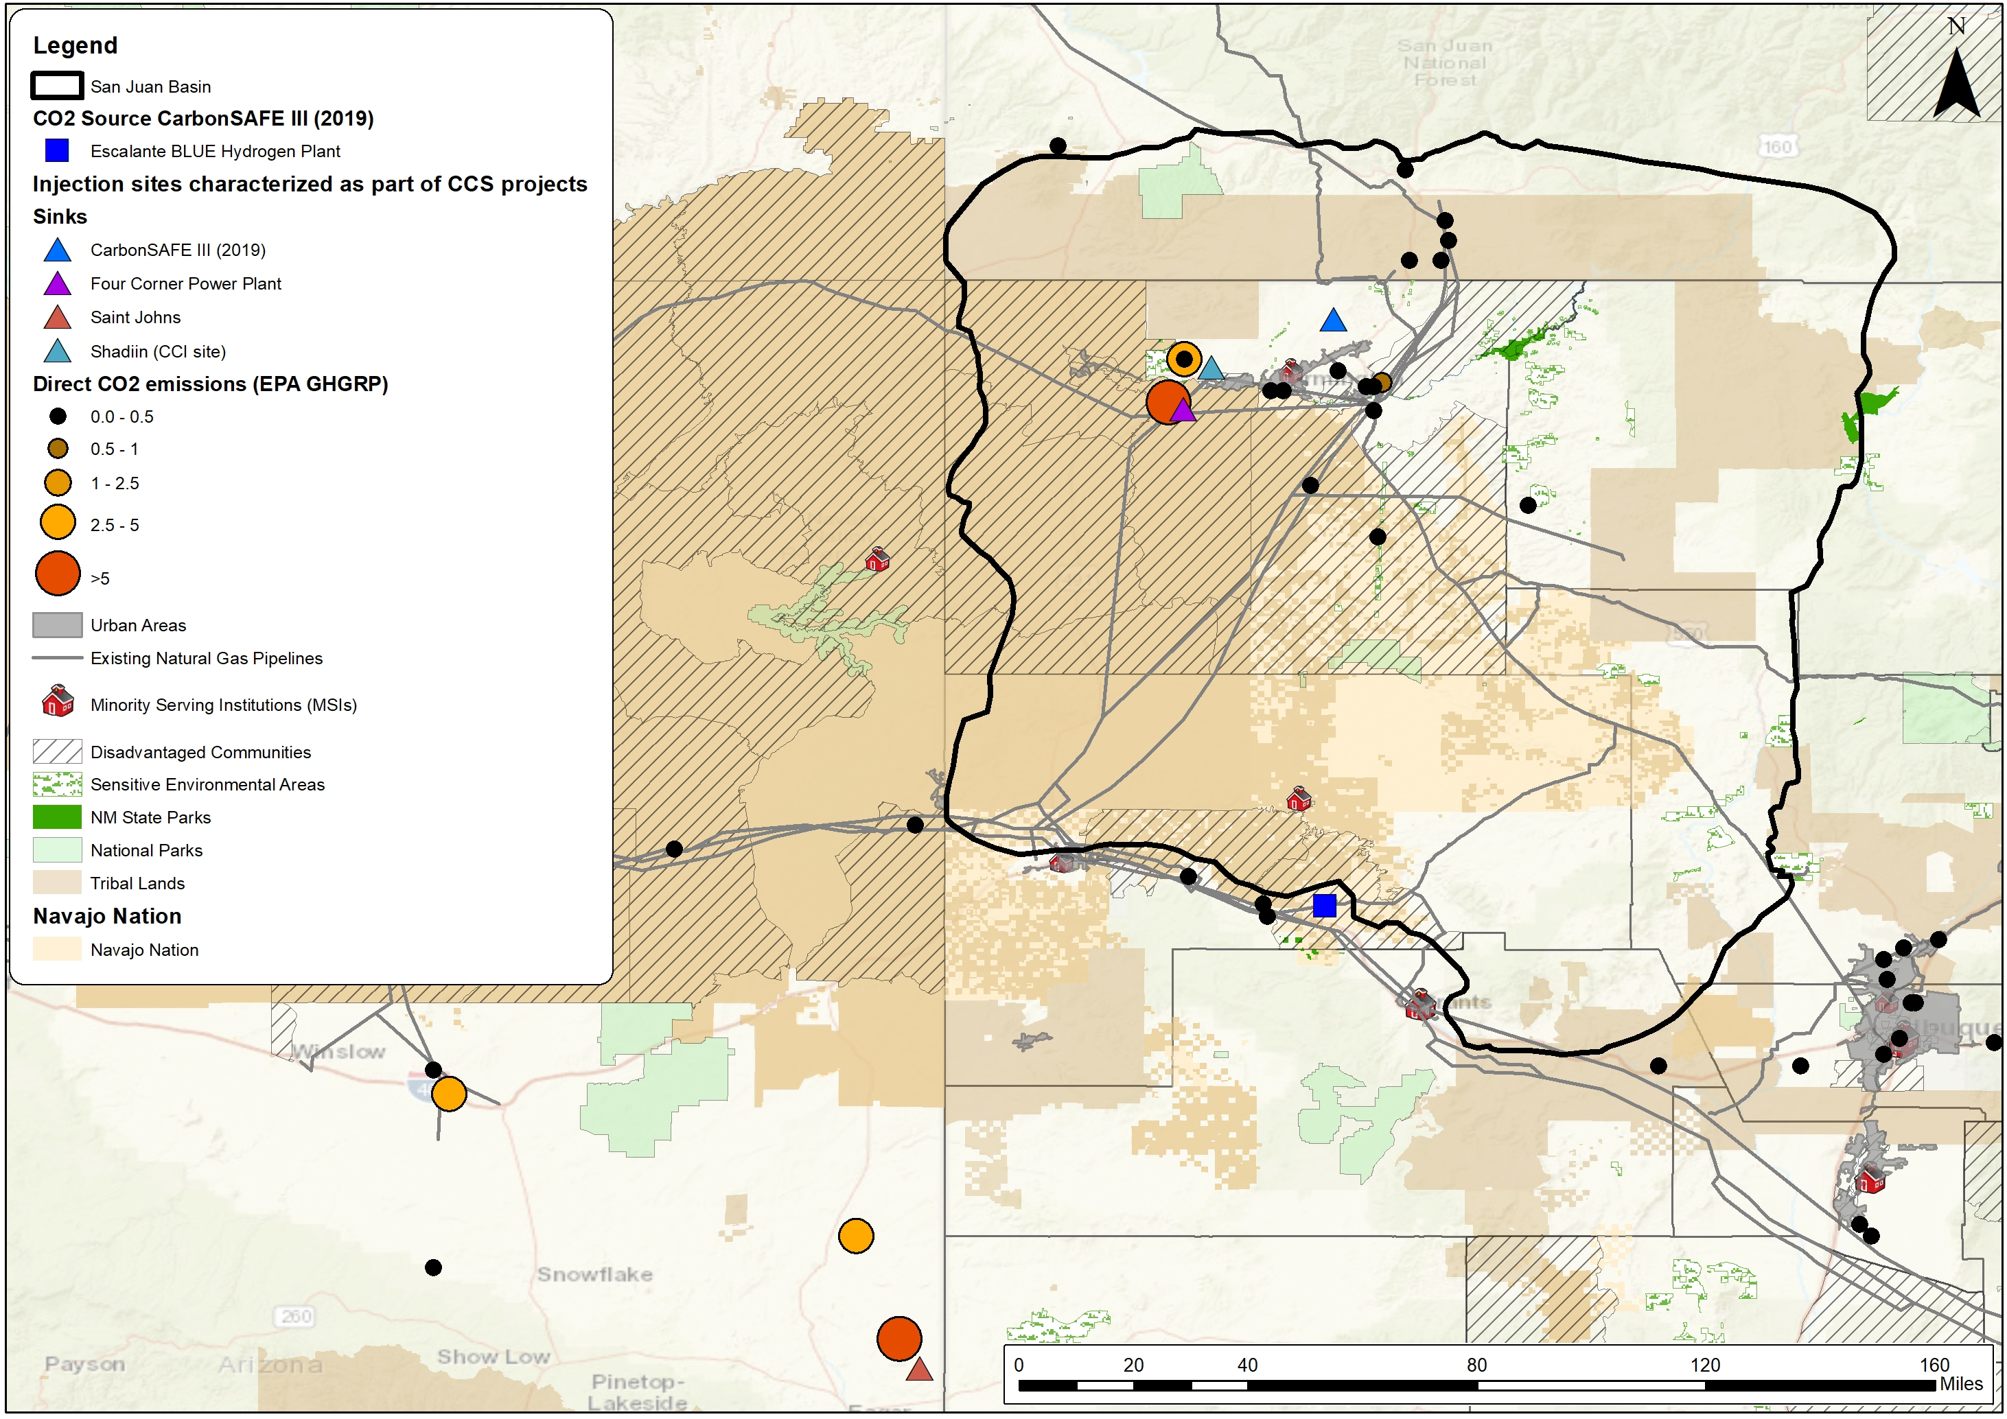
Overview: PRRC-NMT Carbon Storage Program
SJB CarbonSAFE Phase III project
Four Corners Carbon Storage Hub
Four Corners Power Plant Integrated CCS Project
Southwest DAC Hub
Four Corners Regional Initiative

Slide 5
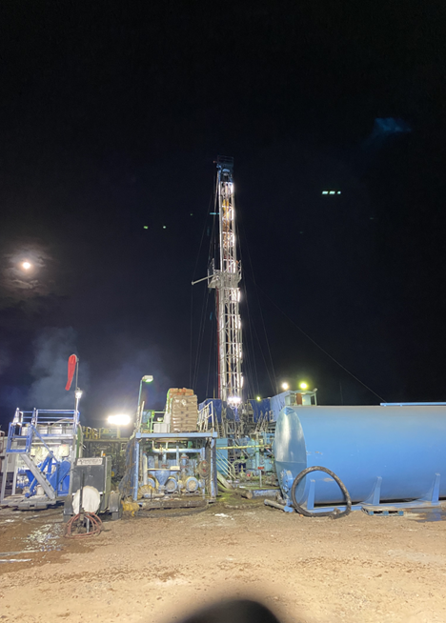
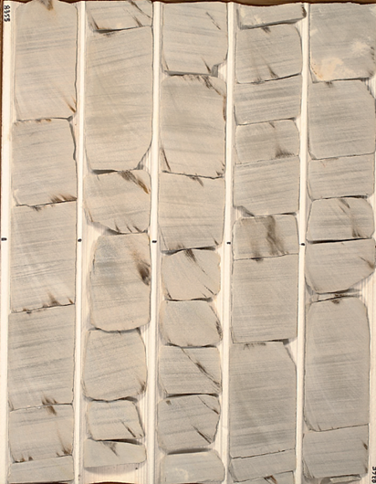
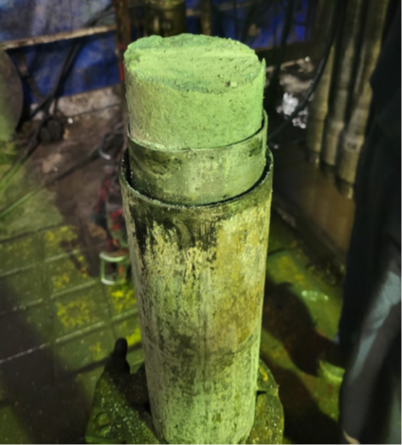
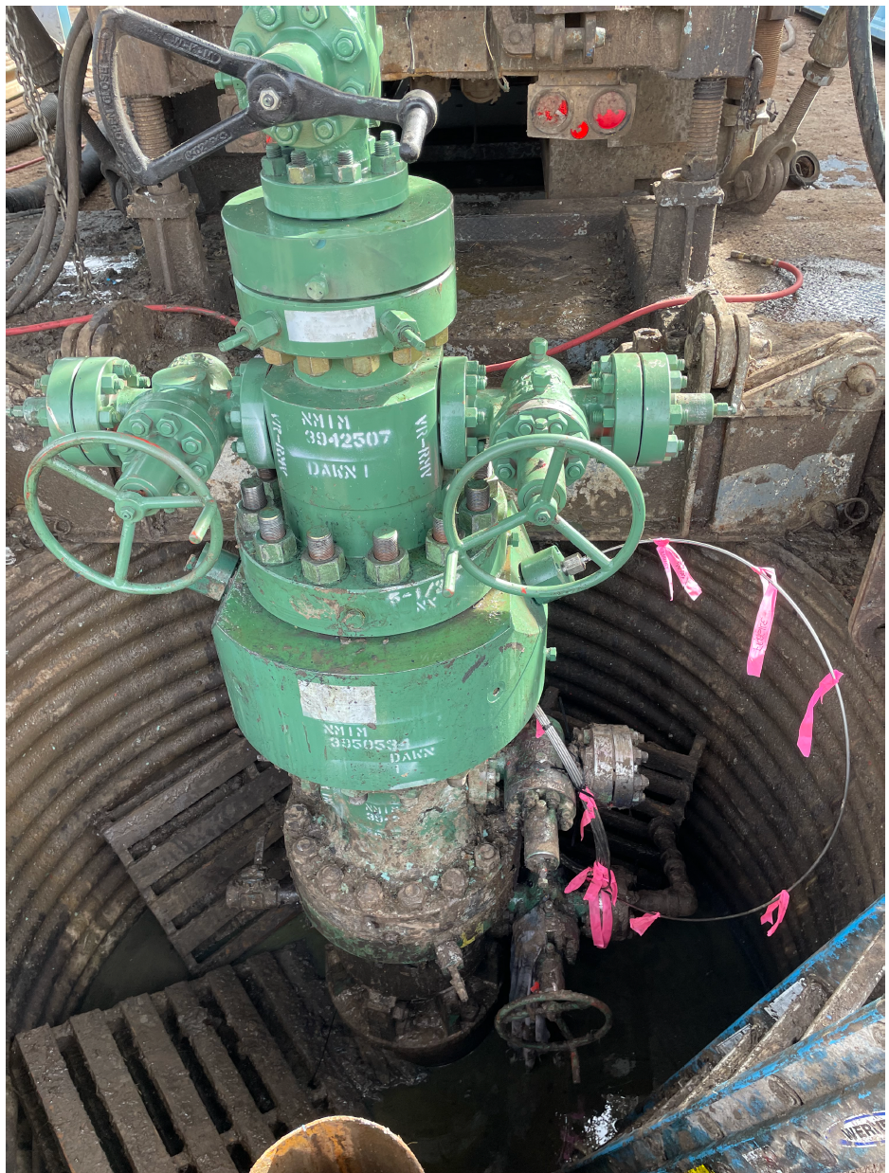
SJB CarbonSAFE Project
Key Project Facts
Funding: $28 Million Project
Perform Site Characterization of storage complex within San Juan Basin
Source CO2 from Escalante H2 plant, located in Prewitt, NM, USA.
Initial UIC Class VI permit submitted in 2023
Community and stakeholder outreach on CCS technology and its benefits
Characterization Plan
Drilled characterization well, perform injectivity tests
Recovered ~ 450 ft of Core, sampled drilling cuttings, advanced log suites measurements
Perform suites of laboratory experiments and numerical models
Purchased 100 sq.miles 3D seismic, acquire 3D VSP,
Installed DAS/DTS/DSS Optical fiber behind casing

Slide 6
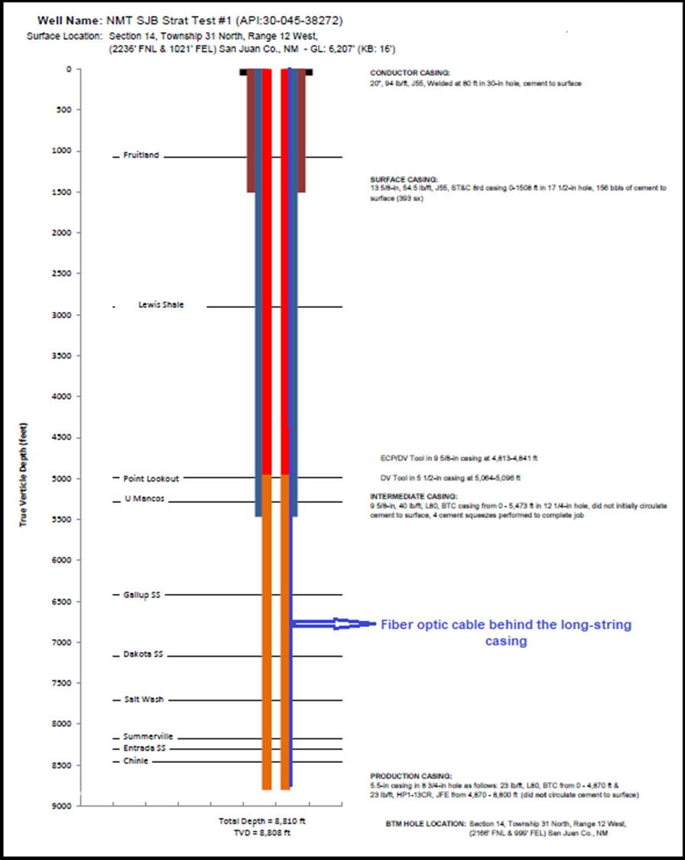
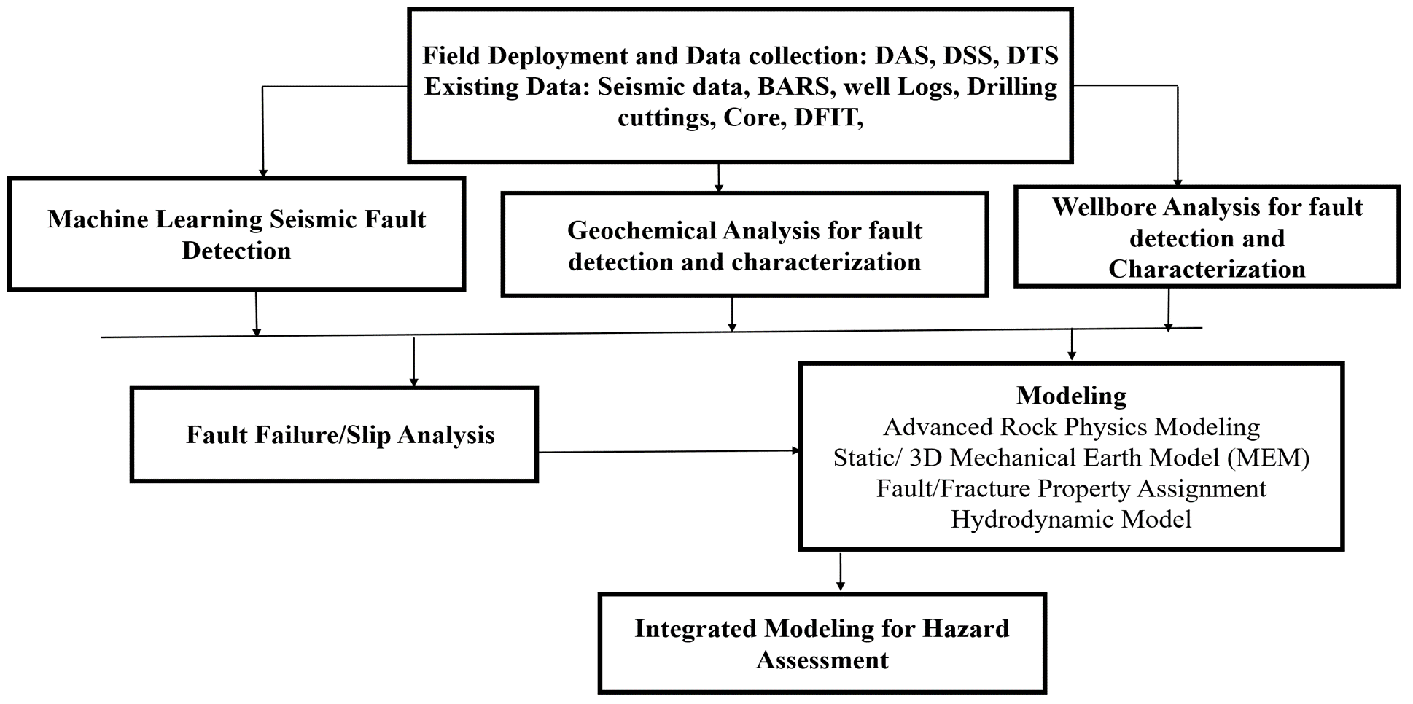
Fault Characterization Project
Project workflow

Slide 7
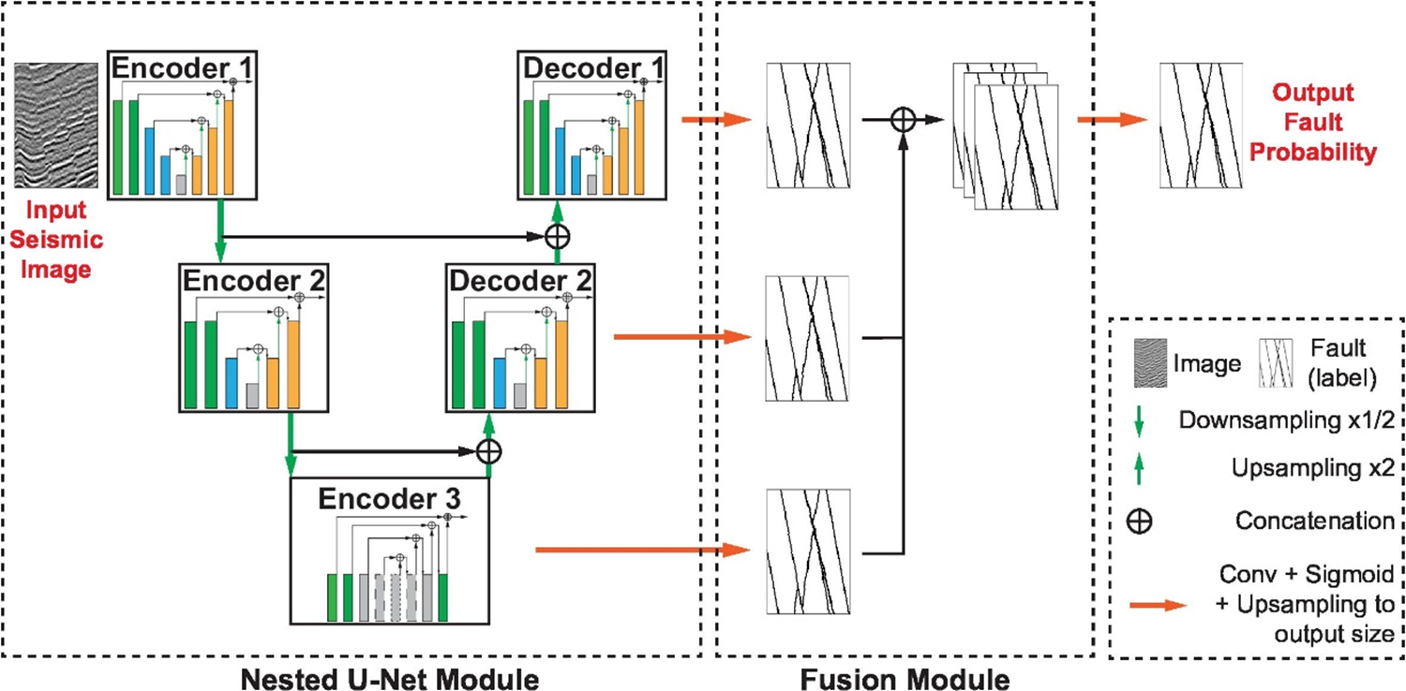
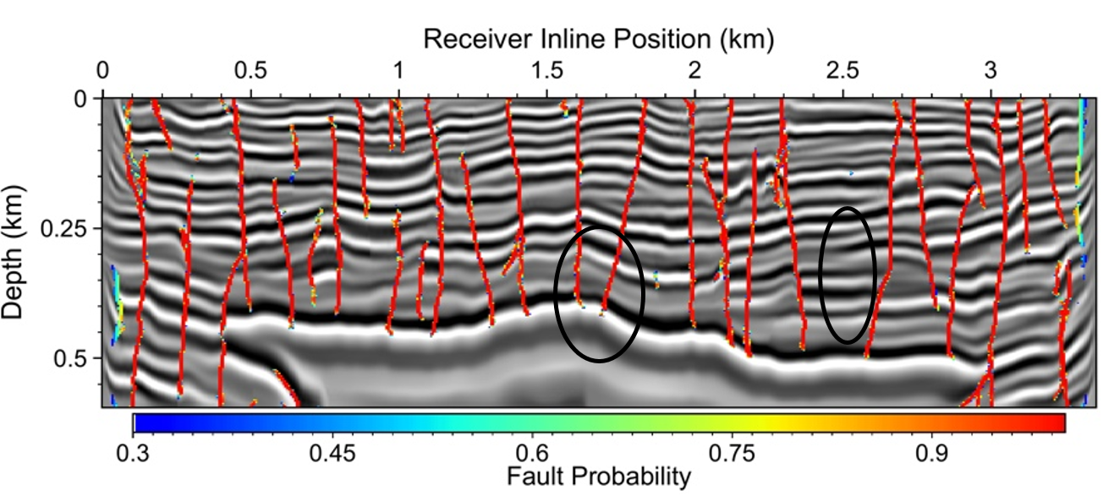
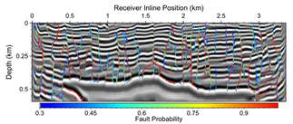
Fault Characterization Project- Machine Learning
Architecture of multiscale connection-fusion convolutional neural network method (MCFU).- Gao, Huang, Zheng, 2022
Fault Segmentation from Seismic Image via MCFU
Technology Advantages
Improved in Faults Detection
Reliable Large-scale Fault Mapping
Enhanced cost efficiency
Ant tracking

Slide 8
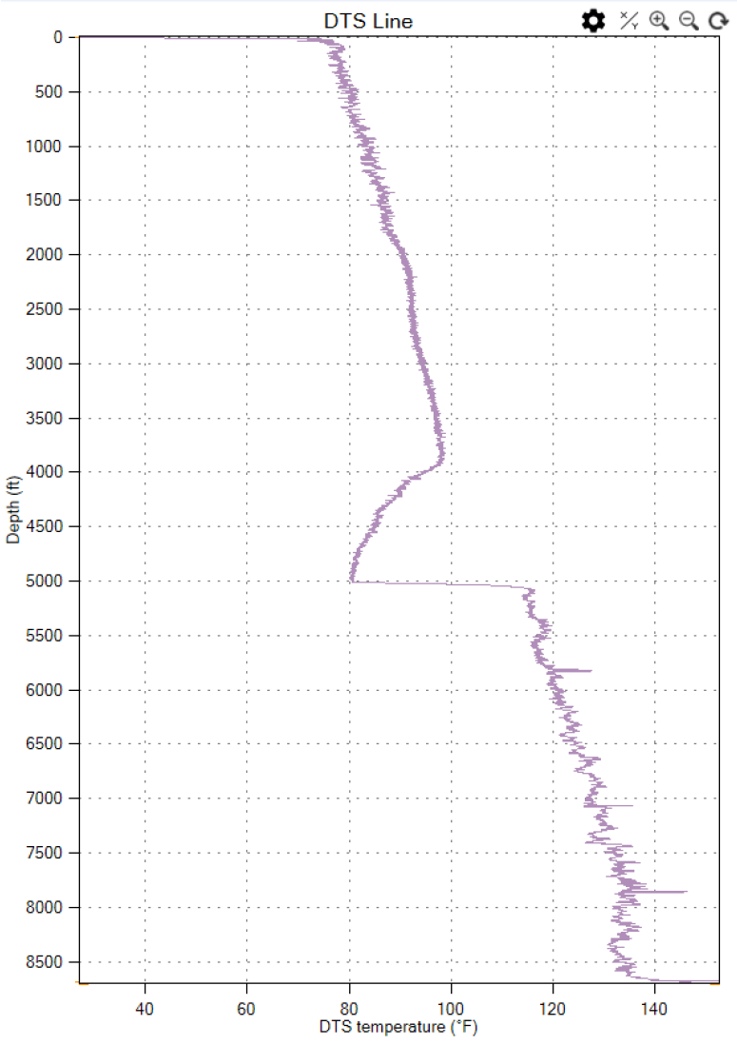
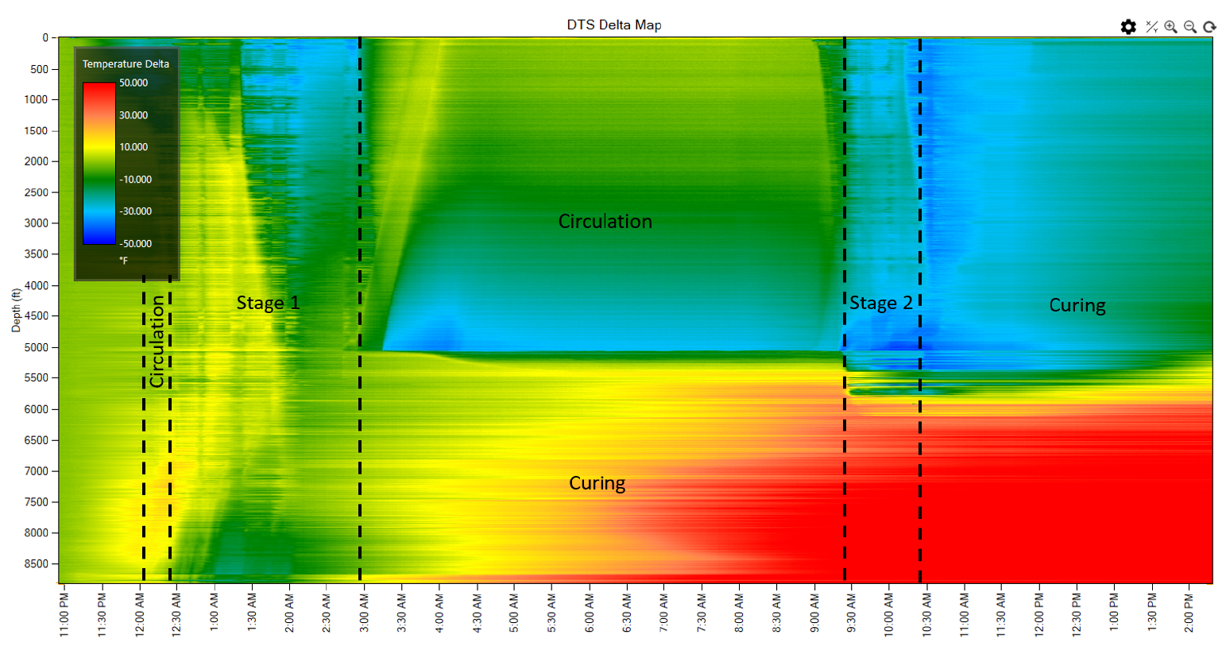
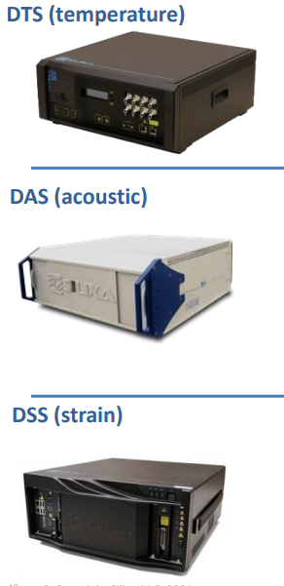
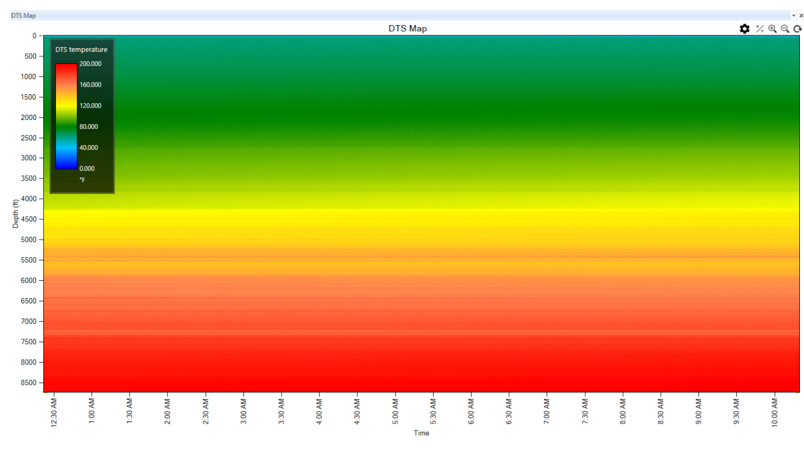
Fault Characterization Project- Fiber Optic Technology
Monitoring Solutions
Data Interpretation
Assess Risks
Faults/Fractures Detection and Characterization
Matrix/Fractures/ Faults Geomechanical Properties Evaluation
Micro-seismicity Monitoring
After several weeks of curing

Slide 9
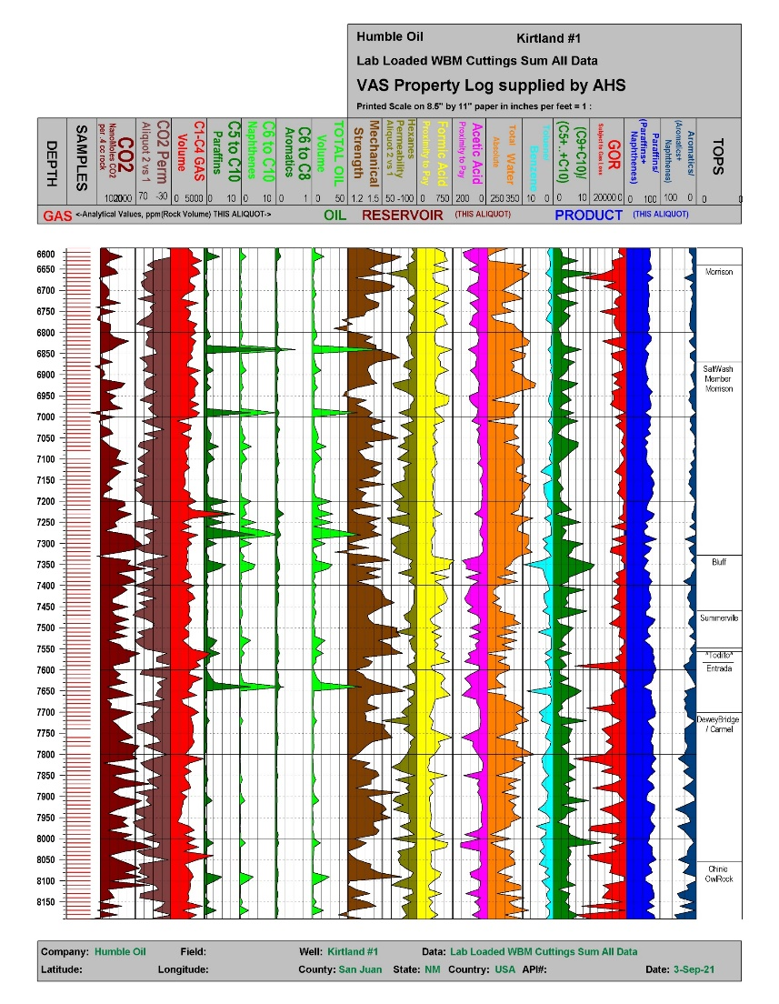

Fault Characterization Project- Geochemistry
Analyze Rock Volatiles Analyze Nearby Well Assess Risks
Humble Oil - Kirtland 1
San Juan Co. NM (1961)
Faults/Fractures
Fault Activating
Fluid Conduits
CO₂ Seals
CO₂ Permeability
Past CO₂ Loss
Future CO₂ Loss
Kirtland 1; 14 miles SSW of CarbonSAFE1 Site

Slide 10
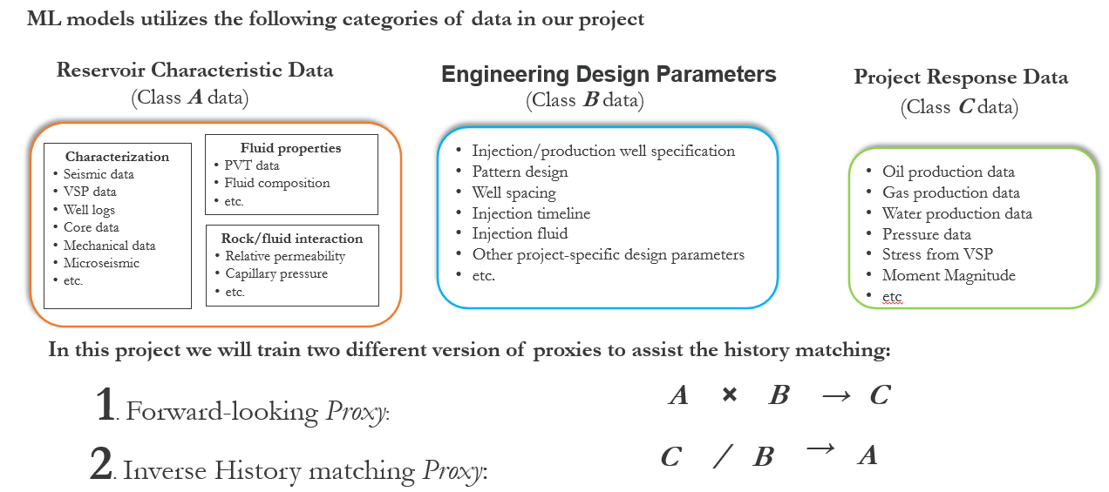
Application of Machine Learning in Simulation Modeling

Slide 11
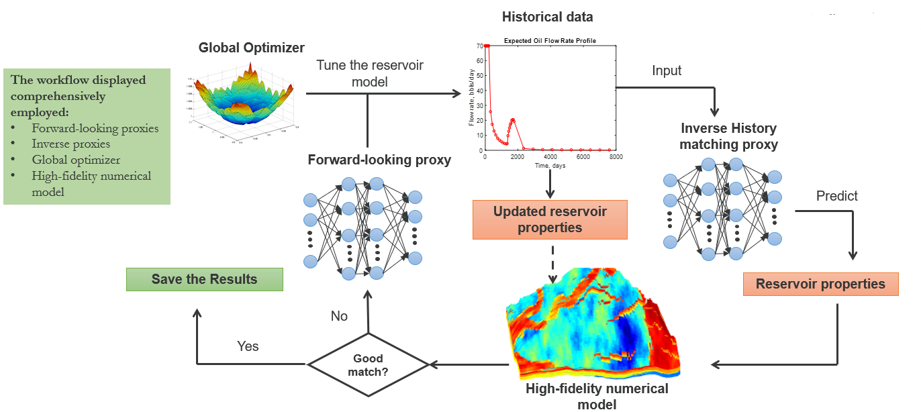
Application of Machine Learning in Simulation Modeling

Slide 12
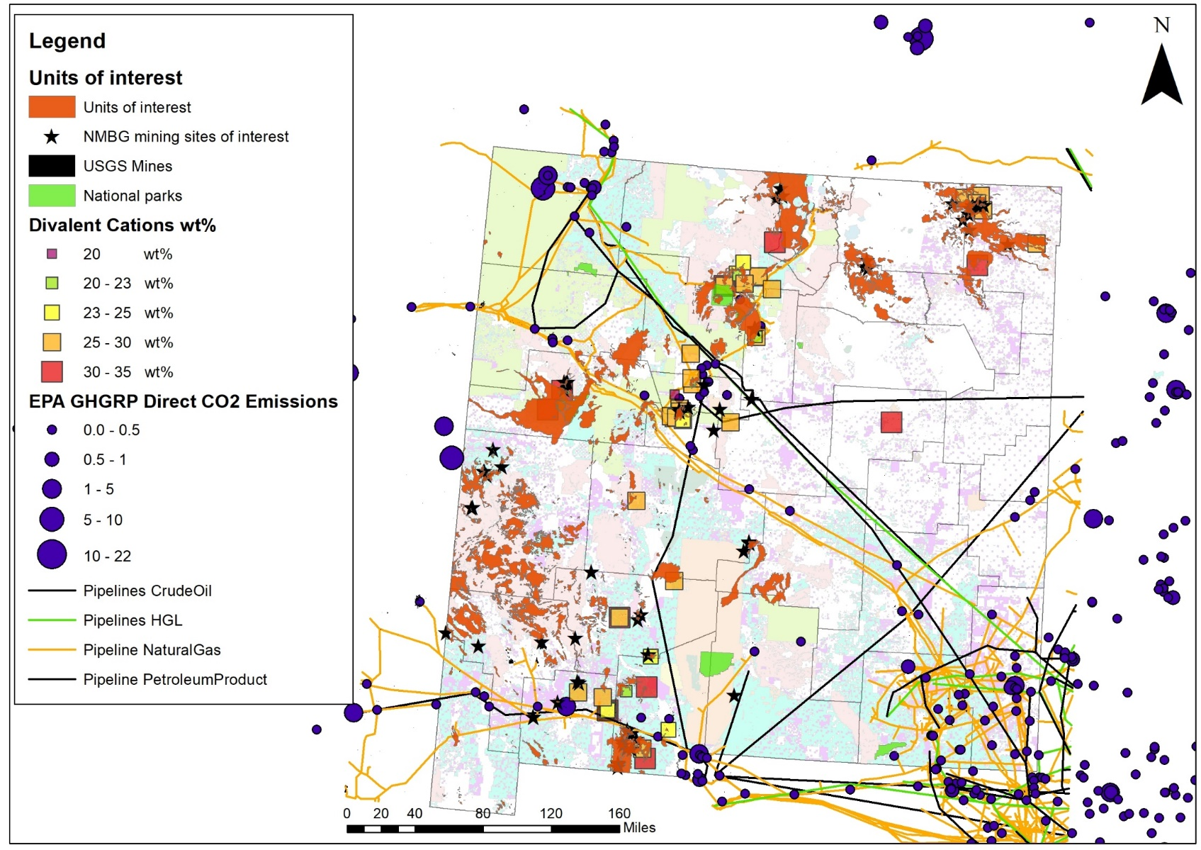
Basalt Storage Project
PI: Dr. Sai Wang, PRRC
Funding: 1.2 Million
Project Overview
Overall Objective:
Identify and access statewide resources for potential CO₂ storage via mineralization processes, including mafic/ultramafic formations (basalts), stratigraphic units, and mining wastes in New Mexico.
Targeted Storage Sites:
Identify and characterize potential storage sites/complexes to determine storage capacity.

Slide 13
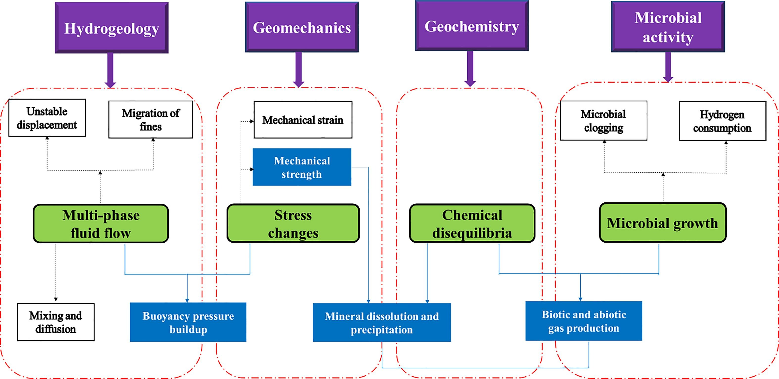
PRRC Hydrogen Subsurface Research

Slide 14
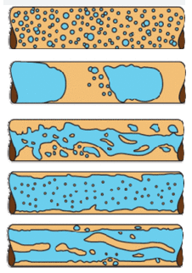
ARPA-E – DOE sponsored project
Recipient: New Mexico Tech (PI: Robert Czarnota)
Sub-recipient: Sandia National Laboratories
Award: $1,200,000
Timeline: 2 years (kick-off in May 2024)
Project Title: Subsurface Engineering Solutions and Management for Sustainable In-Situ Hydrogen Production and Economic Extraction
Summary: New Mexico Institute of Mining and Technology is developing subsurface engineering approaches for geologic hydrogen reservoir management, including ways to mitigate the risk of induced seismicity and hydrogen leakage. In addition to conducting laboratory experiments to explore hydrogen generation rates from ultramafic rocks and transport using steam (multiphase flow), the team will test methods to estimate rock volume expansion and identify ecological indicators of hydrogen leakage.
Complex flow of H2/steam in
tight channels of porous media

Slide 15
Four Corners Carbon Storage Hub
$52 Million Project
Develop 3 storage sites in the San Juan Basin to store at least 50 million tons of CO2
Drill two stratigraphic wells to collect subsurface data
Acquire about 1000 ft of Core for analysis
Perform detailed experimental and numerical analysis on acquired data
Prepare and submit UIC Class VI applications for 3 sites

