Slide 1
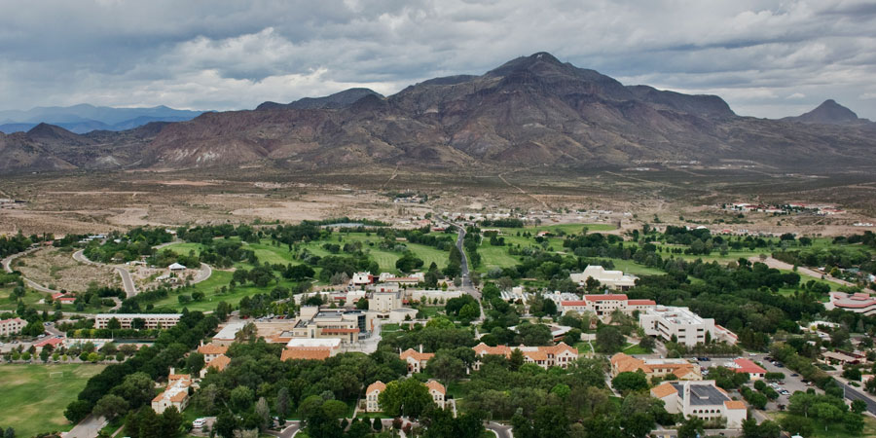
Ignite
New Mexico Tech
A collaborative vision grounded in STEM research leadership, access, and partnership
Research Excellence, Innovation and Opportunity
New Mexico Tech has strong assets—research excellence, national partnerships, and a distinctive identity. This moment calls for alignment, trust, and a clear path forward that connects people, priorities, and purpose.
Montserrat “Montse” Fuentes, Ph.D.
Presidential Candidate
Notes:
Thank the Board of Regents and the New Mexico Tech community. Express admiration for the institution’s impact in science and engineering and outline that the talk will cover who you are, what you bring, and your vision for the future of New Mexico Tech.

Slide 2
Who I Am
WHO I AM
Scholar, president, and collaborative builder of research-centered institutions
Executive leadership across research universities
100+
peer-reviewed
publications
President • Provost • Dean • Department Head
St. Edward’s University | University of Iowa | VCU | NC State
8,400+
citations
Scientific credibility
Leadership style
24
PhD students advised
$28M+
Federal grants as PI
Ph.D. in Statistics, University of Chicago (Argonne National Lab)
Postdoctoral research at NCAR
Visiting scientist at EPA's Atmospheric Modeling Division
Led a strategic partnership with the NSA to establish the Laboratory for Analytic Sciences (LAS) at NCSU
Research supported by NSF, NIH, DTRA, EPA, NASA, and NOAA
Listening-centered, collaborative and transparent
Committed to shared governance and clear, consistent communication
Focused on access, research and academic excellence, and student opportunity
Grounded in partnerships with communities and public stakeholders
A builder of strong board-administration-community relationships
Current role
President, St. Edward’s University
Professor of Mathematics
First-generation college student
Notes:
Brief overview of current role as President of St. Edward’s University and Professor of Mathematics. Mention previous roles as Provost at the University of Iowa, Dean at VCU, and Department Head at NC State.

Slide 3
What I Bring to New Mexico Tech
FIT
Strengths aligned with NMT mission
1
2
3
4
Research university
leadership
STEM and federal
research credibility
Student success
and access
External engagement
and resource growth
Led as president, provost, dean, and department head in complex institutions.
Worked with boards, legislators, local government, industry, donors, and community partners.
Directed an NSF center, worked at NCAR and EPA, partnered with NSA, and built interdisciplinary research capacity and IDC growth
Advanced retention, experiential learning, first-generation success, and Seal of Excelencia student-success work.
Shared governance • academic credibility
Sponsored research • faculty support
Belonging • advising • pathways
Fundraising • visibility • advocacy
Notes:
Highlight research career: over 100 publications, federal funding, interdisciplinary collaborations, and experience working with national laboratories and federal agencies.

Slide 4
New Mexico Tech’s Moment
CONTEXT
A distinctive public STEM institution whose next chapter should be built on research strength and student-centered focus
What stands out to me
My premise
New Mexico Tech is distinctive: a specialized public university combining personalized education with national research impact.
Its identity is rooted in science, engineering, close faculty-student engagement, and hands-on learning.
Its research enterprise, federal connections, and national-laboratory ecosystem are core strategic assets.
Its next chapter depends on aligning and elevating research momentum, student success, partnerships, financial resilience, and a strong sense of community built on trust and shared purpose.
The goal is not to chase an R2 label for its own sake; it is to build the conditions that make research distinction durable: strong faculty and research centers support, effective infrastructure, student talent pipelines, and trusted internal and external partnerships.
Presidential implications
Build a strong community at New Mexico Tech.
Protect academic rigor while widening opportunity and student support.
Invest in research systems that empower faculty/staff to thrive and advance discovery while growing enrollment.
Translate NMT’s strengths into Socorro, state, regional, and national value.
Notes:
Describe leadership philosophy: collaborative leadership, shared governance, strong partnership with faculty and staff, commitment to excellence and transparency.

Slide 5
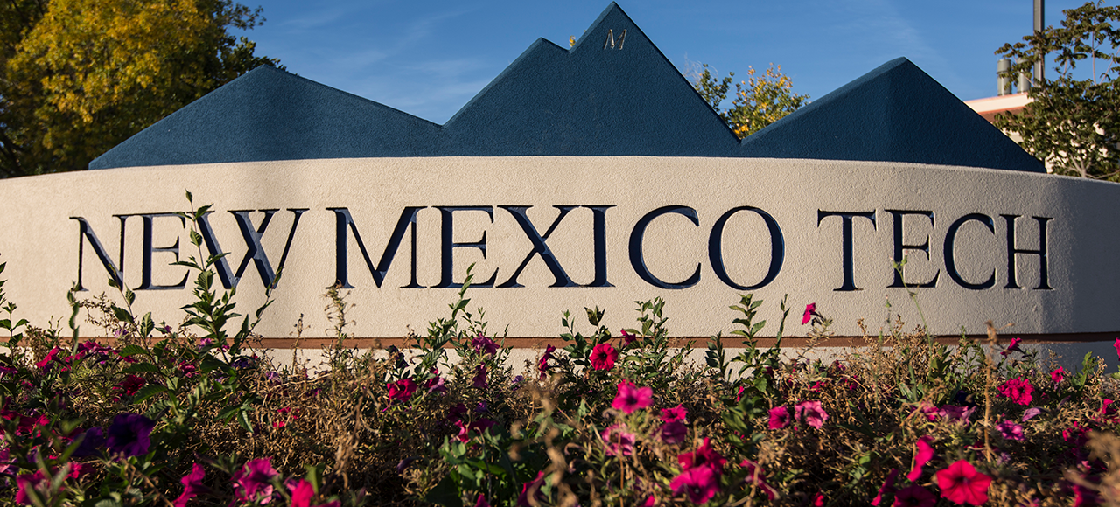
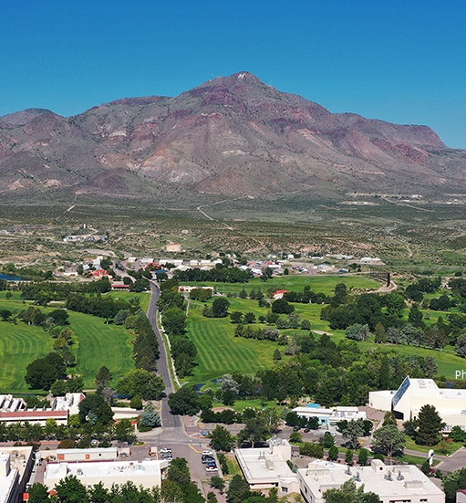
Challenges & Opportunities
NEW MEXICO TECH
for Small STEM Institutions
Challenges
Opportunities
1
Revenue model
1
Signature STEM niche
Small scale and tuition dependence limit flexibility.
A focused identity sharpens market position and story.
Talent & grants
Personalized learning
Distinctive STEM identity
2
Harder to compete for faculty, staff, and research dollars.
2
Faculty access and undergraduate research are differentiators.
3
Enrollment headwinds
3
Agile program design
Demographic shifts and higher-ed skepticism raise pressure.
Launch faster in AI, data, health, and engineering.
4
Research capacity
4
Partnership engine
Labs, equipment, and digital infrastructure are costly.
Grow with labs, industry, healthcare, and K-12 pipelines.
5
Student support load
5
Regional impact
Retention needs are high for first-gen and Pell students.
Align programs with workforce needs and applied research.
High-touch education
Regional innovation
Best path forward: focus the brand, deepen partnerships, and scale student success where small institutions can truly outperform.
Notes:
[Sources] - New Mexico Tech, “NMT Logos and Visual Identity Guidelines” (official palette and typography): https://www.nmt.edu/mac/logosandguidelines.php - New Mexico Tech homepage (institutional positioning and campus imagery context): https://www.nmt.edu/ - Campus image asset: https://www.nmt.edu/advancement/images/Drone_Shot_Campus_August2021_large.jpg - Campus image asset: https://www.nmt.edu/_resources/img/photos/heroimages/NMTGenericHero.png - Western Interstate Commission for Higher Education, “Knocking at the College Door” (11th ed., 2024): U.S. high school graduates are projected to peak in 2025 and then decline through 2041. - Urban Institute, Workforce Alignment Study project page (career and workforce alignment as a strategic opportunity for colleges): https://www.urban.org/projects/workforce-alignment-study - NSF, “Mid-scale Research Infrastructure Incubators and Conferences for STEM Education Research” (infrastructure and partnership needs in STEM): https://www.nsf.gov/funding/opportunities/dcl-mid-scale-research-infrastructure-incubators-conferences/nsf24-027

Slide 6
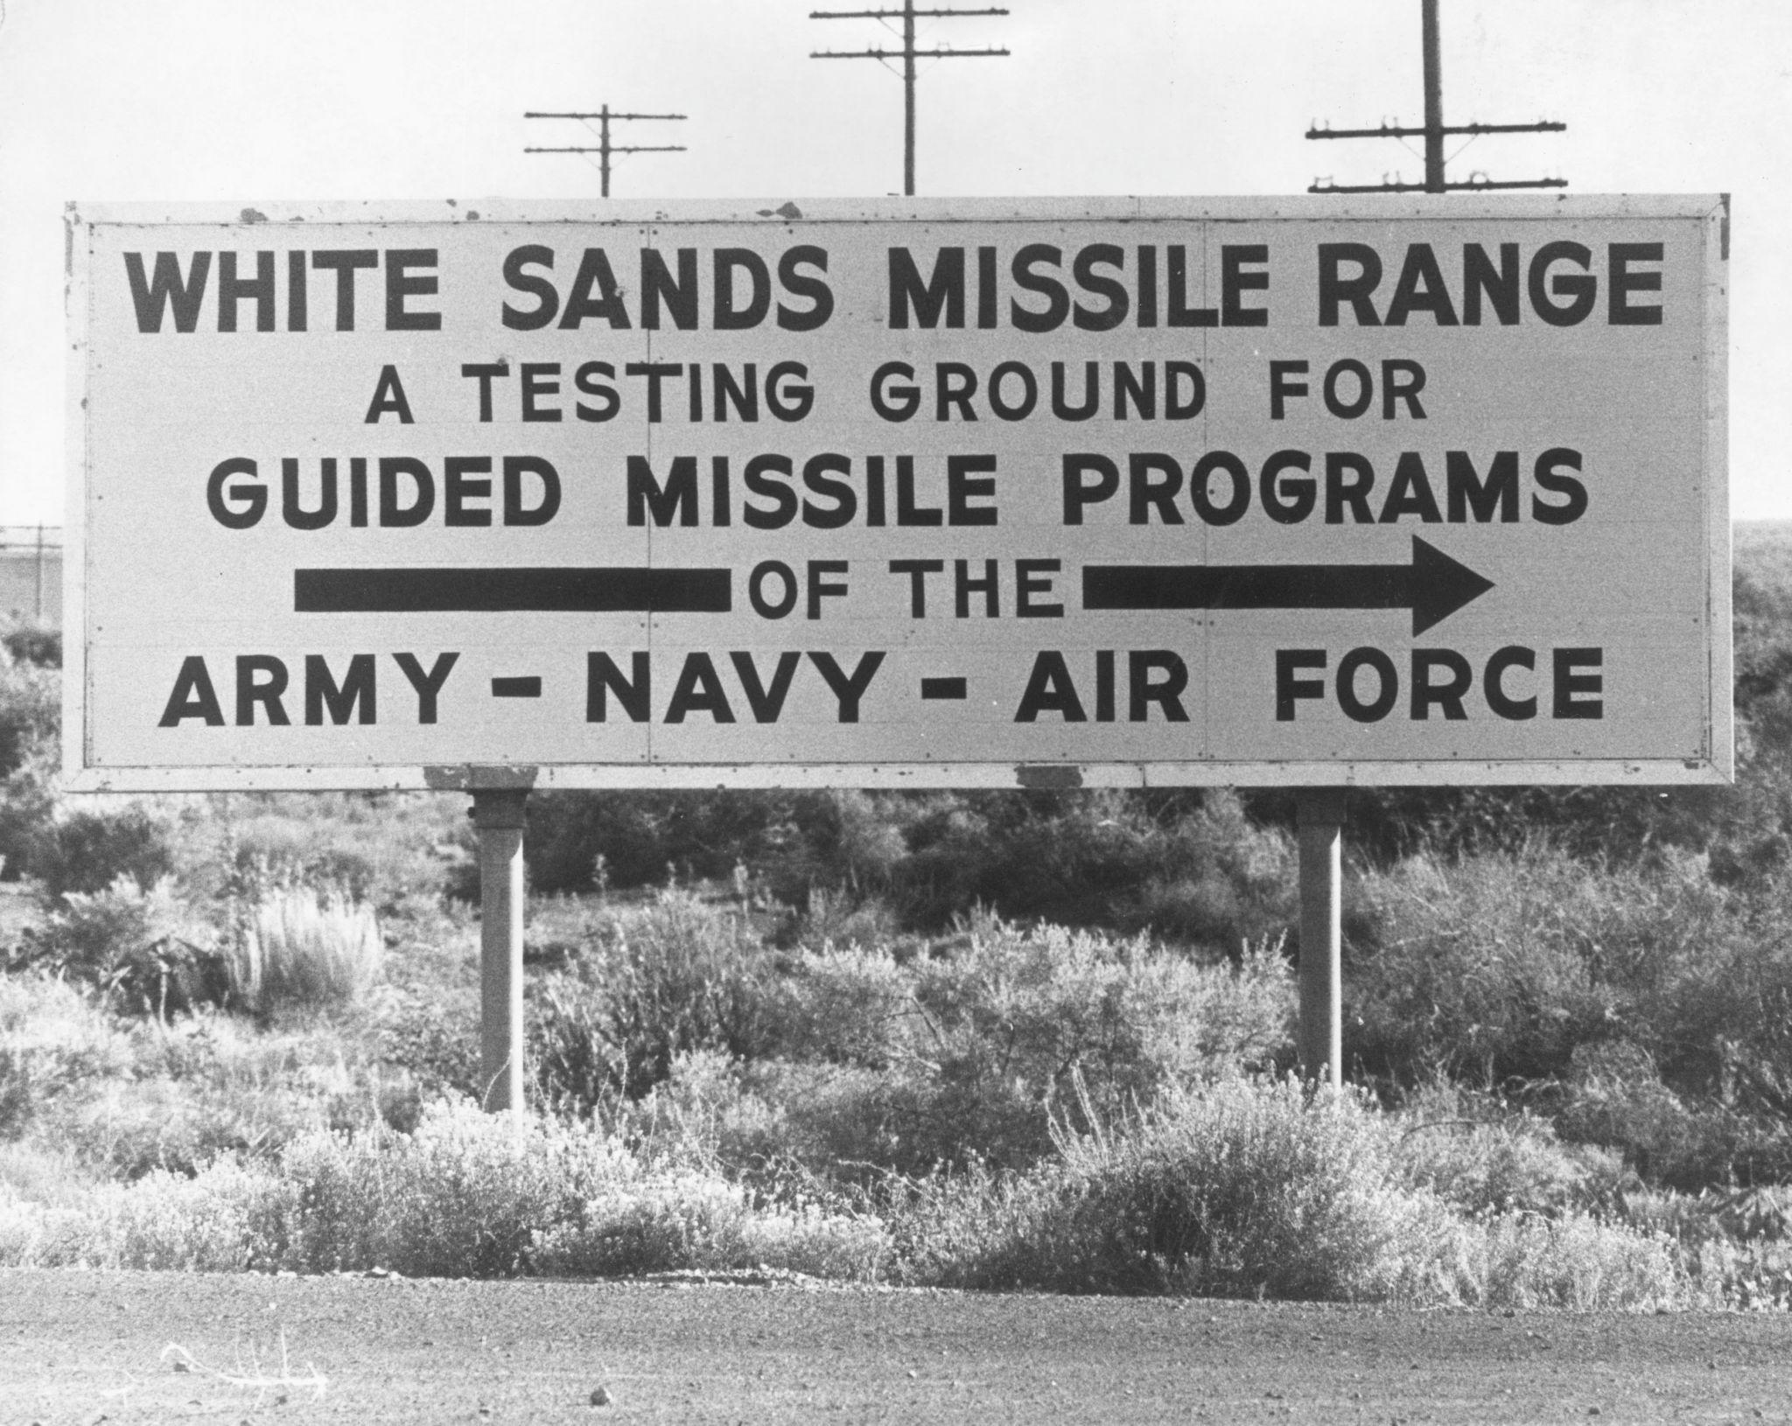
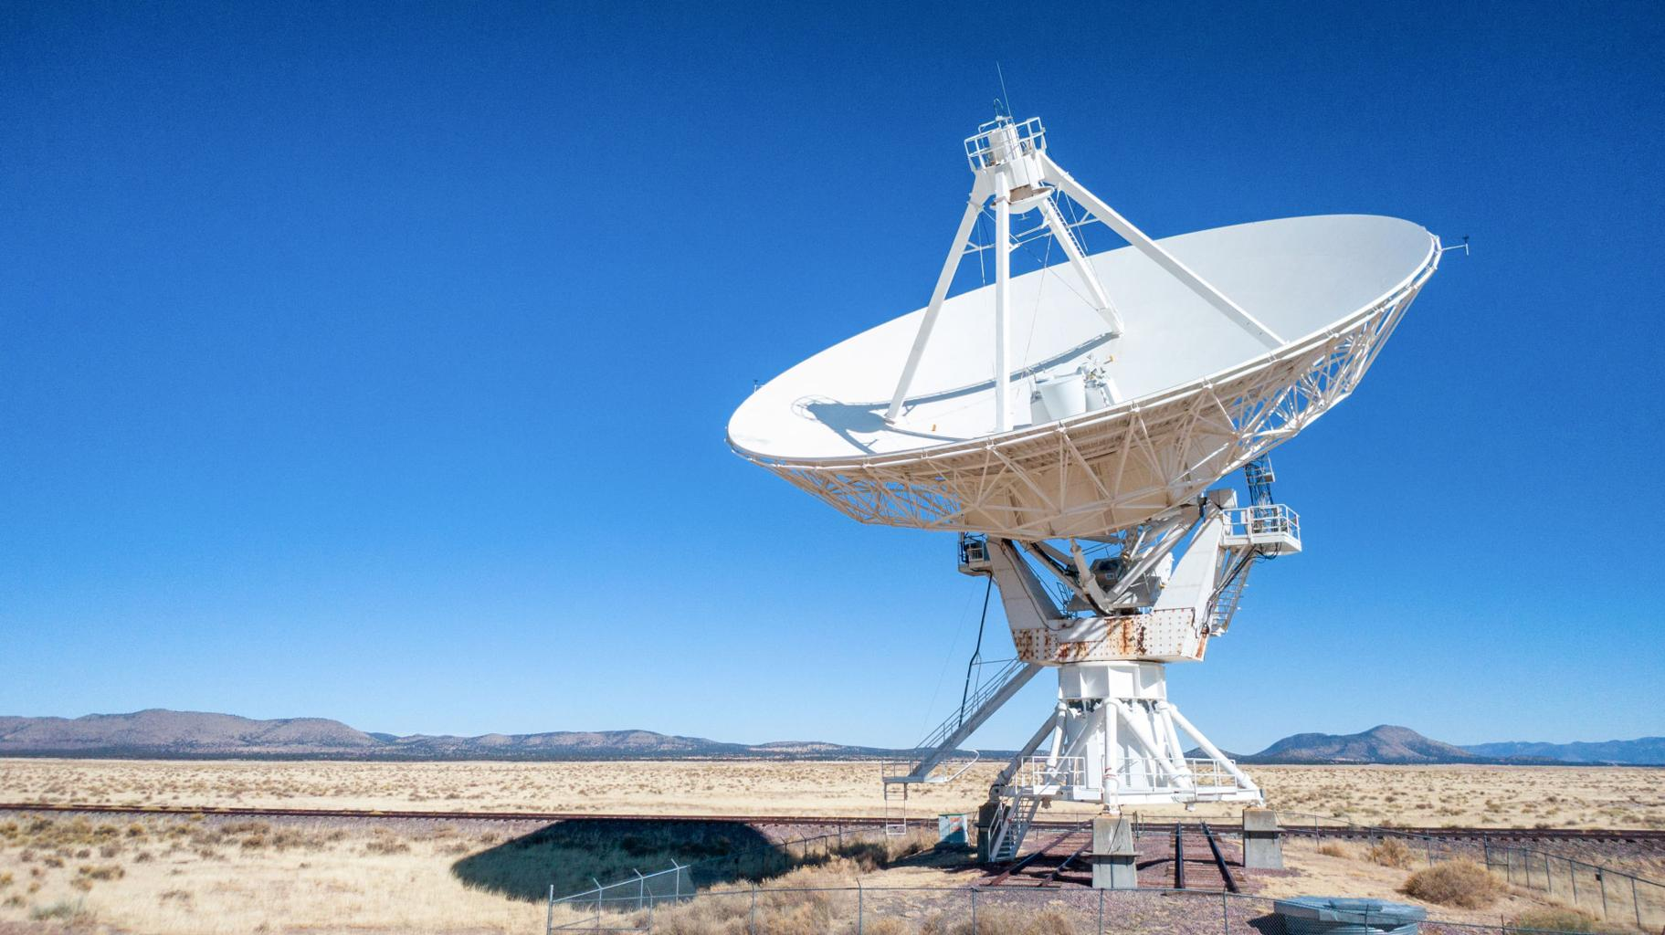
NMT CHALLENGES
Key Challenges for New Mexico Tech
Stabilizing and growing enrollment in a highly specialized STEM institution
Strengthening research infrastructure and sponsored research capacity
Expanding graduate programs and research talent pipelines
Leveraging national laboratories and federal research partnerships
Increasing national visibility and industry collaboration
Supporting economic impact while operating from a rural location
Strengthen the New Mexico Tech community through collaboration, trust, and shared purpose.
Very Large Array
Collaboration with EMRTC
Notes:
Very Large Array (radio telescope dish) Collaboration with EMRTC

Slide 7
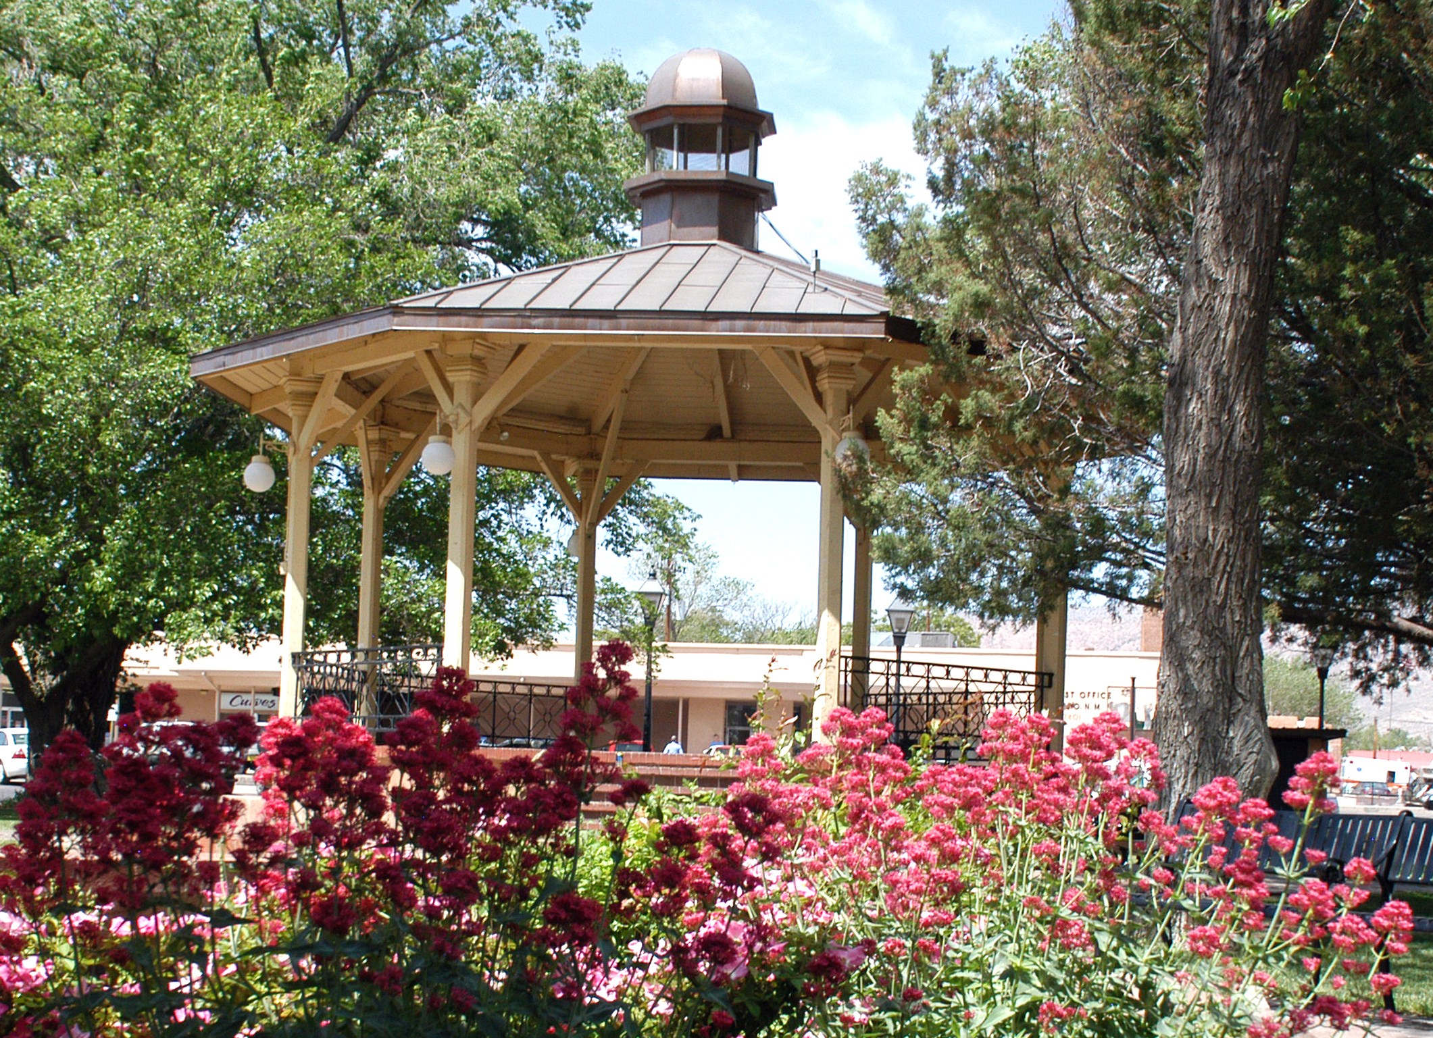
NMT STRENGTHS
Opportunities and Strengths Positioning
New Mexico Tech for the Future
Research distinction: productivity and national reputation
National laboratory ecosystem: strong ties with federal agencies and national labs
Hands‑on STEM education with close faculty–student engagement
Distinctive public mission focused on science, engineering, and applied discovery
Community that supports the Institution

Slide 8
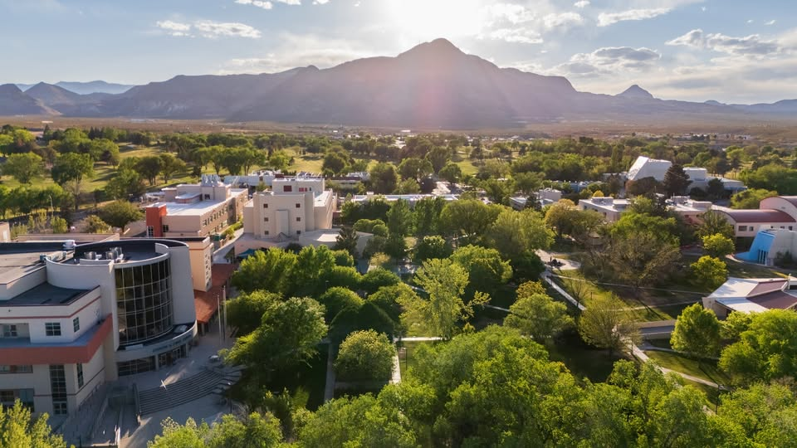
IGNITE NEW MEXICO TECH
VISION
Research Impact
& Infrastructure
Financial Resilience
& Operational Trust
Ignite
New Mexico Tech
Access & Excellence
Strategic
Partnerships
Experiential Learning
& Student Outcomes

Slide 9
Vision for the Next Chapter: Ignite New Mexico Tech
VISION
Five priorities to strengthen New Mexico Tech’s trajectory
1
Research impact with the right infrastructure
Support faculty, research centers, and sponsored programs to strengthen competitiveness and advance toward R2 designation while expanding graduate talent pipelines.
2
Access and excellence together
Advance opportunity for Hispanic, Native American, rural, first-generation, and transfer students while preserving and enhancing the institution’s standards.
3
Partnerships that amplify mission and impact
Deepen ties with national labs, federal agencies, industry, tribal and regional partners, the city of Socorro and the internal and external communities NMT serves.
Student success rooted in experiential learning
Link academic rigor to advising, belonging, undergraduate research, internships, and career pathways while expanding credentials in high-demand areas, including health training. Increase retention and graduation rates.
4
Financial resilience and operational trust
Align strategy, budgeting, research, philanthropy, and communication so the university can invest confidently in its future. Diversify funding.
5
Notes:
Introduce your vision for New Mexico Tech: strengthening its position as a leading science and engineering university while maintaining a personalized academic environment.

Slide 10
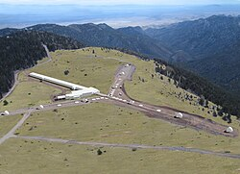
RESEARCH
Priority One: Strengthen National Research Visibility
Build the support structure that allows faculty, centers, and students to do their best work
Langmuir Laboratory
Faculty success
Sponsored research support
Strategic research focus
Student research pipeline
Recruit and retain outstanding faculty and researchers, invest in mentoring and seed support, and build an environment where collaborative research and interdisciplinarity can thrive.
Streamline pre-award and post-award processes, promote interdisciplinarity, accountability, and service.
Identify high-potential areas where NMT can be nationally distinctive and where collaboration across units and with Labs/centers can grow external funding.
Expand undergraduate and graduate research opportunities and growth so students see discovery as part of their education, not separate from it.
Why I can help lead this work
I have led research growth as a president, provost, dean, department head, and NSF center director—including building research infrastructure, supporting faculty development, advancing interdisciplinary, externally funded scholarship. and forging national partnerships such as the NSA-supported Laboratory for Analytic Sciences (LAS).
Notes:
Discuss research growth: expand interdisciplinary research, strengthen partnerships with national labs and federal agencies, and increase external funding.

Slide 11
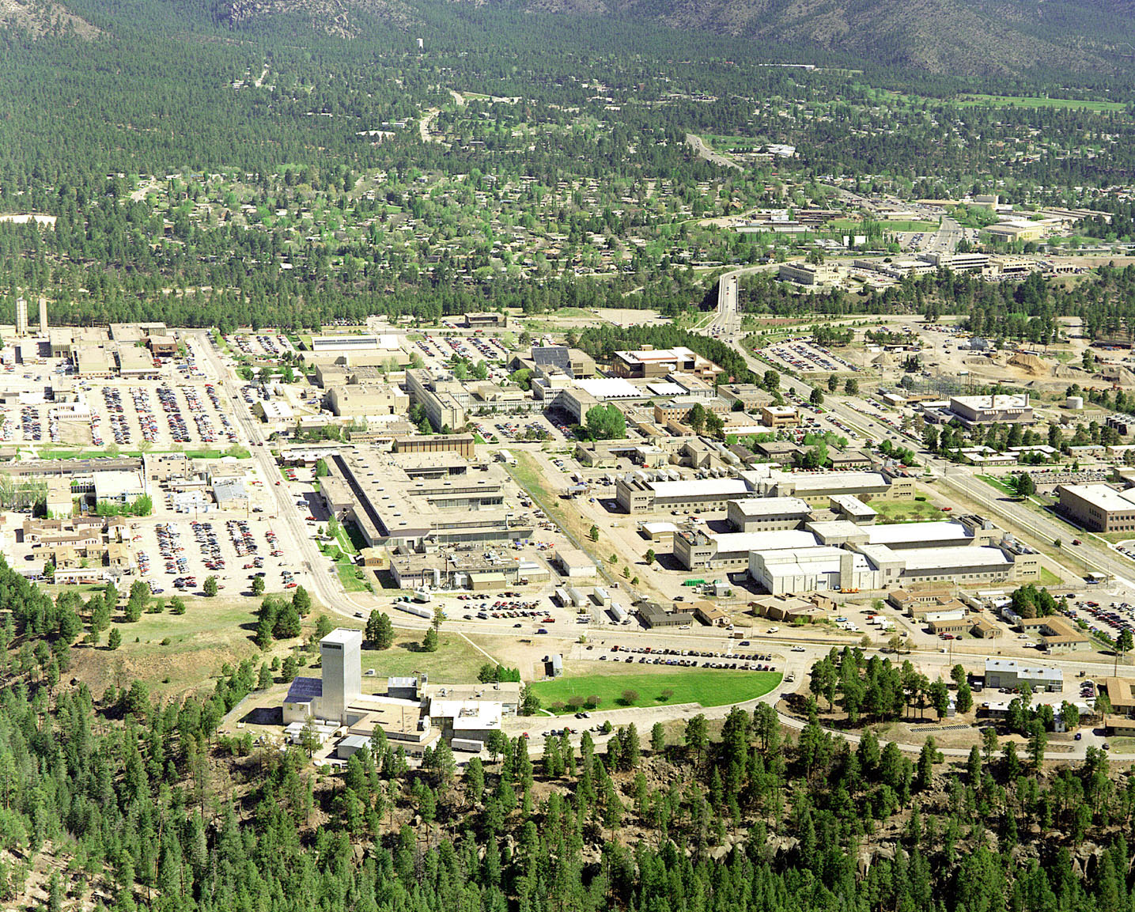
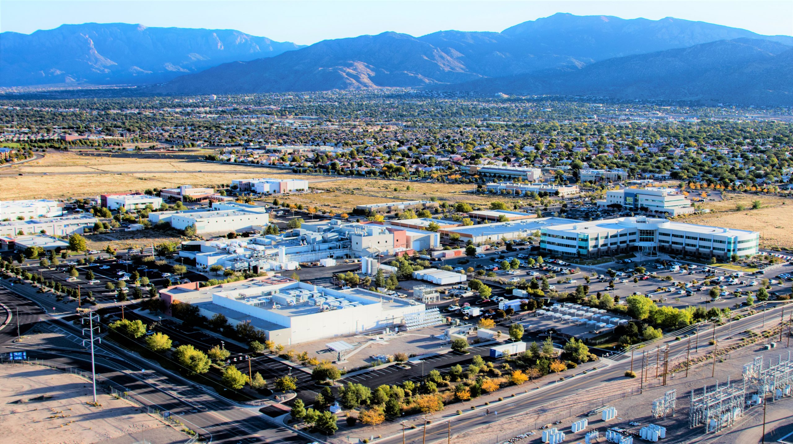
Student Success, Partnerships, and Public Impact
IMPACT
LANL
The strongest research universities connect discovery, belonging, and economic opportunity
Access and opportunity
Partnerships and place
Student success
Treat access as mission-critical: widen pathways for Hispanic, Native American, rural, first-generation, and transfer students while preserving and enhancing rigor and achievement.
Strengthen mutually beneficial relationships with Socorro, the region, state and federal leaders, national laboratories, community colleges, and industry partners.
Support retention, persistence, and degree completion through advising, early intervention, experiential learning, and a culture of high expectations with strong support.
Sandia
What I bring: a record of improving student success, expanding experiential learning, working with legislators and local government, and building community-facing partnerships that connect education to workforce and regional needs.
Notes:
Student success and access: support rigorous STEM education while expanding opportunity for diverse students, mentorship, research experiences, and career pathways.

Slide 12
Financial resilience and operational trust
To secure long-term institutional stability through financial sustainability, data-informed decisions, and a culture of transparency and trust
FINANCE
Strengths
Challenges
Financial Priorities
Grow enrollment and retention to strengthen tuition revenue
Expand and diversify research funding, grow IDC
Increase philanthropy and industry partnerships
Strengthen legislative partnerships to support long-term institutional investment
Strong federal research portfolio (~$100M)
Significant state support (~59% of academic budget)
Unique research facilities (explosives, geology, petroleum recovery)
Low tuition dependency relative to many universities (~20% of academic budget)
Small enrollment base (~1,600 students) limits tuition revenue
Heavy reliance on federal research funding cycles
Limited endowment (~80M) compared to STEM institutions
Need to scale graduate enrollment to support research growth
What I bring: a record of strengthening financial resilience through data-informed strategy and disciplined investment in research and talent, while fostering operational trust through transparent and collaborative leadership
Notes:
The goal is to ensure long-term institutional stability by strengthening financial sustainability, making data-informed strategic decisions, and cultivating a culture of transparency, accountability, and shared trust across the university and with external partners.

Slide 13
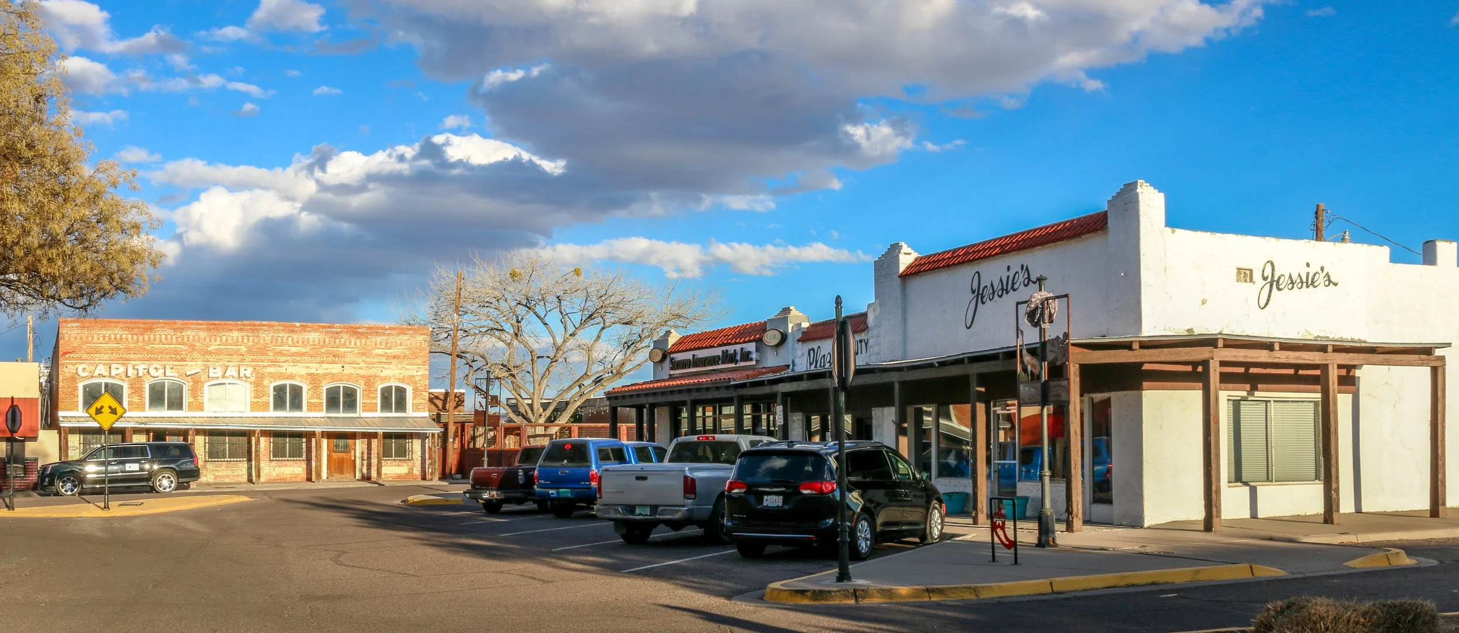
START
First 12–18 Months
How I would begin
Listen deeply and align quickly
1
Set a clear research-and-student-success agenda with measurable priorities.
Meet broadly across campus and with external stakeholders.
Clarify where NMT is strongest and where progress can be accelerated.
Build trust through transparency, candor, and shared priorities.
2
Assess research support systems, talent pipelines, and areas for early visible wins.
3
Strengthen relationships with the Board, faculty leadership, students, staff, NMT Foundation, and Research Park.
4
Engage state and federal partners, local leaders, national labs, and industry in a shared story of NMT’s value.
5
Align budgeting, communication, and philanthropy with the institution’s strategic direction.
Notes:
Community engagement: strengthen ties with Socorro, the state of New Mexico, industry, and national research partners to enhance impact and visibility.

Slide 14
Closing Thought
Research
Access
Partnerships
Student success
Stewardship
New Mexico Tech already has the ingredients of a remarkable future: academic rigor, research credibility, faculty commitment, and a distinctive public mission. My role as president would be to help align those strengths—collaboratively and strategically—so that the institution’s next chapter is even more impactful for students, the city of Socorro, New Mexico, and the nation.
Montserrat “Montse” Fuentes, Ph.D.
Presidential Candidate
Notes:
Closing: emphasize commitment to collaborative leadership, advancing research excellence, and strengthening New Mexico Tech’s national reputation.

