Slide 1
Welcome to the Candidate’s Public Presentation
Michael Jackson, Interim President
New Mexico Institute of Mining and Technology
March 2026

Slide 2
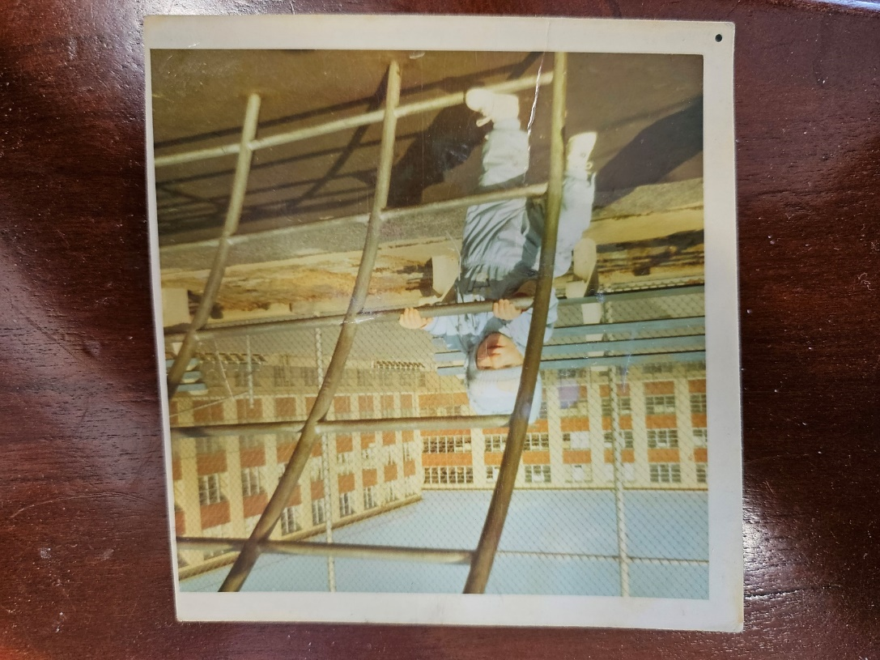
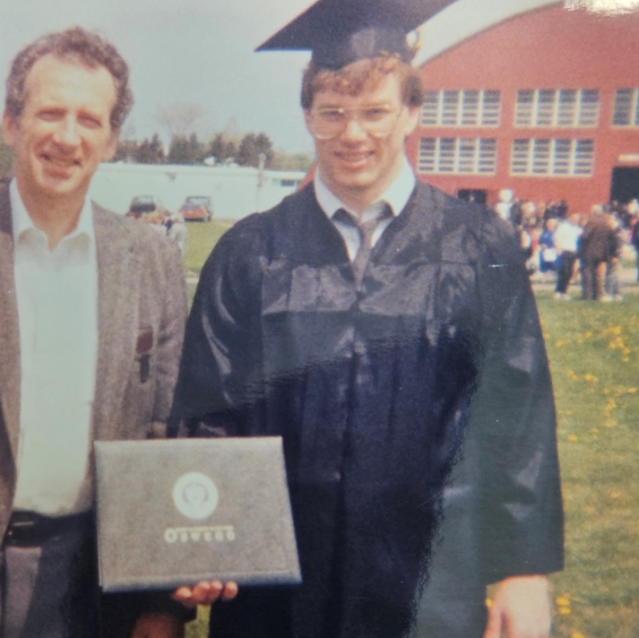
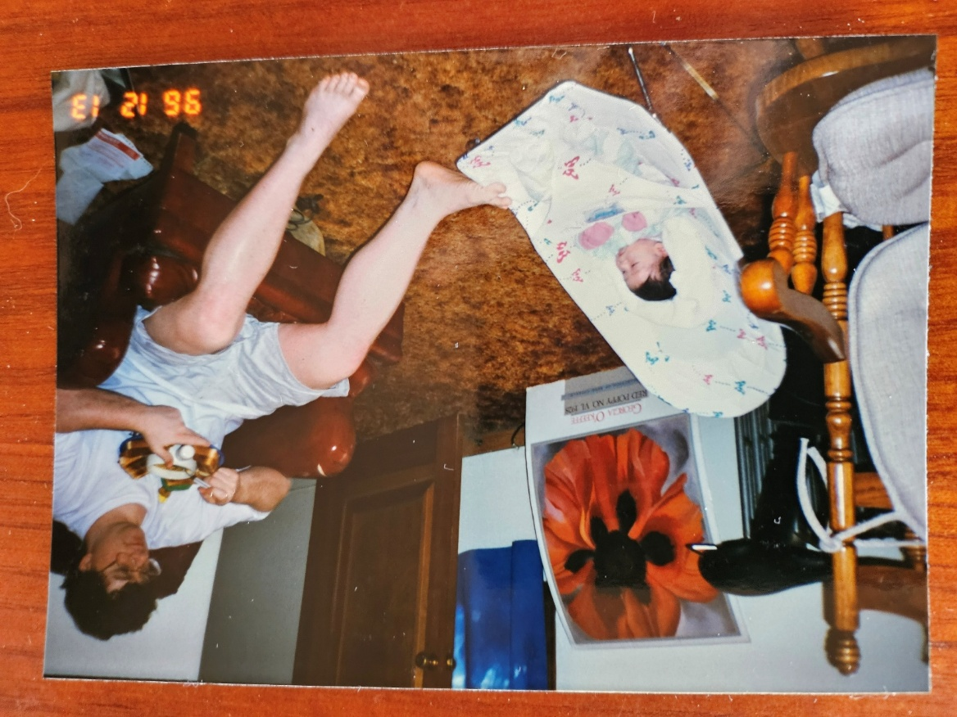
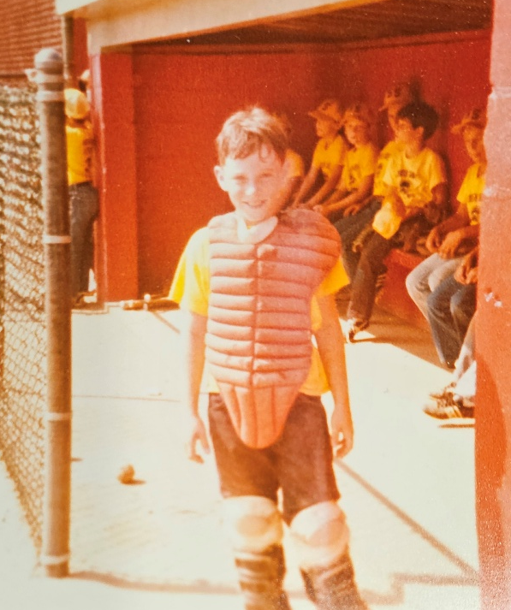
Background – Developmental Experiences

Slide 3
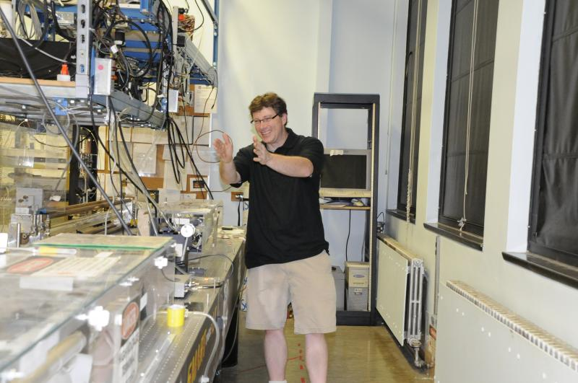
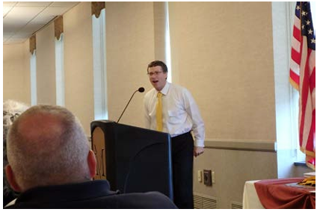
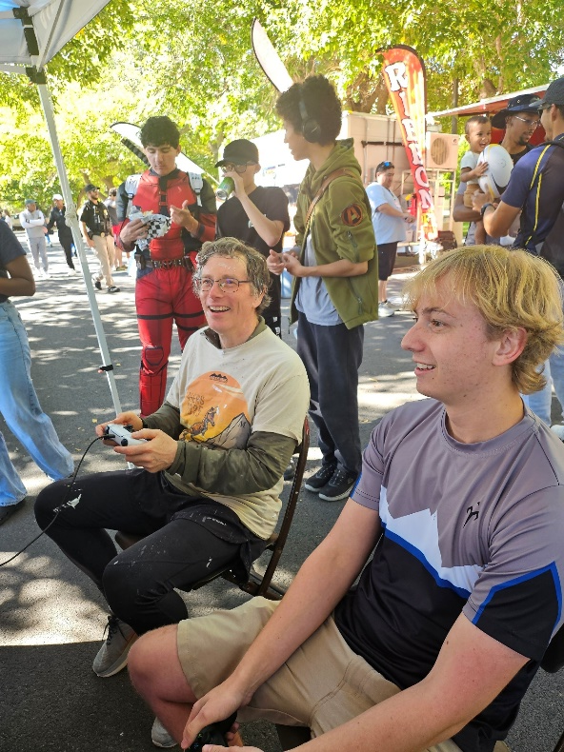
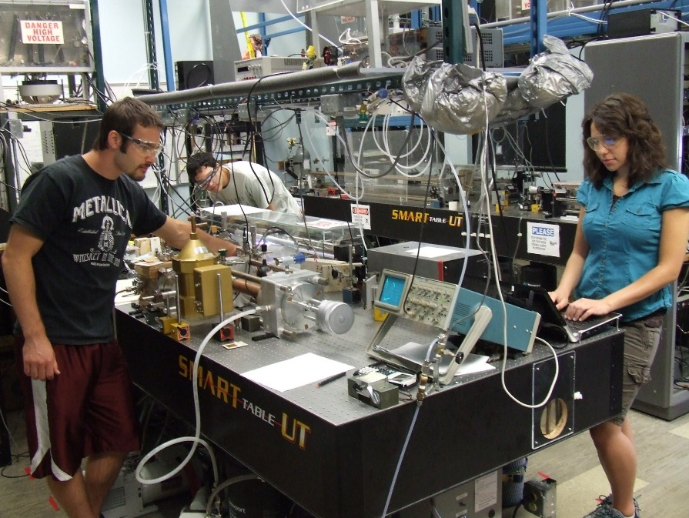
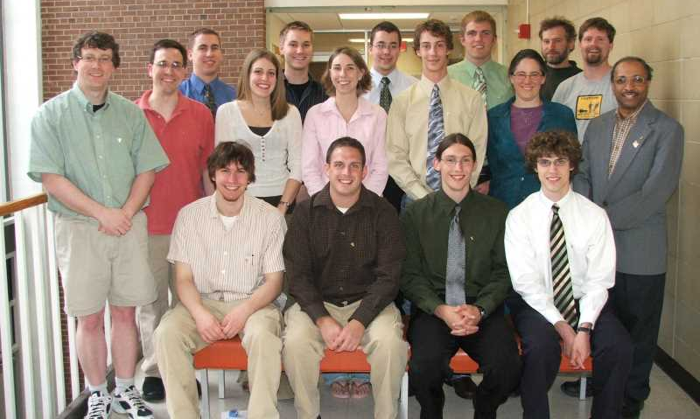
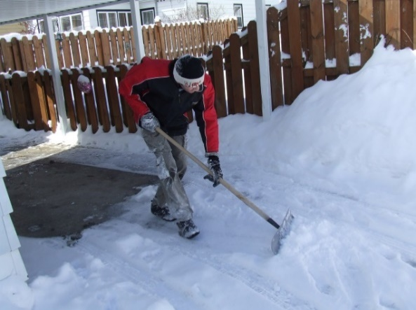
Background – Academic Experiences

Slide 4
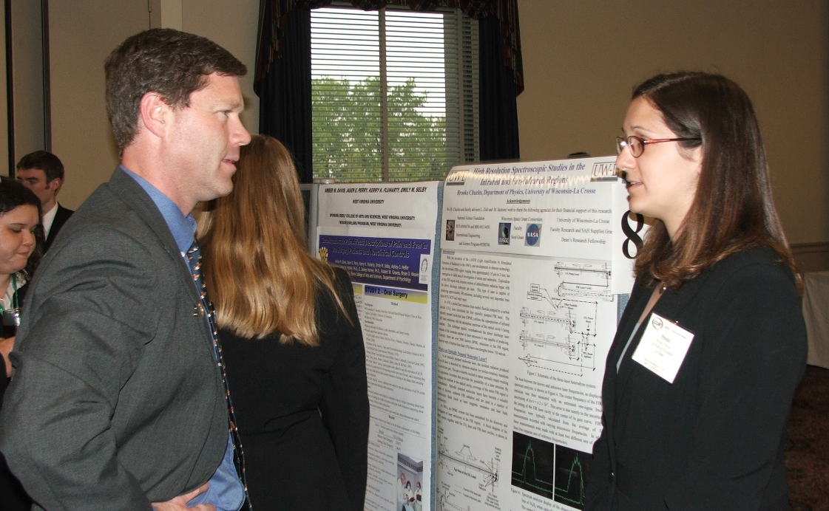

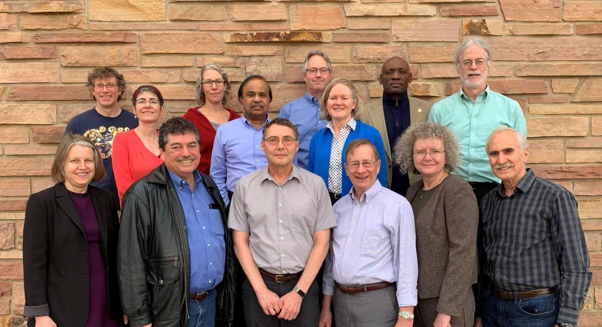

Background – Professional Activities

Slide 5
Prompt
New Mexico Tech is a unique institution with a strong focus on science, engineering, and technology education and research.
As you consider the role of President, please discuss the opportunities and challenges facing institutions like New Mexico Tech in the coming decade. Based on your experience, how would you work with the campus community to build support for initiatives that strengthen the university’s mission while respecting its culture and priorities?

Slide 6
Working with the Campus Community
Policy on Policies
Shared Governance (e.g., shared responsibility for timely feedback, debate, and lively conversation; but not shared management)
Staff Council
Faculty Senate
Administrative Committees (e.g., SEM, Student Data Quality)
Student Government Association
Graduate Student Association
President’s Cabinet
Board of Regents
Campus community and beyond

Slide 7
Strengths and Points of Pride - Part 1
STEM-focused Brand
From Niche.com
#1 College in NM;
Overall Niche Grade: A; Academics: A; Value: A+ (#10 of 1563); Best Small College (#21 of 1010)
Elements of Innovative Curriculum exist
CURE; Design Experiences
Base-plus funding model
State support for tuition
Students
Engagement (e.g., Putnam Exam, Miner Mayhem, Expo. Day, Tea Club);
Club success (e.g., NASA MINDS, NMT Lunabotics);
Team success (e.g., Men’s Rugby, Esports)

Slide 8
Strengths and Points of Pride - Part 2
Diverse interests (within STEM) of faculty & staff
Significant Opportunities for & Interest in Collaboration & P-P-P
Private sector
National Laboratories
Federal Laboratories
Research Centers
Institute for AI (new) to NMBGMR (centennial)
$120⁺M expenditures/yr
Support from multiple sources (e.g., donor, legislature)
Existing programs for & with the community
Community

Slide 9
Institutional Challenges
Structural deficit
Compensation package concerns (all-inclusive; types and groups)
Uncertainty at the federal level
Unfunded mandates (i.e., gaps covered by institutional funding)
Unfunded positions & programs (i.e., one-time funding used for recurring positions / activities)
Gaps in institutional marketing
Gaps in consistent data entry that affects data quality and reporting
Some out of date systems & processes
Limited career progression & professional development
Lack of sufficient support within parts of the institution
Limited cross-training within areas
Inconsistent on-boarding and limited management training
Campus culture (e.g., not always student-centric, limited collaboration)
Living in Socorro (e.g., limited housing & childcare, perception)
Notes:
Infrastructure limitations

Slide 10
Academic (Related) Challenges
Ten⁺ year decrease in undergraduate enrollment while graduate student enrollment leveling off
Number of faculty during this period has increased (as noted by LFC analysts)
Many degree programs exceed 120 credits
Numerous low-enrolled degree programs resulting in single digit class sizes and graduates
Limited course sharing among degree programs
DFW rates for some introductory courses (about 30% average with section highs reaching 50%)
Retention rates (F25 to Sp26 is lowest in past decade)
Portions of the curriculum remain traditional
About 29% of incoming students in F25 enrolled in MATH 1220
Uneven distribution of supporting students (e.g., financial support for graduate students via RA, mentoring and engaging with students)

Slide 11
Challenges - Legislative Quotes
If you are such a good school, why do you need any marketing support?
The economy is tightened, so start preparing yourself for that. If your performance levels are not good, prepare to get harder hit. If there is no performance, we are going to start targeting those places where least performance happens [in the areas of] recruitment, retention, and graduation rates.
Despite state revenues, do not expect new resources.

Slide 12
Are we unique in the challenges we face?
Not really …

Slide 13
So why attend New Mexico Tech?
Hands-on experiences
Accessible faculty & staff
Small class sizes taught by faculty
Financial ROI

Slide 14
Are these reasons to attend NMT different from other institutions?
Not really …
Yet another challenge …

Slide 15
For every challenge … there is an opportunity
What about opportunities?
So what will guide us through these opportunities?

Slide 16
Student Experience
Research &
Discovery
Entrepreneurship
& Innovation
Scholarship
Community
Engagement
Economic
Development
Community
Support
Workforce
Development
Professional
Development

Slide 17
Does that mean …. Students do what they want? Students get what they want? Standards are watered down? Students rule the school?
No …

Slide 18
It means …. We meet them where they are … We listen to their goals and aspirations … We create opportunities … We provide clear, reasonable expectations … We develop surmountable challenges … We provide support systems … We offer a relevant, up-to-date curriculum … We prepare them for what lies ahead …. We are excited to engage them ... We share accountability and responsibility … We lead by example!

Slide 19
When making decisions, the STUDENT EXPERIENCE can serve as our …
Beacon
Guiding Light
Polaris / Southern Cross
M Mountain!

Slide 20
But how do we make NMT’s Student Experience unique?
YOU!
You (WE!) are the secret ingredient!

Slide 21
Are we willing to, together, as a team …
Focus on the future rather than the past,
Step out of our comfort zones,
Consider new ideas,
Communicate and collaborate,
Revise existing processes,
Pursue new initiatives,
Adapt and share the load,
Dedicate ourselves to the Student Experience?

Slide 22
Questions

Slide 24
What are some initiatives / priorities?
Addressing the Structural Deficit
Exploring entrepreneurial activities and P-P-P
R2 status
Post-tenure Review (workload expectations and distribution)
Program Review (curricular review, program viability)
Strengthening Academic-Research Center Collaborations (e.g., Joint Appointments)
Enrollment

Slide 26
SUNY-Oswego: Because of you, our students are able to move beyond the classroom and engage in learning that prepares them for real-world careers. They participate in extracurricular and co-curricular activities that deepen knowledge and help students develop such transferable skills as leadership, teamwork, time management, problem-solving and communication.
CWU is here for one purpose: to deliver transformational learning experiences that have the power to enrich the lives of students, their families, and their communities. Our dedicated team of professionals shows up every day with the goal of helping people from all backgrounds find their place in the world. Whether it’s inside or outside the classroom, CWU faculty and staff are committed to going the extra mile for our students. …
UWL: It starts with strong academics, but the college experience is so much more. From co-curricular opportunities, to career readiness, to the vibrancy of the campus and the community, there are so many factors that contribute to a memorable, high-quality college experience.

Slide 28
‘Respecting its Culture …’ [Challenge]
From my perspective, NMT’s campus culture has elements of
Lack of collaboration
Lack of communication
Unwelcoming to students (walking down a hallway with all office doors closed; windows covered; lack of phone number)
‘To solve this, they (some other office) need to do … .’
‘Coming in more than ____ days is a burden.’
‘What can the university do for me?’
It is worth respecting part of its culture while throwing the rest out.
Notes:
Infrastructure limitations

