Slide 1
Overview of the Chillers for the MRO Interferometer Project
M. Creech-Eakman, MROI Project Scientist, Physics Prof.
W. Cook, Civil Engineering Prof., MROI Consulting Engineer
K. Miller, NMT Head of Purchasing

Slide 2
Outline
Brief Overview of MROI Project
Basic Information about the Site
Need for Chillers
Scoring
Dates

Slide 3
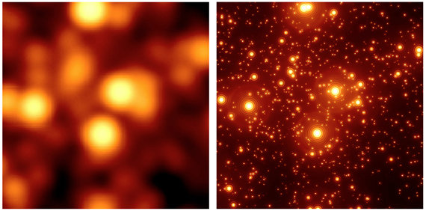
A Key Goal of Astronomy- Resolution
Ways to achieve better resolution
Build bigger telescope
Add adaptive optics
Go into Space
Build an interferometer

Slide 4
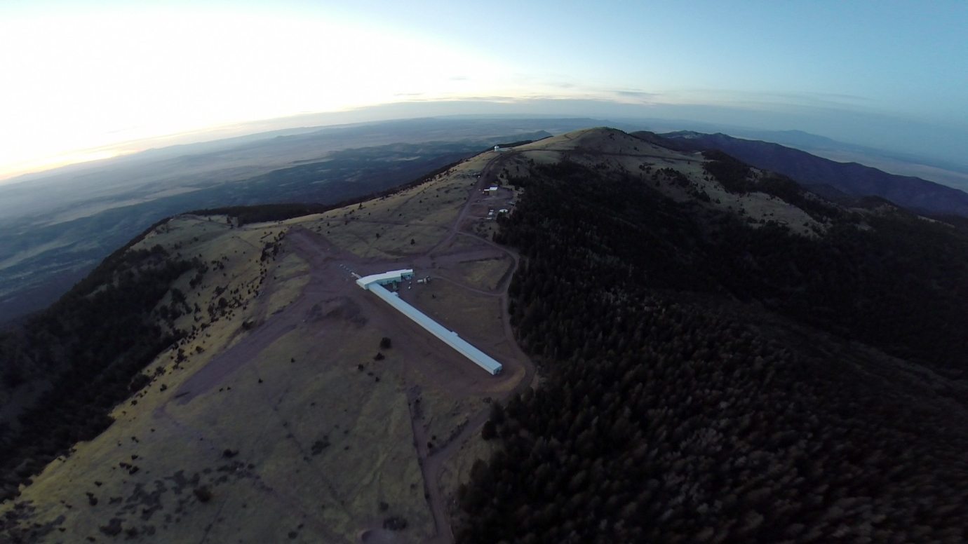
Overview of the Observatory
Magdalena Ridge about 1 hour west of Socorro, NM overlooking VLA
Altitude 10,600 ft
Env. Impact Survey completed in 2003
Two facilities at MRO
Fast-tracking 2.4m
NIR/Optical 10-element interferometer
Third site available
MROI is 10 1.4m movable afocal telescopes in equilateral Y configuration (28 stations)
Optical and near-IR operation, near-IR fringe tracking
Baselines from 7.8 to 347m (58 to 0.3 mas)
Design optimized for imaging mission

Slide 5
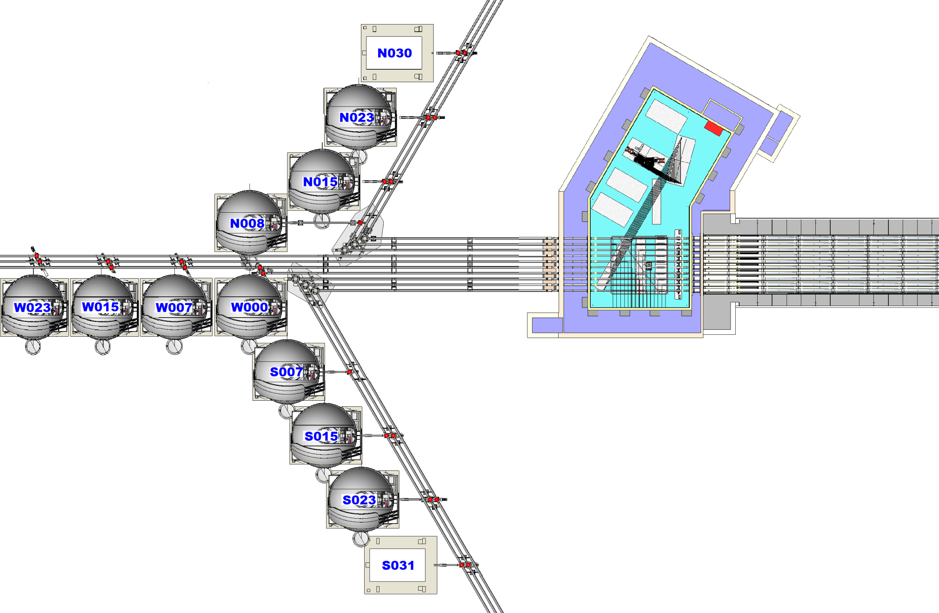
Telescopes & Stations

Slide 6
Basic Site Information

Slide 7
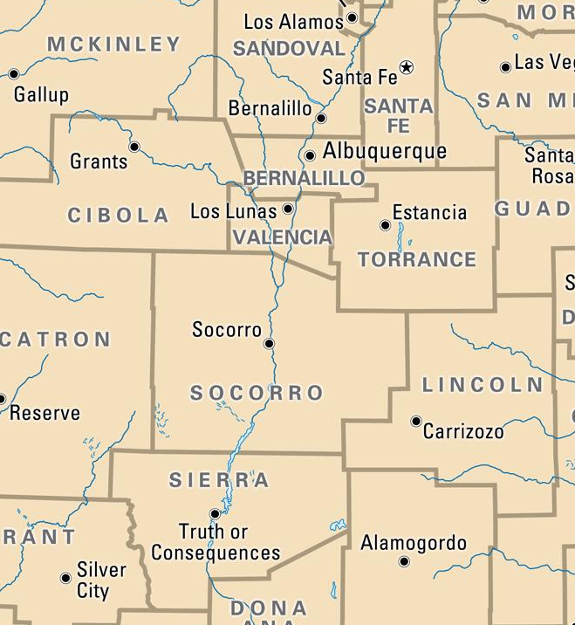
Location of the Site
VLA
New Mexico Tech and VLA Operations Center
MRO Interferometer

Slide 8
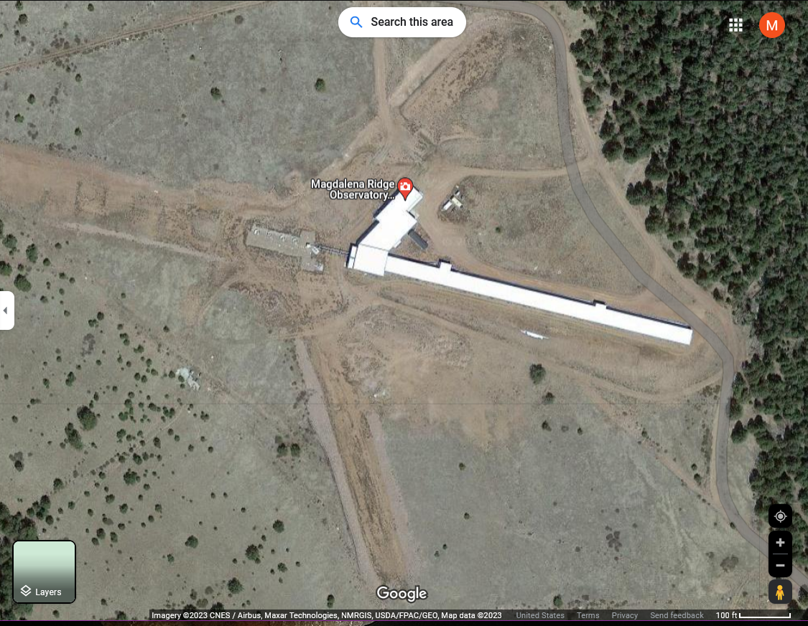
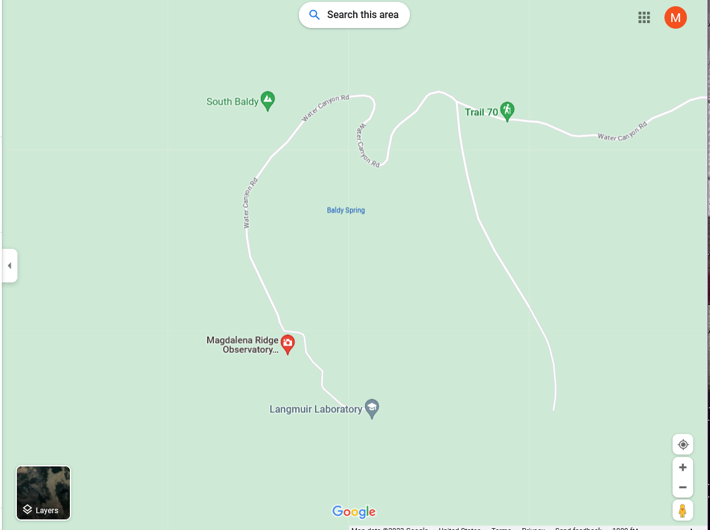
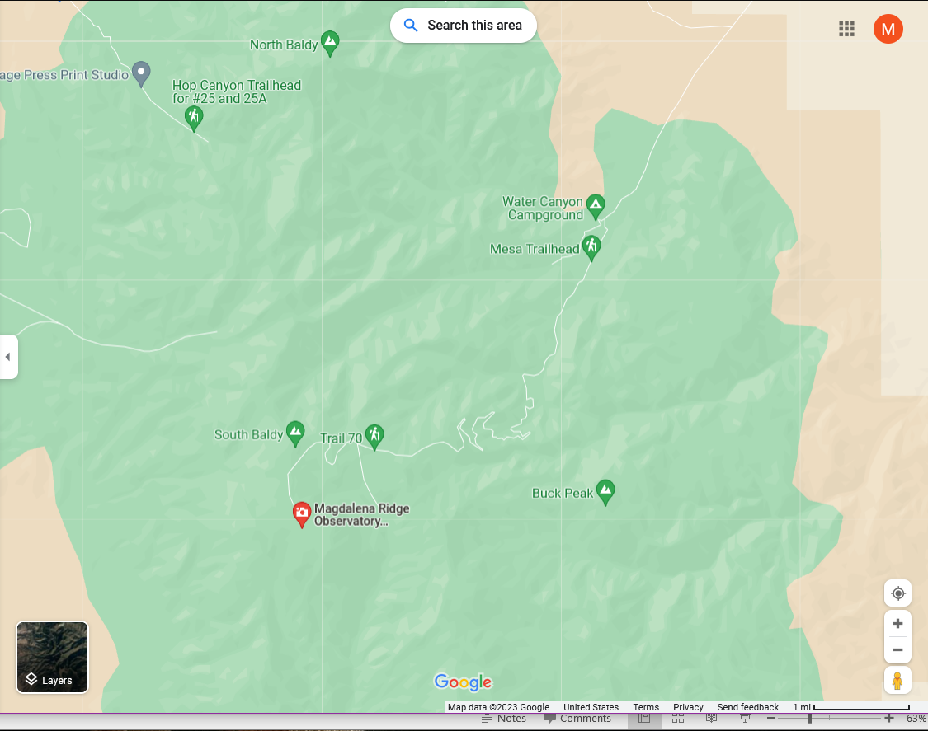
Zoom in on Mnt Top
Elevation at top is 10,600 feet
Road is unpaved from Water Canyon to top – 8 miles long
4WD vehicles are required for access to top

Slide 9
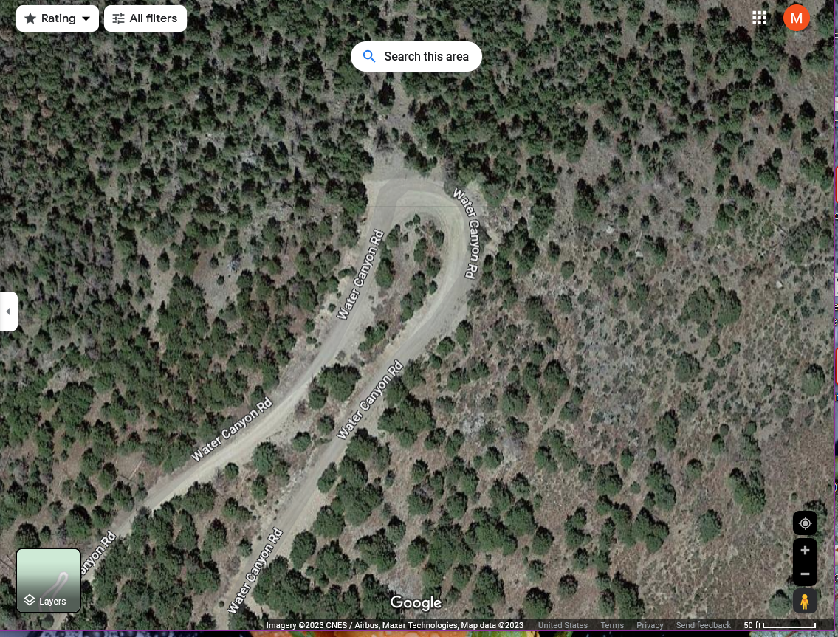
A switchback

Slide 10
Need for Chillers
Telescopes and Enclosures
Maintain day time temperatures close to night time temperatures year round
Reduces turbulence over mirrors
Cool the electronics to reduce heat plumes
Temperature requirements developed with manufacturers of components
Cannot introduce vibrations to the telescopes or beam combining facility
System will support 3 telescopes and enclosures

Slide 11
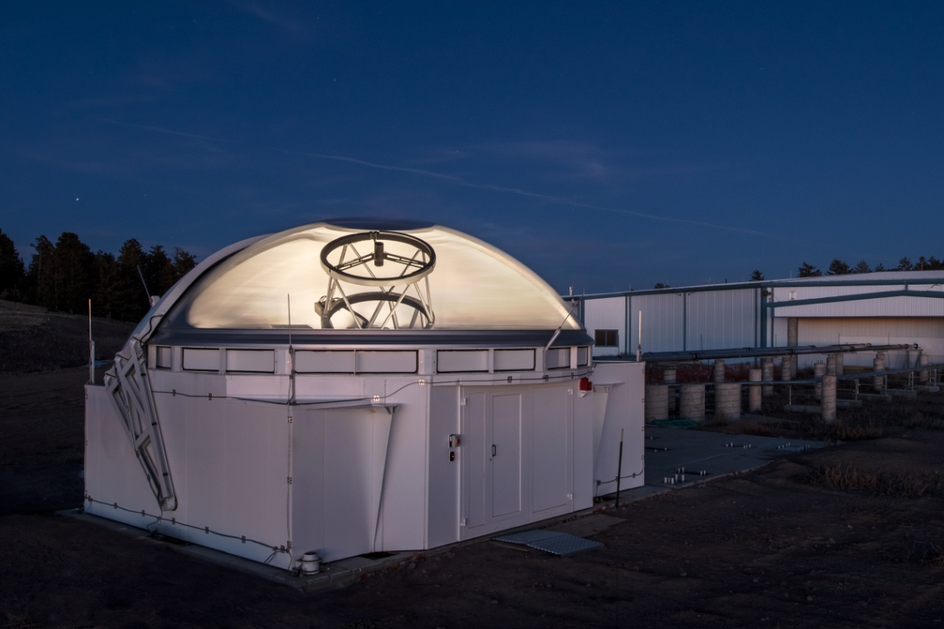
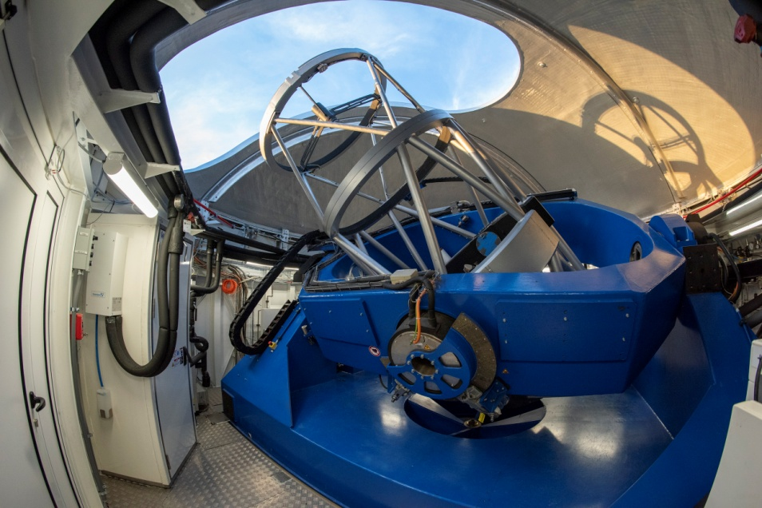
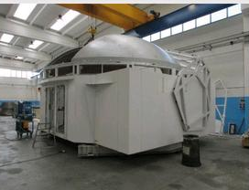
Telescope and Enclosure

Slide 12
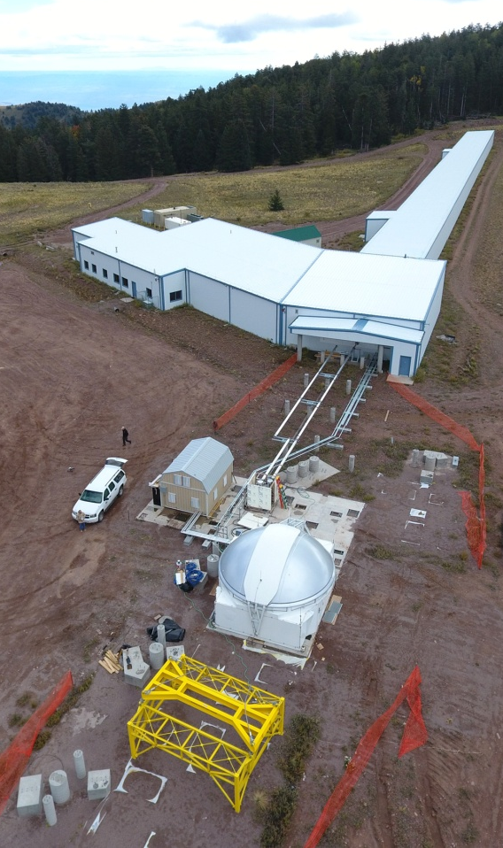
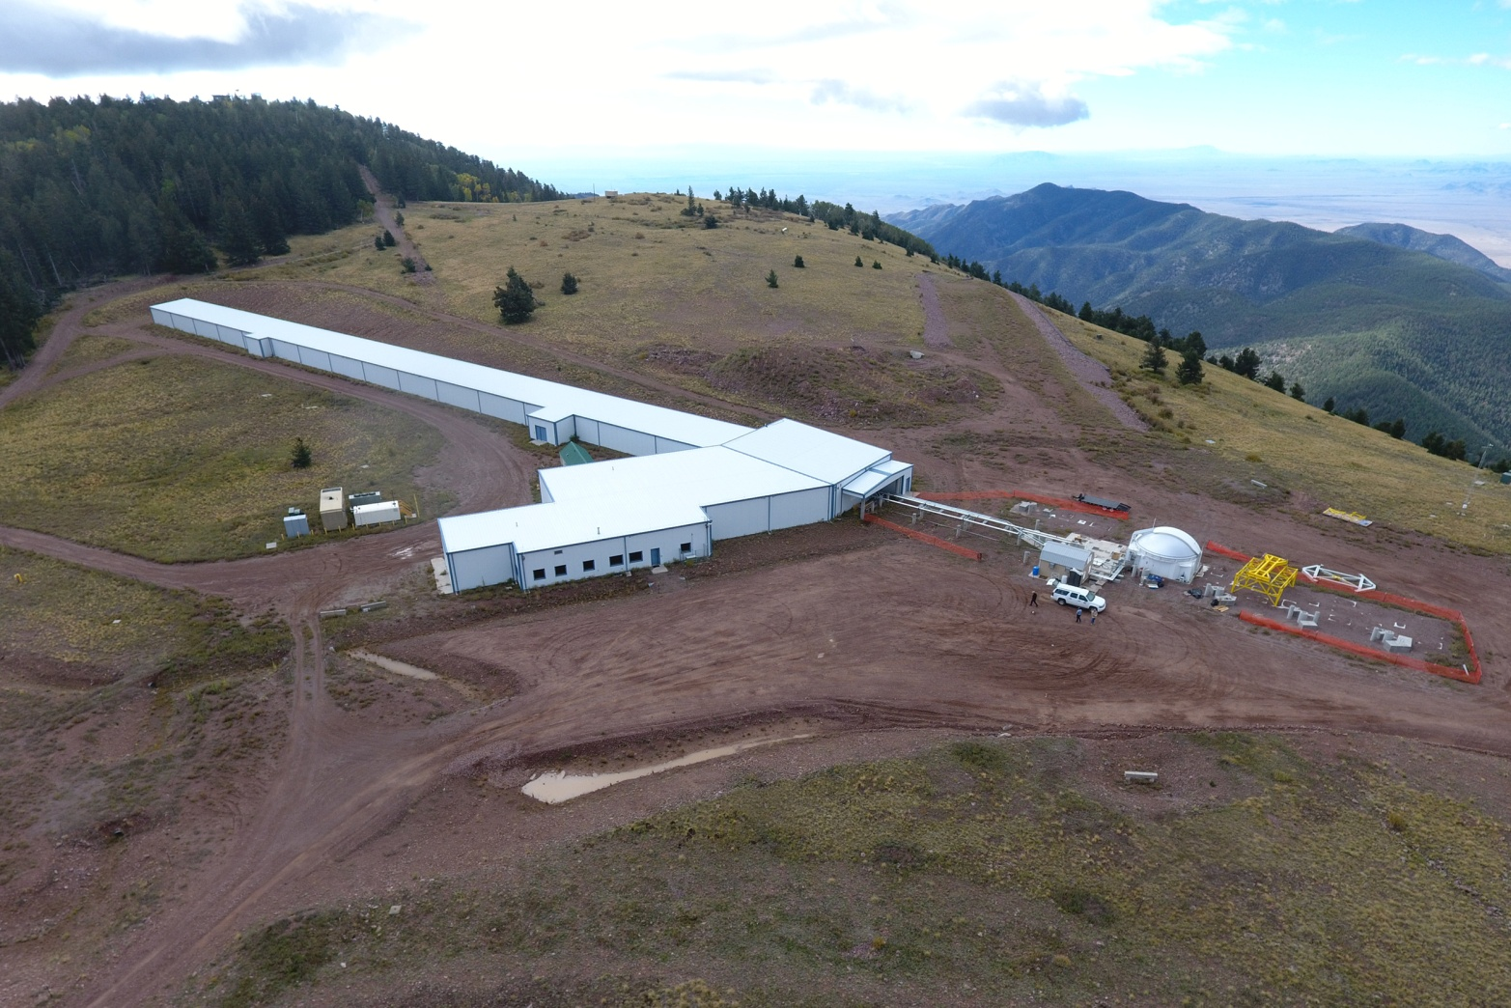

Slide 13
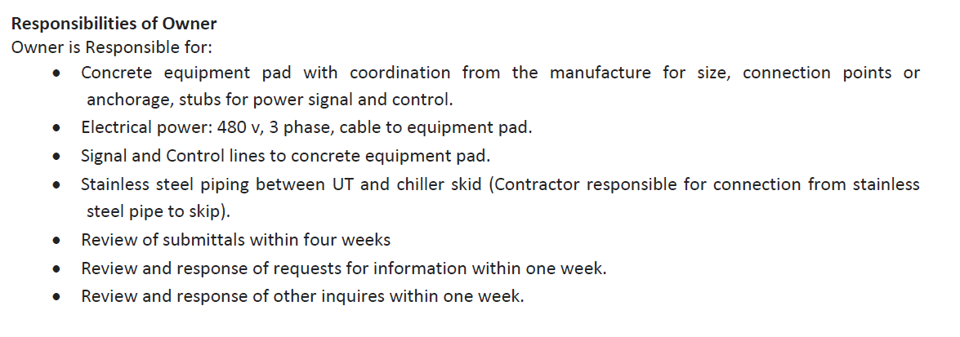
From Page 12 of the RFP
Us at NMT/MROI

Slide 14
Scoring
Experience and Past Performance – 25%
Design Conformity – 30%
Cost – 30%
Time line – 15%

Slide 15
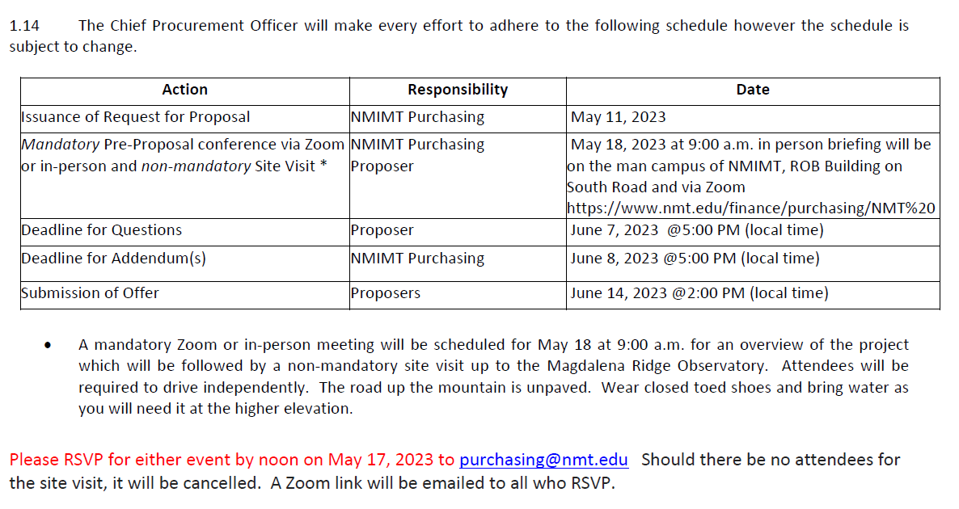
Dates to Know

Slide 16
Questions

