Slide 1
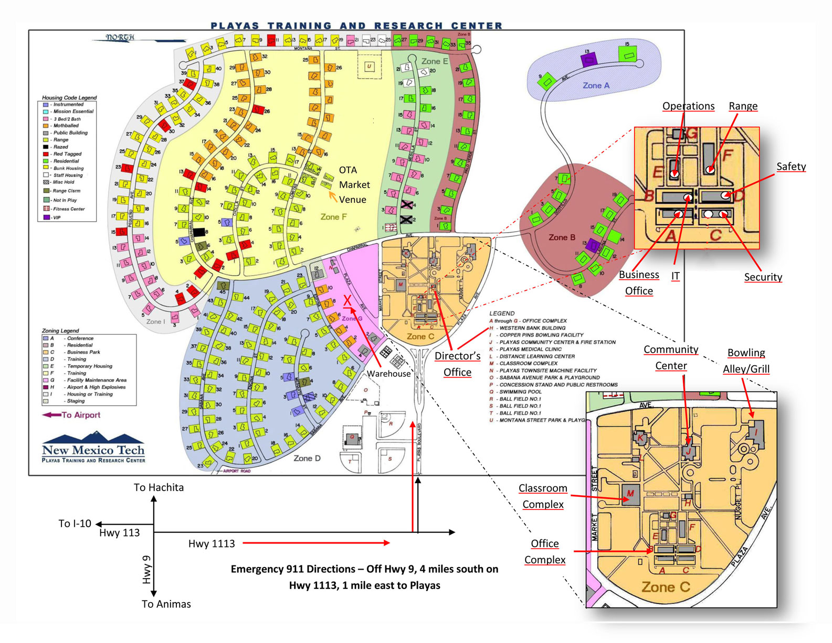
Notes:
Orient yourself in Playas but the town map is non-standard and orientated vertically East-West

Slide 2
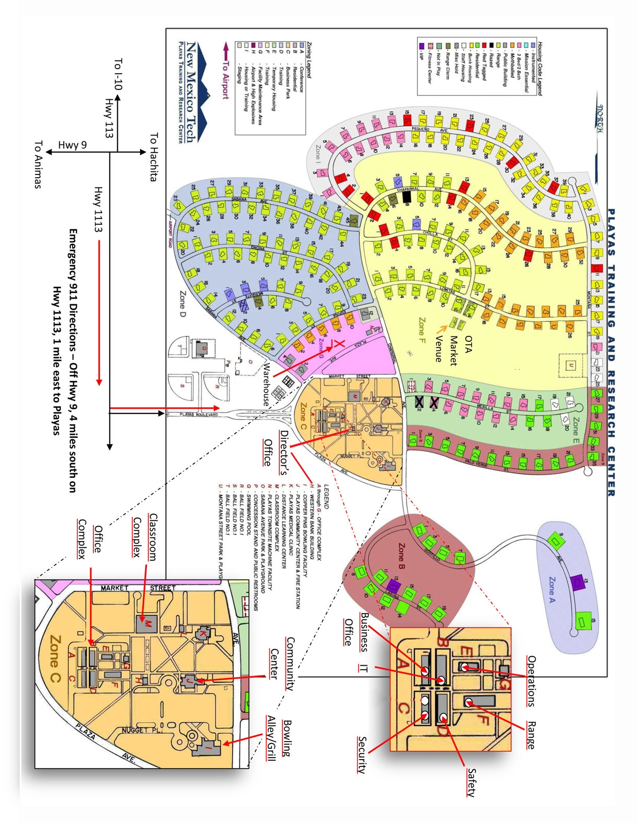
N
W
E
S
Notes:
This is the correct North –South orientation

Slide 3
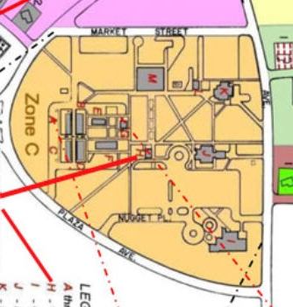

Notes:
You entered Playas through the main gate at the west of the town and we are now sitting in the classroom in the Business Area
Here are some examples of the type of Project with which the A&E Consultant could be involved:
The conversion of the existing Clinic here
The development of the area bounded by Nugget Place, Plaza Ave and Chaparral which I call the ‘Island Site’

Slide 4
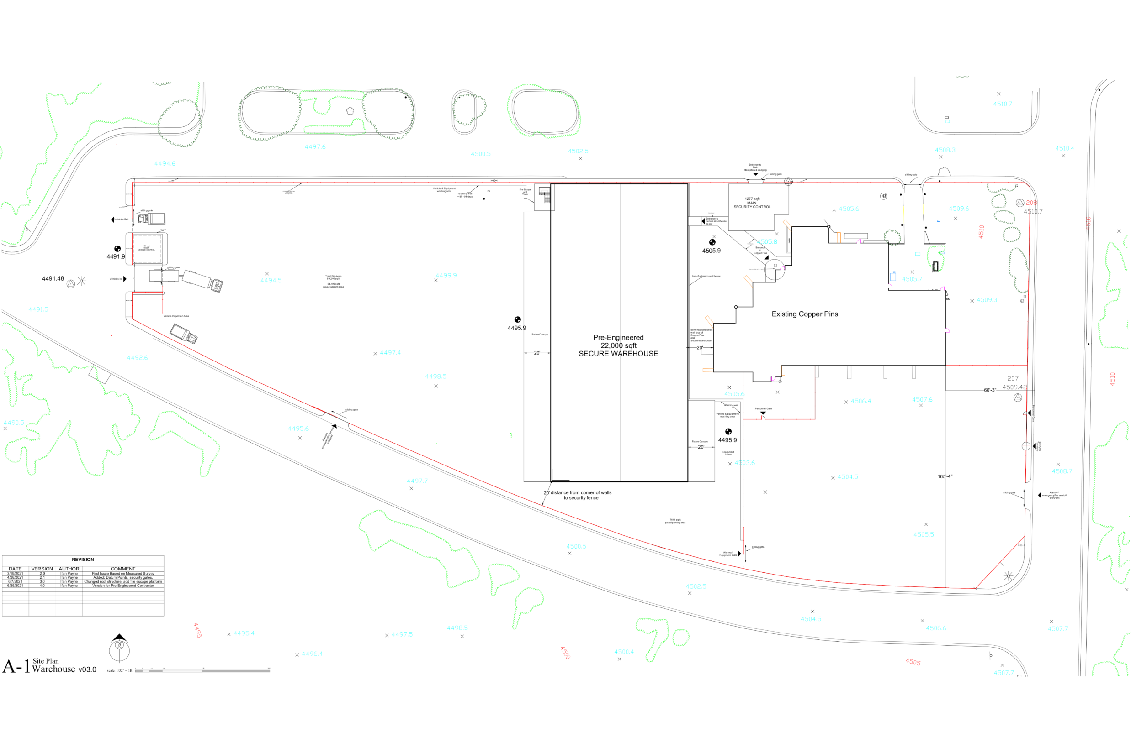
Notes:
The ‘Island Site’ currently contains:
An existing bowling alley, now completed gutted, called Copper Pins. This will be renovated into a highly secure area.
Proposed new development will include:
A new 22,000 sq ft Secure Warehouse
50,000 of hard standing with a vehicle control facility
A 1200 sq ft main reception and badging building

Slide 5
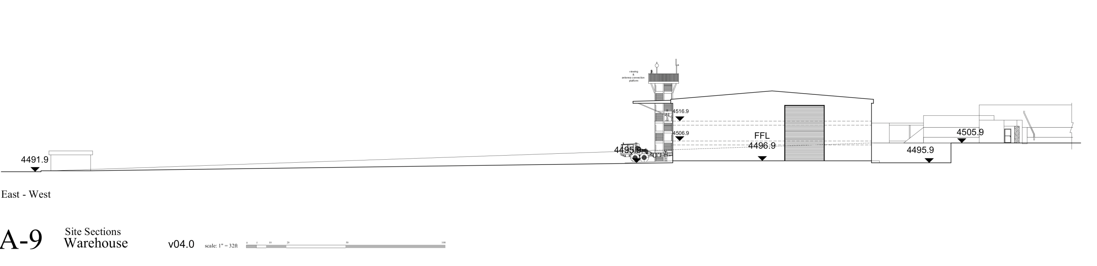
14 ft
Notes:
The is a 14 ft fall from East to West across the western half of the ‘Island Site” This means that entry from Reception and Badging into the administrative accommodation in Secure Warehouse will be on the 2nd floor. The proposed administrative accommodation in the north section of the Secure Warehouse will comprise:
1st floor containing engineering and technical spaces
2nd floor containing office space
3rd floor containing office space

Slide 6
Notes:
The construction will take place in phases, potentially
Secure pre-engineered Warehouse shell
Vehicle control building
Reception and Badging
Fire Escape with observation tower and antenna connection points

Slide 7
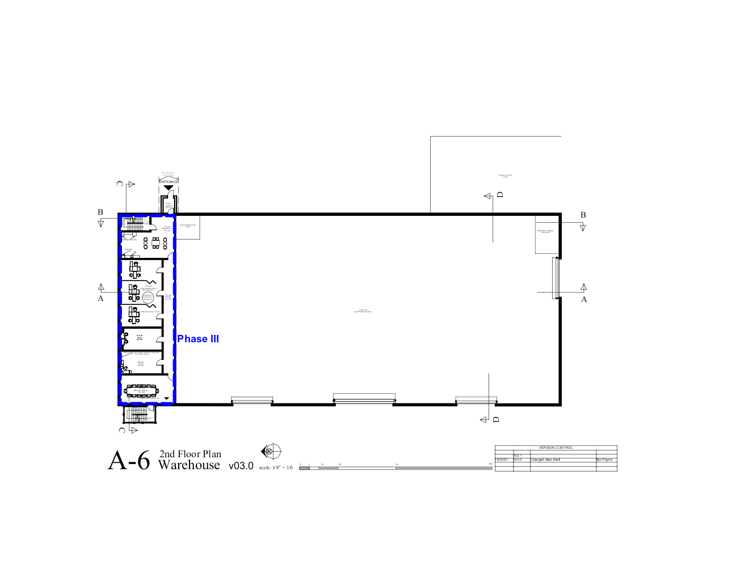
Notes:
Phases continued
- 2nd floor build-out

Slide 8
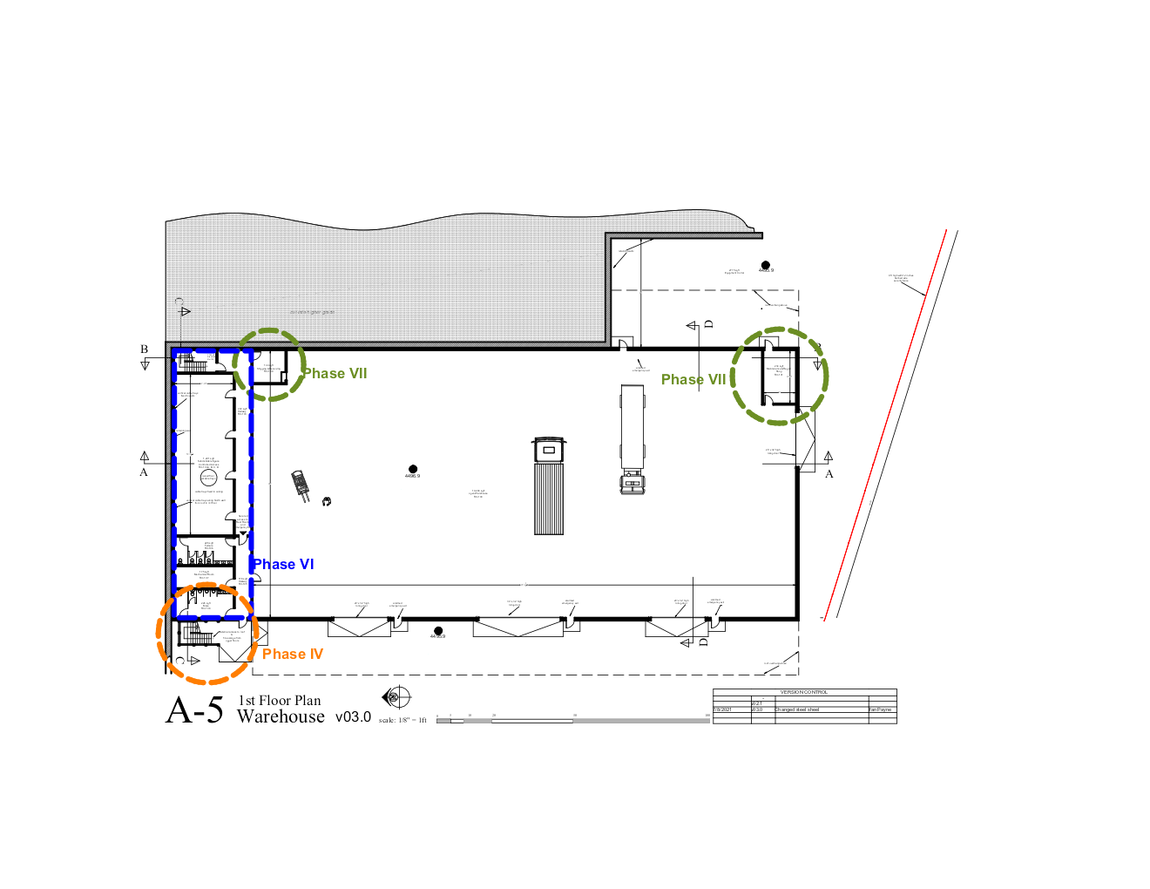
Notes:
1st Floor build-out
Shipping and Receiving
Maintenance Workshop

Slide 9
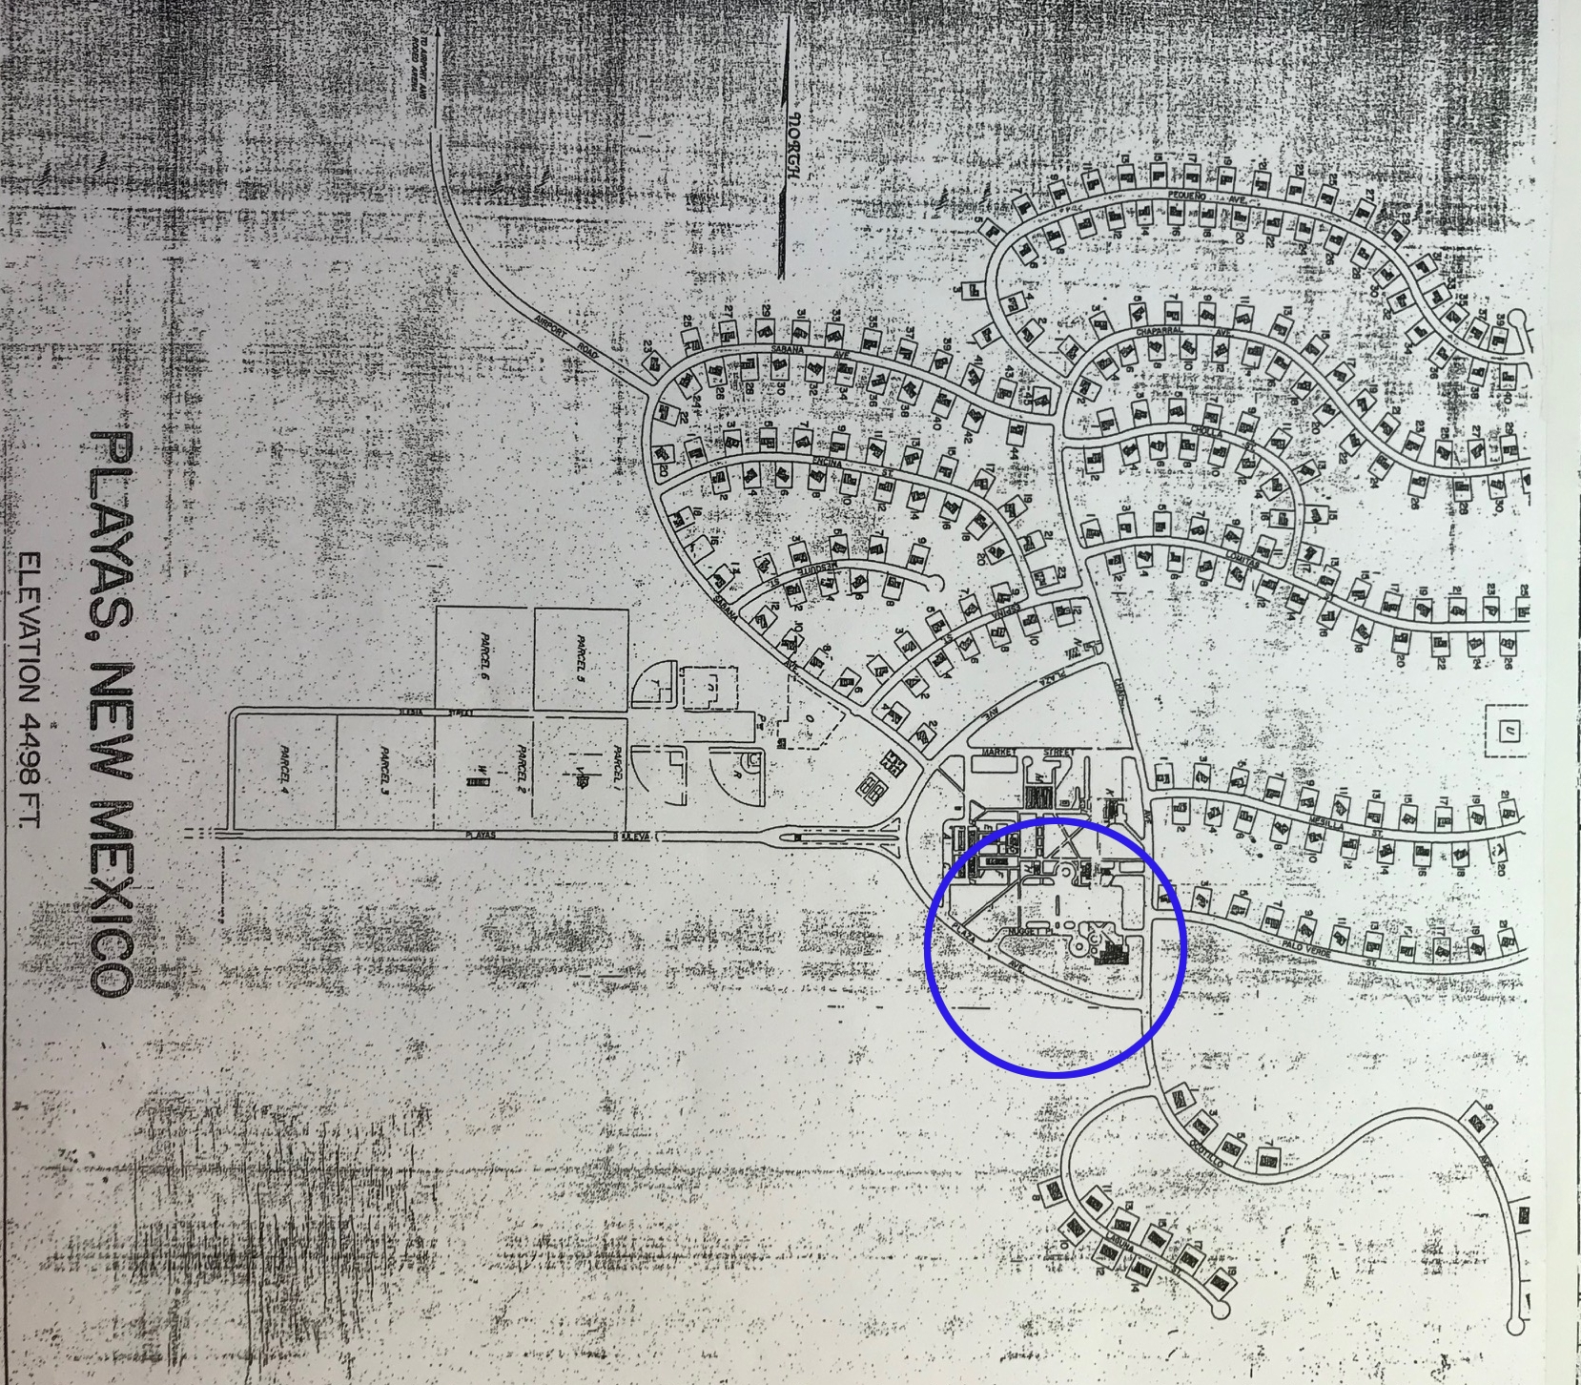
• Secure Facility Design to ICD 705 standards
• Architectural design from inception to contract documents
• Structural Engineering
• Mechanical Engineering
• Piping
• HVAC
• Plumbing
• Electrical Engineering
• Alarm Systems
• Access Control Systems
• Intrusion Detection Systems
• TEMPEST
• Electronic Security
• Fiber network design
• Cost Estimating of ICD 705 Secure Facilities
• Construction Management support
• Secure Construction Management under a framework of a Construction
Notes:
Another known potential project:
- The renovation of the Catholic Church
In addition the A&E Consultant would potentially be involved in town-wide projects that involve:
- Town Utilities – water, sewer, power, data/coms
- Energy efficient town
- SCADA Supervisory Control and Data Acquisition (SCADA) is a system that aims to monitor and control field devices at your remote sites. SCADA is a centralized system that monitors and controls the entire area. This supervisory system gathers data on the process and sends the commands control to the process.
- The NATIONAL COUNTERINTELLIGENCE AND SECURITY CENTER Technical Specifications for Construction and Management of Sensitive Compartmented Information Facilities
TEMPEST, the U.S. National Security Agency specification and a NATO certification referring to spying on information systems through leaking emanations, including unintentional radio or electrical signals, sounds, and vibrations.
The A&E Consultant should be able to provide IN HOUSE the majority, if not all, of the services listed in the Addendum #2 of the RFP. The use of partners of subcontractors is not desirable because of issues arising out of having to provide security clearance for multiple entities.

