Slide 1
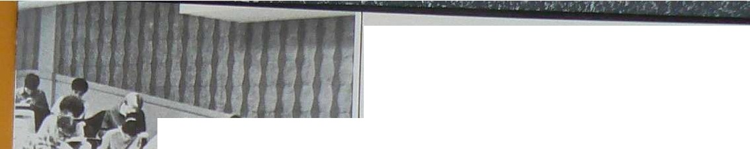
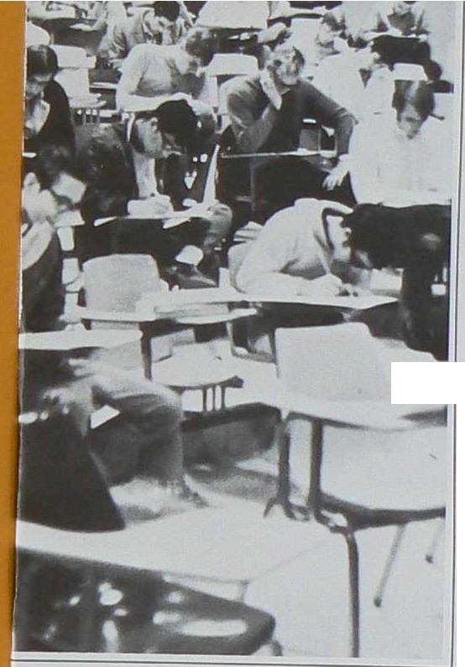
. t,
CONTENTS
l11troduct1on
Student Government
2
•
6
Honors
20
Cln.'ises
Orgnniznt1ons
48
Sports
58
Act1v1ties
68
86
Adm1nlstrat1on
Advertising
114
Index
126
.....
PORPHYRY '70
Suzanne Wr1ght, Editor
Chuck \\ it..c.ihbui,n, Associate Editor
Tom Cryan, Bu!4tnell- M nnger
Bob Gorczyca, Hend Photographer
Jeff Henderson, Sponsor
I

Slide 2
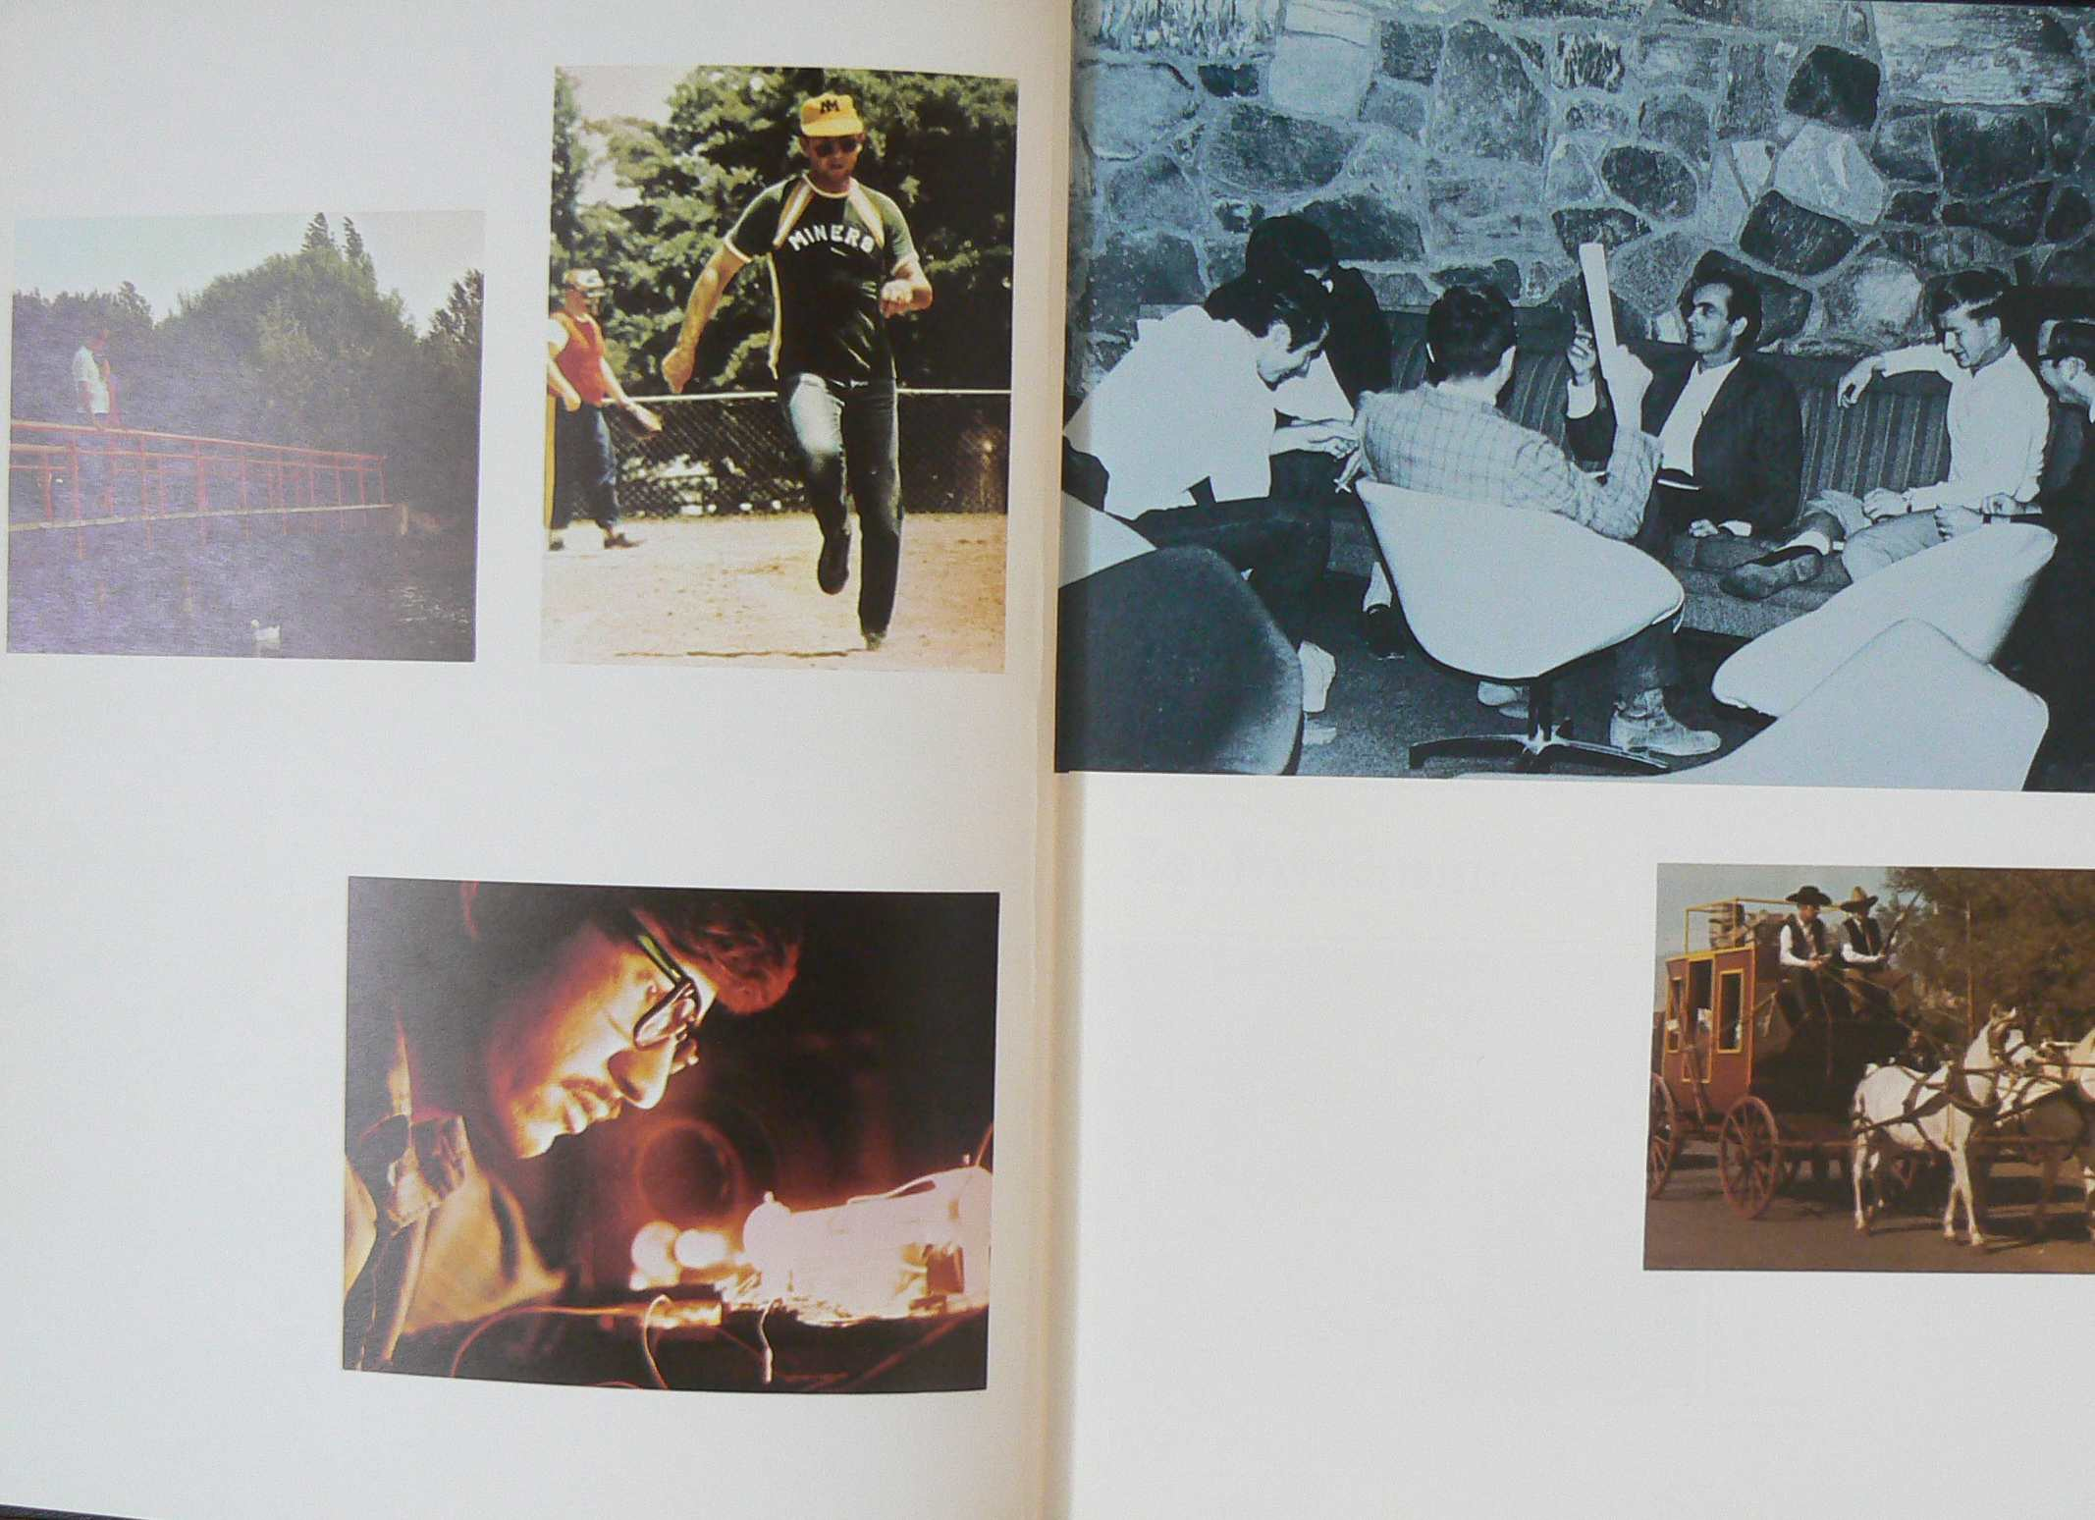

Slide 3
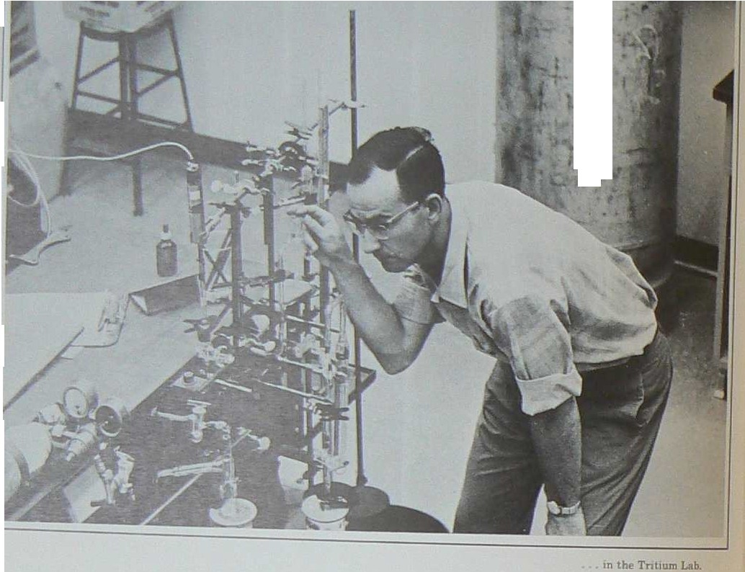
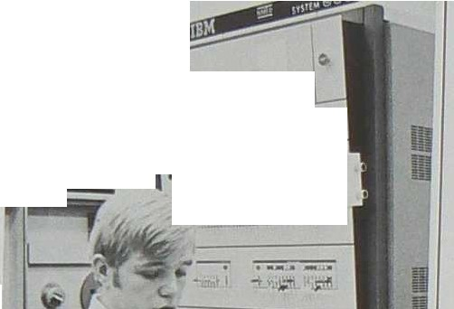
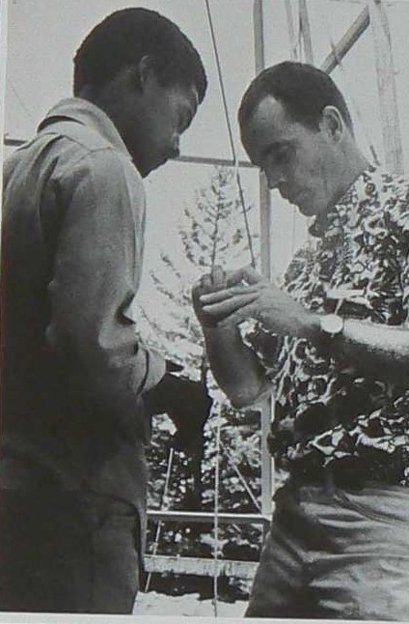
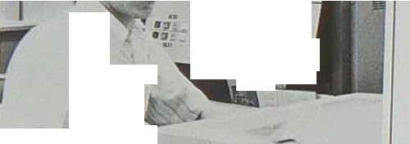


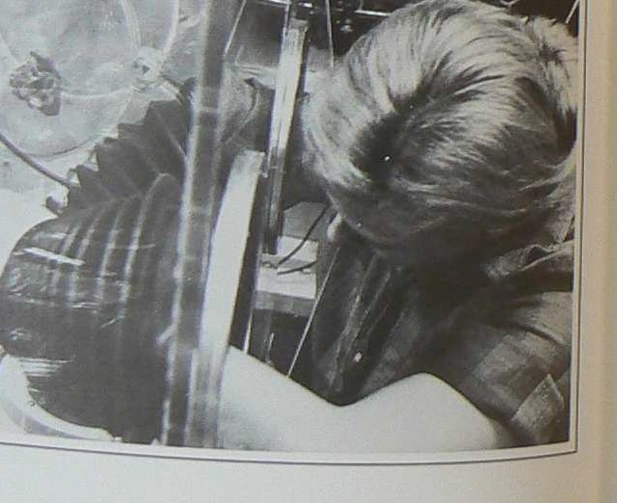
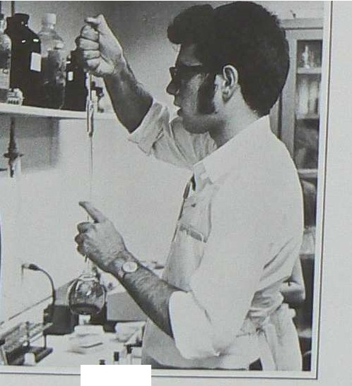
-
t
'
-
-
,. -- ....
)
-- ·--
-
- -- -- -----
-
_{-- ·}.. ............w,lli _
0
....
_{I} \
-
•t •• ••
•
J^{J}.,J^{J}.J^{J}
•' •'
o _,_ ro ai.,
_.._
- =-
-
1n the Tn ttum Lab
1n lhe Computl'r Center
By Working...
Students Beco me Involved
. ut Llln,rmuar Lnb In atmoi1phen ph)'lllt'S
I I

Slide 4
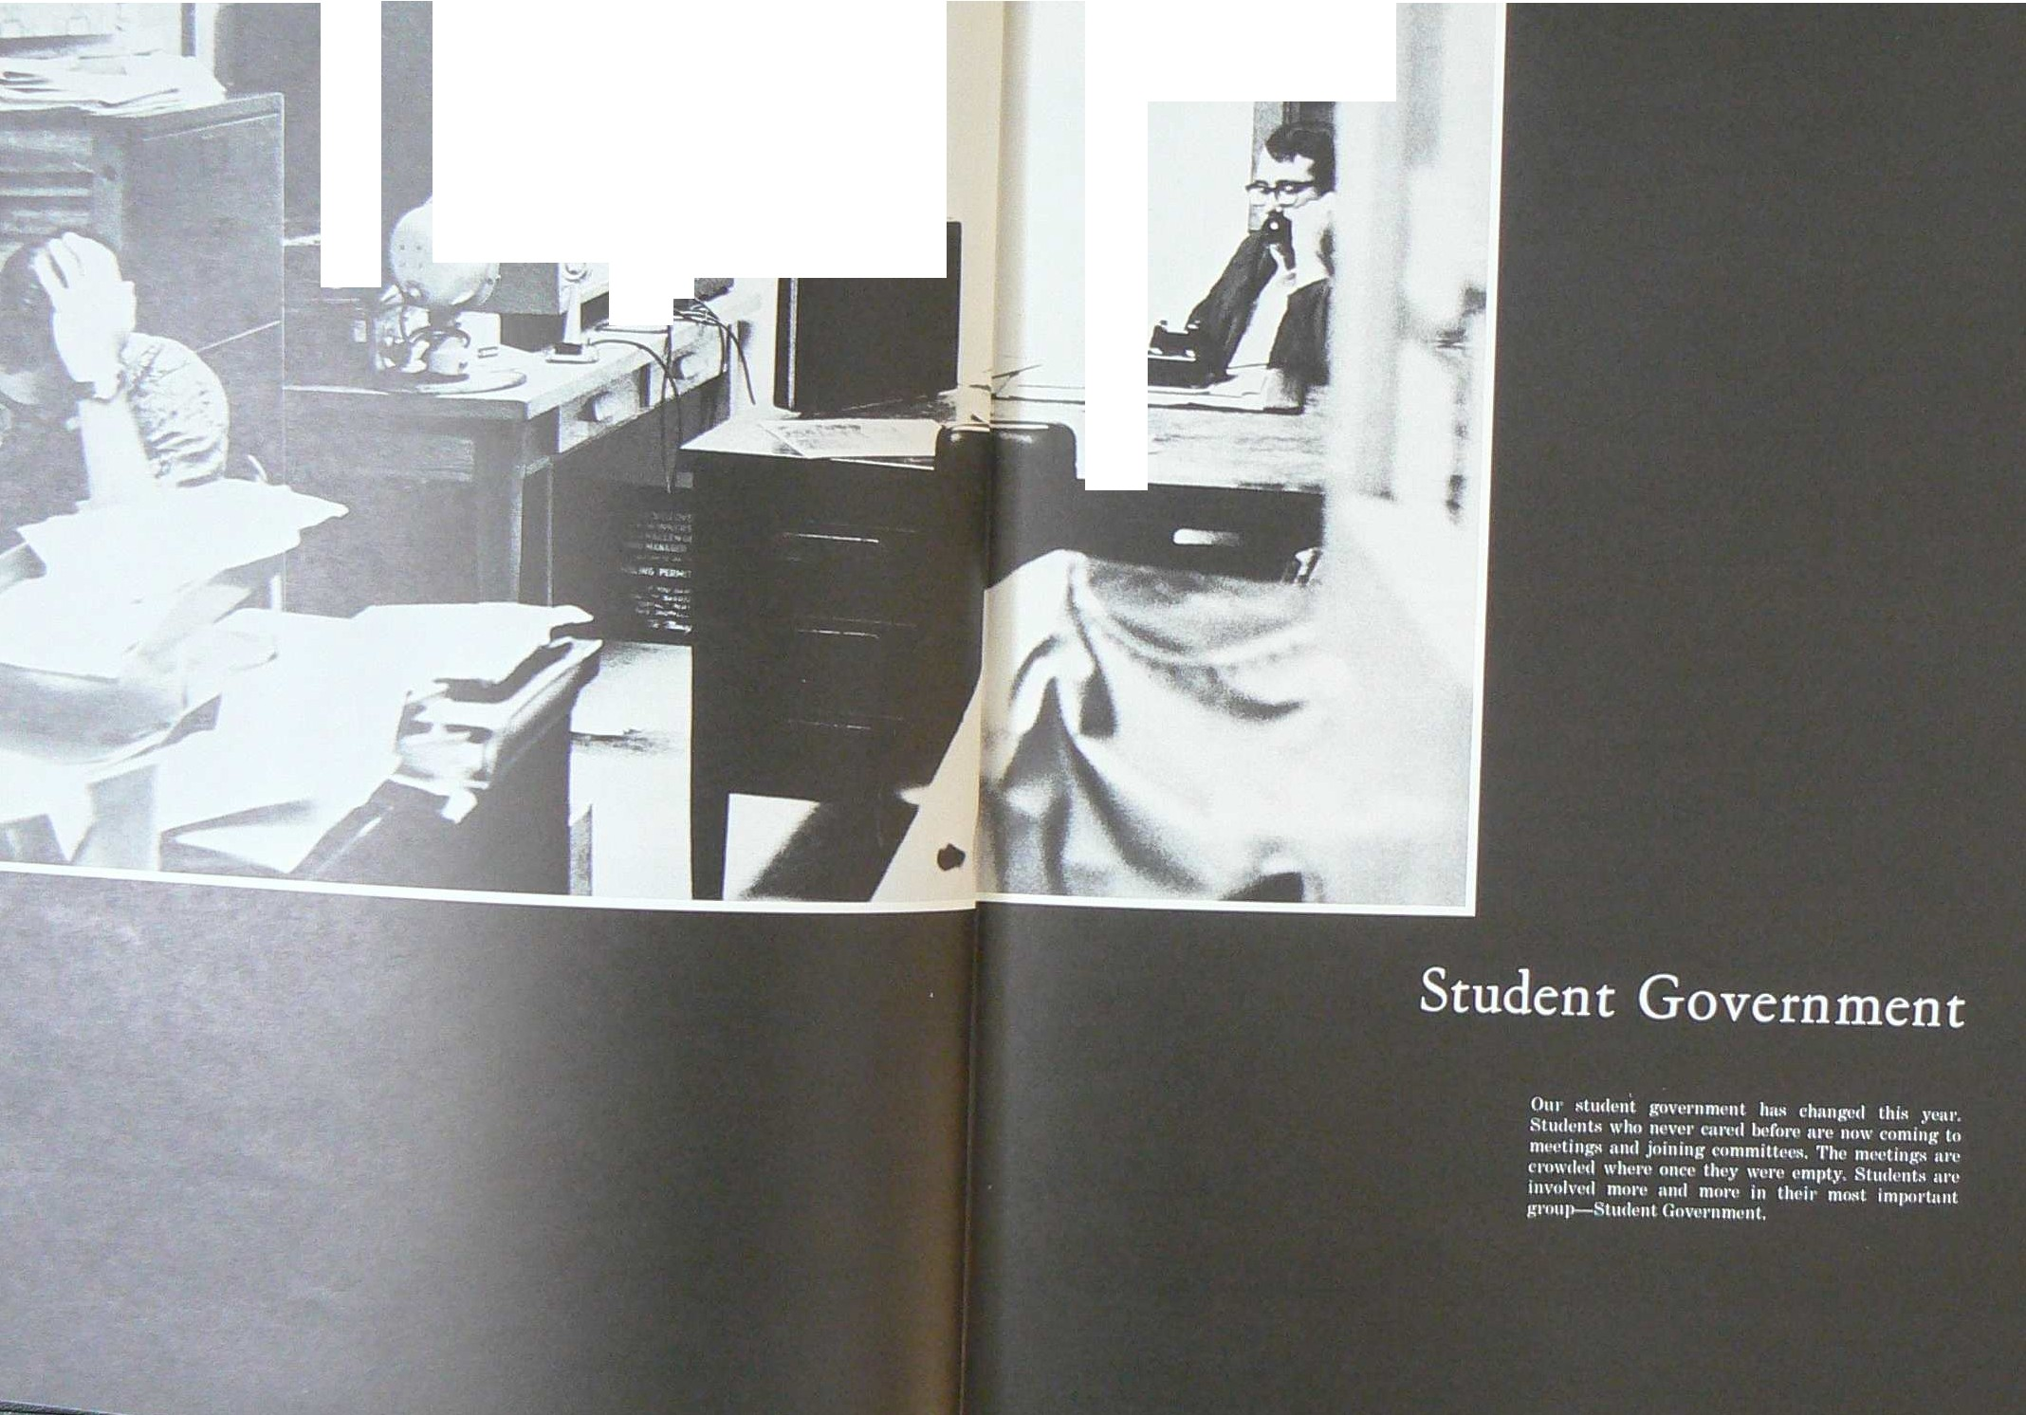

-
I
-
...,•.,
,,,,,,,,,, .
-

Slide 5
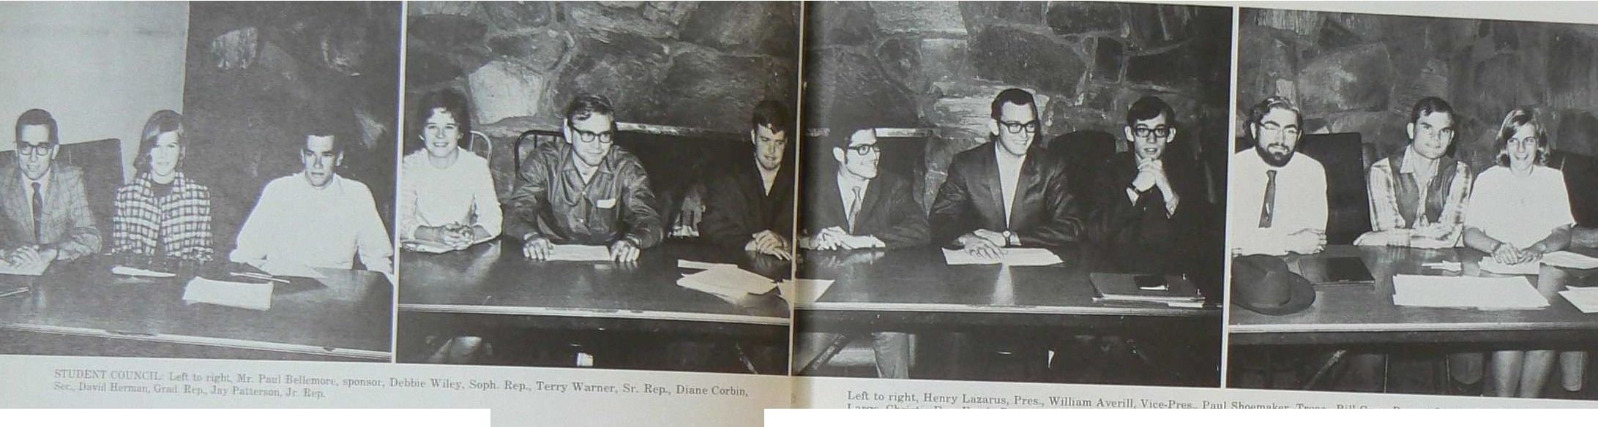

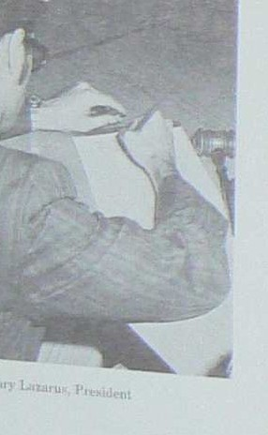
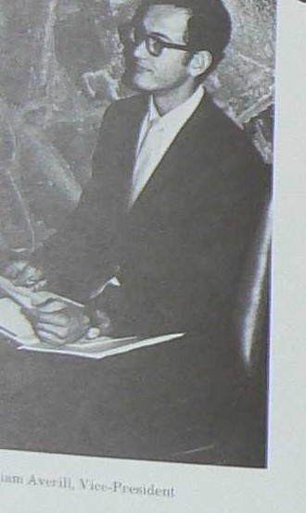
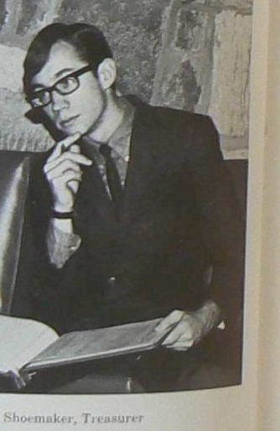
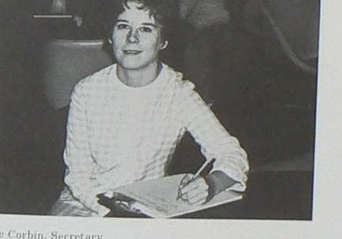
_{r} ' I
Left to 11ght, Henry l,nznrus, Prei WIiham Av,•nll Vace-Ptt l'nul Sh()('mokcr, Trl!ns, Ball Guse, Rep, nt l..arxe, Tam Hull. R p. nl
l.nrgl, C'hrt11t1e Fox, f"rc h. R<'p Rnd Ball\\ 1lhnn1Ron, R,•p 111 1 11,tc
Our Student
Council At Work
'3tudenl Council 1-1 thl' lcg1 lat1ve body of the Tech ':itudent As!loc1at1on 1t. through 1t.s comm1ttee-1 anal boards, represents tht! !ltudeut body to the ,1dm1n1s-­ tr,1t1on nnd to the outside \\ oriel It provides l!lllt•r­ t,11nmt nt in tht• fo1 m of ,vet•kl.} movies, ,, t kl.> dance.-;, nnd monthly cultural cvenL, The ""''spnper, EI. ARRASTRr ye 1 ·book, PORPll) R\", nnll the htc111ry m11gi1z1nt SC R ll'TS nn• 11II funded lrom its
mo111cs..
Ench of the five cJ11s11t• (freshmnn, sophomorc>1,
Juniors, scruon, nnd gruduntcs) hns n r,•presenlaltvt• on <•ounc1l In n1hht1on this ycnr for the first t1n1P th1•1·, nre th1t•c rl'prcscntntt,cs-nt-lnrg{'. fhc othct rr11•mlK!rs of ( ounc1l nn• the 1•.xecuttv1• o0-1cer>1 P1t ,-uh•nt, \'1c{'-Prt s11lent, St•t1et11ry, nnd fn•nsurcr
l h1 venr tor thc fir t time Studl•nt { ounc1I hn11
ht·l·um, 1mp11rt1111l 111 U10 l'ycs of th1• tudenL uody
I
Ua11n, ,
othln
8,,, n:llu y
\\ II
\
J
d I
I
l'uul 1-ih,,.na k(1, T1,11 ur•r
9

Slide 6
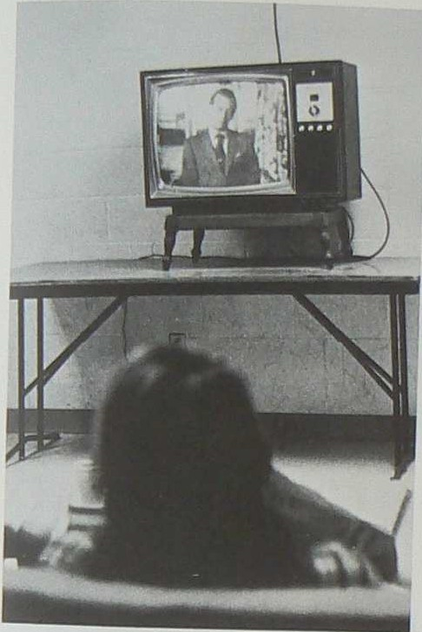
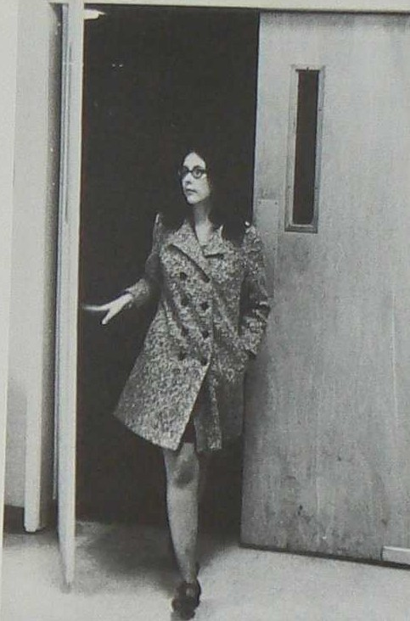
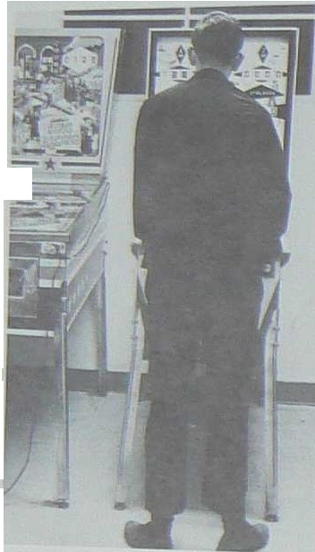
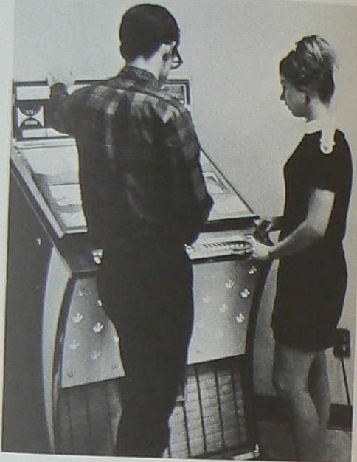

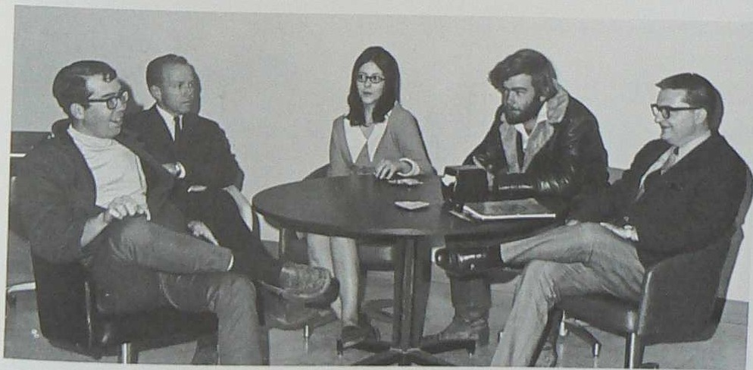
•
C'"
L
'
Student Unio n Plans To Extend
Their Present Building
Imml!d.1ate plans are being mad e to en la rge the L'1110n ar:eu. The patio \\·j11 be ma de i n to th e Book­ store and 1he other offices v,111 be hJfted, leaving the Tele\'l 1on Rclom 1n the pre.-ient Bookstor e.
Other m&Jor changes include ne" · couchei; and loun1,.'lng eha1r.a for the Te le \'1.iSon Room and pwnt- 1ng tile can't(jen area.
At prE!M!-nt, the
Student. Union Bu ildi ng alw
h,•US!!s .1 garne room for the students, i u1 d a co11-­ t1·0\'eri11aJ ne\\ Jukebox, vrh1 ch livens up the morn1.11g and afte111101Jn colfeC? breaks
'fhe operation of the St udlfnt L n1on Building is k·ft tci the St.udent Union Comnu ttee, picLu r ed at the
r tghl Lcll to r1gl1t, they are. ike I' lett, ch11u·Jllllu
and mnnagl r, 1-1r, Spi•ncer ' \'ilson, facu Itr sponsor,
Cundy J:Jolt.i,, Paul OlsQ11, and T ed lf ura,vs kJ
10

Slide 7
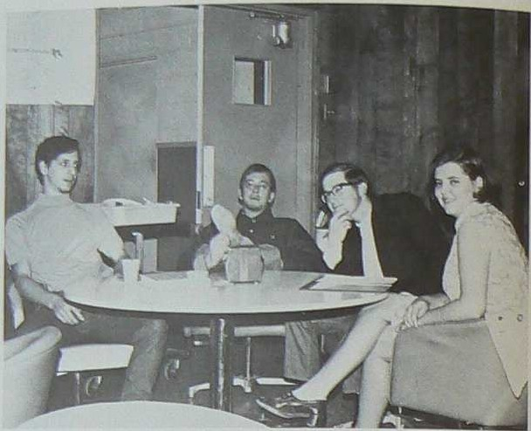
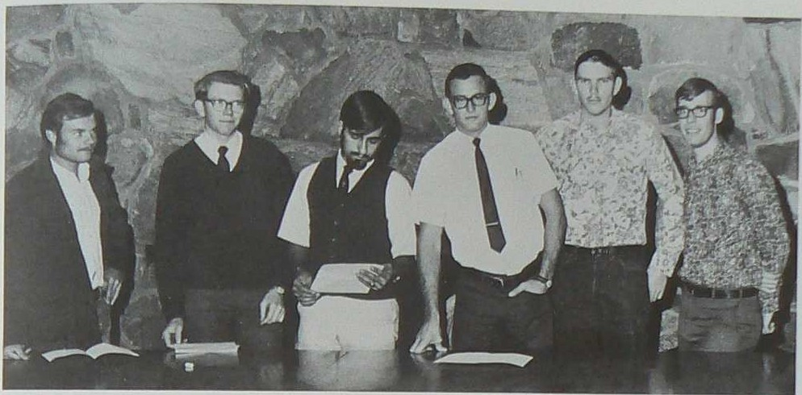
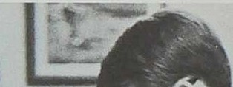

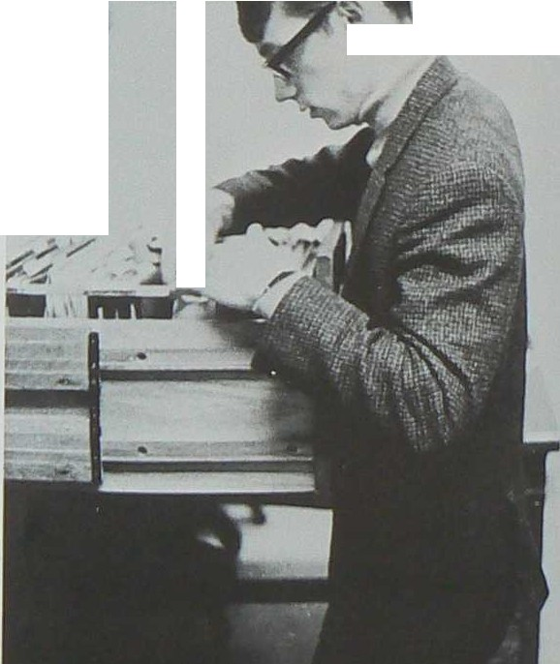
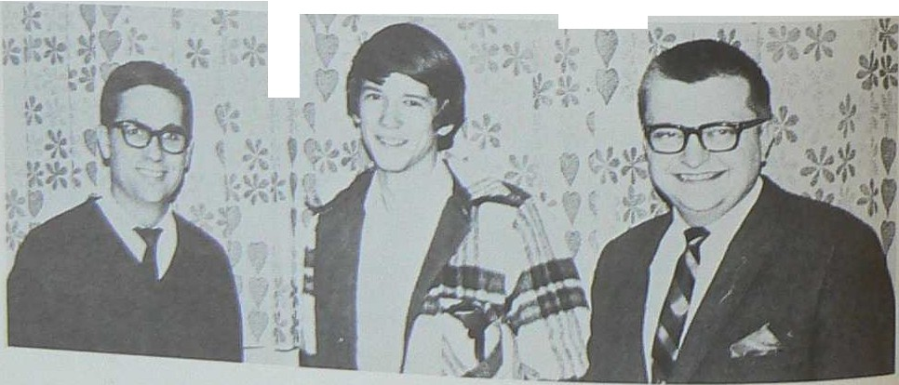
OOR'\I A'll."D FOOD GRJEVENC'E CQl,IMTl'TEE
R u:huro L1t:le!ltC1n,; Les H11nt. C:natrmnn, Jnn
,Jeui;en, and B1lht Kelley
CONSTITUTION COl\tltUTTEE Lars Wnkemon Fntz La­ quer. Jesse Henderson, Allen Averill ehnrl mon, Ben Bust ed, Chuc!< \Va11hbum
Tech Works With
Other Schools
The Offir1• of Intercollegiate RelatJons' primary ob- 1ec!JvE1 1s t.o l?lrt undercJll96men u1ter$ted in ,tudent government One committee from the group (!'athers 1nTonnat10LJ on S.D.S nnd 1l. tactICR 0.1 R w.a., formed n:1 tech n the Summer of 1 169
NM Student Goverument AHsocmt1on, or.gnntzed lit Tech a sair .igo, plnnned their irt.nu.:\\·1rle const1tu­ L1onw i.:onference "htch v.a;: held at Tech 1n
'.iii.)·, U n 1ve rs it )' of Albuquerque and the College of
Sant.a Fe, are t.h e ot he r member s of N 1>-l S G.A.
The ,A ocult1on of Student r,oYernments t'i a t1a­ tional, non-poht1ca l or ga ni zat1on W"h1ch d1strlbute"l 1nfornuit1on to hools
At pre.,ent, the r 0Mt itut1ona l commit tee u; wr1t11tg a ne\\"con st itu ti on for. Coun cil. \Vitb the appointment of this committee b.r th is years councul 1969-1!}70 tn11y b1; t hu last ye.ar for Council tf the constitut1onal comnuttee coni;iders for mation of a student senate.
I I
..
Fr.-bruan· Atw a spnng lf:'ga:Jt1t1\'e conference 1,.
plan11t>d for f:lert1un uf officers. ,rf!f;tern N l\f
l 111\,-Pmif r NP,\ Mexico St..te, E,IBt.er 11 ..\1 !\l t;n1\'er-
AC'TI IOOR!JfNATING CO.M.IIUir-rEE Jticqut,11 P.enuult, fa.cult;· ad ·= Wtll W1 Jkni
son c ha i rman , and Ted }tu row e ki, Thil
cmrmn -'t' """"u nllks cr.u·t;:.odt'ntact1\' L calimder WIto B\"01d confl1c:ta
1
1'
y
r
i
1
-
-
I
I I
Jlo
l'nul Sho muker, cha1rn111n
o( 0 .1 R. and
N lll S.G A., llnd representutiv, from Tech to .\ .S.G
ll

Slide 8
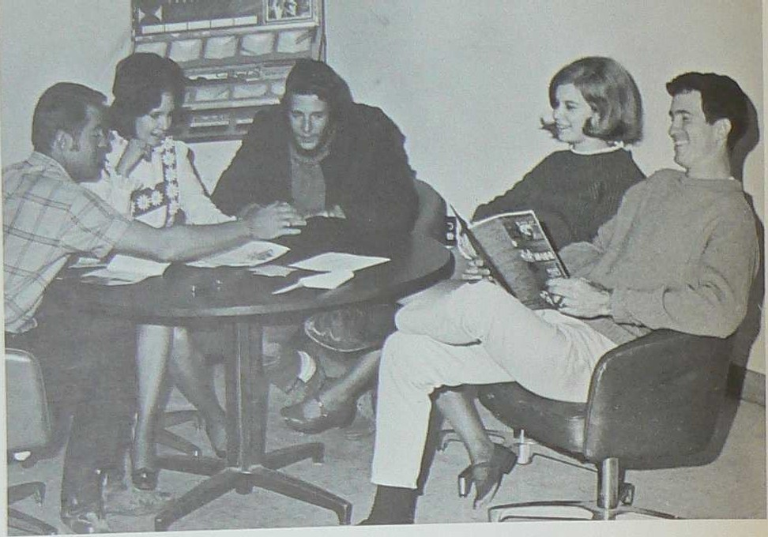
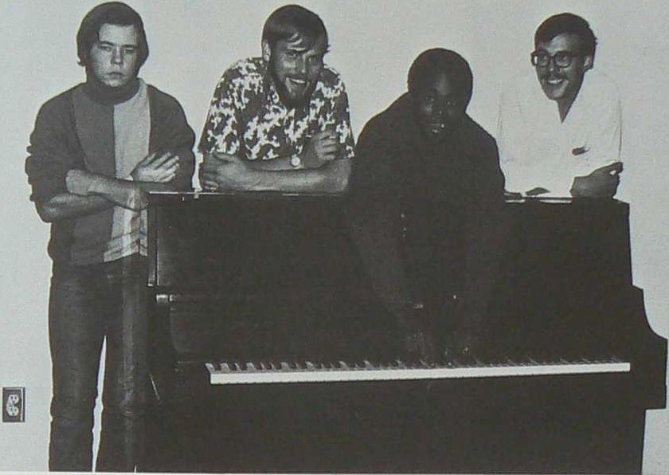
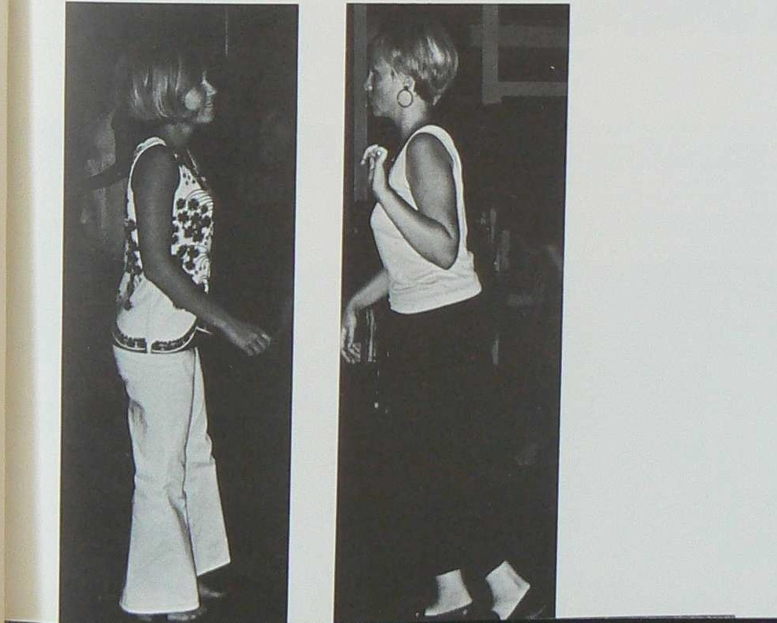
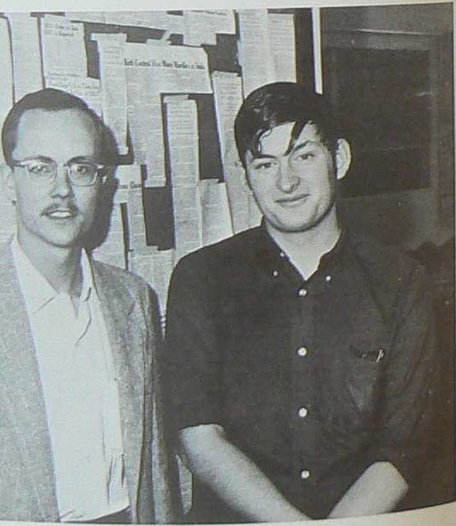


•
0\ E
OJJ.lt!l'TTEE Lee, t,ach cll 1rmnn l nda K lb'. P 1ul ;o.1emlat., D bb1e \\ tle), nndBob Stron
DANCE
C0}1f.lITTEE
Dove Tar box,Edd Beoeh
l harles Blnck, cha1nn11n, nnd Dick EngbrechL
More Entertainment Committees
•
r
p
BW IT"i
r.n tlln P
OJl!Ml'M'EI:.
J I f

Slide 9
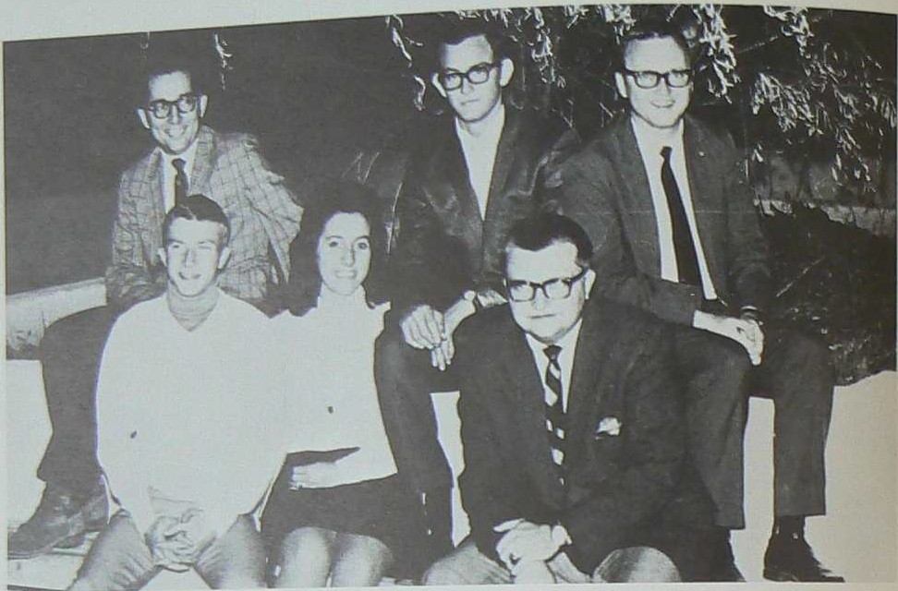
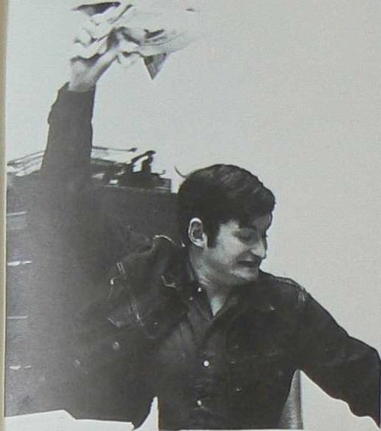
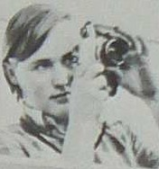

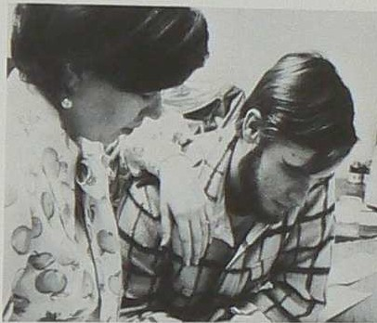
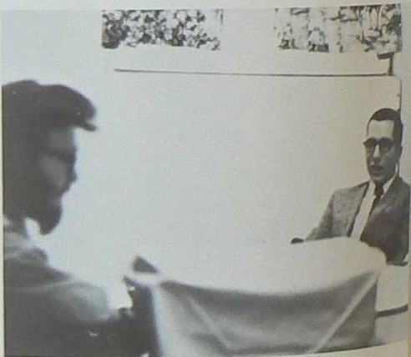
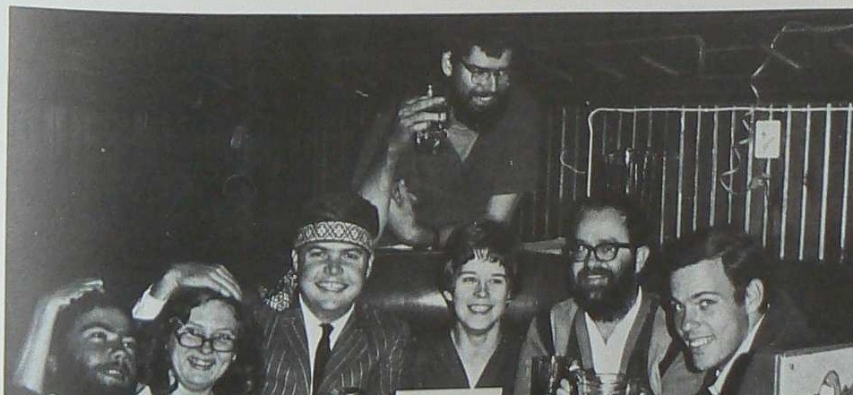
'::r
Jon Harmon, Photographer.
d
Editor Stan Pellow
P[ Bl]( TIOX BOARll
r.!•. Paul Bclleinore for:i.lt, !>ponsor
Danny Belk, h,nntfer B ws, Allen Averill, ah111rm.1n
r ff ill'n
=n.
ftu"Ul
pon!<llr
The EL ARRASTRE. the student body's official newspa per, has a trad1t1on and a. history tracing
Student Publications...
back to the early days of Tech. But never before
has such pressure been on the staff t.o produce a
paper of quality The UNDERTECHER, an un­
derground newspaper, has sparked interest among
Rhonda Deyo, Typ111t, and John Hagood, Loyout
students in all publications.
'rn1 PulJlicat 'lll B<liinl of I udL•nt C'ounc1I ii; the go1, :nung bod, for Lhe ofiic,1r.l!; of the -,tudent :\.,;..
El Arrastre Has Competition
....=L..Jt101 Tnt Iluhl'Cl I responsible for ap1K11nt1ng all
1.. ta merr.b£r of EL AilUA TRE.
PORPITT Hl and &CRJPTS
Tht J>ubhC1Jt1ons
Bo-.i.rd ur. 1derl'd on" if the dut1es Jf the , 1ce-
UN DERTECHER Staff Left to right Paul Olson Sue Ellen Pattel'llon, Jay Patterson Hal Larkin, E<titol', DtM, Corbin l
P u:lc I l. h h 1rm Thr E ard 1s al!lO re.."poni-1-
Jilll" Is, and Grant Wllrtenhurg.
blc fo1 recommimd1ng budg(:b: to Student ounc1l fo1
th pul, e.it101 Ho\\•• l'r the
'>ourd F not
.r%IJOl'll'lt-
t' 0 an oftne a1•t1on ffl unde t..nu pape.ra Uth
ru tht '!\DERTEC'IIEH
H1clU1Jr-o
, hcr Pu
Bo11rd | m1 | ml,er and
,<,..rd pu |  |  | iu..-,
Ir Puul
Btll
r ulih t1u
16

Slide 10
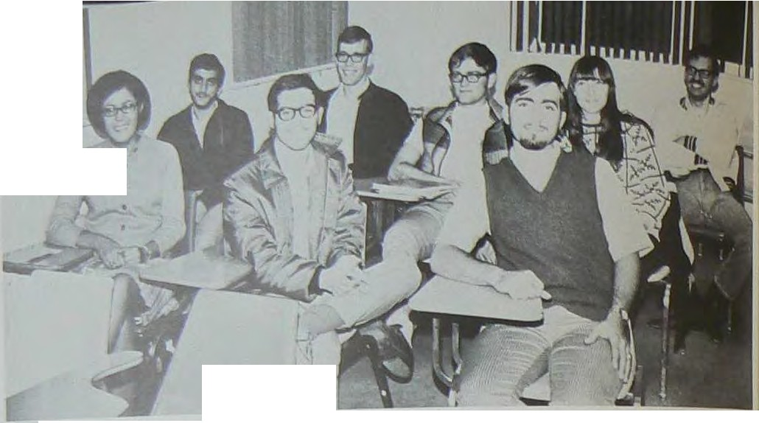

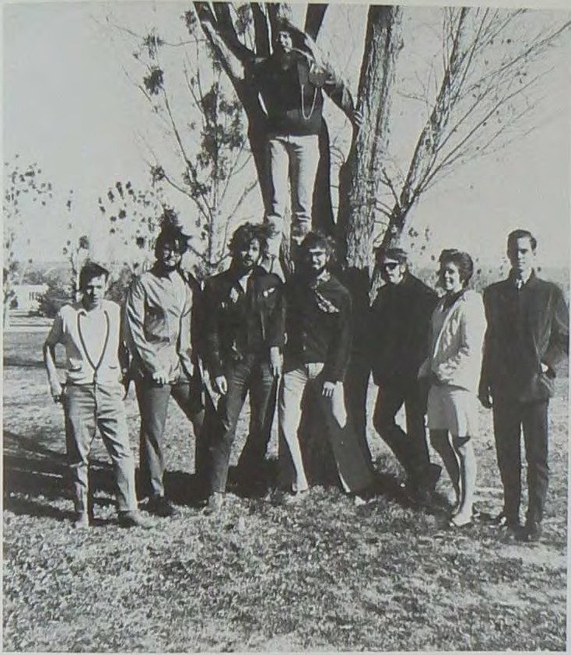
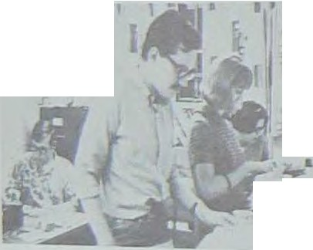
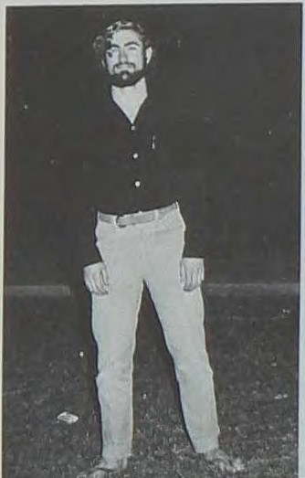
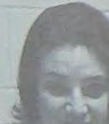
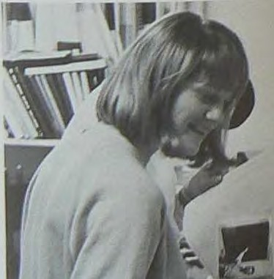
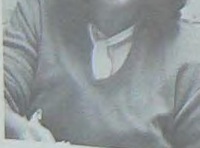

I
...-
•
'
r
I d A cimU. LR;llllt Editor C.arl l\l ctirot>ion, .\sat.. Business MAT,. H nry Luarua, Chuck Wa shburn, Asaoe- Edl-
u,( .;¹ r:ct r, ¹¹"1!1'r.dllo Je.lll.' Ht>ndenon' Linda 'Dawson. and Bob Gorczyc Photog-rapher
Porphyry St rives to Improve
'
After overcoming obstacles earlier in the year, this year's PORPHYRY Staff is striving t.o pro d uce a yearbook which "'111 surpass all of Teeh's prevlo1111 yearbookS
Major improvements include a new and largw
page size layout.a in the style of LI FE , LOOK, and PLA YBO\ magazines, a more qualified consultant, and a more concerned publishing company.
After mounting diapleasure with previous editio,ns
left to right Pat Wade Greg
Bo ah Pnul Olllon, Jo Sgyder,
Bill Ouee, Davi! S elmer, Diane
Corbin und Dennis Prewitt .
Seri pts Increases Quality
SCRIPTS, Tech's lit.erary magAzine, was originat­ ed in 1966 by Richard Murphy Since then tt has published issues of increased qunhty each semester This year, for the first time, SCRIPTS was printed oft campus by Mr Poul Payton of Carr izozo. 'l'hls was n big step nllo\\•ing more freedom of 11tyle nnd 11 more professional looktng
-
th lB vear has been
a tr ial period for the
l
PORPH1'RY The unage of both the book and the
- -
staff 11.1 greatly improving. The staff feels t h1s year ¹¹¹
not tlie end of the PORPHYRY, but the beginnign o f
a new publication.
-p
c::.
Suzanne Wright, Edit.or
magazine. Second aemester, in nddltion to publishing the rrutgnzlne. the SCRIPTS !\tAffspon.. 11ored u pootry rending and , folk concert.
Tho editor, Bill GURe, has worked on the
mugazln<: alnco its li r llt Issue and has served 11-'I ed ito r for all but two ieauell Diltnc Corbin, the rui­ slat:nnt editor, hll:ll been on the ,tuff for two yenl'll. T h e re11t of the stnff, new thifl yenr, con lats of Grttgory Borah, layout t>tlltor Pntrlnk \Vt«le, J>toductlon munngL•t , Donnts P rs \\'ltl., distribution munngor, Jo Snydar, edltorlnl 1u111h1tnnt, P nul Olaon, 1!dl tor ial iu11dst.11nt, nnd Dnvld Selmer, atnff
nrtist
It
19
•

Slide 11
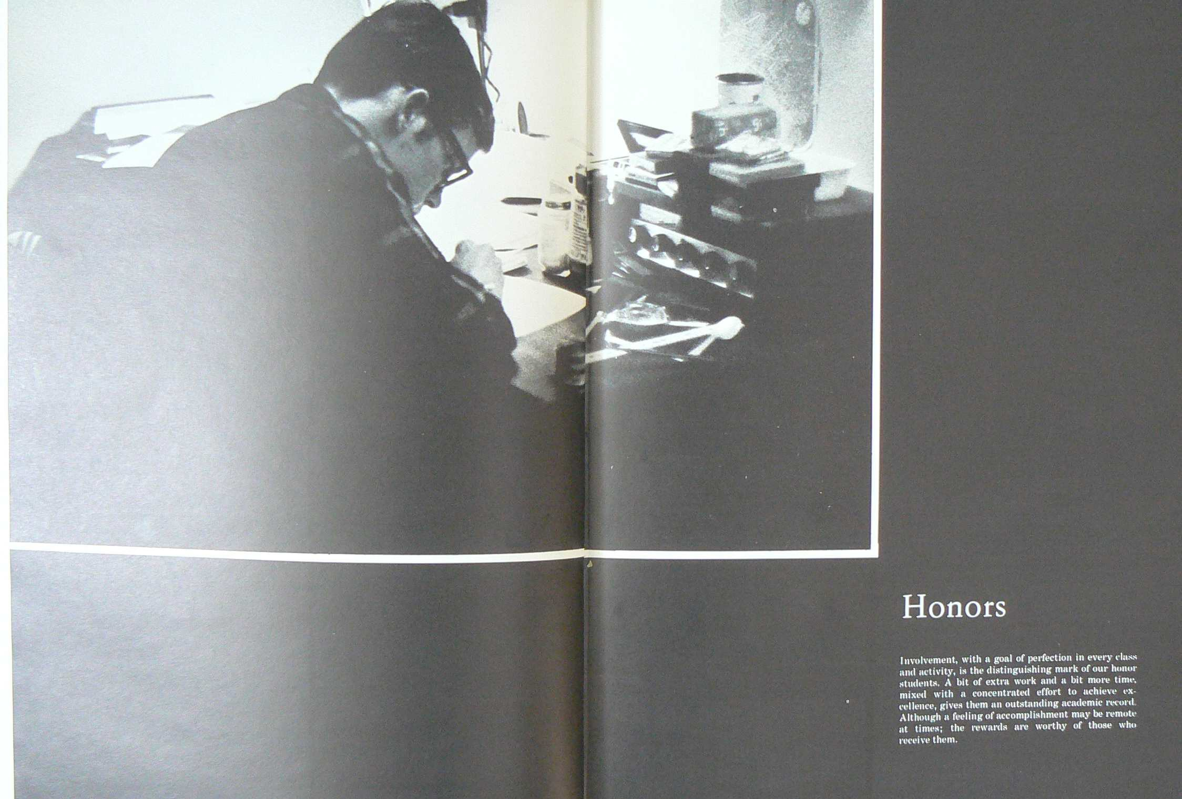

Slide 12
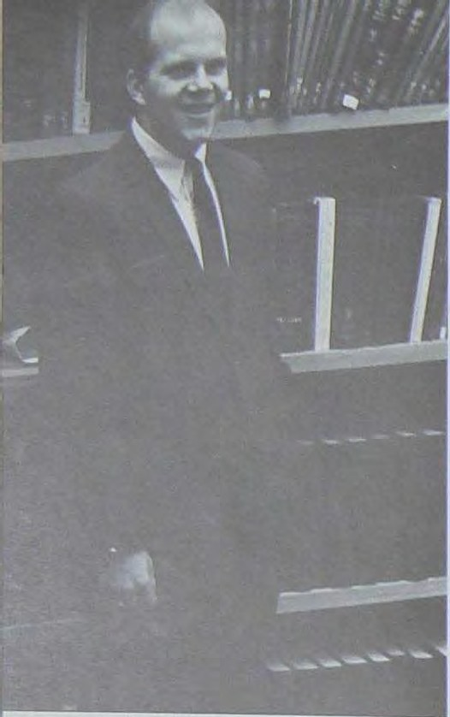

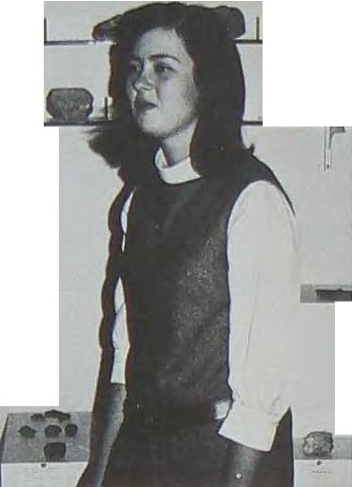
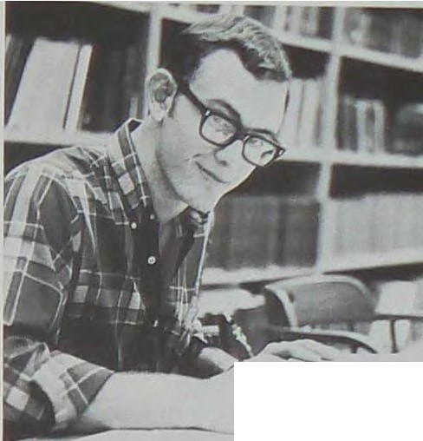

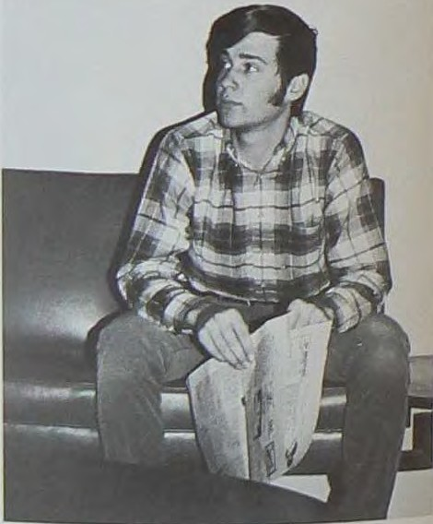
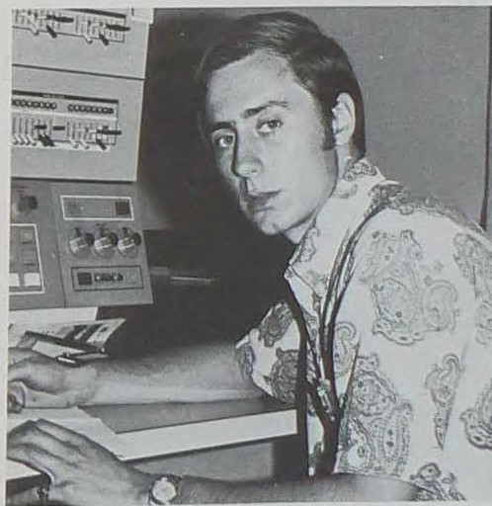
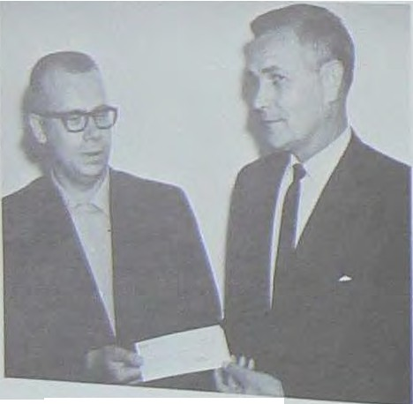
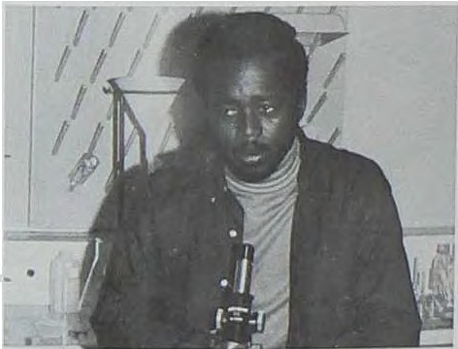
Erbes Received
Brow-n Medal
Involvement and scholar shi p havt. played key roles tn choo. ing the recipient$ of t he follo, ving a,vnrds. The Bro",,, 1fedal 1s nan1ed 1n honor of the lnte }Ir CT Brown, a benefacto1 of the coltegt: and a long time member of the Board of Regents Thts medal 1s presented at com.rnenee m en t to a gr ad uate, choSen by the fucultl. "·ho ranks highest m cholarshtp, con­ duct, and leadersh1p. The 1969 recipient of this aw8.J"d ,,ms Russell E rbes. an ou ts t.nnd1ng scholar and President of the Student Body during1968-1969
Rec1p1ent of a $600 scholarsl11p from the South­ ea.qtern New Mexico chapter of the American Petroleum Institute 1s '\t1ctor Charles Knauf, a oo-op student maJoring in Ph;-sic.s This scholarship Is
renewable each year m the amounts of- $7-00 the sophomore year, $800 the Juruor year. and $1000 1n tbe senior year.
In September Texaco estabhshed a scholarship program for the Petroleum Eng1nee ri ng Depart­ menL An 1n1tial grant of $1550 was presented by Mr Donald Smith of Texaco to Dr Donald Brandvold, cha1rman of the Scholars hip a nd Academic Award Committee.
H
•
•
-
-
Rena ?ilae Bonem, Geology
Kennecott Scholnrahip, Teclb Scholar, Sec.-Trewi. of
N11' .T Gun Clu.b, Seo.-Trcos of N.M.li' RockhQund1, Secret.al')' Qf A.CM , Assistant Museum Cu rotQr Con­ cert Band, 1-Ionor Student.
\Villi.nm A'lerill, Cel"omlc EnM,'ineenng
V1ce-Pres1dent of Student Councif, C1hm. of Pubhcnt1ons BoW'd, Chm. of Con8'trtutionnl Committee Oelegut1on Chm to NM S.G.A. Iden Conference Dele atlon C'hm to NM SC.A. Constitutional Convention, Proctor
Faculty Chooses Who's Who
These students are honored by being named to Who's Who ln American Colleges and Univers1t1es Chosen by the faculty, they are among the ehte few who can combine academics and activities successfully
Charlu11 Bl aa k, Biology .
H
ltorry R. Born, Con1puh•r Science
Mt11"11ber of Dlolog1cal Society, Dnnce Cornn1lttoe, Soc!ll l' ro
Olti
RtlBldent A1al1tnn Acllden1lc- Scholanhip, Co-op Stud,nt.
Mr 8 rnni¹ JJl' ta thTt
Co No l UP ll JGHT,
Trl'uaurer or A11aoa !or Computlnv M11eh ?.!en,ber of l\fo tor•
c)'Cll• Olub, Ttonor Studl•nL
l!Ueo ec:hol1U11h1p 'Lo Dr Bl'lllldvold
Victor Char le. Knallf
22

Slide 13

















-
I
Henry Lnierua, Mntbemet1cs
Grad Asalstant.sh1p 1n ?tinth, PreSJdcm of the Student
Body, Cartoonist of EL ARRASTRE, Loon Fund Com­ mittee, Member of Fencing Club, Alpme Club, Honor Student
Rol1111d P1tbi, Pbj-sica
Qo-op Student., Academic Scholarsb1p, Honor
.::,tadent.
Patricna Giclu, BJology
Honor Student, Member of Damet
Club.
Linda Kell , S0011'1 Scnence
A1111t. Editor of EL ARRASTRE, Student PubUc Relations Rep
,1embcr of DrallUltec!ha, ?tlovle Committee.
Henry J Tlll,Jeron. Mathematics
For Who's Who
Student Assistant for l\(ath Dept. Academ1t
Scholarship, I11tramul'!lls, Academic Schoh.u,1h1p (Go
o(Guam) l\tember 0£Chl!$8 Club, Honor Student.
r
f'.rank Ortl!II'• Mnthu11111uc
Bob Heth, M11thon1nti Soholn-hlp, UPRlGlIT, ln-
Co-op Studont, Acndemlc -•
tr11n1ur11l1, Honor Student
,
o-op Student., Academic Srhoh1rahlp, Jntron1urnl1, lembor or Y1ll Club, Honor Studl'nt

Slide 14


Slide 15
















Graduates
R11,rcr 1\llmendlnlrt'r
Gl'<IIOIC)'
\V1dtc,r, Nllw York
Rnymond I' Amby
Blorhnmlatry
IJul'lllon, < nllfomla
Surjadl Ardlwllngu llfl'talluJ1?Y
Edwin Auin '.\1etnllurgy Sucrl' Bolivia
Dllvld llrown
Grology
\\ inter P11rk, tlorula
Chunn 11ln,r Chnnir
1etnllurgy
811ndun,r, Indone11in
Tnlwnn, Rrpubllr or
Chinn
Chl,plnl(
l'hlun,c
Chlr1•11hnn
Chiu
Drlv1d I'
Cl11rh
Thomn R l ro,wll
l11th m11tlr11
Grl wuhl lowu
1',•troleu1n Engin,•ltrlng
l'hytlC!l
l'hy tr•
Tnlwlln, R11publir of Chino
'Iiilw11n, R puhli<' of Chtn11
IJ111rhn1C1 n, Tt'll&I
-
S₁₁ul ,J f.'Arl\lnr"
\Vnltt•r \
J,'labtor
Hrucu l) •Hnn1
c I I ,I anJ•
t11oph,111lr•
K111n, 1'11 ut"m f,Frm11ny
\ti,tullurrY
C1>Chnh11rn11 llollvln
fi•o•ril'lll'I
<,t'Ol"hnc1
llo•w,111, M
l:l1,cr1rn,
!Ii ,,

Slide 16





























Tomrn, GorwtlM
la thl'mat1ef.
Sncorro, 'Sew Mexico
James M. Grome1
Geology
MIu:hl'll, lnd1an
Joe Hardy
}{aJhematics
J a.ebon, h ss lss lp pi
}Jax Homs
Physics
West Paducah, Kcntucl.1'
Laura L. Li cht b[athl!lllatlcs lrtenton, Ohio
Ch hen Liu Metallurgy
Taiwan, Republic of China
DllVld Bernum
)I IIUl61tlJUJCI!
Boone, Colorado
Rudo! h H J acobson
llJet.allumY
Gowrl S. Kallaa
Dr. Thom as S ZMz, l'tf D., Pro f'esaar of Paychtnt ry from New York. spoke at commencement exerc ises last year.
Chester R. McKee
AstrophyalCll
Vandergrift, Pennsylvania
R11ben G. Mnrt lnez Hydrology Monterey, Mexico
Mining Erurineenng
Summersville, New York
Huntsville, 1'enne.ssee
I
Burha.n H r.llnd(!DIJr
G!:-l>_Ph)-.u:s
laumbw. l'c rla?,}
GulCJc E K.ande1J1.1r
Ph IQI
Istanbul Turkey
Alexa ndr ino C Nogueira
Geology
Mira nda, VenC?ZUela
Richard V Pleegor
Geology
P hilad elphi a , P enn s yl van ia
Walter Pierce
Ghanahyam Rai
?ifsta llurgy Chandradeu Rai, India
Geolotrt
Mun lce, Indiana
Kenl'l' kon Laza.rue M11Uu.ll1!J,II.lea Alron, Ohio
S o mph!Vlli' Rodphot hon1r
Gu op ll.Y1i a,
B an gkok Thaila nd
D av id A Schwab
Geosalence
Wrnna-ell, AJaua
OeraJdlne Schwab
Geology
Blythe, O. lf(orn la
Roh.Int Sharma Mini ng Engineering
Baglunr, Nepal
Richard Upchu,:c b doing hill Thing!
31

Slide 17
































Senio rs
Udar K Sinha
:\Ieta11u rStY
B1hliJ', India
Arun K. Tandon
Mct..allul10'
J u ilu nd11e, India
Alfredo I' Vargaa
Metallt11"1Q Lapaz. Bollvia
AJbert.o Aquirre
11i ota llurgy
El Pru10. Tuna
Lorett.a Apodac.n l\ f othematlca Sant'.l Cruz, N M
Allen A verltJ Ceramic Engineering Albuquerque, N.M
Garr,nrlAJ> 3tnr.l¹
Mei.ailun:r
Jamnm. lnd1a
-.,.
•
Tun J- hal Yu
Pbylllca
Rlehnrd Barbaras l\.lathematica L1vcrpo0I, New York
P,l llford Bena
Oherles Black
Biology
Grand Forlas, North Dakota
Renn Bonem
GeoloS)'
Tucumcari, N M
J I A. orcwk
h=i
Sha-hin WJO·
HydrolOl,l'.Y
Port Hueneme, Califor nia
Kraiwut Wonr,'iwat Geophyaie& Bllngkok, Thailand
Chemistry
V- =""- Pt!l111£)'1nn:i.
Taiwan
Republic of China
Albuquerque, N M
I
Harry Bom
Computer Science
Ola)lton, New Jersey
Dan Brimhall
Chom1tr1
Orem, Utah
Kent Drown
Comt>IJter S cience Sllnta Fe, N r.f
Rita Brown
Bloloff
$0(:om>, N M
'LlhJ1m Zolnu1r.1
Ceolor.y lllU'tliaVlltt, Oltlahoma
•
.-
J
P11t nuoldoy
flhy•lc
Anuh.i•. ltn, f"4llfomh1
Crnlll' Durton
GoolOll'Y
Uur1t.avitle, Al11bumn
WIiiard Chti11totter
Envlronmuntul Enginuerlng Chlaago, rtllnol
33
l2

Slide 18

































\
Grej1; C,"oyle Compuu-r Science Alhuqu erque, I\ M
Thomas Cryan
Petroleum
,, •est Chelmsford Mass.
Chu les Culp Physics
Albuquerqae, N, M
Jnmes Galbraith l\flning Engineering Scotl!!dale, Arizonn
Therese. M. GarreLt
Pre-med
Greensboro, N C
Thomu Gentry Petroleum Hobbs, N M
Hugh G1ggy Mt.>t.aliwlo' Pampne, Texa
I
J
••
Gt::W.;,a Dniley EnVIrorunental Enpneennc Nt"i Lllgonn .N M.
Bmln1e Ed wards
Mllt.hrmatics
Lm Alamos, N .M
•
Jeff E1tr-enbooth
Buie Science
l)au&ury, C.Onnecticut
Kathe de Escalera
Geophymes
G1'8Dd J unction, Colorado
WiUl a m Guse
Biology
Albuqu erque, N M.
Jim Guy
Chemustry
Cl evel an d, Ohio
Lynda Harding Biology Sherwood, Oregon
Ken Hargis Biology Catlsbad, N hf.
.,-,
--
.
Ltt E\1!11\J;
Pn!--me= Santa. F"-..N M.
Gale Fanner Mathematia C'1.rlr.bud, N :i
Bob Fielder Pet.z,oleum Bloomfield, N !it:
Charles Forte
ChemiBtrY
Albuquerque, N. ?ti.
Helen Hnnnan
Biology Bloomfield, N l\1
Millete .RllJ'rison Mathematlee Beamont, Texns
Linda Heath lathemntlos
Albuquerque, N lt.
Calvin Hedgenum
Mothemo.ties
N°"w York, New York
'
Geo.rf(e Heme
Mlnlnr
lnr lewood, CaUrom ln
Gary Jh,rnea Computer Science Roawell, N M
Rohert R Ileth
!lf11th e11U1Llca
Belen, N •
Roger Knutftnan
!\fining
\V esboro, Pennsylvania
Lonnie l111rt!n, President

Slide 19



































. (
Linda Kelly s 1al Sc,enao Socorro, . M
Scott Xelly
Calvin Kessler
Pet.roleum
Butler, hlnryland
Hnrold Larkin
?.!athemetica
Albuquel'qlle, N. 21
Craig Olsen Mining Farmington, N l\t.
Frank Ortega l',tethematica Belen, N M
Thomaa Parkhlll
Geology Newburgh, New York
Roland Pt«.
Phy111cs
Forney, Texna
EnnronmentaJ Engi n
SaD,ego, Califonna
,, ,
...J
I
...
C'ltarhe AIJQor Petrolc1llD
RI chardson, Taas
DorlB Mallard at.he.matics Central. .N ?d.
Lonnie llartin
Biology
Albuquaque, !'-. M.
Debbie lllciver Basic Science A.Jbuquel'qlle, N M
P11t Rodrigllez
Met.ullargy
Santa Fe, N. M.
John Roe Petroleum Farmington, N &!
:}::!t,,mar not
be Elephant Butte, but whnt do you expect l'rom
Johnny Romero
Carolyn Roybal Biology Albuquerque, N M.
Jobn .MelDle­
Gtology
Norristown, PenneyJ.,ama
.Joseph .E. JUaquez Ba111c Science Roswell, N M
Whit Morgan Biology
.Albuquerque, N M.
J,t. R Mosbrdnoor'Y
],fetaUurgy
SanadaJ, Iran
Phnics
Santa Fe. N ltt
I
J.
Robert Sohe111 Geology
EMcondldc>, Callfornh1
John Shipman
Whitney Skallng Geolon,
San!.a Barbun. California
Sheila Smith
Biology
Saint Louu,, l\11$llOUrl
Com11ute-r Sotence
Theodortt t.1.ur.i.11.,111'.1 Jr.
Biology North Hampton,
!IfW!llu.chuaetts
John .Nakoa Phyatca OrJ11ndo, 'I't>XU
Hobb,, N l.\f
37

Slide 20






































•••-------------------------•••••rz••••••••••
Donald Adam•
Dnvtd Aldue
Juniors
Gln1 Ballmer Edd Beach Dann¥ Belk Gory Bild
Den Mother¹" '
Jon Stahl
M1n1ng
Los Alamo.c.;, N M
Davtd Stono Chem1stn Santa Fe, N.lf.
Runell Casey
Kim Cook Frnnk Deln1ck Kent D Duran
I
\
•
Bob Stront" B.uu:Scl Alb:lque:-qt1e, N M
lil!JTT" Tatimm
:Math l!lll■bes
TJll'lllJJlTlin g, Gu llDI
Anthony Tomei
Petroleum Engineenng ML Pleasant.P enn11y l = iJI
Jeanne Upcburcb Baa1c Science Union, New Jersey
Dick Engbrecht JYill Fe:rril Kerry Frame
Stephan Frost
'
)
/ J
Edward Gomes Robert T Gorczyca Tim Hall
C William Harris
Cm , \ lll"d Cbemutry Albuquerque N.M.
Tel'T)' '\\ am er
Ph)'Bh:a
.Albuquerqu .N,H.
Bmit Wlute Computer Sci ence Dalb .11, Tens
Will Wflkinson Geology
A)e:,:andria, Loa111ana
Chr1e Herlugi10"n
r,taq Hume Bel\)1U111n R Husted Lynn llh11m
Cecil V. tlka I' h)'B}c:a
Rocle S_pr1nga,"'yomtng
W J WUhamaon
.Ro11.&ld Woody Metallurgy Hobbe, NM
Suianne wript
Mathen1atin
Truth or Conuqu&nce•, !'/-M
11nic E n1P11een""
C'ar l, bad, N M.

Slide 21











































raol Jansen
1,!1chael Jawort<lct "\\'$del Jone5 Ba.rbarll KeThttr
Naeholu Promin
Jerry Rich
James Kimblt>
Jllffle5 Knecht
Dan Ropeon
Mruiuel Sanchez
S1tvcKn11!'ht
Albert £. LaPonU
I
l
_L
"Bey Lynn, Why ya h1d1ng'I"
De= ?,tcCollaum L11ula Gene AlcCrar,· Doag McGregor Cbrlo \\lat.he\\'!!
Ronald Seay Pntel Sharad Dave Silvn Paul Shoemaker
--
Paul Merillal Wuyne Mtxon Jolinllyde r John Orman
Nnncy..Jo Smith Jeffrey Symonds
?olary Tebbltu
Richard Thnt;cher
I
Lolu Thom(Ulan
S'cott Vall
Grant \\'nrtenburg
Charlea H W1111hburn UT
Jolm Pachla GaryPauiley SLanley Pellow Mtehael Pleu
\
I
Delay o. Weaver Donald Wood Donna Woody
•
'
'It
"
41

Slide 22


































































RUN f' .. her Roger Fn1dhn" Richard FrenLes1 Robert Glenn Gerry Graff
, '.
Sophomores
I .. C\
!'rfiehael Graham Ken Gronaeth Uslie Hunt Barbara Hynd James Ivie
Sophomore Officers-Jean Me)'er, Pres., James Jensen,\' Pres..; Hilda Annendan i, Sec.­
Tl't!a!-
Dolon11 Anllfll Brent Andennn Hilda Annenda.ril: Corine Baca Jame1 Baldo
Rny Jarratt
Jomes Jensen
Gene Jobnaon
Dave Kalin
Bnace Kennedy
•
:Prixdlc &!do Jennifer Bates G "Beatty
!lark Bloom
JaneBaurdinan
L nard Ken,h James Klein Linda Klein John Koster deric Lnquer
J
•
Gref:D?1 Borah
Kevin Lehrke
Fred Leonard
Richard Littlestone Richard T ltfc:Cauley lrlichael ?itatoney
Micbnel J Bro111ll
Genellpd
DonCIDllpbeU
Brur,, Carpenter
-
\'tnct Chnve:: St.eTc Cl&uff Allen Cooper T1mCmhmao Thomu Daly
Wllllom Marblt
Anthony S. Ieketa
Ca.rl J Mesrobillll
Jean l\ieyur
Brian l>lurphy
"'
..L
Jim Demlr.0V1cb John Del·•.:npon. 'Tom DoolitU
Andre Dauchane
Pamebi Duaenlr-""Y
)ltchnel Noee
Charles O'l\lelYet1y
Kevin reanon Donny Pilkenton Harold Porter
-
•,t
--,-

Slide 23













































































l)cnnit rttwl'tt
u •n Rix
Tom Hah l•on
sw, 11 Rochrh1
-
\\ 1111nm $c(ltl
llnbr:1. G Sl:nbnl!r
John Sh10ey
O.cv S1111111r
J l'lfrc!J p. th
llavld 11 Sn)'111&n
Fre sh men
J
•
Freshm1,n O(Ocer&-Ru11i1 Riese, ProR,; Guy SpAnn. Sec.-Troua: Torn Woller!IA, V Pl'f!t • Gl'l'ald Roynold11, Student Union Rllp '
Johll SUlllll r Roberta Steel Cami St.Tiddan
John Alderute
Ruy Alencnr
Sidney Altuna
Rey ArmHo
Bruce Ashc:ro
M11rgt1rite Bnca
Tbomu Stueber
I•oran \ nughrm
Vi Ill \ lbrn
.-,hnrvr. '-oodJII l'lltnck \\ad ll1nl U'uncr tnd 11lll"r n
Steve Barnhart Nancy Bh1ael
Slonley B1ser.ll
Roooccn Blnlne
-
CTni Blatti
Lynn Bodenh1U11or
J
Jeffref J Bollschweller
Dave Bope
l\111rk Bowln11d
ehrn \\ r
ft[nrgar e t Budd ......,...
David Cohill
Rrtndy Chapm11n
Marl; \\ I ry
\\ I n1 W II &m1
fol,; T Wtla
D \1/'m h ler
....
fltike Chnvei Nick Chert1mi11h Oney Coates
Gd,
'i' don
Slovo Cohen
Jim Colet1111n Belinda Cook ./
Wy11l.t Coy
9herrlon Culp
Lindn DnwRon
Don Dul\lar Frnnk Denaro Gllff Dllburt
ltoL, rt Youl\lC
•
..
...,·
.
'/
-
-
-
l\111r k DahRe Robert. Dow
.rt
Jim Ol'llkc
.. ,.;;:i;.._
Ezio l!lboido WOiiam 1-'lorl•s S v11n Foster
I.to'
Zamora
...

Slide 24
































































































Terri Novik
g1·r Alan 01t,,.
Gf"rnld Orman Thoma, F... Palt,i Wullnc4': l'arham Dllllo Patrick
Llndn G mllD
C\lrt Gtmrd
ATI ta Gin on
Bcm G!lcl!
Mnn Gr nhcm
.:lt c l,N' •
RobllJ't D. Pelrc"
tnrllyn Pow•ll 011ry Rnrldey l,aurl Rathmann Gernld Reynold• Hu1ty Rle11c
'
Paul E Roth
llhnbo Sntlnn UlchlU'd Saylor David Sohn11id,r
Gary Schwede
Chnrle" '3henror
Robert Shophnnl Jerry Slmmonr
Bnrbnro Smith Loo Snowhltf Guy R Spnnn
Pnul SJ)c!rr
Cetrl Stnhovlnk Wllllnm ThompKon L11wronce Torroa Jr '.\IIll')' lt0t1c Tm)lllo I nrk1'ru11lceU Dnrrol E. Turner
Cnr-rlt Vall
Teddy V11ro Doloren Voelkl!r Lnrs Wnkemnn
Well Wnlkor r11ttlch1 C Wnllncc
Sara \Y01114!
Thoma• \Vollem1 D nnl• \Vllllnmio Rob1•rt \Vllll nm■ Frnn \Vood

Slide 25


Slide 26




The tudcnt rhaptcr of the Amcr1can l nr.1:1tu t<> or l\1inlns 1,1ctlllluri.11cal nnd PC'troleumEnginocrs is onn of Ute school moro d\'nM11c 61:udr.nt orgnni1.otioni:
Amontt Lhc, proJccls of AlJ.1E WM U,c <'onstruot1on
of the Ore l1oll3C, v.h1ch wns built in1he hn!;cmc-nt of Drl!ICoU flail 4Dd 1t1VCll Lhe lmpr<?SS1on of being ana m1n1. TI11 cnlranet' to U,c, Hau!iC i ii 1unncl f rom ground lm·el, goin11 under thn found11l1c1n to 1hn main meeting room,, and is 11h10 conmuctcd an th t• i-Omc mannl'r os an nctuel mine tunnel Tilts yl'ar I.hr On HOWi wu.q opened to thl' public on 49cr's nnd ,. IS
UI Jr.OOSS
,ult nrQJccta Include thr f111l enginron. p1cn1c the
Fl 1, nd Forg t coc:1 t.111 pmtv, 1u,d a fieJd trip to
Ln. , cgns Nl"Vllda ovts'! EMier vne11bon i\lso, the
chapter hnd one or tho lnrgnst, tudent reprosont.et:lons nt th1J ycnr s nntionnJ 111E mu!!Ung 1n Denver, Colorndo
AIME enllinccra dlacuu Ore HollM' conatructlon deialll
AIME Constru c t s Ore House
ASS OOI A TJON FOR OOM PUTINO MACHINBRY l1 11 pror11•lon1l o l'lfa.nlu tlo n tor tholO lntor111l.ed In Computor Bc ol n ce Th• mombt• l'I nN! lo rt rl 11h t , lat ro w; Rona Donum- S O<!te tary, Marilyn Powell, SIU Ll11o n L11ur11 Rot h ma, n 2n d row l\entBro wnPr n Ha rmon, Hnn-y Dom -'Jro' naUN,!T Brent Whlt o- Vlco-Pro., , 3rd row; DeLoy Weuver, Oary Mol!ey Keith S tou,t JohnBh lp ffllln .
DinIn Onll hf'I' Su1nn Rix •l th row, Or111t Coyto Tom OoolltUa ond Wayne Mixon
Biology, C.S. Students Form Clubs
.,1

Slide 27




The i;wden' .er ofthe Am
Iru tuteof
Mtntng ittallurgical and PE!tloleum Engineers
one
of ihe schoo more dynmruc s--..ud0>t orpn,
zaticms.
Among tht pro;edli f AJ?/E wa; the consiruction
of the Ow House winch wa:; bailtm the basement of
Driscoll Ball. and gves the Jmprc;,gon of bang ma
mme The e.n;J'llllce to fhe House is
a tt.Jnnel u o m
ground lPv!;I. omg undfl' !he !oundauon to the mam
memm" ro , mid 1S £ho oonsuucted m the '3me marme:r an actc1sl mme tanncl Tirts yeJir the Ore Hmce ,ra; opened to the p.i he cm 49er s md was a
h SlltCeS
Other tJI'Ojecl& m de the fall l!Il'lel.'liplCTllC the
Fl,&.lJn end Y coc:tvill party and field tnp to Les \ egs mid.a u.er Easter vacation Ako the ct:apt= tad one af tile hugest fi1Udeni represen tauons
at this year a natum.al AIME meeting m Denvei
onid
AIME mgme-en dilcuu Ore. Houae construction de
AIME Constru c ts Ore House
ASSOCIATION FOR COMPU'I'JNO MACHINERY I a profea10nal orpa}zatioo far thosa ln dmCompu&er Sc:lenc:e The
member» are left to rig.ht 1st row, Rena Bonem Marilyn Powell, Bill Ligon, Laura Ralhnv.n, 2nd rmr t Bro w, n Jon
Harmon, Karry Bom--'l'reuurer Brmt Whiw-Vlce-Pru• 3rd row, DeLoy Wg Ter, Guy Mosley, Keith Stout, John ShJpman Pr e,s Blame GaJther,Susan R.ax 4th row Greg Coyle Tom DooliUJe, and Wqoe Mixon
Biology, C.S. Students Form Clubs
f I
..
b n
I.ti w riaht , l11t row, Paul Roth, Jennifer
The BIOJ...00 V CLUB I• • n- o,ranlzatlon (onned ll'tld• y•ar Tce, rr;i:c J.Clllfle Roybal C1, ralli Brlerly- Vlce-Pr l!II , Bill
Th
J:lata--See 1'r , Oenn la Prew11,U Ot&aO,Y Dol'llh, ²n row m •
Ou- Pffaidrn t, 3rd row, C..'harSH Rlack , and Lynda Jlard1nf
, •

Slide 28







Drama techs Present Encounters
-
Chess,
CHESS CLUB membefs Bill Y.iarble and DaTid Snyman get to etber foran infonnal 'A"l'.""­_{"' game}
Fencing Clubs See k New
Members
.,......
.........
Ohadeno Jerclnovtc and Scott Kellytthearse for TIMES SQUARE
Ben Glick. pteada Cor Lillda Dawso,n'
FERRYBOAT
attention in
UPRIGHT Plays Out Of Town
The FENCING CLUB members are, le!\ to right; Henry Luar1u1, Nigel .Meaos. and !i'rank Denaro.
Tecll'a popular band, THREE PENNY UPRIGII,T 1pent -9\11.ral weekend.a playina In other towm such u Lubbock Clom, and Albuquerque Tbey are Jim Quy-<>rtfflllt (not llhown), Charlie Black- Bus , Gale Fa nner-d rummer, Bob t-tetb · -vocallat, Brent Whi-hr
lead1'hytbm
53

Slide 29











..
I
I
j
The GUN CLUB set up the
present gllJl ranre la.at year
and ate now making plans
£or another one The mem bers are: left to rlahi·Bfn GllcJL, Joe Voro2ilclal: Jerry Reynolds., Alie Cooper Steve Ruifis, Tom Park:hm Prbidtnl Bob Gorczyca-Sec ' Treas., Wil1anl Cbrisl.ottu Rena Bonem, and Bl.am; Gaither
..
The INTERNATIONAL CLUB held a dinner on December 7, where they served several dishes from around the world Precedmg the dinner, diSplays from several foreign countries were set up m the lounge for guests Tlus annual event wos well attended.
Rena Bonem and Tom Parkhill try their hand at al.ow m
on the Tech runl'llllge
International Club Sponsors Dinner
₋t
•
•
•
-
!!l
e₋· ,.
'I
,:-'
-
--
-
-
r
The GYM CLUB meeta once a week in the am to :
-
\
'1HB 1NIERNA1100AL U.UB t.1emben ar.i Kneellni, left to ri11ht Chana, ChunlfPlnll, Shafi, Kapta, LIQ, Che-chen, Moahre!noory,
NH -Pre,udnet, Oulcln Kandt1mlr; Tandon, A.-un,Sinha, U !<;Standll'li left to right, Rodphophonlf, Somphona, Chiu, Chln..h1111, Mni.
,
L,..
their cnmwc tecbnlQUe6. 1be membe.ca are lit ror­
Rodphophong, Wonplwa&. K, Yu, Tung•hal, Rohlol, 9, Way 8hoo-<!hln, Okutnlll'I, Muanorl, Rai, Gbamhyam, D . Fra.alt
Juh_l Culteri- Viee-Pru . Fonk Denaro, PaulSho eai•Xb ie
Ardlwll1111a, S, Kalluh, Oowri, Shand Pet.t-V1111-' Pru, Dorla #.1allard, 8lnlfh, Gurparlap,Dur ha, n Kar111emlr, Auza, Edvm, Georll•
P 11deol, Danny .Belk. Bill Oliff, 2nd raw• W'uey-Sec •Treas , Kim Cook &nd Lou11e Byr •
0
Dalley Shokat, Alencu, R , EGClllwa K,1111d £eaten )3

Slide 30





Rockhounds And
Skin, Scuba
-
Diving Club
J
THE ROCKHOUNDS aponsored a Rock Show during 49era alone with field lrips
and gueat lecturers at their meetings The memhem 1110 lefL to ri11bt Doris Mallard
Rena Bonem-Bec •tren.s., Dlo.ne Larkin, Don Adema-2nd Vice Ptcs, BUI G1111e, and
Roberl Mead-President
Annulilly, the akin and scuba diven go t,o Guaytn.lS over
El1:rter vacation to enjoy the surf
Tech Auto Sponsors Poker Run
The members ot the SKIN AND SCUBA DIVING CLUB are Je!t to right Greg Coytriec·Treu Jeff
Eisenbooth, JeU Symonds-Vice Pres., Bill Guse Te.rry
Wun.er, Nancy Bissel, Lynda Harding, Lynn Isham, .Tun
Guy-President and Allen Averill
On N mber 7, the TECH AUl'O
W'unwi::!'::a t uat Poker
111d alto
car p....._ up• card
' map to I.ht next check
po111t The one with
best
won lt all ended wit.Ji ,._~ b ha:od
Box CU!yon
a """'r ll.t m

Slide 31
-­
,,
'
....,.
' ") "'1,-"}
, -
AMU
.:-
'.
:
• •
..
·

Slide 32




Relaxing In
The Sunshine
The swilJlDllng se.ason at New Mexico Tech starts m early April and lasts until late fall Water sports are very popular at Tech On campus one can enJoy watel' polo diving, swimming. scuba training, or just Sllllbatbing. Socorro is also close to several recrea­ tional areas where water skung and boating are highly
pop uJer-
Tech's beautiful eighteen-hole golf course supplies relaxation and entertainment the yeararound, under the warm sunslune of New Mexico The counie is also the scene of several tournnment.o, among them tbe new E J Workman Intercollegiate Tournament, the famous Conrad Hilton Open. and the unusual El.fego Baca Tournament These toumaments are open to students and amateur alike and are enJoyed by all
.Mr 1Jlm d
proper form,
Bob Glenn demonstrates otbenrise
Scenic beauty ot the go)C coU1'88
t C _-II"..., • r

Slide 33









Excitement
The coming of spnng was accompanied by th,e C('llek of the bats and tbe stinging slap of leather gloves ns the softball season got W1der way. The Tech intramural softball champ1onsh1ps were decided when the Juniors took first place over the Golf CoU?Se During the summer many Tech students took port 1.n City League action m which teams were sponsored by downtown merchants. Last summer the Lonnie's Enco won first place during seasonal play, then lost out dunng the championsln,p tournament as stalllon Site walked away with top honors
TT E.'s Yeadon kick.a off
Tau Tau Eta 1st row Mike Jo.wonk!, Richard Llttlestone, Gtef Beatty, Leonud Kerah, Jell Yeadon 2nd row· Jbn Jen.sen,Gene Byrd, Tim Thomas.
He•• got 11.im at firt;t¹
...and Fury
Though Tech bas no regular football teams, flag football amply supplies the same fury and exette­ ment Du.ring the 1969 season eight teams vied for top honors. Undefeated Tau Tau Et.a won the mtramural champ1onsbip with 11 7-6 wm over the Seruor- Gta,ds. Juruors took third in a battle with Seruor I. The games were truly hard fought and hard won
•
••
•
pettnnlal br.1le or batt.ef 'VI
pilchv
Headlni (or second bue
Bucltwheut 11nd K rah are movln'I

Slide 34






Stamina
1ntrnmu1ul bn,.ketbl\ll ,vns the out. tnnd1ngsp or t on e11mpuP this yenr ns twelve teams untered the pro­ itl·am The doubl1: ohminnt1on chumpioll8h ip tournu­ ment ,\•11s the most exciting part of the seruson us mun}' 11urprising upsets thrilled the uuchenc.es, The Guy renuuned undefeated until the first game of the bnmp1oush1p playoffs during which n hot-b1tt1ng St,1ff team smoth 1·ecl the Guys by a 11core of 68-68, However, revenge wns quick and ure ns the Gu
:1tormed bncl< to whip Starr 69-6 l 1nu sudden-death
plnyoffn few nights later The llalf-and-Hulf team captured third place by slipping pnst the Juniors 66-67 1n an overtime only to lose to Stnff 66-64 It
,vas truly a fine sensonI
The Guyi1, 1ntrnmurul baaketball champ or 1970 Hugh GllllrY Dnvld Stone John NRl<o . Hen!')' Tn1Jeron. Knut• SorensoO: ChtU·I Blnck, Ch11rles Soutball, Joe Pndlllo, John )ltllcner
The champ io nship gamu were a fme diaplayo f skill and 1portamanahlp
-
-
0
Paul Krehh1el in 11.Ctle>n during 49e:r's
Agg ressiveness
Soccerm tramurals proved to psy-turvY m 1969,s teh Soph I team went into the toumament unde f eate, d only to lose to the Grads by a scote of 2.0d urign !eh championship game New Mexico Tech w as also represented in inter collegiate action by tbe fine Soccer Club.They played against opponent.& trom the College or Santa Fe. The Up1versit y oC Abl uqueruqe. and the Alr Force Academy, among others
1111111
•
\
\
John 8u.11ne: atl.empla • &Cutt

Slide 35






Strength and
Coordinatio n
Other nctivit1es on campus that are enjoyed by all include mllramural wrestling, volleyball, pin-g pong. tenrus, billiards, bowling, handball, and gymoastLca, only to name n few Sports may be secondary at Tech, but it ts very much an integral part of the students' lives.
I
0
........
1111111
Cl
•
You"re 101:ta be kidding!!!
:BaWe of 1hr Giallta.
Pa_t Rodriquez volleya one back
67
66

Slide 36


Slide 37




']be s;ummcr I e ttme for fun nnd relaxation Clll$SCS arcre v. and v".Ork 1.5 a challenge The campus 1.11 fn r.ndlv A11d cmclfce Life revol\'e.S around baseb all games, the cv,imJ!UtlC pool, nnd d.:tnces on Sa turday
S
, \
'IUjlht.
At the fre.tunan barbtque, ff@nrJ Lazanu talb IOlht
Df'W studmta
Summer Is Fun
•

Slide 38





'
,
t4
Wlld BW
Did you know that St Pal.'•WIS only lffmmonU..ago?
Even the Undertecbe:t baa It& h•nppi,I
49ers---A Complete Success!!!
Tiu5 year our 49er's celebmtlcm \\'US the most
the parade was the 49er's BarbeqUe, where &0me of the best dam beef in the country wa& &e]Vedl Saturday afternoon was a i;occer game with the College of Santa Fe O! cow:&e we woo. with ⁸
of 6-0. Also Saturday afternoon was the ann
alumni meeting. Then to bJgbhgbt the celebr.ation was
the 49er'& danoe and the yearly opening of the
famous Red Eye Saloon thatevening
aucceEf\11 taince it was restarted m the iall o[ '66 It
mrted "'llil the ope1ung of AIME'& Ore House on Frida:' nigl1L lru:lud!!d in the activities were a JUg band danMnc and thP 1mt1a1ion of tbe bar
Starl.ulg Satwday mommg was tbe patade around
1he.Plau.and down School of l\bnes Road The award
for tbt best float"'·ent 'the Rockhound& Following
T
•t
I Ill ₁,
Anil ot counn th upperci.» rirl■ won tho Powdtr l'uU Voofb,11 O•m•
lll
1
7J
l

Slide 39






Christi Mathews Elected Queen
:Modt!S o( OD
alJo c:bangr fot 49er"J..
Tbe Dtilllng Contest get. to the mlddl1> of thmp
Everyo ne Enjoys 49ers!
Don 'Wells' Rhythm Wrestlers played "ctfcm mu.ale (or the dance
l
But ChrlJU rtally dldll
Jon 8'1.ahl Jwt thinks he won

Slide 40









Geoitette and Sara welcomJo,e
ne,r resident to the dorm
The swlmmln(I pool ii a fafllrite place ror all I'
Sorry gey,, but IllJ' acbeduli, hu more confllcta than ymm
Slllll'ffPpplll
Life at Tech Never Ends!
Cleanl.mea, 1&11tn toGodlm- l
Debbte WDey on tbe B&laoce Bum.
\
Dullwlllklc la bnck
\
\
77
76

Slide 41


The Spirit of Christmas
Thi! aofl glov.· of the lununanns lined the campus '1'.'al.kB, and lhe spint of Christmas hod come to 'J'ech Preparnt1ons for the Christm.ar Du.nee were comptat.ed and the event. proci•t'Cled 11.f planned 'fo provtPW the dance, 11 &pt-eta! dinner wns given m the ca!ctc!n• To hven thmgs up, o cocktail party was pravlded by lht Sl'n1oa, 'l ht•re WIiii much nctlY1ty thnt night, h1ghligbk-d by the perfonnunce of U1e Nco-CJasdca₁l
Jur. QulU't.lt
: An o.ll othenl1,tmilat event& nt Te(h,l h
Chnstmu
Dance v.·tll long bu rt•mcmbored b)' all idlo
ll.1.Lcndoo
I

Slide 42






A New Semester Begins...
Thv folk group, Slegling and Larrabee, performvd at Tech on Febniary 20 SCRIPTS "1POllS0?1td this 011lltandln1
concrcrt
'The Petrolnum Society's minlature demclr. stood1D lhe center of I.be room.
/
l -
..
Pn1puing for the big battle
Ai m past yean;, the apnng semeiter &tarted off m
---
r mood !or lb•
style wrt.h the Flunk and Forget. Dance, ,ponsored by
Tbe eoe)d.&il party puts "1!f)'Olle Ill 1M prope
d.anr.t
thf! Peuoleu.m Society From the mponse, it waa
ob11ous, that most of the people iorgot about tbett Iall mester & grudes ar,d drowned them lves m the mU&lc by the Blar aoa \\'lute.To get mto the proper spm.t of the everunr- a pre-dance cocktail party was SJ:IOIUOred by tb fneridly enl?Jneen of AJ.M.E.
Linda damp,,na Paul'• ,plnla
II

Slide 43








St. Pat's--a rough weekend!!!
Cbllrli:z O'fdfflll.) cd ht
poml l0r the top 20
ViAMprepare Ws:.Hall
Colgat.e will cover thls owr my dead bocb'
-
Under the directlon of Andre Douchane., many hard working sophomores and upperclassmen helped to make the ttaditional St Pats celebration a success.
The freshmen looked upon it as a rough, hard
weekend while the uppercwsmen relaxed and bad
fun
The activities begBn ThutSdaY rugbt with tbe
digging of the pit by the male freshmen anda Tea Party at the Loman1tz's for the female freshmen The diggmg of the pit continued long mto the night, and betore dawn the frdbmen boys proceeded to the rmlroad station to bnngback tlle telephone pole used
m crossing the pit. After break!ast they started up the
mountain to paint the "M", while the girls i;tart.ed
decorating for the dance Tbe first one up the
and.ome of lllem didn't
mountal.n was Bruoe Ashcroft, with a ume of 68 rmnut..es The first lime camera were Ralph sc)unidt. and Randy Chapman After a long, bot, drY day on the mount.am everyone relaxed at. tb.e Tea PartY
Some or lb• llll'la bad trouble1tandf1111
Friday night
,. -
Saturday moming t>epn with the Judging of the₆
scavenger hunt which was won by Team No l. 1'11
tam with the highest number of pomtli tor all of the
St Pat's activities war Team No 8
SouthHallhadmQ lctp than pltll
13

Slide 44






Bill Gu. Charles O'Melveny, Bob Gowa.).:a, and Tim Cuwnan Ill
before I.bl'1ud1JeS of thr 134!arc1 GroWU1g aontert
A good enajneer alway•aoe• down 'l'ri!h blllbndge
Seniors Dubbed Knights
Pat Wade conducted the cont.ests which followed Saturday a:ftemoon. Winners of the mucking contest were Richard Thatcher and Tuck Kunble W1th a time ol 2.25 mmutes. The chilling contest was woo by John Roe and John Hawkins with a depth of 22 mchea The winners ol the Bridge Building cont.est were "The Buda for Lunch Bunch "-Allan Pankey, Bob Strong, Grant Wart.enburg, Dan Ropson, Roger Allmendmger and Stan Pellow. The most handsome beard award went to Bob Gorc2yca in the hairy face category and DaV1d Craft in the clean face category, Bill Guse, the most original, and Charles O'Melveoy with the ugliest. The pie eating cont.est was won by Jay McLaughlin
The most festive activities were those nt the pit. St
Pat and hls court witnessed the march of the frosh ncross the t.elephone pole and their plunge into the muddy water under the gwding hand of \Villard ChnstoUer The tug of war followed and wns quickly ended with the breaking of the rope and a general Cree-for-all m which those near the pit went 1n for a swim
The activities ended W1th n dance Saturday night
St Pllfi, Tim Hall, nnd 1m court, Tuck Kimble, John
Row 'IJaut 1. dab behind lb
other ear?
Ctnyou tmaginl' sb.ovelint rocballyoUJ:life?
TheLincoln Stn,et Exit played al the dance
Nydegger, Crune.ron Almeida, nnd Kerry Frame
dubbed worthy senlora es krughts m the anment !lnd honorublc Order of St. Patrick and gave each a bit or Irish cheer
Gale Fa.rtnff i:ec,l"tU bla St Pal'•certificate
IS

Slide 45



l ,
'_{f}
qi
'
...... --
--
--
....
f
�
-
-
^{r}1,1⁻
n
..
,
r
lJ
..
I
I •
-
..
•
t ...
If I
-..cii:••·
....
'
u
-
-;
•
J
I: .
.
rr
r
4
i
·r
,••
-o-,
Jfl
a■
DI
1
I
...
..,
t
-₋
(.
I
•"f--
lii.i
.. "'r
•

Slide 46








Stirhnt A Colp
Frederick J KueUmcr
Dean or the College
Proreaor or 0110l011Y and S11n1or Gcotopat
Ph D , Unltemlty o( Ohica1to
Pmi!dlmt of !be lnS!llU
Pn>f-,or of Pbycla
Ph.D , (knm ll Unl.mity
President, Regents and Deans
Head the Administration
HUAIU> OF l EGENJ'S It!? lo n
T'arn.. Jr andThc.m |  | Qrainer
i:bL Htnry S. ll tnl&cJ't Su rtln,: A Coll<'a te, R
ic
hard M Z. ml1'er)),, Jr,
'\'\ flllamG
Abbott. St ve
j
\
-Clifford R Kelur
Aa,i-1&111 DrMI or lbe ColleKo
fN>rtuor or ('b emi. try , Heacl of D parlmonl
Ph D Unl• "'"y or llllnoll
William Hum&
Aulalant to th., Pr,ahl,nl
l'rofelUir of Phyaf1:11,
Ph D John Hopldna Unlwrslty

Slide 47







•
Student& 1111: wajtmg for paycheck !I
In . HeTen Rlchanhon
Director of Cen,pua Senlaea
Hemenway Replaces Manning
I
•'
Simon O(JnnJey , Jr
Director of ,\dml&llont
Mn Sldn,y N• Joand Mn JJ&D Stca1illa­
Jntos:m11t1on SerncM
W'dUam F Hem•nway
Buaw• Man.ager
91
I

Slide 48












-
.. _
-
p.,r90nnl!l ■rc l't'!,llr,· CooL• \"11.lencin. "'-atun,r on
stndenu..
Arthur P Sta.tit.on. Registrar,:P nnelMi?,. a.nd Pinaucial Alda
Louis A Gta11dJean
8upemaor of Buildings
..
Professional Staff Keeps Busy
Ma Carole Reny, Boobto Maoae,,r andMr. Mel Apodaca
,f: : : :,:.;.L'!"'!"""'!!"l""1..., •
•
-
..!
-
Oatl B.!O\omp10n
Cblaf Owud
..
Rlclt d Olblon
Plant Superintendent
I

Slide 49















I
f
.,-
Charle, Dal Curto
Po•t111&1iar and
Fred Oriul&r
Con11U1.1otlon for our nt!'W llbnlr')I bepn early In the fall
- -
New Library to be Completed
by Fall
Pr Ahm•n are irylna t,o open their mall bo,c for (ho n.-.t time
I
l
Durln11 tOcr'• weekend, a 1P4clal ,teak dlnno1 wu 11ned In the
oareterla
1 "" flft.,, bulldlnr ta 1<,m t.o lout 111:e lhla
llar,111111 C Tn,jll.lo C1fa1,rta f,f1n1gor and DaYhl ,10110,,
1,tanl Man•11•
,.
_.._.
a IN
IIJI ,

Slide 50


















.
I
-- --,#
-
•
J
I
e:
Dr Donllld Brandvold
Aaatatant r nire.sao-f
Ph D , North Dakot..a State Un1ven11ty
'
I
D, D1vid ShllT".eu. H<.'1111 of llep1rtm-,nt
Dr James Brterl'1'
Au111taut Profuecrr Montan•State University
Chemist r,.y
Aubulnl. ProfC1<311T
Ph.D l'l'IIIUl)iTan,a l:it.ate Uni enntr
Ph.D
₋ ₋-
l
I,
Biology
Dr Carl John Popp
Dr Kay Brower
Assistant Pn,(ffSOr
Profeqor
Ph.D., Univcmilty o( Utah
Ph D. Lehigh Univen1ty
I
I
-....-₋.
--
•
•
Dr Melvin Jta toh
AlllOtlllLll l'rofo,eor
ll r 11.o lit !t haftr
Vr Gilbert Sanch
Or W1Ayn11 Ohllne
All110Chll1: l'rof •or Ph.O, Northw•,;turn
f'hD, Un l v
r11tty or C1dl(ornl• ot L11a A11relea
A.Ml ltb nl l'n,!-r
Aulatant Pr1>fn 110r
Pb.D
olc.radf, Univerw1 ty
P h D , Un1venlty o( JCa.nll#■o

Slide 51










Computer
Science
'
Fine
Arts
Mr. James O'Connor Head or Depattmmt
Auiatant Profes5lll'
M A., UnlTl!faltl of New Mex1eo
Dr Tho=s• artm Head of D ent
Mr John Sllmlelt
lnalnlctor of Computer Sc:ie•tce
M.S. Stanford Un1verelty
A.uue1c.t.? Pmrruor a! Comf/111.er Scienee Ph.lJ TexnsA and ft!.. Ua!Vl'nlt;
Ornmotechii prACll for • ,cene in TllltES SQUARE
-- ¹
t,f r Ke1t.h St.out
p_{a} t'0.1.'J_{N}'O_{.M}ll)J:I_{I}IC_{M}1'"_{T}

Slide 52









Geoscience
<
£
IC2U
Dr Cl Smith
Dr E rnnk '1'1tu11
ay
Dr Anton1ua BuddlnK
AP<>c1ntt Proreuor 11!Geololn' Ph.D Unl\-t'fSIQ- of Amst.enlam
,\a,l11tnn Professor of Geophywlt
l'h O.,
rroreaaor or CJ410lolf)'_
Or Cln,r r h1111ln, 1-1elld of Dn>artment
Ph D , Univcr11it) or New \\lexlco
Callfornla
ln,tltut... of'Teehnololl'Y
Auitlwit 'J'rofcaal!!' o! G.:,cloo·•
U.Sc., Clol:racl Sthool of l1!1nu
-- ---
-
-- -
-- •Iii• • W.-d
1 2 3 4 5 6
1 8 9 10 11 12 ll
141616111818 ZO
21 22 2324 21
28 ZS 30 31 • '
.,
Dr Ohrl1tl11• Ualk
Dr Charla• Jlol111••
l'rofOlllO of G ph.ywlc1
Ph.D., l'cnnaylvanl• '!lllf Unlv raltf
Dr Alla.n &n!UTCI 1.rllf IIOt of .h,,,phyn ,
•h! | rn111 I | n | Utu | or | T
l>i-orc,Mlt of Or<>IC!KY
■
hnoli,q
l'h D J11hn Jlopklna U11iver,ltY
101
100

Slide 53










,s;o
J #
I
Mr Spencer WIison
;\i,11lst1111t Profuaor of History
M A. Unlverwley- ot Nrw Medco
·-
T
addl an t.o hr
E D t p m-tlfflml 1 th e
hbnu".' l!Clied·
Dr RuthGrDM
F lltTI L1111 age lnstruatm
Ph.D• Un1\'EN1ty of New Mexico
Dr . 1ohn.l\1c:Kee
.Assoolate Prore,sor of English
Ph.D , Unlventty of New Mcxtco
hr
-.ilU !St
I ht
H u ltU!n ltJr
ll•• W
ul
{o• comr e
,; ammcr
, •
Dr William R. Juvt<J
·.^{H} uman1..ties
A11Ststant Prof-r or Polltlcal Sclenet!
l'h.D , Univutlty of Ari:tOllll
I
-
Dr P111p Chri1ti11nee11
Mr Jeff Hendaraon lnauudor of l:Jngll•h
l A. Sul &u '; Coll•art
Aa1oclaui l'rOl'e1sor of 11t.tory
Mr Paul ll cl k m011
Infil.lUC\.OF of f:.11,i lt, h
1\1 A Hi>II tah l n l vt nsllY
f' h.D, Unlver1lty or Call(ornh•
IQJ
IM

Slide 54








Mathematics
_{I}I
I
r Clyde Dubbs
Dr lartln Frlb<lrir
Dr Ralph Ball. Head of Department Anoclat.e Profenor o! lll&thematfcs Ph.D., New Mexico State UnlveJ'lnt:,
Instructor or Mat.hemallr
Pro(caaor of ,\lathemlltlca
PhD., Unlvenlty of llinnetM>ta
M A \Vlchlt.11 Stat!!Un1VOT1lty
Dr Merr)' Lofflllnl
Dr Al■n Sh■r Pl"
Awfatan Profr••or ot lathcmatl<a
l'h D., UnlvcnllY elf OklnhollUI
Aa1ool111 llro{r11or at M11thematlc1
l1 h D., Unlvtraity 9( Manrh• 1101 En1h111d
10.,

Slide 55













Metall urg ical
and Materials
•
- -
₋-
Mining and
-r= D n
--
-
Engineering
•
C
-
Petroleum Engineeri• ng
-......
'. | •
avid M1t.che ll, Iiead of Deparl:n umt
O.r D frofessoT
r°h = Berkeley
Ph D Unl\'enlti)" O
Assoe•l rJrt l ty
B ad of Departme l
Dr Geor11e Grlawold,f 1tf1n111g Engjneerlnit
o ! Arizona
I
.,
. -
•
-
DT Chi "
I _,,,., ,
Auoe11rt,; Proleuor a!1"el.illurgy l'h.IJ t, H,nn o!M nnnul.Jl
•
107
106

Slide 56















, ,,..
'r
Ph ysics
\
)
iji'
-·
"•
Dr James D. Klett
Dr Chn$topher Church
Kan: Brook, Head of Pb7au:.s Department Professor of Ph,faice
Ph.D On1=sity o( C.alifonila 11.t Loe Ange}et
1
..u 1stant Profes.sor- ot Phys1ca
ln.•tnictor or Ph}'91Ci'.
Ph.D
Atm011pherh! Phylrice, Un1ve:rslty or CnJlfom10 nt Lc5
Angeles
Ph 0. H atlield CoU l.Tnl-vera1ty or Durham, Epglnnd
".'":,I&...•. .:, '""
Recently the phyt1lc1 deportmen\ baa acqutred mQre f.oeillt1e11 for the sbJdy of l.i,:hlning ■t
Li,.ngt11ulr Lob.
.. . -'...·.
..?
\' \
- ..
..
,
,
":-
.., } -. . .
;
.,
...
,,,,.
.
...₋....
"\
(\
',.(... '
t
·' .,I:
•
-

Slide 57










....
l•r mwn LrJ'abtt
Au!Jt'lat
Prcl or afl'hp1r.s
hJl
t:n,,.C'II
or u1.a1,
Lanl{Dlulr Lab ror nlmoaflherlc 11hya1c11, ll'hlch Ill located In the Mal(dal•nn '1oun1A1nt, 11usuully «now<!CI m Jurin!(' the winter
Physics
Mr (' harln!lloore Profusor of Almosphenc Ph,-lca
8 ChE, 01,orgia lruitlt:ute qf TKhn111olQ·
Dr Peter Noordlln1111r
Dr Bnun D. O'l)onnel
A 1lst11nt Pro!.,,..1or o( l'hy111ts Ph D Un1ven11t)' or All)(!1'1A Cnnlld11
Dr ElholL toor.
Asaldl.Mt Prorusor or Physic,
l•h.O, Un• "nlty orAriwna
Proft11aor of Phya1c11
Ph D, Cnlfforniu tnsUWtc or
Technolt>ln'
(
l>r, Ronald I) St.anll,₇
Pon Dc.etA>rat Felio,.. In Phy•1a PhD Unl\'fl"!llt)'Collei r Dublin, lralalld
1
I
l>r Koa Looianltr.
A• h,L,· l'ro!c160I' or Ph, ••ca
J•I, D Comt11 I nl• n,l)'

Slide 58







* Physical
Education
Dunng the !all wne t.e_r, )!r WIiiiam II Cohen, con­
doctcd • ahort coutt oo Comparative Phlloeopbil!L
r Cohen It Aillat.anL Proftsaar ot Humanltle• at
Ah 1.loyd Collcp m Pippa Pauce Kenlu k,
.Mr V.11ha.m Blair, Hend of DepllJ'tment
All5Utant Prof-.or
0 Psychology
.M.S Unl..-ers1t7 or New Me:xtco
Dr William Reevy, BeAd of Departmenl
AallOCl&te Prtlfeaaor or Psychology Ph D. Pannsyl•aola State Unlver8lty
and
� Education
R.uyell'a Ru.idl!ff
...
Dr Robel'I. Comu1r.k
1•roru,or of l'aychololl'Y
Ur Jolin &hl-l...
I'll o, Unlvor1lty o( Cindnna1i
,\uo<lat l'n>fc11or uf Edu 111io11
l'h D, outhttrn llll1111la Unhc,.lty
Ill
IU

Slide 59


Slide 60








SHIRLEY'S DRIVE IN
GOLDEN MANOR MOTEL
PlllaS
Sf)(lgheth
Chef's Salads Thick Ma lts & Shak
Your Hosts; Mr. & Mrs. W R Aufill, Jr.
The Frtendly Store
GENERAL ELECTRIC DEALER
FURNITURE
AUTO SUPPLIES
LDEN MANOR
HARDWARE
Gene Torres
A G,lbert
DRIVE IN
•
BARKER' S SHELL SERVICE AND
DISTRIBUTORS
408 Collfomfa N.E Phone 835-0288 And
1015 N. Cahforn01
Phone 835-0460
J. C " Buddy" Barker Owner
. ;a,:.
-
T.V.
PHONES
507 CALIFORNIA N.W.
835-0230
SOCORRO AMERICAN PARTS
COMPLETE LINE OF NEW AND REBUILT PARTS
SOCORRO ELECTRIC CO-OP
FARMERS & RANCHERS SUPPLY
CHAMPION PLUGS
MONROE SHOCKS GATES
WALKER
BLACK & DECKER
107 CALIFORNIA N W
835.0752
315 Colifomia N W.
Phone (505) 835-l J
T_{A}y_{r}p_{tM}ewrite rs, Ad.d,,,·,.•. ,_. h
ne$
a1enol Slot1on••0^{•O}ry^{C} ,
Boolls, Gifts
'
S O CORRO O FFICE SUPPLy
lo VillaSho.,..,.,,.in..n, c·_{enter}
F-red & Evelyn Gresswell
310 Co\1fom10 N E.
83.5-0984
Power For The life Of The Community Locally Owned, locally Operated
"'
SER.VICE "mo th
word w,th In re an {11$10
BOOTS HATS WESTERN WEAR
SADDLES & HORSE SUPPLIES

Slide 61







SCOTT'S AUTO SUPPLY
oose
Graduates 1n the know tall us that the fore­ going words and phrases ore "1n" on o no tionol basis to designate 'great," 'sweet' and "super "
SOCORRO SURPLUS
Your NAPA Jobber 1s a Good Man to Know
For the Best Buys ,n Clothing Year Around
A Full Line of Quality Auto Ports,
Tools, and Tires
OWNER Lloyd Scott 835-0550
So rather than choosing our own stuffy words to congratulate you on your groduo tlon, select whatever turns you on
George &Becky Funkhouser
108 Colifom10 N.E.
835-0695
D Neat!
It's a gasl
Out of sight!
Groovy!
It really turned me on!
It really
blew my mind!
Now for the tradlhonol stuff It's your world; It's your future, and plonnlng for the future means success. Kennecott's personnel have done that, and they have made a success of one of the largest copper producers in the United States.
Perhaps Kennecott 1$ ,n your future We sin­ cerely hope so.
'f)rfrnsor 'I
bitftatn
VALLEY FROZEN FOODS
THE BEST MEATS YOU EVER THAW
Puhllth--l Tu•d1J ud ThundaJ'
lle1J11eeolt Copper Corporatioa
PRINTING
StAUGHTERING-?ROCESSING-RETAIL WHOLESALE
Chino Mlnes Division
Hurley, New Mexico
Ar, Equal Oppoliunlty Emptor..-
K
OF
P O Box Q
ALL TYPES
Socorro, N M.
LOCKERS FOR RENT
835-1332
- PHONE 113:rll520 -
220GARAELO AVE.
SOCORRO, N.M.
EAGLE-PICHER INDUSTRIES, I NC.
PRECISION PRODUCTS PLANT SOCORRO, NEW MEXICO
RAYMOND R. GALLEGOS AGENCY
ECONO-WASH
FARM
Close to the Se1hool
Open 6 am to 10 pm For Your Convenience
BUREAU
"We Handle All
Your Insurance Needs"
INS URANGE
T
200 Garfield
836-1757
BILL WRIG HT ' S CIRCLE
- And--
For Your Hard Cleaning
Corner of Callforn10 and Colleg"
SOCORRO LAUNDRY AND
CLEANERS
Your Sanltone Cleaner
835-9922
Open 7 am 11 pm
Every Day of the Year

Slide 62







oose
SCOTT'S AUTO SUPPLY
Graduates In the know tell us that the fore• going words and phrases are ''1n" on o no• lional basts to designate ' great," "sweet" and super •
SOCORRO SURPLUS
Your NAPA Jobber 1s o Good
Vian to Know
For the 811st 8uy1 ,n Clolh1n9 Y or Around
A Full Line of Quahty Auto Ports,
Tools. and Tires
OWNER Lloyd Scott 835-0S.50
So ro1her than choosing our own stuffy words to congratulate you on your gradua­ tion, select wha1ever turns you on
Now for the trodit1onal stuff 11's your world: It's your future, and planning for tho future means success. Kennecott's personnel hove done that and they have made o succ:eu of one of the largest copper producer, in the United State
Perhaps Kennecott b in your future. We stn•
cerely hope so
GeoJ11e & Becky FunkhouJer
108 Callfomro N E
SlS-0695
D Neat!
D It's a 2ast
D Out of st2ht!
□ Groovy!
llrfcn.sor 'I a' ttftain
Palillahed Tu•d11 ud Tllanda'I'
VALLEY FROZEN FOODS
THE BEST MEATS YOU EVER THAW
� f!J:□ It really
turned me on!
Bena1K:OII Copper Coq,oralion
PRINTING
SLAUGHTERING-PROCESSING-RETAIL
WHOLESALE
D It really
blew my mind ¹
Cbloo Mines Dlvhlon
Hurley, New Me11ico
AA!;qua!OppWhlN<y Enlp!,J -r
K
Of
POBcxQ
ALL TYPES
Soc!lrro, NM
LOCKERS FOR RENT
835-1332
- PRONE &'l.'i-0020 -
220 GARAELD AVE
SOCORRO, N.M.
EAGLE-PICHER INDUSTRIES, INC.
PRECISION PRODUCTS PLANT SOCORRO, NEW MEXICO
RAYMONO R. GALLEGOS AGENCY
ECONO-WASH
FARM
Close to the School
Open 6 om to IO pm For Your Convenience
BUREAU
"We Handle All Your Insurance Needs"
INSURANCE
·1
835-1757
200 Garfield
BILL WRIGHT'S CIRCLE
-And--
For Your Hord Cleaning
Corner of Callfornio and Coll119
835 9922
SOCORRO LAUNDRY
AND CLEANERS
Your Son,ton• Cleaner
Open 7 am-1 l pm
Every pay of the Vear

Slide 63











ERNEST W. MOORE
& ASSOCIATES
Gene B. Coomes
·· rour Answer lo Your feed Needs'"
B & M FEED STORE
HARDWARE APPLIANCES
On The Plaza
'' Say
It With
Flowers,.,
Gifts For All Occasions
RASCO DEPT STORE
COMPLETE VARIETY AND READY TO WEAR LINES
835-0251
Paints Pipes FlttingS-
Maytag Frigidaire
Zenith
Hoover
STERO TAPES AND TAPE PLAYERS
604Spring S.W
835-0222
GIFT WRAPPING SERVICE­
-
REMEMBER OUR MOTTO
YOU SAVE MORE AT
Movies Are Better Than Ever
ATTEND THE
LOMA THEATRE
YOUR RASCO STORE
Locally Owned and Operated
Doors Open 6:30
Movies Start at 7:00
Continous Sunday From 1 PM
101 WEST MANZANARES SOCORRO , NEW MEXICO
Tel. 835-0965
-
-₋
-
SOOTS
WESTERN WEAR
SHO ES
Z 1/t\MiRLY
CONF£CTIONtRY
No. I
SOCORRO MOTOR SALES AND SERVICE
BUICK-PONTlAC-OPEt-GMC
NATIONAL CARRENTAL
JomesGr1ce
Tel. 835. 1160
ZIMMERLY 1:IARDWARE
B UILDER'S SUP PLY
8/fNT PL/IGTCfl LIJ/JIIE/1 fftNOOWS' DOUR!, Hf{$
p
H
Q_{u}
I
L C 0
E E N
FABRIC SHOP
VOGUE, McCAllS, BUTTERICK
No 2
232Garfield
No. 3
N,o 1
230 Ga rfi eld Ave.
ZIMMERLY STORES
A.LBERT ZIMMERLY SOCORRO, NEW MEXICO
119 Plaza N.W.
S O CORRO BRO WNBILTSHOE STORE
M r. & M rs, C. H. Good
111 Manzanares N.E.
And Authentic Western Patterns All Kinds of Matet"1al and Trimming s Yorn and All The Kni tting A« e ssorie J
Mrs Santiago .Boca
Phone 835-1821
121

Slide 64














MOTEL
BELEN SAVINGS & LOANS-SOCORRO OFFICE
Carpets Furniture
RCA Whirlpool
Applia nce$
T v & t-1, Fi Equipment
Records
Guns&Ammo Tools Hardware
Sherwln-Wrllioms
Points Electrrcol Needs
•
•
-
-
---
•
... t!
---
RESTAURANT & MOTEi!
CHINESE & AMERICAN FOOD
Heated PooJ-:Television­ Telephones
CRABTREE BUILDERS SUPPLY
TB.EPHONES 835-0276 - 83 1371
O n The Plam
835-0250
U.S. RT. 60 & 85
*
SOCORRO, N M.
41/2% CURRENT PASSBOOK RA TE, QUARTERLY
THE FAIR STORE
BALDWIN AGENCY
THE HILTON
PHARMACY
WOODRUFF & SONS
Socorro's largest Clot½ung & Shoe
Deportment Store
REAL ESTATE • INSURANCE
" SINC E 1925"
♦
Auto mo tive Parts Wre.c king Se rvice
ON THE PLAZA
835-1120
.,. I
'
FAIR STORES
Automo,ive Machine Shop
103 S. California
835-0260
Photo Service Sooki Magazines Greeting Cards Gifts
The Only Place To Go For School Needs
03s-02n
Congratulations and e-st Wishes
to the Gradua ting Class of 1970
BETTY & MIKE PICCININI
WELCOME YOU

Slide 65
























t
lJallmnr, Yirglnb 39
Bl!.u:h, &!will 15 311
Ilclk, Danlel 16, 30, 6,1
Bild,Gnry 30
Brimhall, Daniel 33
Brown, K<in 38 51
9
Imdex
o,E,.2i<l4S
fl ,William -15 Foct.l>t. St 'fl!ll 45 fo1t Cht M !I.46
l".tll klln, Jat'frcy ⁴6 l:rouJ,ir Anll)onf -46
Thont1>.ion₁ WIiiiam 47 Torres, Lawrence •I7 Tru1lllo, MIIIY 47
Ttu•ketL,?.tark 47
Turn r, Dan-all 47
He rm an , Janel 42
C NIC Cl-IE
r I"₋ ₋
,
Vall Curle 47
VMikel\ DoloTI!ll 4 7
Casey, lluqell 30
I
rive anaccop
...
Tvle, J111I1C11 <lO
1 r,:,r ony fiv
Cook, l<lrnt-le ao, 54
r I
Dtlnlck, Frai\k 39, 40
DIIJ'lln,Ken 39
l
Wllk001an, Lara 13 , 47
W11lker, \'fwey -17
w ru1111e,Patricio '}7
\Yard, Jllllllll 7{>.,/
01
_ -
)
CH '"'P.
Jam1tt., Ray -lll
Wel.sao, Sarah. d/1'}77
3 ,
"'t1!/le\\.rd11 1a 42' 43, es
.1ltcl o91 €fl¥. 3 Johnson, BrnclF'78 Joh.moll, Eu one '1.'3
Oue , r .t7
OrmM, Gerald 1
Wallerna, Thol'nlla 46, 47
Willto1N, Robert 47
Fenn, Jym 14 39
-Pf am o-, rey 39"
\Vllllams, \fOl.illll\ •17
lulin David 43 -
\Vood Fra\Ct5 47 \b)
= l, t
-.f-e-0nard ,(a,68
Palp,Th 47
SOPHOMORES
Atmcndatiz, HUdn 18, 42, 72
Kleln,u.;lno¹ 11 43
Pullam. Wallaea t7
K011t.er, Jolui 43
Go.mez, Edward 39
GoTczyca, Robm 18, 39 64
Patrick.Billie 47, 70
Pattt!ISOll,Suet)tql 17
Baldo , Jal42
4i
' ,;:)
-
h!J,c,t, RolieJ'l -l2
P o,retl, Mm1Jll 4'7,61 , "14
lb ca, Corine! A 42,
..
Jiagoqd, John 17
Hagood, Rhlllldo 17
Hall Timothy 9
.B;;:;imc, Ethe?da 35, 6J,
J{ams,Chlllles a9
Baldo, Prl In 42
BlltU, Jen er 16, ,12, 51
57
Cm
Cb11:1C •
Criffll.aruu
Cben'J=h }lleb <I
Jcftr\(!I.. Do&ald 46
Johll.SOU,1\'u.r.k. 46
l)eal1)1, Gregory 42, 63
Bloom.Mark 42, 70
Bonih, Gregory 19, ,12, 61
Byrd,O ne 18, 42,6S
McCauley, Richard 4.S 'Mc:Cnuy, Linda '10
McOtellot; Dougla• 40
MaJonf!'l'31ichael 48
M.1.tble,WUIJll!l'1.3 I 62
Meke ta, lb.lnl)'43
Mesrobian, Carl 18, 43
Meyer, JeM 42, •13 , 70
R l upo n, Chri•topber 89
K.svaD•ui:1h- 'F'atnck 46
111Jt, P.IDJY Helen 3!l,.ao HllSU!d, BenJQmln 13,
Wy, Billie 46
Campbell, Don 42
Chavez, Vincent 42
Clou!f,S Yl!n 42
Cooper, Allen 42, 64
Cushmffl, Timothy 42
Kelly,.Jehu13.46
bhnm Lynn P 89 ,t 1, 57
0
Ju=e.d;i. Rl,1,ert 4
I
K-aanen,Robert 4
,Kimble,l'hilllp-4if
Newmon, Pnul 46
::- ;N oc1>, bael j;.,
-
.Jnown Paul -10
Jaworlllu, Mlc:iusl!l 40, 68
Johnaon, Randall 77
Jones, Wendell lO
aim
Dary.'l'holl1llS 42 '-4
Sh,n.ria%l 4£
'Km,g, Karen 46
-GH3G
-t;Hz CHO
•
Jash .64
Elem .mnea 4sJ
Devenport, Johii"'l\2
KmuC, V,c22
Xolimki, Alli«t ..;6
DooOt Ue, Thomas 4 21 61
O'MclVllDY, Ch11r1es 43
Doucbo.no, n9"142
Dusenbu
ry
,,f!\r.nola 42.
(• l
CH
CH
1r , \34,17,40
Ktlhcr, l'll40
K \ c'alvin 36 67
1G.mble,James 40
Knttbt,.hitncs- 40
Koi1bt,Stephen -1.0
LaPomt. Alben 40
/
3
•
F isher, RU&&cll 43
Plllc'ent.on nny 43
Fretdilnl!, Rogtir 43
Frenlrn$1, Richard 48
Porwr Harold -l3
Prewett, Denni!19, 4.4, 51
Frost, Stephen 39, 71
-1;0
•
... I Rix- 4 44,..6T •
Robison, 1'.l\omo., -fl
Roehrli,St.l!pben 4-1
l
C -
TH E CAPITOL
For fun and Fellowship
?-fcCollauA o '10
ll,lnlhn'II, n.cUntt 40, 75
t.felld, llobut 67
fmllat Po.ul 1 <1 40
0
'1,e4 ,51
S&M
FORD CO.
Nfd111J(1.<T John 40
O!Aon, Pli\ll ) 1 17, 19
01111• .totin 40 Okumura, Ma.-nUTI 'iii
cet
m d
Pat lll, ohn 40
Pal$1lly f'M lO
Pattmson, Ja,v 8, 17 72
P\el , llUchocl 6, 11 10, 'll.-..._
7.1
Pl'!ntln WolOu1r4-'II
, 1:j:@lli\₋
1
RnPli0/1, Danl,1
l
Y •do111.Oaofft-ey -14, OJ Yo11na₁ nob¢rt -I
111- l l ,
Z,ullora,1',l') Jof I
JUl!llO!tS
l!»tJ,n .,J)Qbmd Ji1l4 e -t!,i•J tb
Aldtti-ela, Daviil Oil

