Slide 1
NMT Miners
Team Pics, 2023-2024

Slide 2
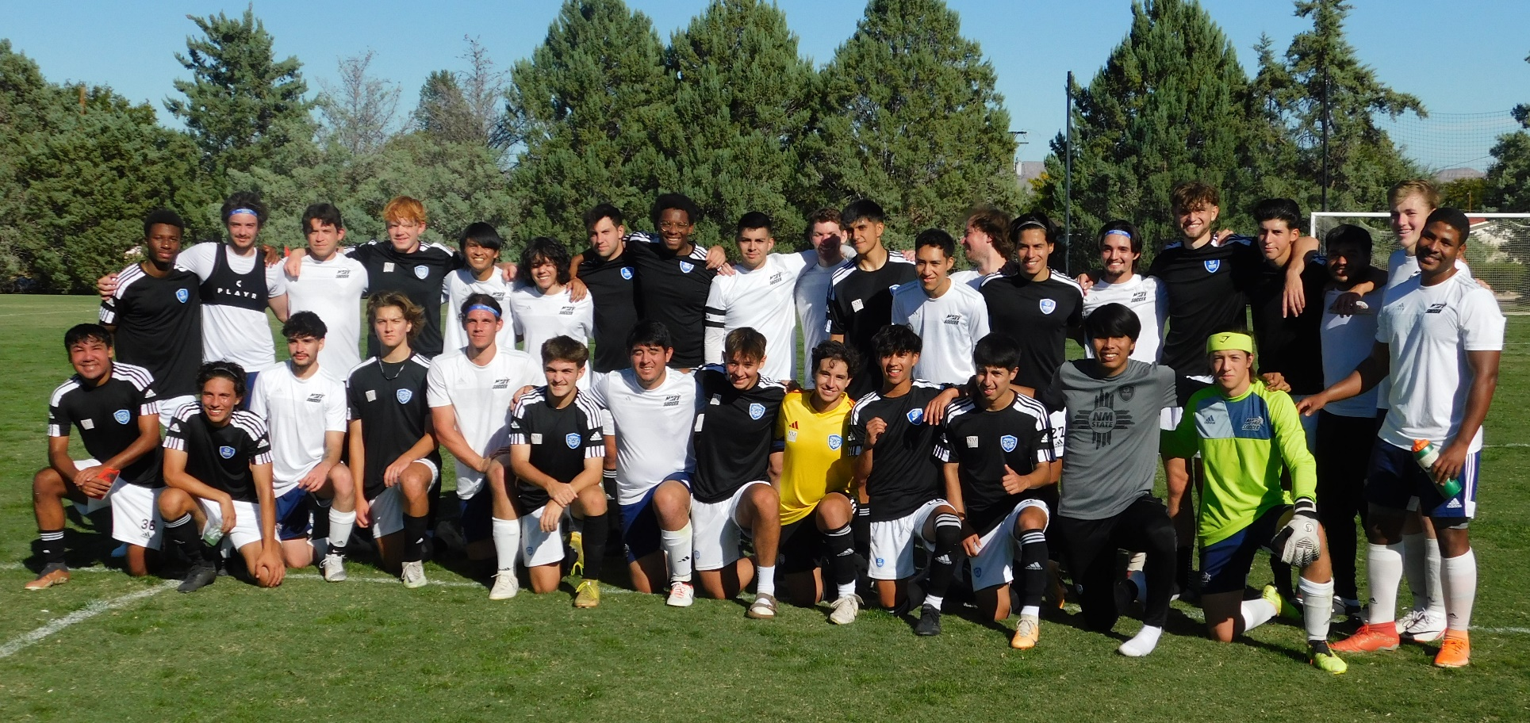
2023 Miners (white jerseys) with NMSU opponents

Slide 3
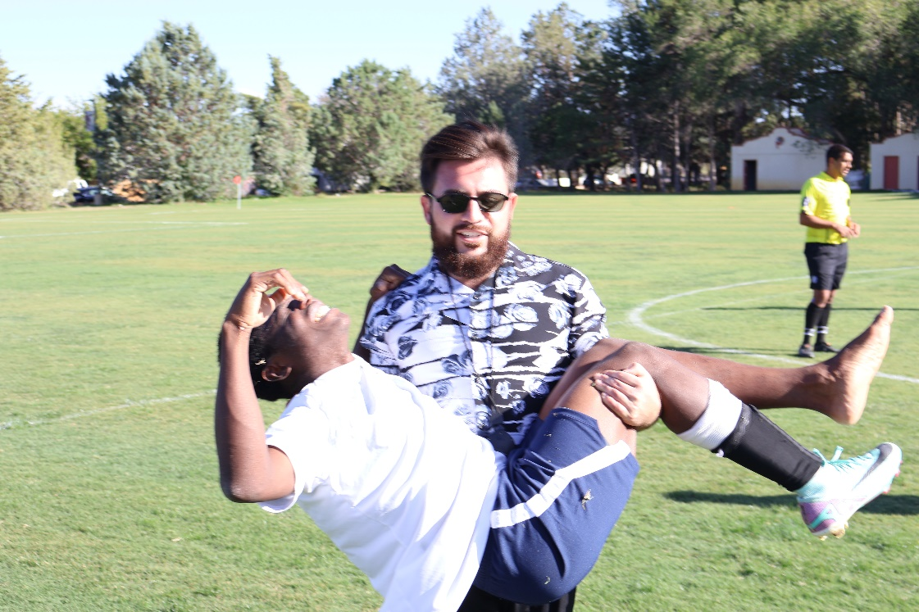
Coach (& Trainer) Mike

Slide 4
