Slide 1
NMT Miners:
Blast from the Past
Paul Fuierer
Miners Faculty Advisor

Slide 2
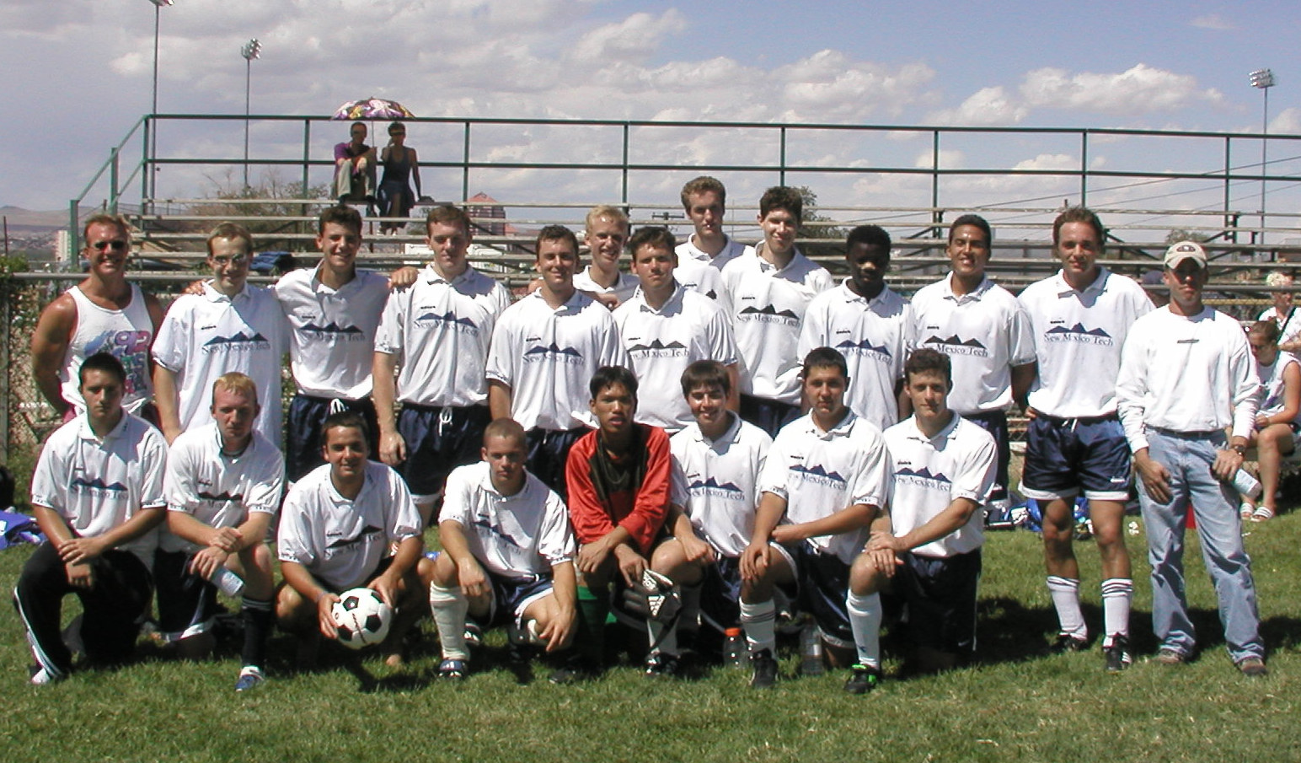
The Early (21st Century) NMT Miners
Circa 2001, Milne Field, Albuquerque

Slide 3
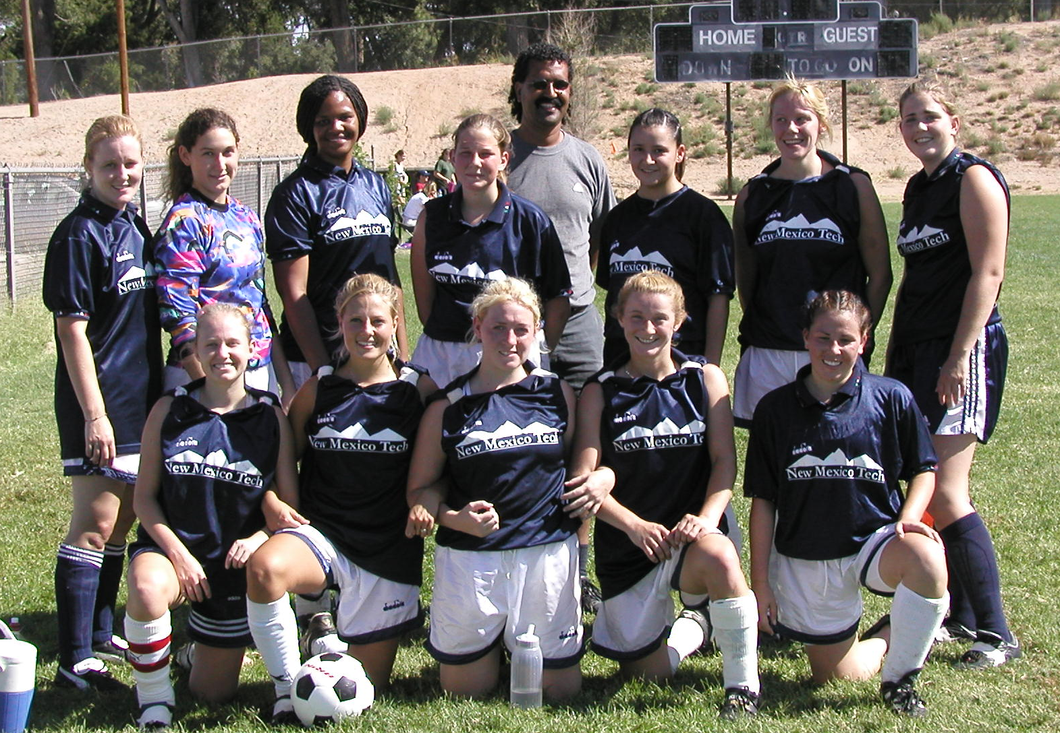
The Original Minerettes
Sept. 2001

Slide 4
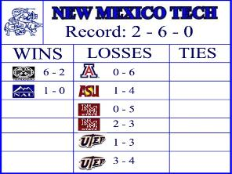
Miners, first NIRSA season, Fall 2003
Rankings, Commissioner Paul Fuierer (NMT)
Oct.20, 2003
Region 6, Southwest Conference
#1 NMSU
#2 UTEP
#3 UofA
#4 ASU
#5 NMT
#6 T-bird
#7 NAU

Slide 5
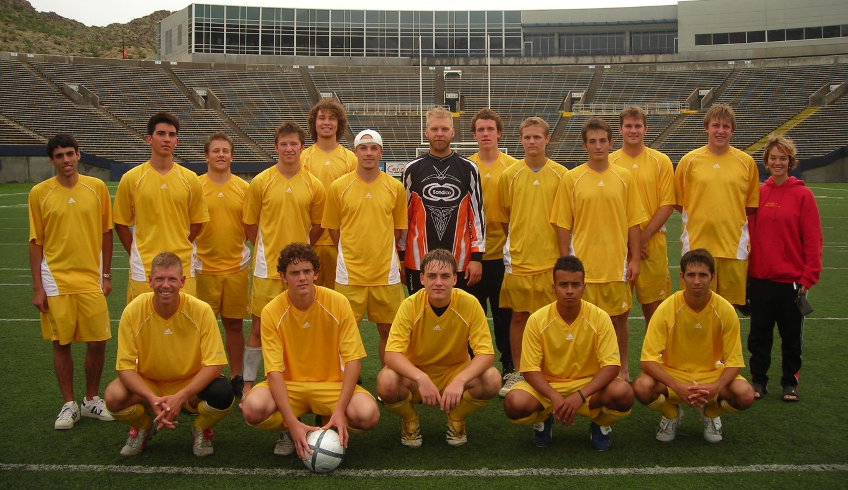
Sunbowl, El Paso, 2006

Slide 6
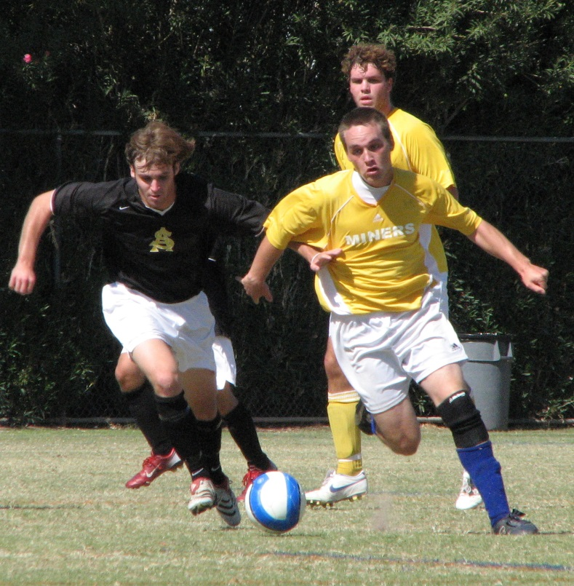
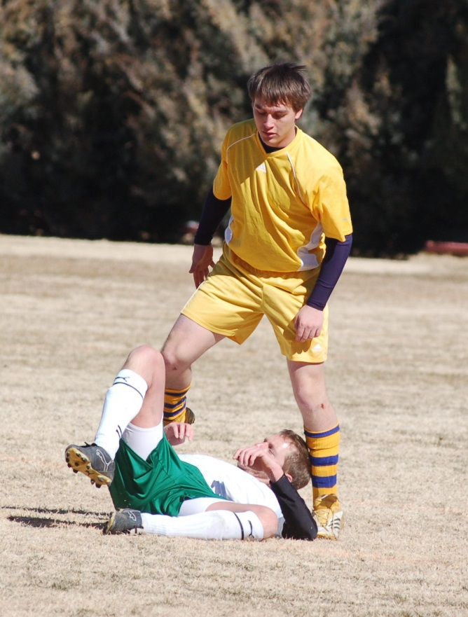
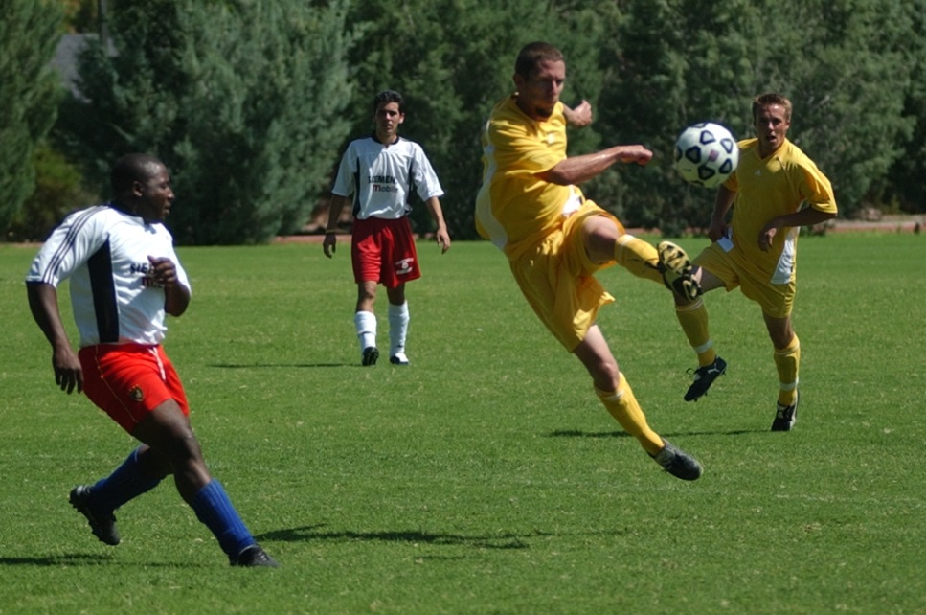
Homefield Action

Slide 7
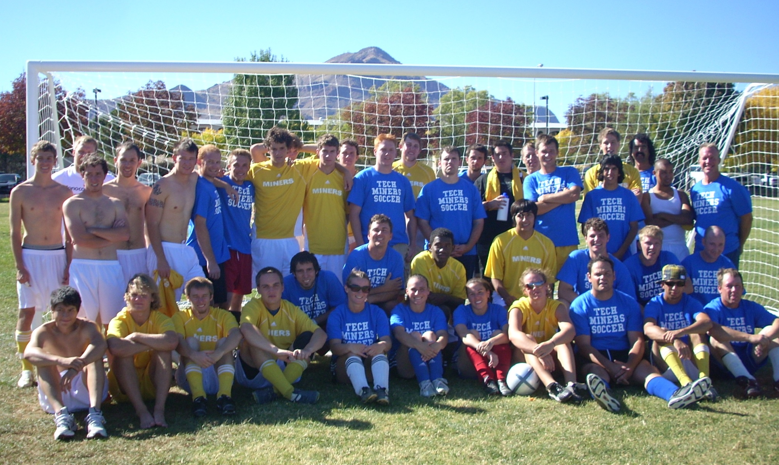
49ers Alumni Match (2007)

Slide 8
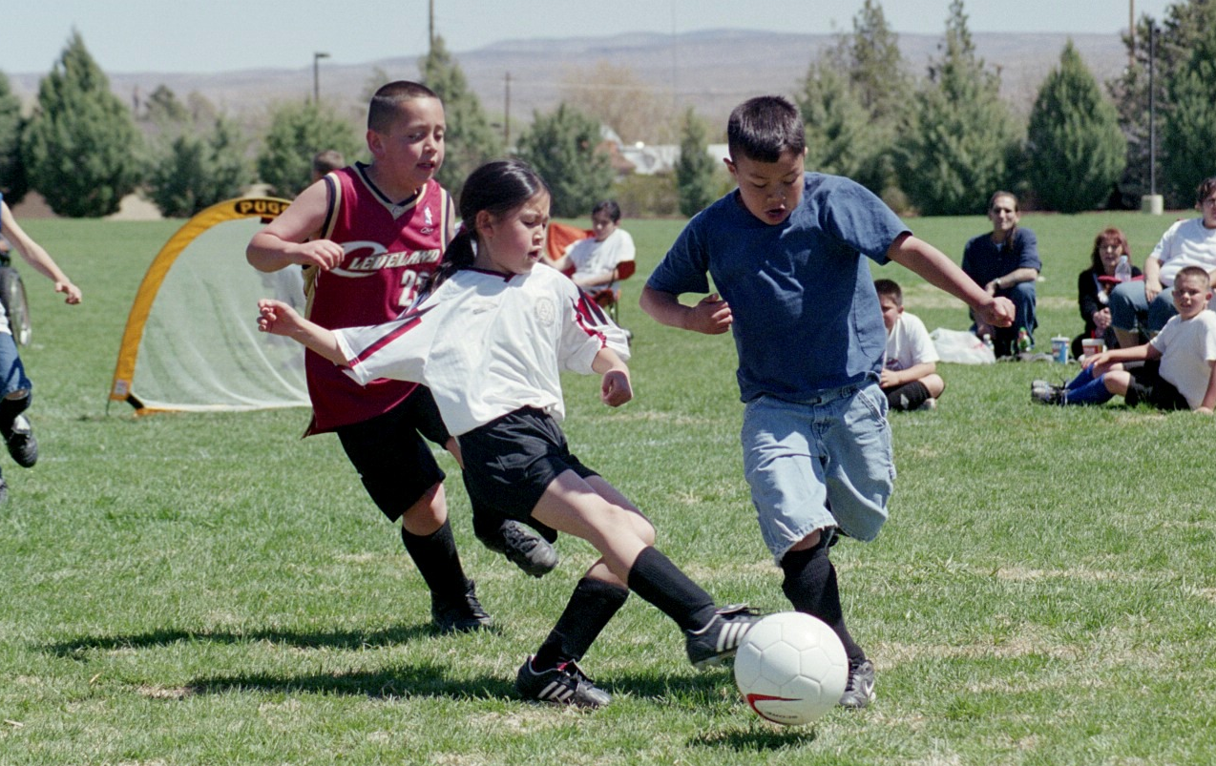
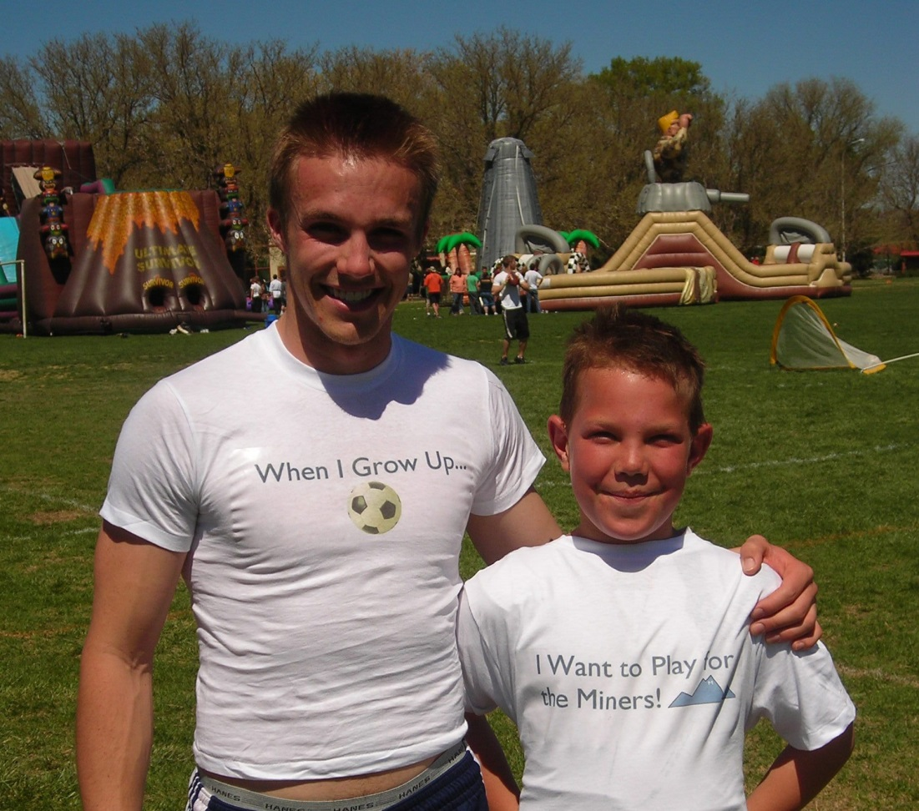
Community Outreach

Slide 9
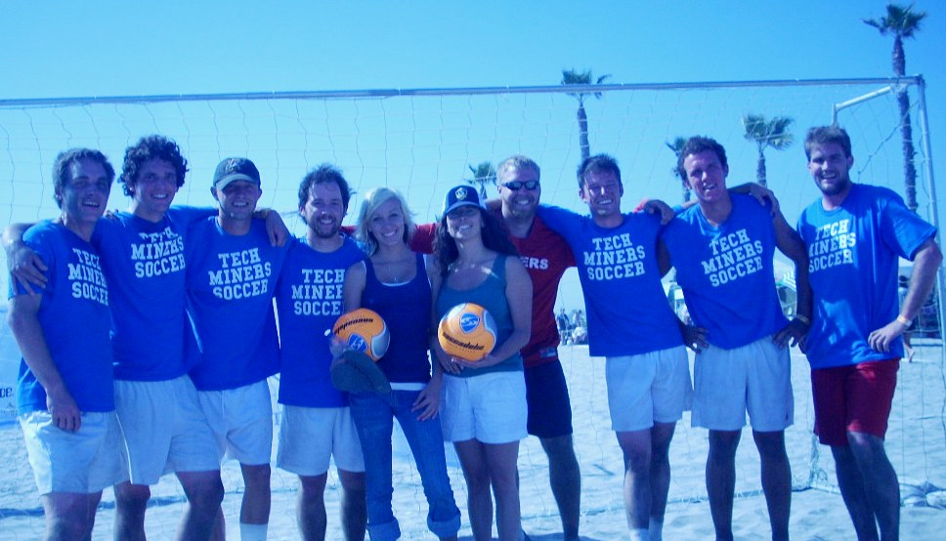
California Beach Soccer

