Slide 1

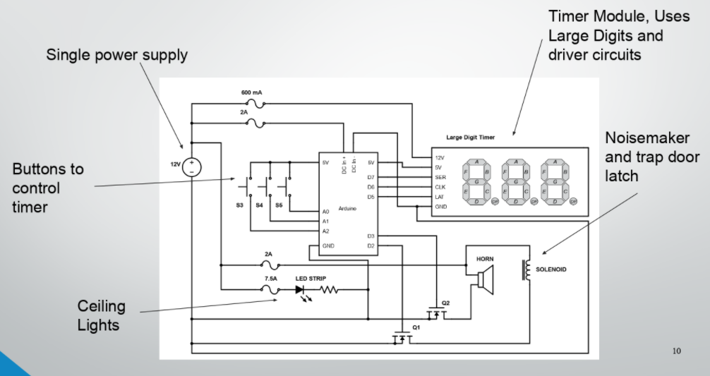
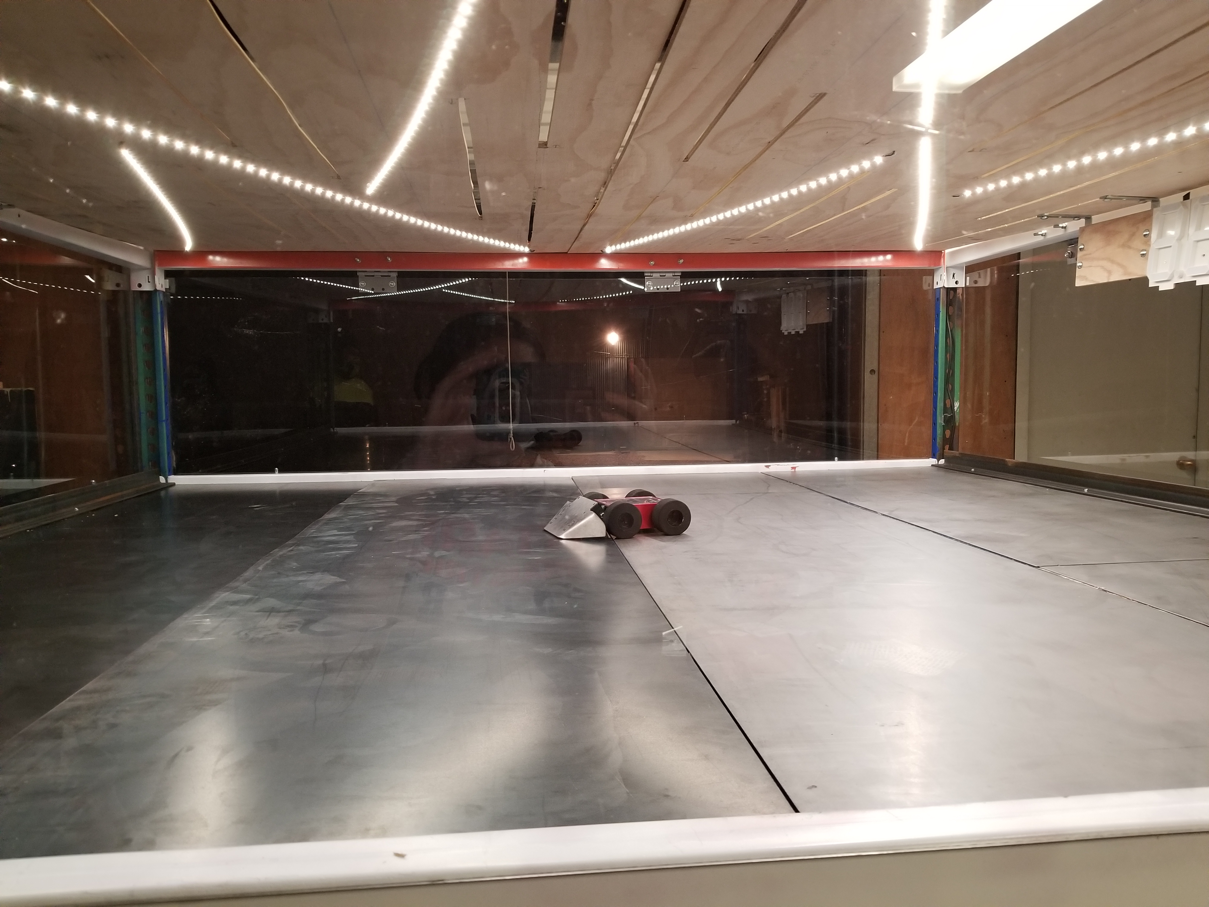
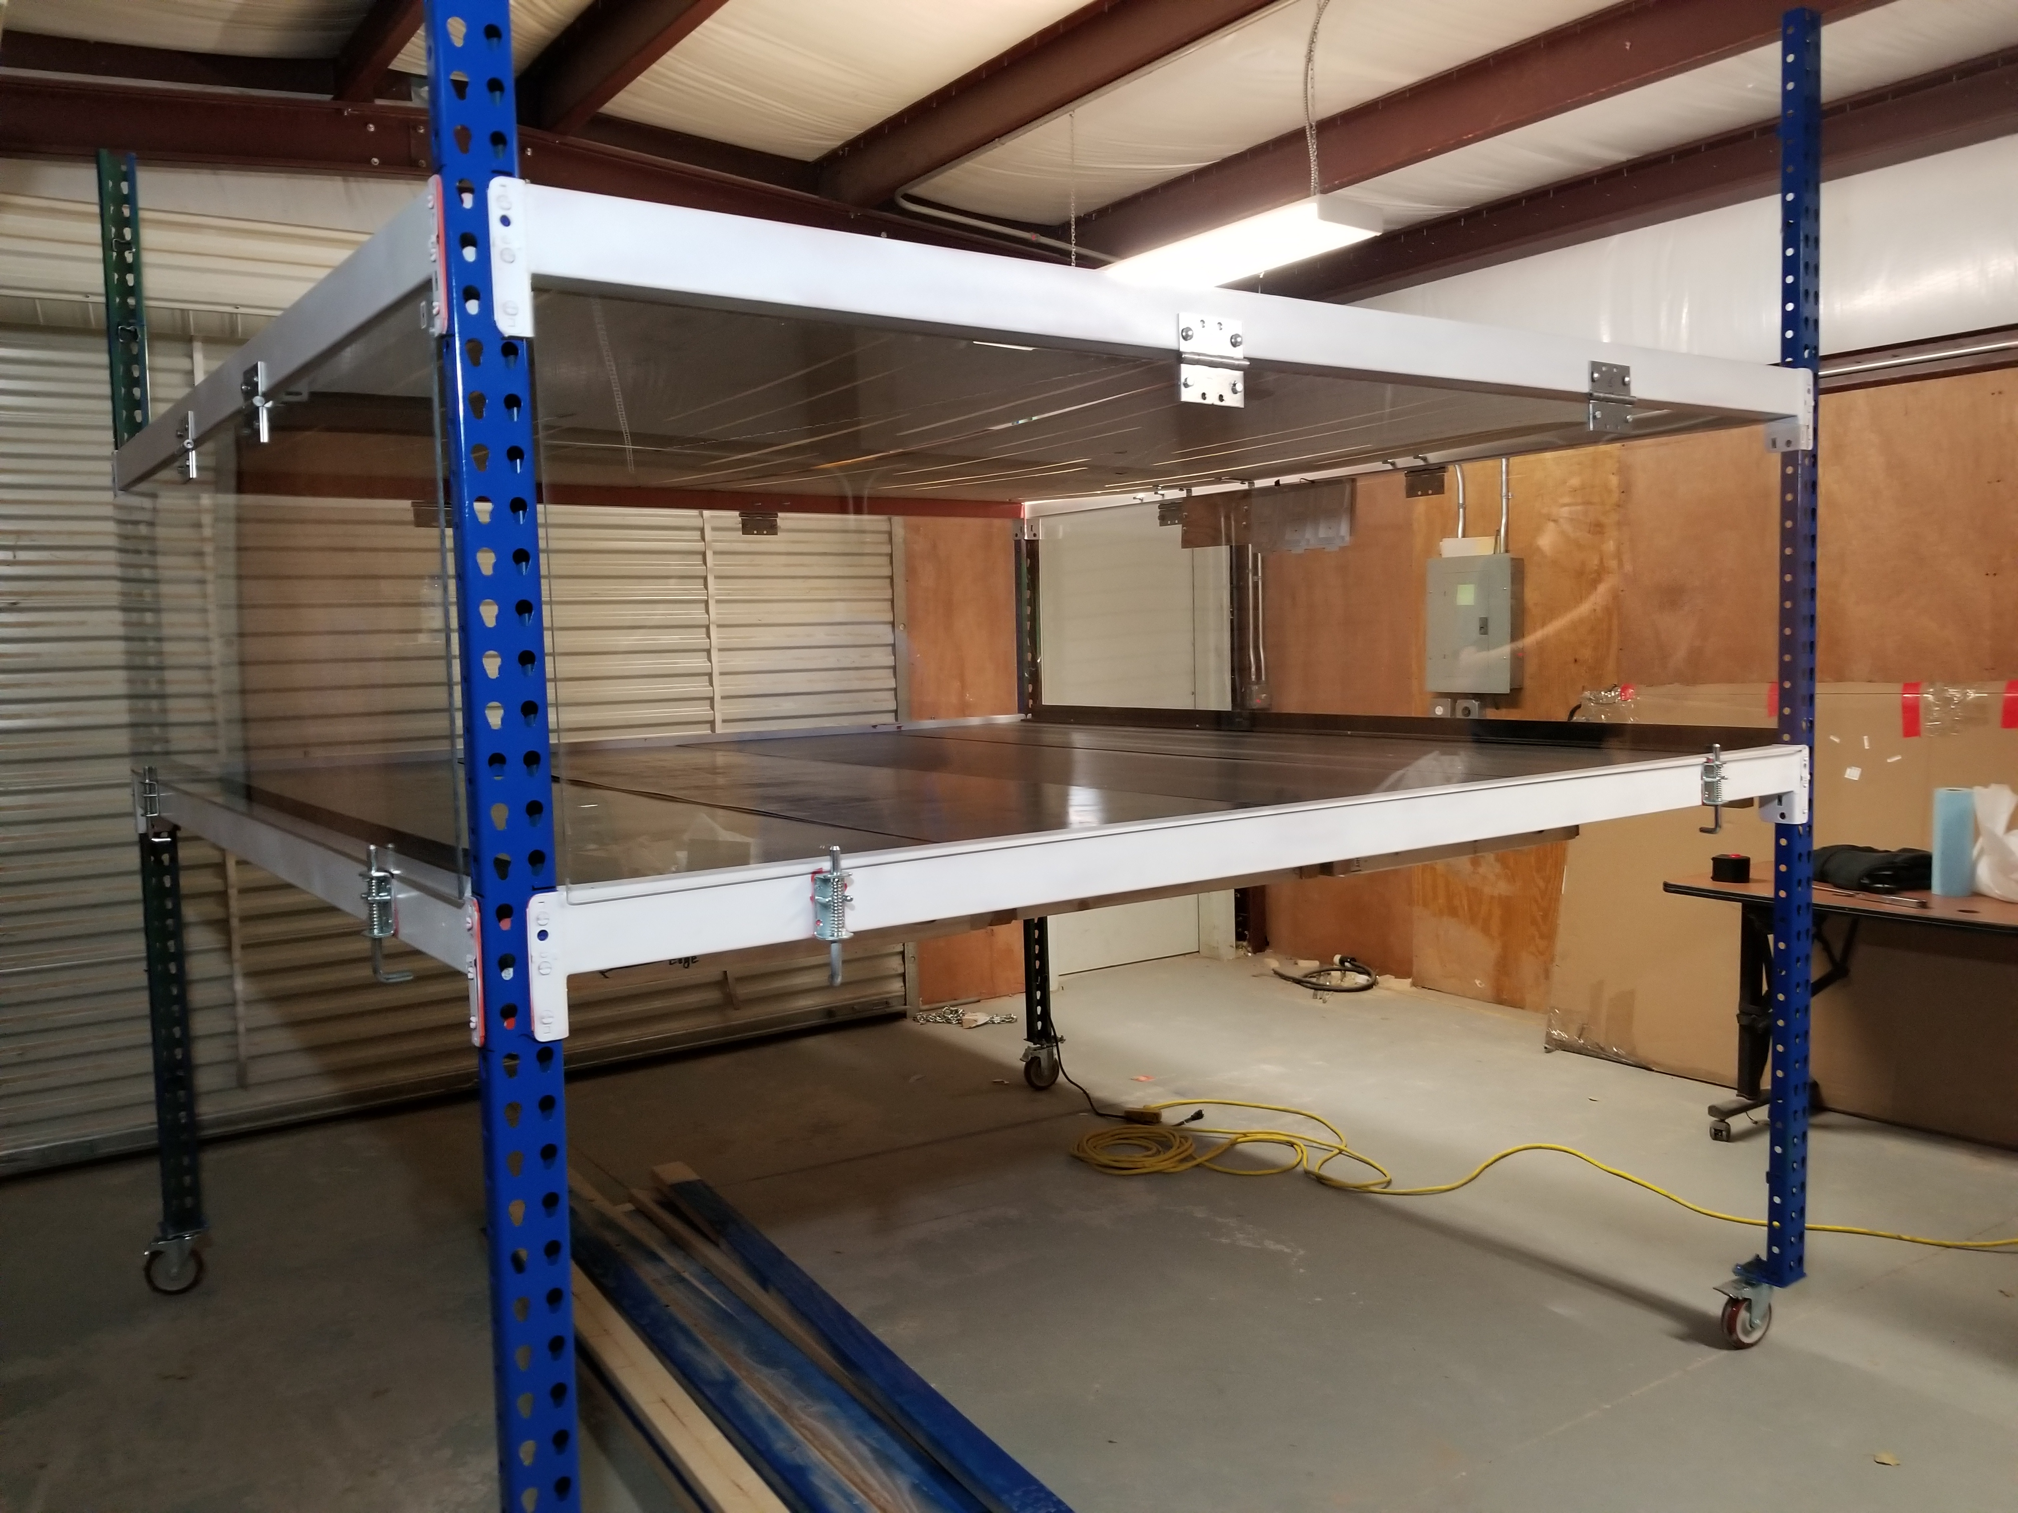
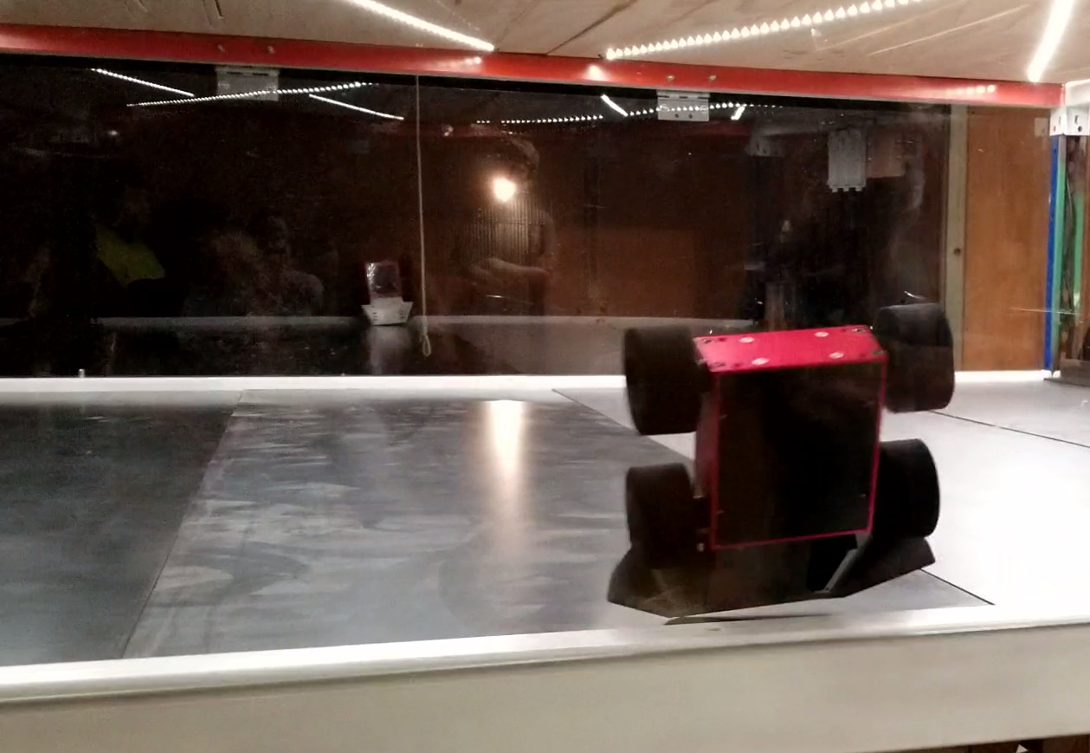
NMT Robot Combat Arena
Background and Objective
The goal of this project was to build a robot combat arena for New Mexico Tech to use for on-campus events that adheres to four aspects and meets the SPARC rules set by Dallas Area Robot Combat (DARC). The four aspects include portability, durability, modularity, and cost efficiency.
Construction
Testing
Assembly/Disassembly
Approximately 1 hour to assemble and 1 hour to disassemble
3 people recommended
Efficiency
Warped floor prevents smooth movement for robot with weapons located near the floor
Specifications
Frame
8' x 8' x 8' pallet rack on castors
Arena height is 4' from the ground
2' viewing area
Floor
Four 2' x 8' wood sections
Sections composed of 2'' x 4'' wood grid covered by ½'' thick waferboard with 12 gauge steel sheeting on top
Angle iron bumpers placed on two opposing sides
Ceiling
Two 4' x 8' plywood boards, ½'' thick with cut in air vents
Windows/ Doors
Four 2' x 8' polycarbonate sheets suspended by 2 industrial hinges with 2 latches on the bottom each
Electronics
White LED strips on the ceiling
LED timer display suspended from ceiling
One button for referee to start/reset timer
Figure 1. Electronics wiring layout
Figure 3. Robot testing
Progress
Attached steel sheets to wooden floor section with liquid nails
Cut ventilation into ceiling
Attached LED lights to ceiling
Cut polycarbonate for windows/doors
Attached hinges and latches to frame
Attached angle iron to floor
Painted arena frame
Completed button and timer display
Figure 2. Completed arena
Figure 4. Robot crashing into window
Future Improvements
Repair warped floor
Setup timer and electronics
Add 3D printed timer case
Add ¾’’ x ¾’’ aluminum angle to windows
Add obstacles
Fall 2020 Team
Adam Shannon, Jack Rains, Dade Lincoln, Leonor Merino Osornio
Acknowledgements
Dr. O'Malley
Mr. Ruff
Pic of window
And pic of floor assembled

