Slide 1



New Student
Awareness Training
Sexual Misconduct, Hazing, and
Drug & Alcohol Awareness
August 11, 17 & 20, 2026
Presented By:
Peter G. Phaiah, Ph.D.
NMT Title IX Coordinator (TIXC)

Slide 2
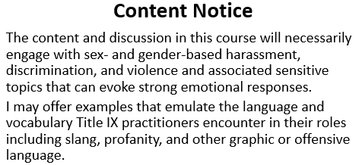

Slide 3
NMT Sexual Misconduct Policy (updated August 1, 2024)-One policy different procedure.
Other Related Regulations & Policies
  Violence Against Women Act Reauthorized (VAWA)
  Clery Act
  NMT’s Title IX Procedures
  Student Code of Conduct
  NMT Res. Life Community Standards (https://www.nmt.edu/reslife/policies/index.php)
  Sexual Misconduct Reporting Options & Procedures (see hand-out)

Slide 4

Title IX
“No person in the United States shall, on the basis of sex, be excluded from participation in, be denied the benefits of, or be subjected to discrimination under any educational program or activity receiving Federal financial assistance”

Slide 5

Title IX Responsibility
If a school knows or reasonably should know* about sexual discrimination, it must take immediate action to:
  Help stop and eliminate it,
  Prevent its recurrence, and
  Address its effects and
  Remedy the situation

Slide 6
Statements Regarding Sex Discrimination & Sex-based Harassment
New Mexico Tech prohibits sex discrimination and sexual violence including domestic violence, dating violence, sexual assault, stalking, and sex-based harassment.
New Mexico Tech does not discriminate on the basis of sex in its employment and educational programs nor in its student and employee application process.

Slide 7
Statements Regarding Sex Discrimination & Sexual Harassment
Sexual harassment and sexual violence are types of sex discrimination.
The University prohibits retaliation against an individual for:
reporting sexual misconduct; or
participating in a University investigation or hearings for sexual misconduct; or

Slide 8
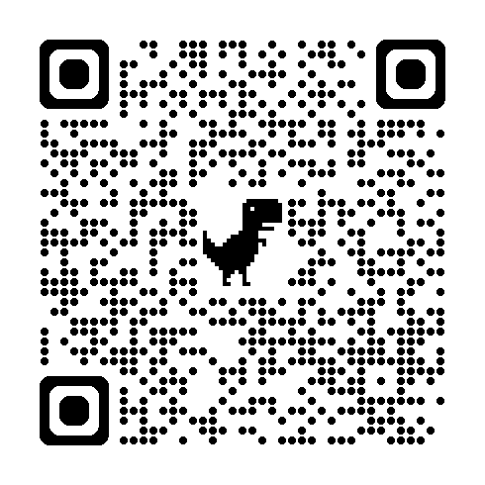
Sex Misconduct Awareness Video
Student Version 2: https://www.brainshark.com/trainedsolutions/nmtstudentv2tix

Slide 9
Sexual Harassment occurring under education programs or activities in the United States (Title IX Jurisdiction):
  Occurs in education program/activity if:
    Building owned/controlled by the institution
    Under institution's disciplinary authority
  In the United States
  Means sexual harassment and other harassment on the basis of sex that satisfies one of the following:
    Quid pro quo harassment
    Hostile environment harassment
    Specific VAWA offences (sexual assault, dating violence, domestic violence, stalking)

Slide 10
Quid Pro Quo Harassment
Employee conditions aid, benefit, or service of the institution on an individual’s participation in unwelcome sexual conduct (i.e. something for something)
  Applies to all aspects of education program or activity, including extracurricular and employment
  Power Differential (e.g. Instructor & Student, Supervisor and Employee)-examples:
    Supervisor conditioning promotion on participation in sexual advance
    Professor conditioning grade on participation in sexual advance

Slide 11
Hostile Environment Harassment
  Unwelcome conduct (on the basis of sex) determined by a reasonable person to be so severe, and pervasive, and objectively offensive that it effectively denies a person equal access to the institution’s education program or activity.

Slide 12
Hostile Environment Harassment
Examples: Multiple incidents of the following conduct may constitute hostile environment sexual harassment:
  Unwelcome sexual flirtations, advances, or propositions
  Requests for sexual favors
  Verbal abuse of a sexual nature, obscene language, off-color jokes, sexual innuendo, and gossip about sexual relations
  The display of derogatory or sexually suggestive posters, cartoons, drawings, objects, notes, letters, photos, emails, or text messages
  Visual conduct such as leering or making gestures
  Sexually suggestive comments about an individual’s body or body parts, or sexually degrading words to describe an individual

Slide 13
Hostile Environment Harassment
Examples: Multiple incidents of the following conduct may constitute hostile environment sexual harassment:
  Unwelcome touching of a sexual nature such as patting, caressing, pinching, or brushing against another’s body
  Unwelcome verbal or physical conduct against an individual related to the individual’s gender identity or the individual’s conformity or failure to conform to gender stereotypes (not Title IX but NMT Sexual Misconduct Policy)
  Cyber harassment, including but not limited to disseminating information, photos, or videos of a sexual nature without consent
  Videotaping or taking photographs of a sexual nature without consent

Slide 14
Title IX—Sexual Harassment
Sexual assault:
  Any actual, attempted or threatened nonconsensual sexual act (e.g., unwanted touching, kissing, groping, trying to have sex with another person) proscribed by Federal, tribal, or State law, including when the victim lacks capacity to consent.*
VAWA crimes- Dating violence, Domestic violence, and Stalking as defined by Cleary Act
*Source: http://www.justice.gov/ovw/sexual-assault

Slide 15
Title IX—Sexual Harassment
Sexual assault (continued):
  Rape: The carnal knowledge of a person, without the consent of the victim, including instances where the victim is incapable of giving consent because of his/her age or because of his/her temporary or permanent mental or physical incapacity.
  Sodomy: Oral or anal sexual intercourse with another person, without the consent of the victim, including instances where the victim is incapable of giving consent because of his/her age or because of his/her temporary or permanent mental or physical incapacity.
  Sexual Assault With An Object: To use an object or instrument to unlawfully penetrate, however slightly, the genital or anal opening of the body of another person, without the consent of the victim, including instances where the victim is incapable of giving consent because of his/her age or because of his/her temporary or permanent mental or physical incapacity.

Slide 16
Title IX—Sexual Harassment
Sexual assault (continued):
  Criminal Sexual Contact (Fondling) is defined as the intentional touching of the clothed or unclothed body parts of another without consent for the purpose of sexual degradation, gratification, or humiliation. This definition also includes instances where the victim is forced to touch the offender's body parts. Lack of consent is a key element and does not require physical resistance from the victim. It can also be established if the victim is unable to give consent due to age or mental or physical incapacity.
  Incest: Non-forcible sexual intercourse between persons who are related to each other within the degrees wherein marriage is prohibited by law.
  Statutory Rape: Non-forcible sexual intercourse with a person who is under the statutory age of consent.

Slide 17
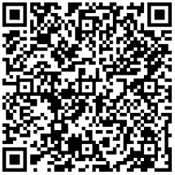
Reporting Incidents of Sexual Misconduct
See NMT Sexual Misconduct Reporting Options & Procedures hand-out
Call the Title IX Coordinator, Peter Phaiah at 575-835-5953, x-5953, or 575-322-0001 (cell. #)
Email titleixcoordinator@nmt.edu
Bring the student or employee to the Title IX Office, Fidel Student Center Rm. 288
Complete and submit Tech’s online Sexual Misconduct & Title IX Reporting Form

Slide 18
Sex Discrimination Protected by the NMT Sexual Misconduct Policy
Differential Treatment:
  Stereotypes,
  Sex characteristics,
  Pregnancy or related conditions,
  Sexual Orientation
  Gender Expression and
  Gender Identity
Restroom & Locker Room (Gender-neutral)
Preferred Names
Gender Pronouns

Slide 19
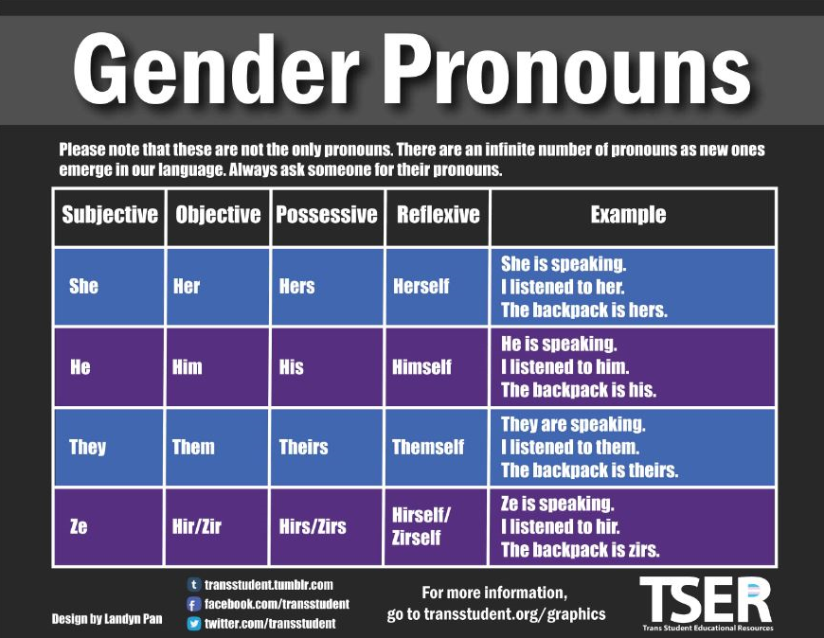

Slide 20
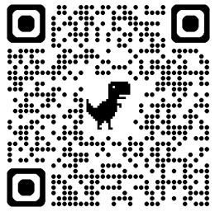
Drugs & Alcohol
NMT Drug and Alcohol Policy

Slide 21
Red Zone Dangers & Contributing Factors
Red Zone starts at the beginning of the school semester and lasts until Thanksgiving break. During this time, more than 50% of all campus sexual assaults occur. This vulnerable window coincides with increased social activity, parties and transitioning into college life, particularly for freshmen
Young students often seek connection, belonging and identity, which can lead them into unfamiliar environments without established support systems. Female freshmen are at the highest risk. This is partly because they know little about campus culture and their surroundings — they also lack trusted peer networks.

Slide 22
Red Zone Dangers (Cont.)
The surge in alcohol and drug use during this period further complicates safety. While alcohol doesn’t cause sexual assault, it is a major contributing factor. It’s estimated that in at least half of college sexual assaults, one person involved was drinking alcohol. This makes education around responsible substance use and clear communication even more critical.

Slide 23








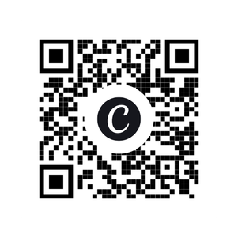



We offer FREE resources and supplies in the following areas
Community
Resource Room
Harm Reduction
Substance Misuse Prevention
Mental Health
Naloxone First Aid Kit
Fentanyl & Xylazine Test Strips
Pill Organizers
Medicine Lock Boxes
Pamphlets for Youth and Adults
Drug Disposal Kits
Poison Control Info
Treatment Info
Suicide Prevention Resources
Mental Health Informational Books
Crisis Line Info
Pamphlets on Bullying
Worksheets and Journals
Scan the QR Code for our website
Sexual Health & Reproductive Resources
LGBTQ+ Resources
Grief Supports
Internal and External Condoms
Information Sheets
Alternative Contraceptives
Pamphlets and Information
PRIDE Materials
Youth and Children Grief Kits
Informational Guides and Books
Grief Journals
Come Visit Us At
215C Fisher Ave.
Socorro, NM

Slide 24
Hazing &
The Stop Hazing Act

Slide 25

The Stop Campus Hazing Act (SCHA) was enacted by the federal government on December 23, 2024.
To prioritize the prevention of and transparency about hazing incidents at colleges and universities
As of 2025, the State of New Mexico does not have an anti-hazing law.
For the purposes of defining hazing, NMT will use the federal definition.
Hazing, for the purpose of reporting statistics on hazing incidents, means any intentional, knowing, or reckless act committed by a person (whether individually or in concert with other persons) against another person or persons regardless of the willingness of such other person or persons to participate, that:

Slide 26
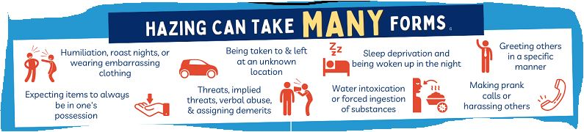
Is committed in the course of an initiation into, an affiliation with, or the maintenance of membership in, a student organization; and
Causes or creates a risk, above the reasonable risk encountered in the course of participation in the institution of higher education or the organization, of physical or psychological injury.

Slide 27

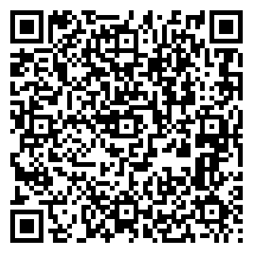
How to report possible Hazing
1. Online: go to the Student Support Resource Webpage, under Report an Incident, Concern, or Non-Academic Complaint or Grievance, click on Hazing Reporting Form.
2. Or contact the Dean of Students at 575-835-5548 or deanofstudents@npe.nmt.edu.
Hazing includes three key components:
It occurs in a group context
Humiliating, degrading, or endangering behavior
It can happen regardless of an individual's willingness to participate, regardless of consent
Hazing Reporting
Form QR Code

Slide 28
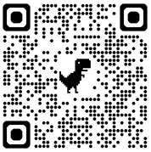
Question & Answers Session
Thank you!
Peter Phaiah, Ph.D.
Title IX Coordinator
575-835-5953, x-5953, or 575-322-0001 (cell. #)
titleixcoordinator@nmt.edu
Fidel Student Center Rm. 288
Title IX Website

