Slide 1
tristine.hayward@nmt.edu
www.nmt.edu/career-services
Tristine & Michael
NMT Career Services
presents
EFFECTIVE
INTERVIEWING

Slide 2
PURPOSE OF INTERVIEWS
for you:
SELL YOURSELF
SEE IF YOU FIT IN
LEARN ABOUT THE JOB
https://unsplash.com/bchild311

Slide 3
PURPOSE OF INTERVIEWS
for employers:
SELL THE COMPANY
SEE IF YOU FIT IN
HIRE THE BEST CANDIDATE
https://www.flickr.com/photos/samchurchill/

Slide 4
PREPARING FOR THE INTERVIEW
https://unsplash.com/bchild311

Slide 5
KNOW
RESEARCH
CONTACT
the job position
the type of interview
your references
the company
Notes:
Know the type: One-on-One, Group, Phone, Videoconference/Teleconference, Behavioral, Second, On-Site
Learn about the position: What does the position involve?, What skills are required?, Job description, Internet research, Talk to people in similar positions
Research the organization: Printed materials, Website, News articles/press releases, Talk with people you know who work there
Consider the fit: Review the job description, Highlight qualifications, Assess your own qualifications (Strengths + Weaknesses), Salary range, Start date, Benefits

Slide 6
On Campus Interviews
Tokyo Electron
9/20 in Graduate Office
Naval Surface Warfare Center
9/20 in the CSLE
CNS-Pantex
9/20 in the CSLE
NAVAIR
9/21 in the CSLE
Puget Sound
9/21 in the CSLE
Hunting Titan
9/21 in Financial Aid
Progressive
9/21 in the CSLE
Intel
9/22 in the CSLE

Slide 7
WEAR A SUIT
when in doubt:
WHAT TO WEAR
www.flazingo.com

Slide 8
SUIT
MATCHING SHOES
MATCHING BELT
Notes:
Suit: dark-colored, silk tie, light-colored shirt
Coordinating shoes: polished, matching socks
Matching belt: if pants have loops

Slide 9
SKIRT OR PANTSUIT
MATCHING SHOES
CONSERVATIVE JEWELRY
Notes:
Skirt or pantsuit: light-colored shirt, conservative neckline
Coordinating shoes: closed-toe and heel, moderate heel
Nylons: No visible undergarments or skin
Conservative accessories: minimal make-up, simple jewelry

Slide 10
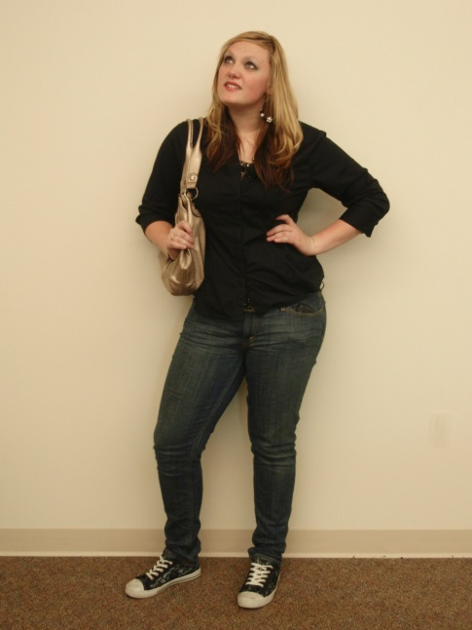
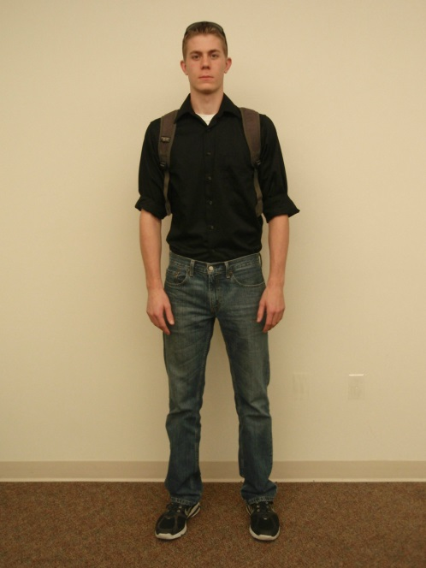
What NOT to Wear

Slide 11
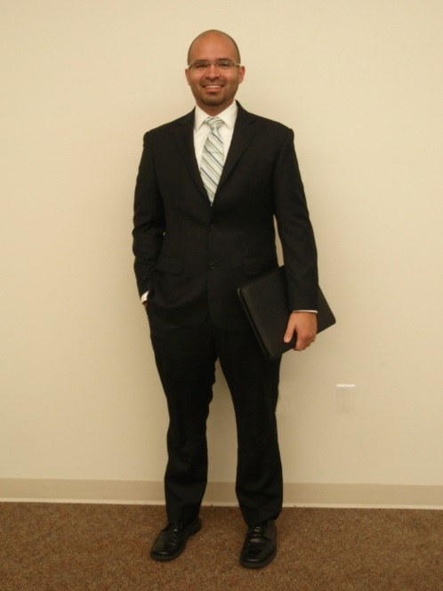
What to Wear:

Slide 12
INTERVIEW STAGES
https://unsplash.com/bchild311

Slide 13
ARRIVAL
GET DIRECTIONS
ARRIVE EARLY
TURN OFF PHONE
Notes:
Arrival: Get directions ahead of time, Leave early, Interview begins the minute you arrive, First impressions are critical (Eye contact, Shake hands firmly, Smile), Turn off your cell phone

Slide 14
INTRODUCTION
Talk about the company
Visit informally
https://unsplash.com/alejandroescamilla

Slide 15
Common Interview Questions
Tell me about yourself.
Short personal history
Relate background to position
Focus on skills, experience, training
Something fun/interesting/unique about you
What do you know about the company?
Do your research- website, faculty, alumni, Career Services

Slide 16
Common Interview Questions
Why should we hire you?
Include specific numbers/information
Personality traits, skills, training, experience, etc.
Where do you see yourself in five years?
Employers want to know you will stay on the job and work hard for your pay.
Salary, leaving jobs, overqualified, residency are concerns they have

Slide 17
Common Interview Questions
What are your strengths?
Focus on transferable skills vs. job related skills
What are your weaknesses?
Choose a positive weakness

Slide 19
Behavioral Questions
Describe a difficult situation you encountered in a previous job, and how you resolved it.
Tell me about a team project when you had to work with someone difficult?

Slide 20
Behavioral Questions
Describe a time when you saw some problem and took the initiative to correct it rather than waiting for someone else to do it.
Can you provide an example of a time when you made a mistake at work and how you overcame this.

Slide 21
Other Questions
If you could be any animal in the world, what animal would you be and why?
Demonstrate quick thinking, poise, creativity, and even a sense of humor
What things do you not like to do?
Employers get a clearer picture of you.

Slide 22
Other Questions
Estimate how many windows are in New York.
Employers see your reasoning skills as well as see if you are willing to ask questions.
Would the last person you worked for hire you again?

Slide 23
HOW TO ANSWER
NO
“YES OR NO”
ANSWERS
AVOID CONTROVERSIAL SUBJECTS
BE
PROFESSIONAL
Notes:
Talk about yourself
Tell stories
No “yes or no” answers
Concrete examples
Admit if you don’t know answer
Sit up
No slang
Be ready for any question
If you don’t know an answer, admit it
Pause prior to answering
Buy yourself more time if needed
Ask for clarification if necessary
Finish the main part of the interview with substantive questions

Slide 24
EATING OR DRINKING
FIDGETING
THINGS TO AVOID
DOMINATING THE CONVERSATION
Notes:
Eat or drink: no gum, food, or non-water beverages
Fidgeting
Playing with jewelry
Checking your watch

Slide 25
WRAP UP
Ask questions
Find out timeline
Thank the interviewer
https://unsplash.com/flenjoore
Notes:
Say thanks- ask for business card
Convey that you want this position: not just any position
Timeline: Find out the next steps
Interview doesn’t end until you drive away

Slide 26
Dear Mr. Thomas,
Thank you for taking the time to talk with me this morning regarding your open position for _____________.
I believe the position we discussed would be a very good fit for my skillset. After our conversation, I know that I would enjoy working with you and your team.
I look forward to hearing from you soon and may be reached at 000-000-0000 or at JP@anymail.com at any time.
Sincerely,
John Powers

Slide 27
PHONE INTERVIEWS
Prepare for a call any time
Prepare notes
Remove noise
Be professional
Notes:
Be prepared for a call any time: Answer “This is he/she”, Don’t answer unless you can interview right then, Allow at least 2 hours
Prepare notes: Have a copy of your resume, position description, and anything else you submitted in front of you, Keep a list of positions you have applied for, be ready to write, ask questions
Remove noise: Turn off anything that makes noise, Close and lock the door, Do not eat, drink, or chew gum, Don’t take any other calls
Be Professional: Smiles come across the phone, Be enthusiastic, Clearly signal the end of your responses, Professional voicemail message, be articulate

Slide 28
FINAL POINTS
https://unsplash.com/bchild311
Notes:
The interviewer’s perception of you is critical, Decisions are made early, so make a strong first impression
There is no substitute for being prepared
Be confident

Slide 29
FIRST IMPRESSIONS MATTER
BE PREPARED
BE CONFIDENT

Slide 30
Preparing for the Fair Workshops
Wednesday 9.14
Start at 12pm and repeats again at 5:30pm
Located in the Center for Student Leadership and Engagement, Fidel 262
Flash Resume Reviews
Thursday 9.15 and Friday 9.16
From 11:30 am to 1pm Fidel Atrium
Career and Graduate School Fair
Tuesday 9.20
From 9:00am to 2:30pm
Fidel Ballrooms

Slide 31
Any Questions?
https://unsplash.com/breather

